Slide 1


Employment
Slide hidden from learner
Mouse/ Trackpad and Navigation Skills
Be Organized
Notes:
Slide hidden from learner
Title slide

Slide 2
Pre-Requisite Skills
Slide hidden from learner
Physical ability to hold a mouse/ use a trackpad
Ability to recognize very simple symbols
Basic mouse/trackpad skills: hold mouse/ use trackpad correctly; click; double click; right click; hover; scroll; click, drag and drop
Basic navigation: scroll; cursor shapes; where and how to place a cursor; recognize some icons (search etc. )​
Ability to recognize letters and Enter key on keyboard and type (one finger is ok)
LINK to the DLCR:
https://digital-literacy.issbc.org/for-teachers/
Password: Diglit4T
Notes:
Slide hidden from learner
Pre-Requisite Skills
Remember: like all lessons in Module 9 – Employment (Review), this is a review lesson of the digital skills, and the learners may not be ready for this lesson.
Make sure the learner has the “Prerequisite Skills” listed in this slide.
These skills are not specifically reviewed in this lesson, but the learner needs to have them to be able to do the lesson.
You can do this as review but if the learner struggles, stop the lesson and go to the following module in the Digital Literacy Curriculum Resource (DLCR) and teach the pre-requisite skills before doing this lesson:
Module 1 Mouse and Navigating

Slide 3
Skills Reviewed in this Lesson
Check the Notes of this Slide
Notes:
Slide hidden from the learner.
Information for the Tutor
These skills are specifically reviewed in this lesson.
It is assumed the learner has already learned these skills and is doing this lesson as a review.
Create a Folder
Understand why we need to keep files in folders,: to be organized, so we can find them easily.
Understand that we can put any file into a folder (documents, photos etc.)
Open a menu on the Desktop
Choose “New” then “Folder” in the menu
Name the new folder: type a name
Find the newly created folder on the Desktop
Move Files into Folders
Understand what file to put in a folder
Find the file you want on your Desktop
Choose the file you want to move (Click on it)
Move the file (Drag and drop it into the folder)
Create a Sub Folder
Understand what a sub folder is and how it helps us be more organized
Find a folder on the Desktop
Open a folder on the Desktop (Double click to open it)
Create a new folder inside the folder: Right click, click on “New” the “Folder”.
Name the new sub folder: type a name
Find the newly created sub folder inside the folder
Move Files into Sub Folders
Choose the file you want to move into a sub folder
Move the file into the sub folder (Click drag and drop it)
Check the files are in the sub folder
Open the sub folder
Find the files
Close the folder
Find Files
Understand different ways to find a file you need on your computer
Find a file when you know where it is
Find and use “File Explorer”
Open “File Explorer”
Find the location you want inside “File Explorer” (Documents, Downloads etc.)
Open the location (Documents etc.)
Find the folder you want inside “Documents”
Open the folder
Find a sub folder inside
Open the sub folder
Find the file you want
Open the file
Find a file when you don’t remember where it is
Find and use the search bar to find files on your computer
Type the name or keywords you remember in the search bar
Find and use “Documents” to find the best document matches for your search
Find the best match in the list offered
Open the best match
Check that it is the document you are looking for

Slide 4
Slide hidden from learner
Instructions
For Using this PowerPoint Lesson
Notes:
Slide hidden from learner
This PowerPoint lesson contains everything the tutor needs: the lesson notes, suggested instructional language, the links to the video lesson(s), and also Practice for each part. ​
IMPORTANT
Read through the entire lesson a few days before tutoring so you are clear about what to do and have time to get any questions answered and to do any preparation.
The first 12 slides are hidden from the learner; they contain information and instructions for the tutor.
Green Slides = Lesson Objectives
Blue Slides = The Start of each Part of the Lesson
Yellow Slides = Practice Activities
Instructions specific to each lesson are in the notes pages of each PowerPoint. ​
Identical notes are also available as a separate PDF for tutors who prefer that format. ​See Option B below.
You will NOT be able to copy and paste from this PowerPoint because it is “Read Only”.
In the Practice for each Part of this lesson, you may be asked to copy some text from this lesson and paste it into a Word document to use with the learner.
You will not be able to do that from this PowerPoint lesson. Instead, copy and paste the text from the PDF version of the (same) lesson.
There are different options for using this PowerPoint lesson and /or the PDF version of this (same) lesson.
Format Options for the Tutor:
Option A
Use a printed version of the notes for you as tutor (not for the learner)
plus
Use the PowerPoint slideshow for the learner.
How:
Open the PowerPoint, download and save it.
Click “File” then "Print" ​
Then under “Settings” choose " Notes Pages" .
Print
Now, you can use the printed version for tutoring.
Option B
Use the separate electronic PDF of the PowerPoint slides and notes for you as tutor (if you don’t have PowerPoint on your computer or if you prefer to use a PDF version)
Plus
Use the PowerPoint slideshow for the learner, or the PDF-Slides Only version (if the learner’s computer doesn’t have PowerPoint). ​
You can have the PDF open to use for you as tutor beside the PowerPoint slideshow, or the PDF version of the slides (for the learner).
Option C
Use the PowerPoint slideshow in “Presenter View”.
This lets you show the slideshow to the learner, and also lets you see the notes as well as the slideshow that the learner sees.
This works for remote and in-person tutoring.
However, for in person tutoring for small groups you need a separate monitor or projector to do this: one for you and one for the learners.

Slide 5
Lesson Objectives – Part One
Slide hidden from learner
      Create a Folder
      Move Files into a Folder
Notes:
Slide hidden from learner
Instructions to the Tutor
These are the skills learners will master at the end of the lesson.

Slide 6
Lesson Objectives – Part Two
Slide hidden from learner
Create a Sub Folder
Move Files into a Sub Folder
Notes:
Slide hidden from learner
Instructions to the Tutor
These are the skills learners will master at the end of the lesson.

Slide 7
Lesson Objectives-Part Three
Slide hidden from learner
Find files
  Using File Explorer
  Using Windows Search Bar
Notes:
Slide hidden from learner
Instructions to the Tutor
These are the skills learners will master at the end of the lesson.

Slide 8
Keep in Mind
Slide hidden from learner
Only do as much as the learner can absorb in one session.
Do one part of the video lesson at a time.
Check in with the learner after each part.
Notes:
Slide hidden from learner
Information for the Tutor
According to the learner’s pace, do one part of the video lesson, check their understanding, and have the learner practice the skills. Then, let them show you they can do the skills (at least three times) before proceeding to the next part.
Look for signs of learner fatigue. Check in with learner after each part.
Is the learner is doing any of the following ? :
Expressing frustration
Not asking questions, shutting down, not taking in what you are saying
Seeming overwhelmed
Saying, “Are we done yet?” etc.
Lots of yawning etc.
These are clues that it is time to stop the session and resume another day.

Slide 9

Set Up
Slide hidden from learner
Before In-Person Tutoring
Notes:
Slide hidden from learner
Information for the Tutor
Refer to TUTOR CHECKLIST- Set up for In-Person Tutoring
PREPARATION
Preparation specific to the PRACTICE for each Part of this lesson is in the notes of each “PRACTICE” slide.

Slide 10

Checklist
Slide hidden from learner
During In-Person Tutoring
Notes:
Slide hidden from learner
Information for the Tutor
Refer to:
TUTOR CHECKLIST- During In-Person Tutoring Sessions

Slide 11
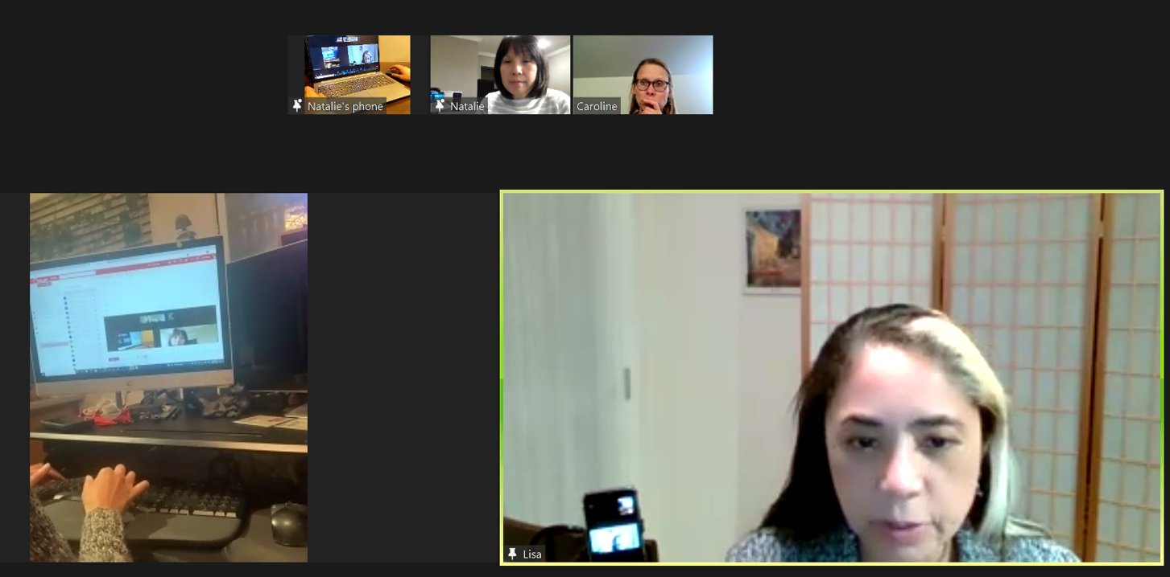
Set Up and Preparation
Slide hidden from learner
Before Remote Tutoring
Notes:
Slide hidden from the learner.
Information for the Tutor.
SET UP
Refer to:
TUTOR CHECKLIST- Set up for Remote Tutoring Session via Zoom, Ms Teams etc.
LEARNER CHECKLIST- Set up for Remote Tutoring Session via Zoom, Ms Teams etc.
IMPORTANT:
Go through the Learner Checklist as well. Then, you will be able to more easily troubleshoot with the learner if they have difficulty in their set up.
Communicate beforehand with the Support Person (if that learner has one):
Email the Learner Checklist listed in #2 above to the Support Person.
Email any instructions for this lesson to the support person (see the notes for specific slides /parts of the lesson):
Have the support person do the preparation for the lesson on the learner’s desktop. Tutor needs to guide them re. how to do this.
Preparation for Remote Tutoring only:
Support person must inform you if the learner has a Gmail account already. If they do not have one, use Module 5 as detailed in the note above under ”Pre-Requisite Skills” (Slide #2).
Have support person make sure the browser icon (or Gmail shortcut if they use that) is easy for the learner to find on the desktop.
If no preparations were made on the learner’s computer before the session by a support person, you could use the Request Remote Control function in Zoom on the learner’s desktop if the learner struggles, and before they get frustrated.
IMPORTANT: Keep in mind the following:
Before using Remote Control, be sure to get permission from your organization first.
It is crucial that the learner understands what it means, and gives you informed consent.
It is somewhat invasive and must be done respectfully and honouring the confidentiality of the learner.
Don’t use the Request Remote Control feature first! It should be a last resort.
First, try your best to teach the learner and the support person how to do things using Share screen and demonstrating.
Use it if other ways do not work and the learner really needs to learn digital skills.
You may want to record the Zoom tutoring session in case of any possible accusations afterwards.
PREPARATION
Preparation specific to each Part of this Gmail Lesson is in the notes of the relevant slides.

Slide 12
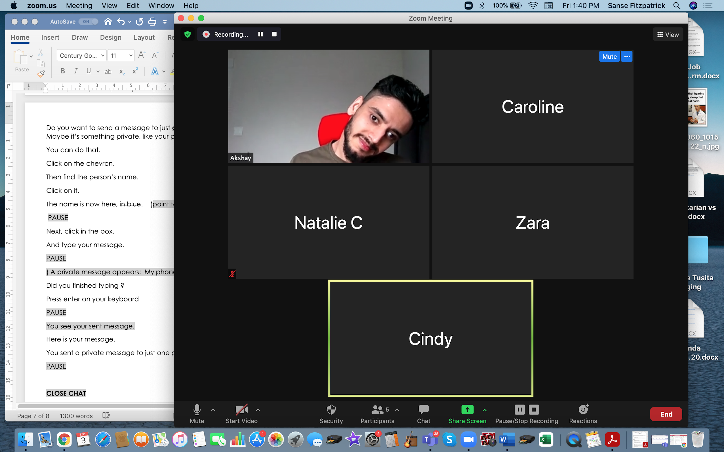
Checklist
Slide hidden from learner
During Remote Tutoring
Notes:
Slide hidden from learner
Refer to:
Tutor Checklist: During Remote Tutoring Session
Learner Instructions: How to let your Tutor have Remote Control of your Computer During a Zoom Session
SET UP SPECIFIC TO THIS LESSON
Be ready to assist learner by using the Requesting Remote Control function (refer to checklists 1 and 2 listed above).
You may have to set up learner’s desktop with relevant files if no support person is available to do that beforehand. This is possible to do using Request Remote Control in Zoom.
IMPORTANT:
Keep in mind the following:
Before using Remote Control, be sure to get permission from your organization first.
It is crucial that the learner understands what it means, and gives you informed consent.
It is somewhat invasive and must be done respectfully and honouring the confidentiality of the learner.
Don’t use the Request Remote Control feature first! It should be a last resort.
First, try your best to teach the learner and the support person how to do things using Share screen and demonstrating.
Use it if other ways do not work and the learner really needs to learn digital skills.
You may want to record the Zoom tutoring session in case of any possible accusations afterwards.

Slide 13

Employment
Mouse/ Trackpad and Navigation Skills
Be Organized
Notes:
Show slide to the learner
Say to the learner:
So today, we’re going to focus on how to be more organized on our computer/ laptop.
We’re going to review mouse / trackpad skills and navigation skills, how to move around and find things on the computer.

Slide 14
Lesson Objectives-Part One
Create a Folder
Move Files into a Folder
Notes:
Instructions for the Tutor
These are the skills the learner will master at the end of the lesson.
Say to the learner:
To be organized on our computer, we’re going to do the following:
learn how to create a folder on your computer…
Learn how to move files into folders

Slide 15

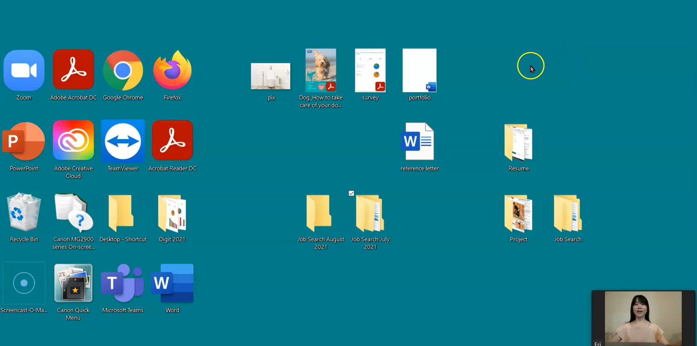
Lesson-Part One
Notes:
Say to the Learner:
We are going to learn how to organize files on the computer, so we can find them easily when we need them. We will watch a video. We can watch the video several times. So, don't worry if you don't catch everything the first time.
First, we’ll look at how to create a folder and move files into a folder.
Instructions for the Tutor:
•The icon in the slide with the red triangle is a link to the video on YouTube.
•Just click on that link (in Slideshow mode) to open the video LESSON.
•Here is that link in case the one in the slide doesn’t work:
https://youtu.be/YEHd5X-E8nc
Video length: 0:04:06
For remote tutoring, when you share screen to play the video, make sure you have shared the audio.
Play the lesson a bit and check the learner can hear it ok.
Play it until the end, then check for understanding. See the next slide for comprehension check questions.

Slide 16

Check Understanding
Notes:
Instructions for the Tutor:
After watching Part One of the video lesson, check understanding (review and elicit) before moving on to Part Two.
Check understanding - ask the learner as you watch the video or as you demonstrate on your computer.
Ask these comprehension check questions, or others, to check understanding:
Say to the Learner:
Create a folder
We want to create a new folder on the desktop. Do we left click or right click on the mouse/trackpad to open the menu? Answer: Right click
Where do we click on the trackpad to open the new folder menu? Answer: Bottom right of the trackpad, or tap with two fingers
Show me how to right click on your desktop. (If tutoring remotely, learner’s cell phone camera must capture learner’s mouse, trackpad and computer screen)
How do we change the name of a folder? Answer: Click on the name of the folder, then click on the name to highlight it. Type the new name over the highlighted name.
Move a file into a folder
How do we move a file into a folder? What do you do first? Answer: Click on the file. What do you do next? Answer: Drag the file into the folder. What do you do last? Answer: Drop the file.
How do we open a folder? Show me. Answer: Double click on the folder.
How do we close the folder? Show me. Answer: Click X at the top right corner of the window.
Instructions for Tutor:
Then ask the learner:
Do you want to watch the video again?
If the learner is struggling, stop the session.
Say to the learner:
Let’s do more work on X before we do this. (so, learner does not feel bad they can’t yet do something)
For example, learner may not be able to click, drag and drop files into folders. If so, go to Module 1 Mouse and Navigating Digital Skill 7 Click, drag and drop to practice the skill with the learner.

Slide 17

Practice 1
Create a folder
Move files into a folder
Notes:
Instructions for the Tutor:
Demonstrate first, then let the learner practice.
Practice 1
Create a folder and move files into a folder.
Preparation
Make sure learner’s desktop screen has four files. They can be empty but name them e.g., Save-on-Foods Resume, Save-on-Foods Cover Letter, Reference Letter, Doctor’s Note. The learner will practice moving these files into folders.
Learner desktop should be clean and not cluttered.
If the learner is using their own laptop, put the relevant files onto the desktop before their practice session.
Preparation for Remote tutoring only:
Support person at home must put files on learner’s computer (as per Set up/ preparation notes at beginning of this lesson)
If no preparations were made on learner’s computer beforehand, use the Request Remote Control function to put files on the learner’s desktop.
Say to the Learner:
Now it’s time to practice.
We’re going to practice how to create a folder and move files into a folder, like in the video.
[After each of the following steps, wait for the learner to complete the step. Guide the learner as needed.]
[You may need to write the folder names on the board -for in person tutoring, or in the Chat-for tutoring remotely]
Say to the Learner:
Create a new folder on your desktop.
Name the folder: Job Search.
Let’s create another folder.
Name this folder: Job Leave and Benefits.
Now find the file called Save-on-Foods Resume on your desktop.
Let’s move Save-on-Foods Resume into the Job Search folder.
Find the file called Save-on-Foods Cover Letter on your desktop.
Let’s move Save-on-Foods Cover Letter into the Job Leave and Benefits folder. Is this file in the right folder? No, it should be in the Job Search folder. Let’s move it there.
Now, find and move Reference Letter. Which folder would you put it in? (wait for answer) Yes, into the Job Search folder.
What about Doctor’s Note Aug 31? (wait for answer) Yes, into the Job Leave and Benefits folder. Let’s move it there.
Instructions for the Tutor:
Have the learner repeat this activity and practice as many times as they need (at least three times.)
Check the Learner's skills. Has the learner shown you they can do the skills at least three times without support?

Slide 18
Lesson Objectives – Part Two
Create a Sub Folder
Move Files into a Sub Folder
Notes:
Instructions for the Tutor:
These are the skills the learner will master at the end of the lesson.
Say to the learner:
Let’s be more organized!
We can make a sub folder. A sub folder is a folder inside a bigger folder.
This helps us find files more easily when we need to.
We are going to do the following:
learn how to create a sub folder inside a folder on your computer
learn how to move files into sub folders.

Slide 19
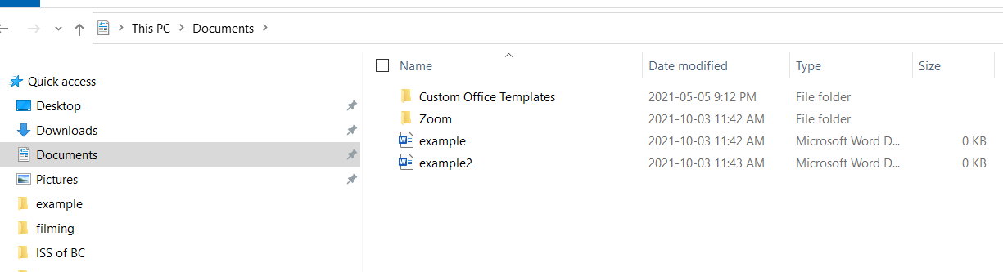
Lesson-Part Two
Notes:
Say to the Learner:
Now, let’s watch a video on how to create sub folders inside a folder, and move files into a sub folder. We can watch the video several times. So, don't worry if you don't catch everything the first time.
Instructions for the Tutor:
•The icon in the slide with the red triangle is a link to the video Lesson on YouTube.
•Just click on that link (in Slideshow mode) to open the video Lesson.
•Here is that link in case the one in the slide doesn’t work:
https://youtu.be/Vtd-8fFn1RE
Video length: 0:02:32
For remote tutoring, when you share screen to play the video, make sure you have shared the audio.
Play the lesson a bit and check the learner can hear it ok.
Play till the end of the video, then check for understanding. See the next slide for comprehension check questions.

Slide 20
Check Understanding
Notes:
Instructions for the Tutor:
After watching Part Two of the video lesson, check understanding (review and elicit) before moving on to Part Three.
Check understanding - ask the learner as you watch the video or as you demonstrate on your computer.
Ask these comprehension check questions or others to check understanding:
Say to the Learner:
Create a sub folder
We want to create a sub folder. Where do we click in the folder to open the menu? Answer: Any blank or white space.
What should we choose after the menu opens? Answer: Choose New, then Folder.
How do we change the name of a folder? Show me. Answer: Click on the name of the folder, then click on the name to highlight it. Type the new name over the highlighted name.
Move a file into a sub folder
How do we move a file from a folder into a sub folder? What do you do first? Answer: Click on the file. What do you do next? Answer: Drag the file into the folder. What do you do last? Answer: Drop the file. Now, you show me.
How do we open a sub folder? Show me. Answer: Double click on the folder.
How do we close the sub folder? Show me. Answer: Click X at the top right corner of the window.
Instructions for the Tutor:
Then ask the learner: Do you want to watch the video again?
If the learner is struggling, stop the session.
Say to the learner:
Let’s do more work on X before we do this. (so, learner does not feel bad they can’t yet do something)
For example, learner may not be able to click, drag and drop files into folders. If so, go to Module 1 Mouse and Navigating Digital Skill 7 Click, drag and drop to practice the skill with the learner.

Slide 21
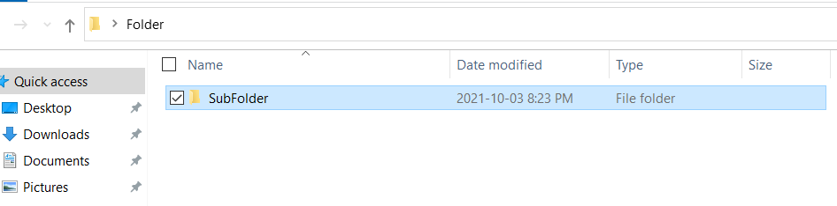
Practice 2
Create a Sub Folder
Move Files into a Sub Folder
Notes:
Instructions for the Tutor:
From doing Activity / Practice 1, learner’s Job Search folder on the Desktop has at least two files: Save-on-Foods Cover Letter and Save-on-Foods Resume.
Practice 2
Create a sub folder and move files into a sub folder.
Preparation
Add two more files in the learner’s Job Search folder: Superstore Cover Letter and Superstore Resume. They created the Job Search folder in Practice 1.
Say to the Learner:
Now we’re going to practice how to create a sub folder and move files into a sub folder, like in the video.
(After each of the following steps, wait for the learner to complete the step. Guide the learner as needed.)
A)
Find the folder Job Search. Double click on it to open it.
Make a sub folder here. Right click anywhere on the blank or white area. It opens a menu.
Find ‘New’. Click on it.
Then click on ‘Folder’.
Now name the new folder. Let’s call it Save-on-Foods Oct 2021.
Type Save-on-Foods Oct 2021, then click or press enter on your keyboard.
Great! You created a sub folder inside the Job Search folder! That’s going to help you be more organized.
Now you try on your own. Let’s create another sub folder. Let’s call it Superstore Oct 2021.
B)
Now, let’s practice moving some files into the sub folders.
Let’s move the file Save-on-Foods Cover Letter into the Save-on-Foods Oct 2021sub folder.
Now, move the Save-on-Foods Resume into the same Save-on-Foods Oct 2021 sub folder.
Let’s check… double click on the Save-on-Foods Oct 2021 sub folder.
Are the two files Save-on-Foods Cover Letter and Save-on-Foods Resume there? Yes? Good.
Now, move the Superstore Cover Letter and Superstore Resume into the Superstore sub folder.
After you’ve finished, check that the two files are in the Superstore Oct 2021 sub folder.
C)
We just practiced moving files, folders and sub folders on the desktop. However, the desktop is not the best place to keep all our files and folders. Before long, the desktop will become cluttered and messy.
It is a good habit to keep your files and folders in Documents if you are using your own computer (open File Explorer to show it).
If you are using someone else’s computer, keep your files on a portable USB device. This way, you can retrieve your files when you plug in the USB device on any computer. (open File Explorer and show the portable drive)
Let’s move the sub folders Save-on-Foods Oct 2021 and Superstore Oct 2021 into Documents. They are now in the Job Search folder, which is on your Desktop.
Click on the Job Search folder. You see the two sub folders. How do we move these two sub folders into Documents? Yes, we do it the same way as when we move files: click, drag and drop. (Tutor demonstrates and then lets learner do it on their computer.)
Finished? Let’s check that the sub folders are now in Documents.
Instructions for the Tutor:
Have the learner repeat this activity and practice as many times as they need (at least three times.)
Check the Learner's skills. Has the learner shown you they can do the skills at least three times without support?

Slide 22
Lesson Objectives-Part Three
Find Files on the Computer
                Using File Explorer
              Using Windows Search Bar
Notes:
Instructions for the Tutor
These are the skills the learner will master at the end of the lesson.
Say to the learner:
E.g. Sometimes we can’t find the file we want on our computer. Does that happen to you? It happens to me. Today we are going to learn and practice how to find files on our computer.
We’re going to do the following:
– Find Files Using File Explorer
– Find Files Using Windows Search Bar

Slide 23

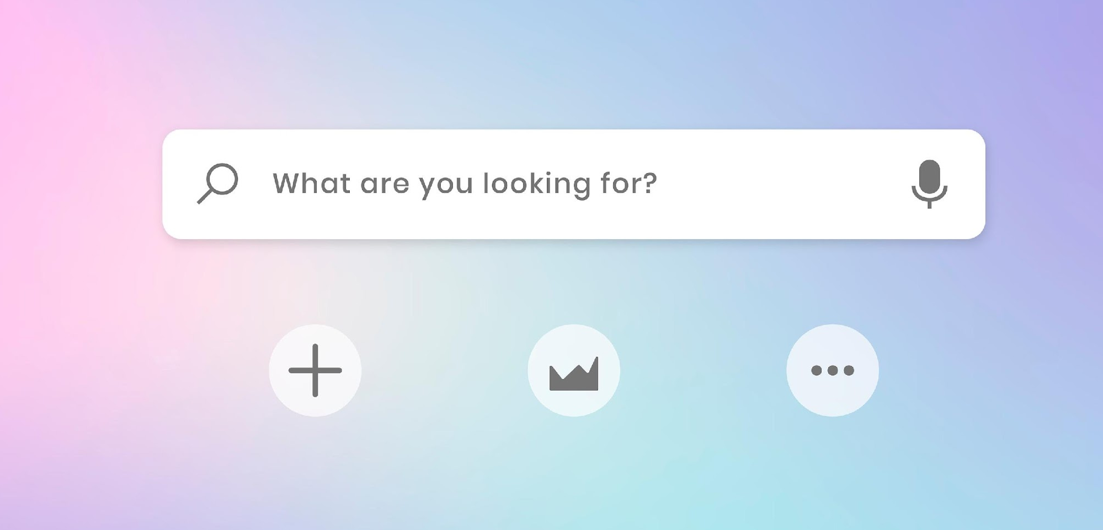
Lesson-Part Three
Notes:
Say to the Learner:
Now, we’re going to learn how to find files on our computer.
There are two ways: using File Explorer and using the Windows search bar. We will watch a video. We can watch the video several times. So, don't worry if you don't catch everything the first time.
Instructions for the Tutor:
•The icon in the slide with the red triangle is a link to the video Lesson on YouTube.
•Just click on that link (in Slideshow mode) to open the video Lesson.
•Here is that link in case the one in the slide doesn’t work:
https://youtu.be/qVhdskAa5FE
Video length: 0:03:18
0:00:09 – Find Files Using File Explorer
0:01:20 – Find Files Using Windows Search Bar
For remote tutoring, when you share screen to play the video, make sure you have shared the audio.
Play the lesson a bit and check the learner can hear it ok.
Play till the end of the video, then check for understanding. See the next slide for comprehension check questions.

Slide 24
Check Understanding
Notes:
Instructions for the Tutor:
After watching Part Three of the video lesson, check understanding (review and elicit).
Check understanding - ask the learner as you watch the video or as you demonstrate on your computer.
Ask these comprehension check questions or others to check understanding:
Say to the Learner:
Find files
Show me File Explorer.
Using File Explorer, find the file Save-on-Foods Cover Letter. (Tutor demonstrates first, step by step. Learner will practice later in the activities that follow)
If you forgot where you saved a file, how can you search for it? Answer: Use the search bar at the bottom of the screen. Etc.
Show me the search bar.
How do we use it ? Answer: click in the box, type what you are looking for, press enter on your keyboard.
What do you type in it? Answer: any keywords that you remember.
Instructions for the Tutor:
Then ask the learner: Do you want to watch the video again?
If the learner is struggling, stop the session.
Say to the learner:
Let’s do more work on X before we do this. (so, learner does not feel bad they can’t do something)
For example, learner may not be able to click, drag and drop files into folders. If so, go to Module 1 Mouse and Navigating Digital Skill 7 Click, drag and drop to practice the skill with the learner.

Slide 25
Practice 3
Find Files
- File Explorer
Notes:
Instructions for the Tutor
Practice 3
Find files using Files Explorer
Preparation
Make sure files and folders from the previous activities are still available on tutor’s and learner’s computers.
Say to the Learner:
Now we’re going to practice how to find files using File Explorer, like in the video.
[After each of the following steps, wait for the learner to complete the step. Guide the learner as needed.]
Say to the Learner:
If we are organized, we can remember more easily where we saved our files. On your computer, look for the folder where you saved the file.
Let’s find the file Save-on-Foods Cover letter using File Explorer.
Now open File Explorer. Remember in the video where it was?
Can you find Documents on the left side of the window?
Find the folder Job Search. Double click on it to open it.
Find the file Save-on-Foods Cover letter. Double click to open it.
Now you try. Find the file Superstore Resume using File Explorer.
Instructions for the Tutor:
Have the learner repeat this activity and practice as many times as they need (at least three times.)
Check the Learner's skills. Has the learner shown you they can do the skills at least three times without support?

Slide 26


Practice 4
Find Files
Windows Search Bar
Notes:
Practice 4
Find files using Windows Search Bar
Preparation
Make sure files and folders from the previous activities are still available on tutor’s and learner’s computers.
Say to the Learner:
If you don’t remember where a file or folder is, what do you do? Yes, use the Windows search bar.
Where is it? Yes, on the bottom left corner of your screen.
Click in the search box. Then, type the name of the file, folder, or any keywords you remember.
Let’s type Superstore Cover letter.
Click on Documents. Look at the best matches.
Choose the one you are looking for. Click on the file to open it.
Now find the file Save-on-Foods Resume using the Windows search bar.
Instructions for the Tutor:
Have the learner repeat this activity and practice as many times as they need (at least three times.)
Check the Learner's skills. Has the learner shown you they can do the skills at least three times without support?

Slide 27

Extra Practice
Notes:
Extra Practice
Instructions for the Tutor
Preparation
Create two empty document files on the learner’s computer in Documents:
Shift Schedule Jan – Mar 2022
Overtime Dec 2021
Say to the learner:
Let’s practice some more.
Make a folder inside Documents. Name it Shift Schedule.
Make a sub folder called Shift Schedule 2022
Move the file Shift Schedule Jan – Mar 2022 from Documents into Shift Schedule 2022 sub folder.
Close the file.
Find the file Overtime Dec 2021 using the Windows search bar.
Instructions for the Tutor:
Have the learner repeat this activity and practice as many times as they need (at least three times.)
Check the Learner's skills. Has the learner shown you they can do the skills at least three times without support?

Slide 28

Practice Between Sessions
What did you learn/practice today?
When are you going to practice?
Practice Plan
Notes:
Instructions for the Tutor:
In-person tutoring and Remote Tutoring:
Make sure the learner knows how to access the video lesson(s) you just used so they can practice between tutoring sessions.
If relevant, make sure the support person at home knows how to access the video(s) too.
Option One
Email the video link to the learner, and if relevant the at-home support person. They can use the link in the email to access the video lesson(s).
Option Two
Put a link to the specific video lesson(s) you did on the learner desktop so they can access the video easily.
How:
Open the website address for the lesson in the browser.
In the address bar, click to highlight the lesson address.
Drag the address (link) onto the desktop. It will make an icon on the desktop.
Find the icon on the desktop and check that the link works.
Show the learner where it is. Tell them to just click to access it for practice.
Remote Tutoring Only:
You can do Strategy Two by using Request Remote Control in Zoom during the tutoring session.
Refer to the following for the steps on how to do that:
Tutor Checklist-During Remote Tutoring Sessions
Learner Instructions: Let Tutor have Remote Control of your Computer During a Zoom Session
IMPORTANT: Keep in mind the following:
Before using Remote Control, be sure to get permission from your organization first.
It is crucial that the learner understands what it means, and gives you informed consent.
It is somewhat invasive and must be done respectfully and honouring the confidentiality of the learner.
Don’t use the Request Remote Control feature first! It should be a last resort.
First, try your best to teach the learner and the support person how to do things using Share screen and demonstrating.
Use it if other ways do not work and the learner really needs to learn digital skills.
You may want to record the Zoom tutoring session in case of any possible accusations afterwards.
*********************************************************************************************************************
Say to the Learner:
You did well today.
So, what did you learn and practice today?
Today, we learned and practiced how to:
[only mention the parts you covered]
Create a Folder
Move Files into a Folder
Create a Sub Folder
Move Files into a Sub Folder
Find Files on the Computer
Using File Explorer
Using Windows Search Bar
It’s really important to review and practice as much as you can! Please do that before our next tutoring session.
Watch the video again, as many times as you need.
I’ve emailed you the link. Let/s make sure you can open it.
(OR)
We’ve put the link on your desktop. Here it is. Just click on it to watch the video.
Let’s make sure it works ok.
[Practice Plan]
Preparation
Check there’s still a file called Reference letter in the Job Search Folder on the learner’s computer. This was created in Practice / Activity 1.
If learner is going to use another computer for the practice, have home support person create Reference letter and Job Search folder. Put the Reference letter in the Job Search folder
Say to the learner:
Practice at least three more times before our next session.
Here is what to practice:
Practice creating folders and sub folders on your Desktop, then move them into Documents. Move them back to Desktop again.
Use File Explorer to find the file called Reference Letter.
Use the Windows Search Bar to find the file called Reference Letter.
Show me at our next session.
I will email you this Practice Plan. Please reply to the email so I know you got it and have what you need to do the practice.
[Get learner to confirm they will practice and tell you when. Get specific.]
When are you going to do the practice? How many times ? etc.
Instructions for the Tutor:
Email the Practice to the learner, and if relevant to the home support person.

Slide 29

Confirm Next Session and Support
Notes:
Instructions for the Tutor:
Confirm the next tutoring session.
Clarify any support in-between sessions if you are offering that.
If offering support outside the session time, put boundaries, be clear about when and how you are giving support.
Say to the Learner.
e.g. Great work today! etc.
Let’s meet again on X date at X time. Does that work for you?
Wonderful.
[If offering support before next session:]
If you need support before our next session, please .........
[For remote support:]
I will send you the Zoom link the day before the tutoring session.
etc.

Slide 30
See you!
Keep Practicing
Notes:
Bye and see you on X date at X time.
Keep practicing !

