Slide 1

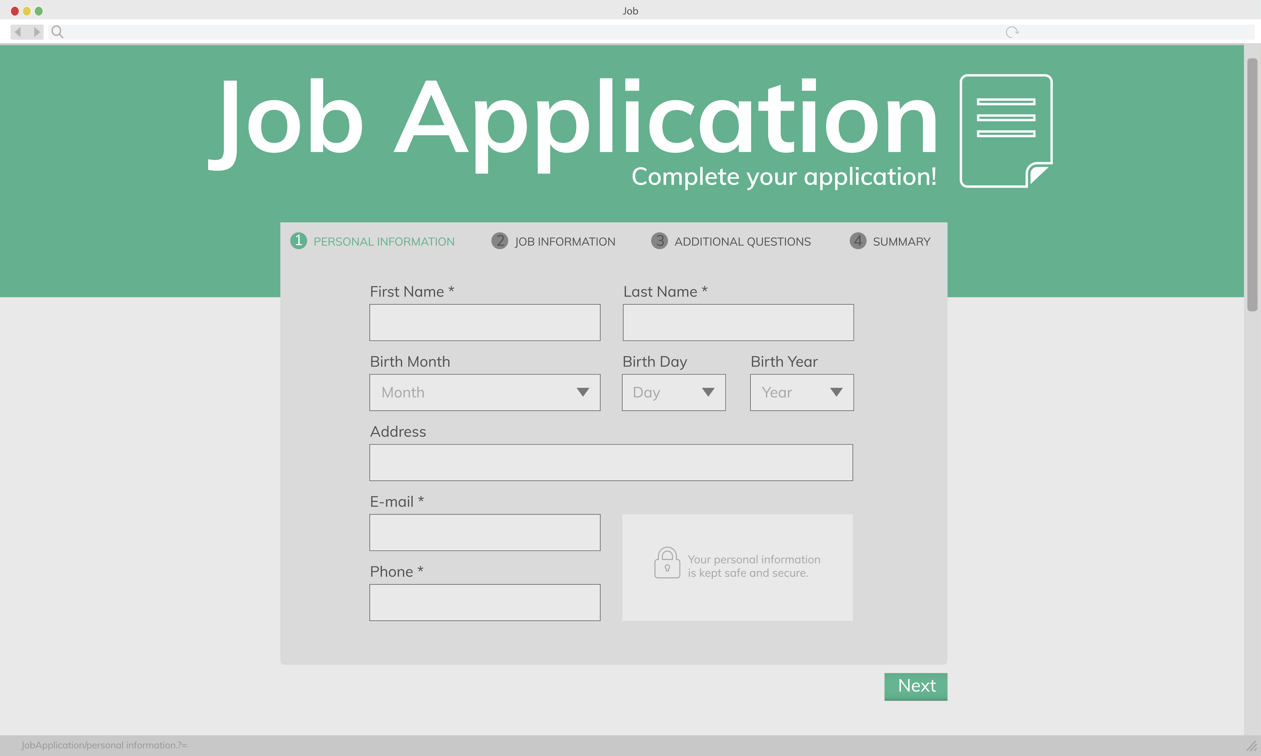

Employment
Slide hidden from learner
Online Job Application Form
Notes:
Slide hidden from learner
Title slide

Slide 2
Pre-Requisite Skills
Slide hidden from learner
Mouse / Trackpad Skills: hold mouse/ use trackpad correctly; hover; click; double click; scroll
Reading: ability to recognize simple symbols; read words and phrases
Keyboarding: Can type letters, common symbols and use Enter key on keyboard (one finger typing is ok)
Basic navigation: scroll down and up; cursor shapes; where and how to place a cursor
Online Skills: open a browser; find a website; sign in using email and password; recognize icons; recognize text boxes; recognize links; know how and where to place a cursor
Email Skills: open app; check Inbox for new mail; open an email
LINK to the DLCR:
https://digital-literacy.issbc.org/for-teachers/
Password: Diglit4T
Notes:
Slide hidden from learner
Pre-Requisite Skills
Remember: like all lessons in Module 9 – Employment (Review), this is a review lesson of the digital skills, and the learners may not be ready for this lesson.
Make sure the learner has the “Prerequisite Skills” listed in the slide.
These skills are not specifically reviewed in this lesson, but the learner needs to have them to be able to do the lesson.
If the learner struggles, go to the following modules in the Digital Literacy Curriculum Resource (DLCR) and teach the pre-requisite skills before doing this lesson:
Module 1 Mouse and Navigating
Module 2 Keyboarding
Module 3 Online Skills Basic
Module 4 Online Skills
Module 5 Email

Slide 3
Skills Reviewed in this Lesson
Slide hidden from learner
Check the Notes of this Slide
Notes:
Slide hidden from the learner
Information for the Tutor
These skills are specifically reviewed in this lesson.
It is assumed the learner has already learned these skills and is doing this lesson as a review.
Create an Indeed Account
Understand that you need to create an account (to get the most from Indeed)
Sign in to Indeed.ca, if you already have an account, using your email address and password
Know where to click and then type to enter your email and password
Know where to click when you see “I am human”.
Recognize links: “Create an account” etc.
Understand how you can create an account (using your existing Google, Facebook or Apple accounts or using an email address and password
Understand the password for Indeed needs to be different from your email password
Understand what a good password looks like
Understand it’s important to record your password and keep it in a private place
Understand when you’d want to check or not check “Keep me signed in on this device”.
Know how to uncheck a box that is already checked (“Keep me signed in on this device”)
Recognize icons: “Create Account” etc.
Understand what “Verify your email to continue means”
Know what to do to “Verify your email”
Open email Inbox
Find the email
Open the email
Know where to click: on “Confirm your Indeed account”
Understand that you are signed into your Indeed account
Fill out an Online Application Form on Indeed.ca
Enter your Contact Information
Know where and how to enter your personal information
Read the heading (Name, etc. )
Know which text box each heading refers to
Click in the text box
Type the relevant information
Understand what “optional” means on a form and when it’s good to include that information
Recognize icons and links: “Continue”
Add a Resume
Add a resume to your Indeed application
Understand you can upload a resume if you already have one
Recognize that “upload resume” is a link and you need to click on it
Recognize a pop-up menu and how to use it:
Find your resume file on your computer
Choose your resume file: double click on it
Recognize that your resume was uploaded
Know to click on “Continue” to go to the next step
Answer Questions from the Employer
Understand that the questions from the employer will differ depending on the job
Know how to answer the employer’s questions:
Click in the text box’
Type your answer
Know to click on “Continue” to go to the next step
Enter a Past Job that Shows Relevant Experience
Understand what “relevant experience” means
Know how to enter the information:
Read the headings (Job Title, Company)
Click in the text boxes
Type your answers
Know to click on “Continue” to go to the next step
Include any Supporting Documents
Understand you have two choices: “Apply without cover letter” or “Write Cover letter”
Understand when to apply without a cover letter
Recognize that “Apply without cover letter” and “Write cover letter” are both links
Know you can click on “Write Cover Letter ” then type in the box to write your letter
Scroll down to the bottom to see links for the next step
Understand what to do when you see “Additional documents (optional)”:
Recognize that “Upload file” is a link and you need to click on it to add files
Recognize a pop-up menu and how to use it:
Find a file on your computer:
Choose and open the folder containing the file
Choose the file and double click on it
Recognize that your file was uploaded
Know to click on ”Review your application” to go to the next step
Please Review your Application
Understand why it’s important to review your application before sending it: The information matches your resume
Understand that it’s important to check the spelling
How to check the entire document using scroll up and down
Understand what it means: “Notify me by email when similar jobs are available”
Know where to click to enable that
Know the last step is “submit your application “
Know where to click to submit your application
Understand how to know if your application has been sent / submitted
Understand that you need to check your email Inbox each day for emails from potential employers

Slide 4
Slide hidden from learner
Instructions
For Using this PowerPoint Lesson
Notes:
Slide hidden from learner
This PowerPoint lesson contains everything the tutor needs: the lesson notes, suggested instructional language, the links to the video lesson(s), and also Practice for each part. ​
IMPORTANT
Read through the entire lesson a few days before tutoring so you are clear about what to do and have time to get any questions answered and to do any preparation.
The first 11 slides are hidden from the learner; they contain information and instructions for the tutor.
Green Slides = Lesson Objectives
Blue Slides = The Start of each Part of the Lesson
Yellow Slides = Practice Activities
Instructions specific to each lesson are in the notes pages of each PowerPoint. ​
Identical notes are also available as a separate PDF for tutors who prefer that format. ​See Option B below.
You will NOT be able to copy and paste from this PowerPoint because it is “Read Only”.
In the Practice for each Part of this lesson, you may be asked to copy some text from this lesson and paste it into a Word document to use with the learner.
You will not be able to do that from this PowerPoint lesson. Instead, copy and paste the text from the PDF version of the (same) lesson.
There are different options for using this PowerPoint lesson and /or the PDF version of this (same) lesson:
Lesson Format Options for the Tutor
Option A
Use a printed version of the notes for you as tutor (not for the learner)
plus
Use the PowerPoint slideshow for the learner.
How:
Open the PowerPoint, download and save it.
Click “File” then "Print" ​
Then under “Settings” choose " Notes Pages" .
Print
Now, you can use the printed version for tutoring.
Option B
Use the separate electronic PDF of the PowerPoint slides and notes for you as tutor (if you don’t have PowerPoint on your computer or if you prefer to use a PDF version)
Plus
Use the PowerPoint slideshow for the learner, or the PDF-Slides Only version (if the learner’s computer doesn’t have PowerPoint). ​
You can have the PDF open to use for you as tutor beside the PowerPoint slideshow, or the PDF version of the slides (for the learner).
Option C
Use the PowerPoint slideshow in “Presenter View”.
This lets you show the slideshow to the learner, and also lets you see the notes as well as the slideshow that the learner sees.
This works for remote and in-person tutoring.
However, for in person tutoring for small groups you need a separate monitor or projector to do this: one for you and one for the learners.

Slide 5
Lesson Objectives – Part One
Slide hidden from learner
      Create an Indeed Account
Notes:
Slide hidden from learner
Instructions to the Tutor
These are the skills learners will master at the end of the lesson.

Slide 6
Lesson Objectives – Part Two
Slide hidden from learner
Fill out an Online Job Application Form
on Indeed.ca
Notes:
Slide hidden from learner
Instructions to the Tutor
These are the skills learners will master at the end of the lesson.

Slide 7
Keep in Mind
Slide hidden from learner
Only do as much as the learner can absorb in one session.
Do one part of the video lesson at a time.
Check in with the learner after each part.
Notes:
Slide hidden from learner
Information for the Tutor
According to the learner’s pace, do one part of the video lesson, check their understanding, and have the learner practice the skills. Then, let them show you they can do the skills (at least three times) before proceeding to the next part.
Look for signs of learner fatigue. Check in with learner after each part.
Is the learner is doing any of the following ?
Expressing frustration
Not asking questions, shutting down, not taking in what you are saying
Seeming overwhelmed
Saying, “Are we done yet?” etc.
Lots of yawning etc.
These are clues that it is time to stop the session and resume another day.

Slide 8

Set Up
Slide hidden from learner
Before In-Person Tutoring
Notes:
Slide hidden from learner
Information for the Tutor
Refer to TUTOR CHECKLIST- Set up for In-Person Tutoring
PREPARATION
Preparation specific to the PRACTICE for each Part of this lesson is in the notes of each “PRACTICE” slide.

Slide 9

Checklist
Slide hidden from learner
During In-Person Tutoring
Notes:
Slide hidden from learner
Information for the Tutor
Refer to:
TUTOR CHECKLIST- During In-Person Tutoring Sessions

Slide 10
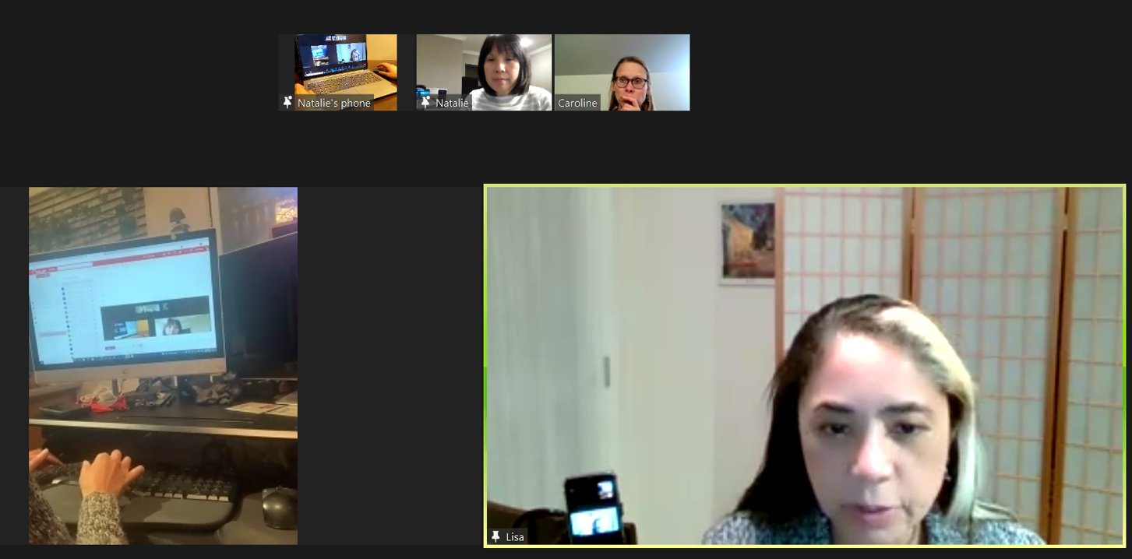
Set Up and Preparation
Slide hidden from learner
Before Remote Tutoring
Notes:
Slide hidden from the learner.
Information for the Tutor.
SET UP
Refer to:
TUTOR CHECKLIST- Set up for Remote Tutoring Session via Zoom, Ms Teams etc.
LEARNER CHECKLIST- Set up for Remote Tutoring Session via Zoom, Ms Teams etc.
IMPORTANT:
Go through the Learner Checklist as well. Then, you will be able to more easily troubleshoot with the learner if they have difficulty in their set up.
Communicate beforehand with the Support Person (if that learner has one):
Email the Learner Checklist listed in #2 above to the Support Person.
Email any instructions for this lesson to the support person (see the notes for specific slides /parts of the lesson):
Have the support person do the preparation for the lesson on the learner’s desktop. Tutor needs to guide them re. how to do this.
Preparation for Remote Tutoring only:
Support person must inform you if the learner has a Gmail account already. If they do not have one, use Module 5 as detailed in the note above under ”Pre-Requisite Skills” (Slide #2).
Have support person make sure the browser icon (or Gmail shortcut if they use that) is easy for the learner to find on the desktop.
If no preparations were made on the learner’s computer before the session by a support person, you could use the Request Remote Control function in Zoom on the learner’s desktop if the learner struggles, and before they get frustrated.
IMPORTANT: Keep in mind the following:
Before using Remote Control, be sure to get permission from your organization first.
It is crucial that the learner understands what it means, and gives you informed consent.
It is somewhat invasive and must be done respectfully and honouring the confidentiality of the learner.
Don’t use the Request Remote Control feature first! It should be a last resort.
First, try your best to teach the learner and the support person how to do things using Share screen and demonstrating.
Use it if other ways do not work and the learner really needs to learn digital skills.
You may want to record the Zoom tutoring session in case of any possible accusations afterwards.
PREPARATION
Preparation specific to each Part of this Gmail Lesson is in the notes of the relevant slides.

Slide 11
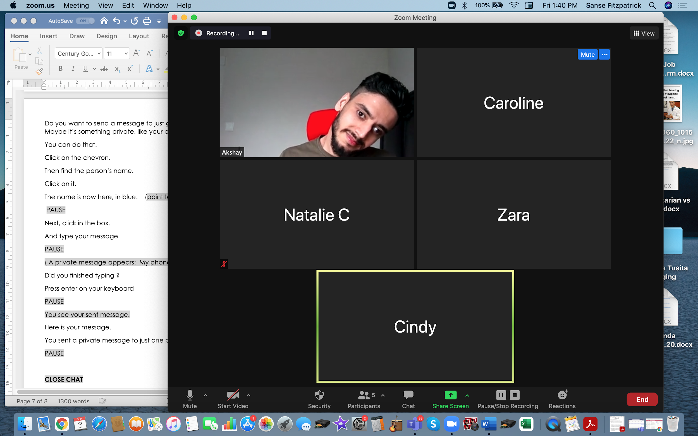
Checklist
Slide hidden from learner
During Remote Tutoring
Notes:
Slide hidden from learner
Refer to:
Tutor Checklist: During Remote Tutoring Session
Learner Instructions: How to let your Tutor have Remote Control of your Computer During a Zoom Session
SET UP SPECIFIC TO THIS LESSON
Be ready to assist learner by using the Requesting Remote Control function (refer to checklists 1 and 2 listed above).
You may have to set up learner’s desktop with relevant files if no support person is available to do that beforehand. This is possible to do using Request Remote Control in Zoom.
IMPORTANT:
Keep in mind the following:
Before using Remote Control, be sure to get permission from your organization first.
It is crucial that the learner understands what it means, and gives you informed consent.
It is somewhat invasive and must be done respectfully and honouring the confidentiality of the learner.
Don’t use the Request Remote Control feature first! It should be a last resort.
First, try your best to teach the learner and the support person how to do things using Share screen and demonstrating.
Use it if other ways do not work and the learner really needs to learn digital skills.
You may want to record the Zoom tutoring session in case of any possible accusations afterwards.

Slide 12

Employment
Online Job Application Form
Notes:
THIS SLIDE AND THE FOLLOWING SLIDES ARE TO SHOW TO THE LEARNER
Say to the learner:
To apply for most jobs now, we have to apply online, not in person.
Usually, you have to fill out a job application form online not on paper.
So, we’re going to review how to do that, how to fill out an online job application form.
Have you ever done that ?
We’re going to use Indeed.ca
Have you heard of Indeed ?
It’s a website where you can search for job openings and apply for jobs online.
Many employers put job openings on Indeed.
There are many steps to filling out an online job application form.
So, we may not fill out all of the form in one session.
Part One
First, we’re going to review how to create an account on Indeed.ca
Part Two
Then we’ll review how to apply for a job on Indeed.ca by filling out the online job application form

Slide 13
Lesson Objectives-Part One
Create an Indeed Account
Notes:
Part One
Instructions for the Tutor
These are the skills the learner will master at the end of the lesson:
Create an account on Indeed.ca
Find out if the learner already has an account on Indeed.ca.
They can still watch the lesson to review the steps but will not need to create a new account during the practice part of the lesson.
Say to the learner:
Before you apply for a job posted on Indeed, it’s a good idea to create an account on the Indeed.ca website.
You don’t have to do this but it helps you get more out of the Indeed website.
This account is free.

Slide 14

Lesson-Part One
Create an Indeed Account
Notes:
Say to the Learner:
Let’s learn how to create a free account on the Indeed.ca website.
We’ll watch a video to learn how to do this.
We can watch the video several times. So, don't worry if you don't catch everything the first time.
Instructions for the Tutor:
•The icon in the slide with the red triangle is a link to the video on YouTube.
•Just click on that link (in Slideshow mode) to open the video LESSON.
•Here is that link in case the one in the slide doesn’t work:
https://youtu.be/3-ecPoJtS7s
Video length: 0:00-0:05:47 minutes [5:47 mins]
For remote tutoring when you share screen to play the video, make sure you have shared the audio.
Play the lesson a bit and check the learner can hear it ok.
Play it until the end, then check for understanding. See the next slide for comprehension check questions.

Slide 15

Check Understanding
Notes:
Instructions for the Tutor:
After watching the video lesson for Part One, pause the video and check understanding (review and elicit).
before moving on to Part Two.
Check understanding - ask the learner as you watch the video and/or as you demonstrate on your computer.
Ask these comprehension check questions, or others, to check understanding:
[Create an Indeed.ca Account]
Say to the Learner:
You found a job on Indeed.ca. You want to apply for it. What do you click on first ? Answer: Apply Now.
It says “Sign in”.
If you already have an account on Indeed.ca. what do you do ? Answer: Enter your email address and (Indeed) password. Then click “Sign In” (the blue icon)
If you don’t have an Indeed.ca account. What do you do ?
Answer:
Find where it says “New to Indeed? Create an account.”
Click on those words. They are a link. (See how the cursor changes to a hand so you know it’s a link.)
You don’t see the words, ““New to Indeed? Create an account.” What do you do to find them ? Answer: Scroll down until you see them.
You see “Create an Account (it’s free). There are different ways to create an account. Do you remember them ?
Answer: By using your existing Google, Apple or Facebook accounts, or using your email address and a password.
[Create an Indeed Account using an Email Address]
The video shows how to create an Indeed account using your email address and a password.
You have to enter a password. Do they mean your email password or a password for your Indeed account ? Answer: A password for your Indeed account.
When you create a password, how can you make sure it is secure ?
Answer:
Make it different from your email password. Don’t use the same password
Make sure it includes upper and lower case letters, numbers and symbols.
What should you do to help you remember your password ?
Answer:
Write down your password
Keep it in a private place.
NOTE: For more information and practice on passwords, see the following lessons:
“Online Safety” in Module 9-Employment (Review) and Module 7-Safety and Security
You see “Your Role”. What do you click on ? “Employer” or “Job Seeker” ? Answer: Job Seeker (because you are looking for a job)
You see “Keep me signed in on this device.”
[On a Shared Computer]
If you are using a shared computer or a public computer, do you check or uncheck this box ? Answer: Uncheck it.
Why do you uncheck it ? Answer: Then it keeps your information safe, private. (Because you have to enter your email address and Indeed password next time you use Indeed. )
[On Your Own Computer]
You are using your own computer that you don’t share with other people. Can you check this box ? Answer: Yes. It’s ok to check the box.
Why would you want to check that box ? Answer: Then you don’t have to enter your email address and Indeed password next time you use the Indeed.ca website.
You see “I am human”. What do you do now ? Answer: Click on the box beside this.
What icon do you click on next ? Answer: “Create Account”
What colour is the icon “Create Account” ? Answer: Blue
[Verify Your Email]
After you create your new Indeed account, you see this: “Verify your email to continue”. What does this mean ? Answer: It means they sent you an email and you need to go to your email inbox (and confirm it).
Who is the sender of the email ? Answer: John from Indeed
What’s the subject of the email ? Answer: Please confirm your email address
After you click on the email to open it, what does it say ?
Answer: (NOTE: You need to read the text on the screen for this answer) Confirm your email address on Indeed”. “Thanks for signing up at Indeed! Please click on the following button to verify your email address.”
How do you confirm your email address ? Answer: Click on the icon/ button that says “Confirm your Indeed account”.
What colour is this icon ? Answer: Blue
Show that icon to me now.
When she says, “You are now signed into your account.” What do you see on the screen ?
Answer: (NOTE: You need to read the text on the screen for this answer) You see a white box showing the user’s email address, then a list of items (Profile, My Jobs, My reviews, etc.
Instructions for Tutor:
Then ask the learner: Do you want to watch the video again?
If the learner is struggling, stop the session.
Say to the learner:
Let’s do more work on X before we do this. (so, learner does not feel bad they can’t yet do something)
For example, the learner may not be able to recognize cursor shapes or where to place a cursor. If so, go to Module 1 Mouse and Navigating and Module 3 Online Skills Basic etc. to practice the skills with the learner.

Slide 16
Practice
Part One
Create an Indeed Account
Notes:
Practice-Part One
Instructions for the Tutor:
Preparation
The learner needs an email address to practice what they reviewed in the video lesson.
Before the tutoring session, look on the Indeed Canada website and find a job title that could be relevant to the learner.
You need to find one that has a posting that includes the “Apply Now” icon not the “Apply on Company site / website” icon.
When the learner is prompted to type a job title, have them use the title for the posting you found.
For example, stocker, dishwasher, clerk etc.
If the learner already has an Indeed account and tells you they use it, get them to show you how they log into it.
Have them log out and log in again at least three times so you are sure they can do it independently.
If the learner already has an Indeed account but you want them to practice the skills in the video lesson, you could have them create another account for practice. However, this is not recommended. They will need to use another email address and need to think of another password for Indeed. That may be confusing for most learners.
IMPORTANT:
The steps on the live website may be different than in the video lesson and different than the steps in Practice below. This is because websites are constantly changing. So, before having the learner practice, make sure you, the tutor, check out the live website to be aware of the steps the learner will have to do.
Practice
Demonstrate first, then let the learner practice.
After each of the following steps, wait for the learner to complete the step. Guide the learner as needed.
[Create an Indeed.ca Account]
Say to the Learner:
Now it’s time to practice.
We’re going to practice how to create an Indeed account like in the video.
Open the browser.
Go to the Indeed Canada website:
Click in the search bar and type “Indeed Canada”
Press Enter on your keyboard
Choose the “Indeed: Job Search Canada” website by clicking on the name or the website address: “ca.indeed.com”
Check the address bar and make sure it is the correct website. “ca.indeed.com”
In the “What” text box, type a job title. (For example, “Stocker”).
In the “Where” text box type a location where you want to work. (For example, “Victoria”).
Choose one of the jobs listed.
Don’t read all the information now.
Just find the “Apply now” icon and click on it.
Now you see this . What do you need to do now ? Answer: Either create an account or sign in (if you already have one)
You don’t have an Indeed.ca account. So you need to create one.
Practice what we saw in the video lesson.
Does it say “New to Indeed? Create an account.”
If so, click on those words. They are a link. (See how the cursor changes to a hand so you know it’s a link.)
You don’t see the words, ““New to Indeed? Create an account.” What do you do to find them ? Answer: Scroll down until you see them.
Do that now.
[Note: You may just see “Email Address”.]
[Create an Indeed Account using an Email Address]
Say to the Learner:
Find the text box that says, “Email address”. Click in the box, type your email address now. Then press Enter on your keyboard.
Then, you have to enter a password. Remember, this is not your email password. You need to think of a new password, one just for your Indeed account.
Make sure it includes at least 8 characters and includes upper and lower case letters, numbers and symbols.
Write down your password now.
Keep it in a private place. Don’t share it.
You see “I am human”. Do you remember what to do ? Answer: Click on the box beside this.
Do that now.
What do you see now ? Answer: You see “Your Role”.
What do you click on, “Employer” or “Job Seeker” ? Answer: Job Seeker (because you are looking for a job)
Do that now.
You see “Keep me signed in on this device.”
[On a Shared Computer]
Are you using a shared computer ? Yes. Then uncheck this box. You don’t want to stay signed it. Other people could look at your personal information. Uncheck it and your information is safe, private.
Do that now.
OR
[On Your Own Computer]
You are using your own computer that you don’t share with other people. Can you check this box ? Answer: Yes. It’s ok to check the box. Then you don’t have to enter your email address and Indeed password next time you use the Indeed.ca website.
So do that now. Make sure the box is checked.
Remember what to click on next ? Answer: the blue “Create Account” icon
Great ! You created an account on Indeed.
Instructions for the Tutor:
The learner can’t repeat Practice, Part One unless they do it with a different email address and think of a new Indeed password. However, this is not recommended. It may be confusing for most learners. So, we recommend you do this practice once and spend time doing more practice in Part B of this lesson.
Tip:
For more information and practice on passwords, see the following lessons in the Digital Literacy Curriculum Resource:
“Online Safety” in Module 9-Employment (Review) and Module 7-Safety and Security

Slide 17
Lesson Objectives – Part Two
Fill out an Online Job Application Form on Indeed.ca
Notes:
Slide hidden from learner
Instructions to the Tutor
These are the skills learners will master at the end of the lesson.
Fill out an Online Application Form on Indeed.ca
Note:
There are many steps (six ! ) to fill out a job application form on Indeed.
So, depending on the learner, you may just do a few steps in one session.
Then, review and continue in the subsequent session(s).
Remember, the goal is for the learner to build confidence, independence and feel successful !
Say to the learner:
You created an account in Part One of this lesson (or you already had an account) on the Indeed Canada website.
Great!
Now, we’re going to review how to fill out an Online Application Form on Indeed.ca to apply for a specific job posting.

Slide 18
Lesson-Part Two
Fill out an Online Job Application Form on Indeed.ca
Notes:
Say to the Learner:
Let’s review how to apply for a specific job posting by filling out an Online Application Form on Indeed.ca.
We’re going to watch a video to review how to do this.
We can watch the video several times. So, don't worry if you don't catch everything the first time.
Instructions for the Tutor:
•The icon in the slide with the red triangle is a link to the video Lesson on YouTube.
•Just click on that link (in Slideshow mode) to open the video Lesson.
•Here is that link in case the one in the slide doesn’t work:
https://youtu.be/CBad94Y2KvU
Video length: 0:00-0:09:21 (end) minutes [9:21 mins]
For remote tutoring, when you share screen to play the video, make sure you have shared the audio.
Play the lesson a bit and check the learner can hear it ok.
Play till the end of the video, then check for understanding. See the next slide for comprehension check questions.

Slide 19
Check Understanding
Notes:
Instructions for the Tutor:
Note:
There are many steps (six ! ) to fill out a job application form on Indeed.
So, depending on the learner, you may just do a few steps in one session.
Then, review and continue in the subsequent session(s).
Remember, the goal is for the learner to build confidence, independence and feel successful !
Check Understanding
After watching each step of the video lesson for Part Two, pause the video and check understanding (review and elicit).
Ask these comprehension check questions or others to check understanding:
Say to the Learner:
This is your first time filling out an online application form on Indeed. How many steps are there ? Answer: Six steps
[Step One]
What information do you have to fill out in “Step one” ? Answer: Your Contact information (first and last name)
What information in “Step One” is “optional” ? Answer: Your phone number, city and province
What do you click on to move to “Step Two” ? Answer: "Continue"
[Step Two]
What do you have to do in “Step Two” ? Answer: Add a resume.
You made a resume before and have it saved on your computer. So, what do you do now? Answer: Upload the resume onto Indeed
How do you upload your resume ?
Answer:
Click on the “Upload resume” icon
Look at the pop-up menu
Find your resume file
Double Click on the file
The resume is then uploaded
Do you click or double click on the resume file to upload it ? Answer: Double click
Optional question- Note: the tutor would need to point this out to the learner by reading the text in the video as the video actor does not talk about this:
Say to the learner:
If you don’t have a resume already made, what can you do ? Answer: Click on “Create online resume”. Indeed can guide you through creating one.
What do you click on to move to “Step Three” ? Answer: "Continue"
[Step Three]
Say to the learner:
What do you do need to do in “Step Three” ? Answer: Read and answer the questions from the employer
Are the questions for each employer the same or different ? Answer: They are different
Who is the employer in the video ? Answer: Nesters Market
What is the question Nesters Market asks in the video ? Answer: Please list 2-3 dates and time ranges that you could do an interview.”
What do you do after you answer the employer’s questions in “Step Three” ? Answer: Click on the blue “"Continue"” icon.
[Step Four]
Say to the learner:
What do you do need to do in “Step Four” ? Answer: Enter a past job that shows relevant experience
Do you have to fill out this part or is it optional ? Answer: It’s optional
(Note: This is implied not stated in the video): Why is it good to include this information even if it says it’s “Optional” ? Answer: It may help you get hired for the job
What two text boxes do you have to fill out ? Answer: Job title and Company
What do you click on when you have finished “Step Four” ? Answer: "Continue"
[Step Five]
Say to the learner:
What do you do need to do in “Step Five” ? Answer: Include any supporting documents like a cover letter etc.
Do you have to fill out this part or is it optional ? Answer: No, it’s optional
What two choices do you have in “Step Five” regarding cover letters ?
Answer: “Apply without cover letter” or “Write cover letter”
If you want to apply without a cover letter, what do you do ? Answer: Click “Apply without cover letter”
If you want to include a cover letter, what do you do ? Answer:
Click on “Write cover letter”
Click in the box
Type a cover letter
After you type the letter, what do you do ? Answer: Scroll down
Why do you scroll down ? (Note: This is implied not stated in the video): Answer: To see the instructions and icons at the bottom of the page.
In the video, she included a cover letter. What additional document does she include/ upload too ? Answer: a reference letter
Is it optional or do you have to include “Additional documents” ? Answer: It is optional
Why is it good to include a reference letter in “Step Five” ? Answer: It may help your job application
How do you include a reference letter or other file? What are the steps ? Answer:
Click “Upload file” icon
Look at the pop-up menu
Find the place where your file is on your computer (For example “Documents”)
Click on it
Find the folder that has the file (For example, “Job Search folder”)
Double click on the folder to open it
Find the file (For example, “Reference letter”) inside the folder
Double click on it to upload it
Do you click or double click on the file to upload it ? Answer: Double click
The file is then uploaded on Indeed
What do you click at the end of “Step Five” ? Answer: “Review your application”
[Step Six]
Say to the learner:
What do you do need to do in “Step Six” ? Answer: Review your application
What does that mean ? Answer: Check that all the information is correct and that the information in your resume and the application matches.
Can you see all the information or do you have to scroll up and down to check it ? Answer: You need to scroll up and down
What else is important to check ? Answer: Spelling. Is everything spelled correctly?
What does this mean:“ Notify me by email when similar jobs are available” ?
Answer: You’ll get other job openings like this one in your email.
What do you have to click on if you want to get similar jobs sent to your email ?
Answer: Click in the box beside “Notify me by email when similar jobs are available”
What is the last step? Answer: Send/Submit your application
How do you send your application ? Answer: Click on “Submit your application”
How do you know if your application was sent ok ? Answer: You see “Your application has been submitted!”
What do you need to do each day ? Answer: Check your email inbox every day.
Why ? Answer: An employer may contact you.
Instructions for the Tutor:
Then ask the learner: Do you want to watch the video again?
If the learner is struggling, stop the session.
Say to the learner:
Let’s do more work on X before we do this. (so, learner does not feel bad they can’t yet do something)
For example, the learner may not be able to identify links or click and type in text boxes. If so, go to the relevant module(s) in the Digital Literacy Curriculum Resource and practice the skill(s) with the learner.
For example, Module 1-Mouse and Navigation, review cursor shapes or Module 3-Online skills Basic, learn to identify and fill in text boxes, etc.

Slide 20
Practice
Part Two
Fill out an Online Job Application Form on Indeed.ca
Steps 1-3
Notes:
Practice-Part Two
Steps 1-3 of the Indeed Job Application Form
Instructions for the Tutor:
IMPORTANT:
The steps on the live website may be different than in the video lesson and different than the steps in Practice below. This is because websites are constantly changing. So, before having the learner practice, make sure you the tutor check out the live website to be aware of the steps the learner will have to do.
PREPARATION
Before the tutoring session, look on the Indeed Canada website and find a job posting that could be relevant to the learner.
You need to find one that includes the “Apply Now” icon not the “Apply on Company site / website” icon.
When the learner is prompted to type a job title, have them use the title for the posting you found.
For example, stocker, dishwasher, clerk etc.
Note: There are many steps to filling out an online job application form on Indeed.
It’s ok if you don’t finish all the steps in one session. In subsequent sessions, have the learner repeat the steps they did before- it’s good digital skills practice! And have them do more steps until they have done all the steps needed in order to fill out an online application form on Indeed.
PRACTICE
Demonstrate first, then let the learner practice.
After each of the following steps, wait for the learner to complete the step. Guide the learner as needed.
Say to the Learner:
Now we’re going to practice how to Fill out an Online Application Form on Indeed.ca, like in the video.
[Sign in to your Indeed Account]
The first thing to do is to sign in to you Indeed account.
Remember how to do that ? Yes, first open the browser and find the Indeed Canada website. (ca.indeed.com)
Now, sign in to your Indeed account. You created this when we did Part One (or maybe the learner already had one).
How do you sign in ? Answer: Yes, enter your email address and Indeed password
Great. Now you are signed in.
[Step One]
What information do you have to fill out in “Step one” ? Answer: Your Contact information (first and last name)
Do that now. Click in each text box and type that information
Do you have to fill in your phone number ? Answer: No it’s optional
What about your city and province ? Answer: No, it’s optional too
Let’s fill out the city and province. Click in each text box and type that information.
Let’s not fill out the phone number. To be private.
Do you remember what to click on to move to “Step Two” ? Answer: "Continue“
[Step Two]
What do you have to do in “Step Two” ? Answer: Add a resume.
You made a resume before and have it saved on your computer. So, what do you do now? Answer: Upload the resume onto Indeed
Do you remember how to upload your resume ? Do that now:
Click on the “Upload resume” icon
Look at the pop-up menu
Find your resume file
Do you click or double click on the resume file to upload it ? Answer: Double click
The resume is then uploaded
What do you click on to move to “Step Three” ? Answer: "Continue“ Do that now.
[Step Three]
What do you do need to do in “Step Three” ? Answer: Read and answer the questions from the employer
Who is the employer ? Answer: (Depends on the job posting)
What question is this employer asking ? Answer: (Depends on the job posting)
Answer the questions. How do you do that ? Answer: Click in the box and type an answer.
What do you do after you answer the employer’s questions in “Step Three” ? Answer: Click on the blue “"Continue"” icon.
Do that now.
Instructions for the Tutor:
Have the learner repeat Steps 1-3 or continue with Steps 4-6 (See next slide) depending on their skills.
Have them practice as many times as they need (at least three times.) Repeat with the same job posting, then with a new job posting.
Check the Learner's skills. Has the learner shown you they can do the skills at least three times without support?

Slide 21
Practice
Part Two
Fill out an Online Job Application Form on Indeed.ca
Steps 4-6
Notes:
Practice-Part Two
Steps 4-6 of the Indeed Job Application Form
Instructions for the Tutor:
IMPORTANT:
The steps on the live website may be different than in the video lesson and different than the steps in Practice below. This is because websites are constantly changing. So, before having the learner practice, make sure you the tutor check out the live website to be aware of the steps the learner will have to do.
PREPARATION
Note: There are many steps to filling out an online job application form on Indeed.
It’s ok if you don’t finish all the steps in one session. In subsequent sessions, have the learner repeat the steps they did before- it’s good digital skills practice! And have them do more steps until they have done all the steps needed in order to fill out an online application form on Indeed.
For Step Five
Create a Word document with a very simple, short cover letter. The learner will copy from this.
Look on the internet for examples if you don’t have one.
Print this for the learner if it’s easier for them to copy from a paper document.
Or, be ready to open the electronic version of it on the learner’s desktop. Open it beside the browser window that has the Indeed job application open, so they are side by side on the screen.
The learner will either copy the text from the paper or electronic document and type it in the text box on the Indeed website. Or, if they know how to copy and paste text, they can copy and paste the text from the Word document into the box in Step Five of the Indeed job application form.
Optional: Teach the learner how to copy and paste text before doing Step Five.
Go over this cover letter with the learner before starting Step Five, so they know what it is.
Create a PDF of a simple reference letter. The learner will upload this.
Look on the internet for examples if you don’t have one.
Save it in a folder on the learner’s desktop. Be ready to help the learner find it when it’s time to upload it.
Go over this reference letter with the learner before starting Step Five, so they know what it is.
Tip: Help the learner create a folder on their desktop called “Job Application Documents”. Put a cover letter and a reference letter inside. Then they can find these easily. Use the following lesson in Module 9-Employment (Review) to tutor the learner in how to do that: “Be Organized-Mouse/Trackpad and Navigation Skills
***********************************************************************************************************************
PRACTICE
Demonstrate first, then let the learner practice.
After each of the following steps, wait for the learner to complete the step. Guide the learner as needed.
Say to the Learner:
Now we’re going to practice how to Fill out an Online Application Form on Indeed.ca, like in the video.
[Step Four]
What do you do need to do in “Step Four” ? Answer: Enter a past job that shows relevant experience
Do you have to fill out this part or is it optional ? Answer: It’s optional
Let’s fill it out. Remember it can help your application.
Find the two text boxes to fill out. What are they ? Answer: Job title and Company
Click in them and type the information
What do you click on when you have finished “Step Four” ? Answer: "Continue"
[Step Five]
Note to Tutor: Read the “Preparation” “For Step Five” above.
Say to the learner:
What do you do need to do in “Step Five” ? Answer: Include any supporting documents like a cover letter etc.
Do you have to fill out this part or is it optional ? Answer: No, it’s optional
Remember there are two choices regarding cover letters. You can apply without a cover letter or write a cover letter now.
If you want to apply without a cover letter, what do you do ? Answer: Click “Apply without cover letter”
Let’s write a cover letter, like in the video. It makes your application better.
Do you remember what to do ? Answer:
Click on “Write cover letter”
Click in the box
Type a cover letter
Options:
Give the learner the print version of the Cover letter (Word document). Have them copy it, typing the text
in the box in Step Five.
OR
Open the electronic version of the Cover letter (Word document) on the learner’s computer. Resize it so the learner can see it clearly beside the browser window that has the Indeed job application. Have the learner copy the text, typing it in the box in Step Five.
OR
If the learner knows how to copy and paste text, they can copy and paste the text from the Word document into the box in Step Five of the Indeed job application form.
Say to the Learner:
Here is the cover letter to use. Let’s read it first.
Now, copy and paste it into the box. (If the learner knows how to copy and paste text)
OR
Now, copy the text. Type it in the box
Great !
Let’s check. Does it look ok ?
Great!
So, the letter is there. What do you need to do now ? Answer: Scroll down
Why do you scroll down ? Answer: To see the instructions and icons at the bottom of the page.
Do that now.
Find “Additional Documents”.
What other documents could you upload here ? What might help your job application ?
Answer: a reference letter etc.
Is it optional or do you have to include “Additional documents” ? Answer: It is optional but remember it could help you get the job.
So, let’s upload a reference letter now.
How do you include a reference letter or other file? Do you remember ? What are the steps ? Answer:
Click the “Upload file” icon
Look at the pop-up menu
Find the place where your file is on your computer (For example “Documents”)
Click on it
Find the folder that has the file (For example, “Job Search folder”)
Double click on the folder to open it
Find the file (For example, “Reference letter”) inside the folder
Double click on it to upload it
Do you click or double click on the file to upload it ? Answer: Double click
The file is then uploaded on Indeed
What do you click at the end of “Step Five” ? Answer: “Review your application”
[Step Six]
What do you do need to do in “Step Six” ? Answer: Review your application
What does that mean ? Answer: Check that all the information is correct and that the information in your resume and the application matches.
Remember you need to scroll up and down to check it.
Do that now.
Does the information look correct ? Does it match your resume ?
Great!
What else is important to check ? Answer: Spelling. Is everything spelled correctly?
Do that now.
Does the spelling look correct ?
Great !
“ Notify me by email when similar jobs are available” ? Do you want to get other job openings like this one in your email ? If so, click in the box.
What is the last step? Answer: Send/Submit your application
How do you send your application ? Answer: Click on “Submit your application”
Do that now.
What do you see now ? “Your application has been submitted!”
So you know it was sent ok.
Remember in the video, she said you need to check your email inbox every day.
Why ? Answer: An employer may contact you.
So, you may get an email from an employer about your application.
We are just practicing your digital skills, how to fill out the form. So, if you get an email, you can tell me and I can help you reply to that email. Or you can just ignore it.
Instructions for the Tutor:
Have the learner repeat this activity and practice as many times as they need (at least three times.) Repeat with the same job posting, then with a new job posting.
Check the Learner's skills. Has the learner shown you they can do the skills at least three times without support?

Slide 22

Practice Between Sessions
What did you learn/practice today?
When are you going to practice?
Practice Plan
Notes:
Instructions for the Tutor:
In-person tutoring and Remote Tutoring:
Make sure the learner knows how to access the video lesson(s) you just used so they can practice between tutoring sessions.
If relevant, make sure the support person at home knows how to access the video(s) too.
Option One
Email the video link to the learner, and if relevant the at-home support person. They can use the link in the email to access the video lesson(s).
Option Two
Put a link to the specific video lesson(s) you did on the learner desktop so they can access the video easily.
How:
Open the website address for the lesson in the browser.
In the address bar, click to highlight the lesson address.
Drag the address (link) onto the desktop. It will make an icon on the desktop.
Find the icon on the desktop and check that the link works.
Show the learner where it is. Tell them to just click to access it for practice.
Remote Tutoring Only:
You can do Strategy Two by using Request Remote Control in Zoom during the tutoring session.
Refer to the following for the steps on how to do that:
Tutor Checklist-During Remote Tutoring Sessions
Learner Instructions: Let Tutor have Remote Control of your Computer During a Zoom Session
IMPORTANT: Keep in mind the following:
Before using Remote Control, be sure to get permission from your organization first.
It is crucial that the learner understands what it means, and gives you informed consent.
It is somewhat invasive and must be done respectfully and honouring the confidentiality of the learner.
Don’t use the Request Remote Control feature first! It should be a last resort.
First, try your best to teach the learner and the support person how to do things using Share screen and demonstrating.
Use it if other ways do not work and the learner really needs to learn digital skills.
You may want to record the Zoom tutoring session in case of any possible accusations afterwards.
*********************************************************************************************************************
Say to the Learner:
You did well today.
So, what did you learn and practice today?
Today, we learned and practiced how to:
[only mention the parts you covered]
Create an account on Indeed.ca
Fill out an Online Application Form on Indeed.ca; Steps 1-3 or 4-6 (for example)
It’s really important to review and practice as much as you can! Please do that before our next tutoring session.
Watch the video again, as many times as you need.
I’ve emailed you the link. Let/s make sure you can open it.
(OR)
We’ve put the link on your desktop. Here it is. Just click on it to watch the video.
Let’s make sure it works ok.
[Practice Plan]
Preparation
For Step 5: Check the learner knows the name of the folder containing the cover letter and reference letter. For example, “Job Search Documents”.
Check that they also know where the folder is on their computer. They need this folder to practice Step Five.
If they are using a different computer at home, have the support person help them create this folder on their computer Desktop. Email the cover letter and reference letter to the learner and /or support person for them to download and save in that folder.
Say to the learner:
Practice at least three more times before our next session.
Here is what to practice:
I will email you the link to the video lesson.
Open the link and watch the video as many times as you want.
Go to the Indeed Canada website.
Search for jobs using the “What” (Job Title) box and the “Where”(location) box.
Put “Stocker” in the “What box (or another job relevant to the learner)
Put “Vancouver” in the “Where” box (or the location relevant to the learner)
Choose one of the job postings that come up for that job title. But be sure to choose one that includes “Apply Now”
Click on “Apply Now” and try to fill out the job application form, like we practiced.
It’s ok if you just fill out a few steps. You don’t have to fill it all out.
You don’t have to submit the application.
Just practice filling out the form.
You can show me at our next session.
I will email you this Practice Plan. Please reply to the email so I know you got it and have what you need to do the practice.
[Get learner to confirm they will practice and tell you when. Get specific.]
When are you going to do the practice? How many times ? etc.
Instructions for the Tutor:
Email the Practice to the learner, and if relevant to the home support person.

Slide 23

Confirm Next Session and Support
Notes:
Instructions for the Tutor:
Confirm the next tutoring session.
Clarify any support in-between sessions if you are offering that.
If offering support outside the session time, put boundaries, be clear about when and how you are giving support.
Say to the Learner.
e.g. Great work today! etc.
Let’s meet again on X date at X time. Does that work for you?
Wonderful.
[If offering support before next session:]
If you need support before our next session, please .........
[For remote support:]
I will send you the Zoom link the day before the tutoring session.
etc.

Slide 24
See you!
Keep Practicing
Notes:
Bye and see you on X date at X time.
Keep practicing !

