Slide 1


Employment
Slide hidden from learner
Email Skills-Gmail
Part One
Notes:
Slide hidden from learner
Information for the Tutor.
This PowerPoint lesson covers the following video lessons:
Check Inbox for New Mail
Write and Send an Email to One Person
Send an Email to More Than One Person-Use “To”
Send an Email to More Than One Person-Use “Cc”
Reply to an Email
Reply All to an Email
Forward an Email

Slide 2
Pre-Requisite Skills
Slide hidden from learner
Mouse/ Trackpad skills: hold mouse / use trackpad; hover; left click; double click; right click
Basic Navigation: scroll; cursor shapes; where and how to place a cursor
Keyboarding: Type words, numbers, some symbols, use Shift and Enter keys
Online Skills: Open a browser; use the address bar; search for a website
Email Skills: Open email app; sign in; use inbox; recognize & use common icons; write and send an email​
LINK to the DLCR:
https://digital-literacy.issbc.org/for-teachers/
Password: Diglit4T
Notes:
Slide hidden from learner.
Information for the Tutor.
Pre-Requisite Skills
Remember: like all lessons in Module 9 – Employment (Review), this is a review lesson of the digital skills, and the learners may not be ready for this lesson.
Make sure the learner has the “Prerequisite Skills” listed in the slide.
These skills are not specifically reviewed in this lesson, but the learner needs to have them to be able to do the lesson.
If the learner struggles, stop the lesson and go to the following modules in the Digital Literacy Curriculum Resource (DLCR) and teach the pre-requisite skills before doing this lesson:
Module 1 Mouse and Navigating
Module 2-Keyboarding
Module 3-Online Skills Basic
Module 5: Email
IMPORTANT:
The Learner needs to have a Gmail account in order to practice each skill in this lesson. If they don’t have one, STOP this review lesson.
Instead, do the following:
Go to the DLCR (Digital Literacy Curriculum Resource).
Use Module 5-Email. Teach them how to create an account first.
https://digital-literacy.issbc.org.
Go to the Teachers tab.
Password: Diglit4T

Slide 3
Skills Reviewed in this Lesson
Slide hidden from learner
Notes:
Slide hidden from the learner.
Information for the Tutor
These skills are specifically reviewed in this lesson.
It is assumed the learner has already learned these skills and is doing this lesson as a review.
Email Skills-Check Inbox for New Mail
Find and open Inbox
Recognize new email
Check if an email is safe to open
Open an email
Recognize & use common icons in email Inbox
Email Skills- Send an Email to One Person
Find and use “Compose” icon
Find and use the email address box
Type the email address
Find and use the email subject box
Type the subject of the email
Find and use the email message box
Type a short email in the email message box
Double check the email before sending it: the address, subject and message
Find the send icon and click on it to send the message
Check the Message was Sent Ok
Find the “Sent” icon/folder in the email folders menu
Open the “Sent” folder
Check if the email you sent is inside the “Sent” folder.
Email Skills- Send an Email to More Than One Person
Use “To”
Find and use “Compose” icon
Find and use the email address “To” box
Type the email addresses for multiple people
Click on an email address if it appears below the email address box
Find and use the email subject box
Type the subject of the email
Find and use the email message box
Type a short email in the email message box
Find the “Send” icon and click on it to send the message
Check the Message was Sent Ok
Find the “Sent” icon/folder in the email folders menu
Open the “Sent” folder
Check if the email you sent is inside the “Sent” folder.
Email Skills- Send an Email to More Than One Person
Use “Cc”
Understand when you would use “Cc”
Find and use “Compose” icon
Find and use the email address “To” box
Type an email addresses in the “To” box
Find and use the email address “Cc” box
Type an email addresses in the “Cc” box
Find and use the email subject box
Type the subject of the email
Find and use the email message box
Type a short email in the email message box
Double check the email before sending it: the address, subject and message
Find the “Send” icon and click on it to send the message
Check the Message was Sent Ok
Find the “Sent” icon/folder in the email folders menu
Open the “Sent” folder
Check if the email you sent is inside the “Sent” folder.
Email Skills- Reply to an Email
Recognize & use “Reply” icon
Recognize that the sender’s address is in the address box
Type a short email reply in the email message box
Find the “Send” icon and click on it to send the message
Check the Message was Sent Ok
Find the “Sent” icon/folder in the email folders menu
Open the “Sent” folder
Check if the email you sent is inside the “Sent” folder.
Email Skills- Reply All to an Email
Understand when you would use “Reply All”
Check if a sender sent an email to you and Ccd others
Recognize & use the “More Options” icon (Three vertical dots) to find the “Reply All” icon
Recognize & use “Reply To All” icon
Understand whose emails are in the “Cc” address box and whose are in the “To” address box; who you are sending the reply to and who is getting a copy of the reply.
Type a short email reply in the email message box
Find the “Send” icon and click on it to send the message
Email Skills- Forward an Email
Understand when you would use “Forward”
Recognize & use the “More Options” icon (Three vertical dots) to find the “Forward” icon
Recognize & use “Forward” icon
Find and use the “To” email address box to forward the email
Type an email address in the “To” email address box to forward the email
Type a short email in the email message box to explain why you are forwarding the email
Find the “Send” icon and click on it to send the message

Slide 4
Instructions
For Using this PowerPoint Lesson
Slide hidden from learner
Notes:
Slide hidden from learner.
Information for the Tutor:
This PowerPoint lesson (PPT) contains everything the tutor needs: the lesson notes, suggested instructional language, the links to the video lesson(s), and Practice for each part. ​
IMPORTANT
Read through the entire lesson a few days before tutoring so you are clear about what to do and have time to get any questions answered and to do any preparation.
The first 13 slides are hidden from the learner; they contain information and instructions for the tutor.
Green Slides = Lesson Objectives
Blue Slides = The Start of each Part of the Lesson
Yellow Slides = Practice Activities
Instructions specific to each lesson are in the notes pages of each PPT. ​
Identical notes are also available as a separate PDF for tutors who prefer that format. ​See Option B below.
You will NOT be able to copy and paste from this PowerPoint because it is “Read Only”.
In the Practice for each Part of this lesson, you may be asked to copy some text from this lesson and paste it into a Word document to use with the learner.
You will not be able to do that from this PowerPoint lesson. Instead, copy and paste the text from the PDF version of the (same) lesson.
There are different options for using this PowerPoint lesson and /or the PDF version of this (same) lesson:
Lesson Format Options for the Tutor
Option A
Use a printed version of the notes for you as tutor (not for the learner)
Plus
Use the PPT slideshow for the learner.
How:
Open the PPT, download and save it.
Click “File” then "Print" ​
Then under “Settings” choose " Notes Pages" .
Print
Now, you can use the printed version for tutoring.
Option B
Use the separate electronic PDF of the PPT notes for you as tutor:
Email Skills-Gmail -Notes Pages.pdf
Plus
Use the slideshow for the learner. ​
You can have the PDF open to use for you as tutor beside the PPT slideshow (for the learner).
Option C
Use the PPT slideshow in “Presenter View” in PowerPoint.
This lets you show the slideshow to the learner, and also lets you see the notes as well as the slideshow that the learner sees.
This works for remote and in-person tutoring.
However, for in person tutoring for small groups you need a separate monitor or projector to do this: one for you and one for the learners.

Slide 5
Lesson Objectives – Part One
Slide hidden from learner
Check your Inbox for New Mail
Write and Send an Email to One Person
Notes:
Slide hidden from the learner.
Information for the Tutor.
Instructions to the Tutor
These are the skills learners will master at the end of the lesson.
Total Video length: Part One: 4:51 mins
Part A: Check your Inbox for New Mail: 0:00-2.24 mins [2.24 mins]
Part B: Write and Send an Email to One Person: 2.24-4:51 mins/ END [2.27 mins]
For a list of the discrete skills in each section listed above, see slide 3 “Skills Reviewed in this Lesson”

Slide 6
Lesson Objectives – Part Two
Slide hidden from learner
Write and send an email
to more than one person
Use “To”
Use “Cc”
Notes:
Slide hidden from the learner.
Information for the Tutor.
Instructions to the Tutor
These are the skills learners will master at the end of the lesson.
Total Video length: Part Two: 5:27 mins
Write and Send an Email to More than One Person: Use “To”: 0:00-2:17 mins [2:17 mins]
Write and Send an Email to More than One Person: Use “Cc”: 2:18-5:27 mins [3:09 mins]
For a list of the discrete skills in each section listed above, see slide 3 “Skills Reviewed in this Lesson”

Slide 7
Lesson Objectives-Part Three
Slide hidden from learner
Reply to an email
            Reply
            Reply All
Notes:
Slide hidden from the learner.
Information for the Tutor.
Instructions to the Tutor
These are the skills learners will master at the end of the lesson.
Total Video length: Part Three: 3:44 mins
Part A: Reply: 0:00-1:46mins [1:46 mins]
Part B: Reply All: 1:47-3:44 mins [1:97 mins ]
For a list of the discrete skills in each section listed above, see slide 3 “Skills Reviewed in this Lesson”

Slide 8
Lesson Objectives-Part Four
Slide hidden from learner
Use “Forward”
Notes:
Slide hidden from the learner.
Information for the Tutor.
Instructions to the Tutor
These are the skills learners will master at the end of the lesson: Forward an email
Total Video length:
Part Four: Use Forward: 00:00-01:58 mins [1:58 mins]
For a list of the discrete skills in each section listed above, see slide 3 “Skills Reviewed in this Lesson”

Slide 9
Keep in Mind
Slide hidden from learner
Only do as much as the learner can absorb
  in one session.
Do one part of the video lesson at a time.
Check in with the learner after each part.
Notes:
Slide hidden from the learner.
Information for the Tutor
According to the learner’s pace, do one part of the video lesson, check their understanding, and have the learner practice the skills.
Then, let them show you they can do the skills (at least three times) before proceeding to the next part.
Look for signs of learner fatigue.
Check in with learner after each part.
Is the learner doing any of the following? :
Expressing frustration
Not asking questions, shutting down, not taking in what you are saying
Seeming overwhelmed
Saying, “Are we done yet?” etc.
Lots of yawning etc.
These are clues that it is time to stop the session and resume another day.

Slide 10

Set Up and Preparation
Slide hidden from learner
Before In-Person Tutoring
Notes:
Slide hidden from the learner.
Information for the Tutor
SET UP
Refer to TUTOR CHECKLIST- Set up for In-Person Tutoring
PREPARATION
Preparation specific to the PRACTICE for each Part of this lesson is in the notes of each “PRACTICE” slide.

Slide 11
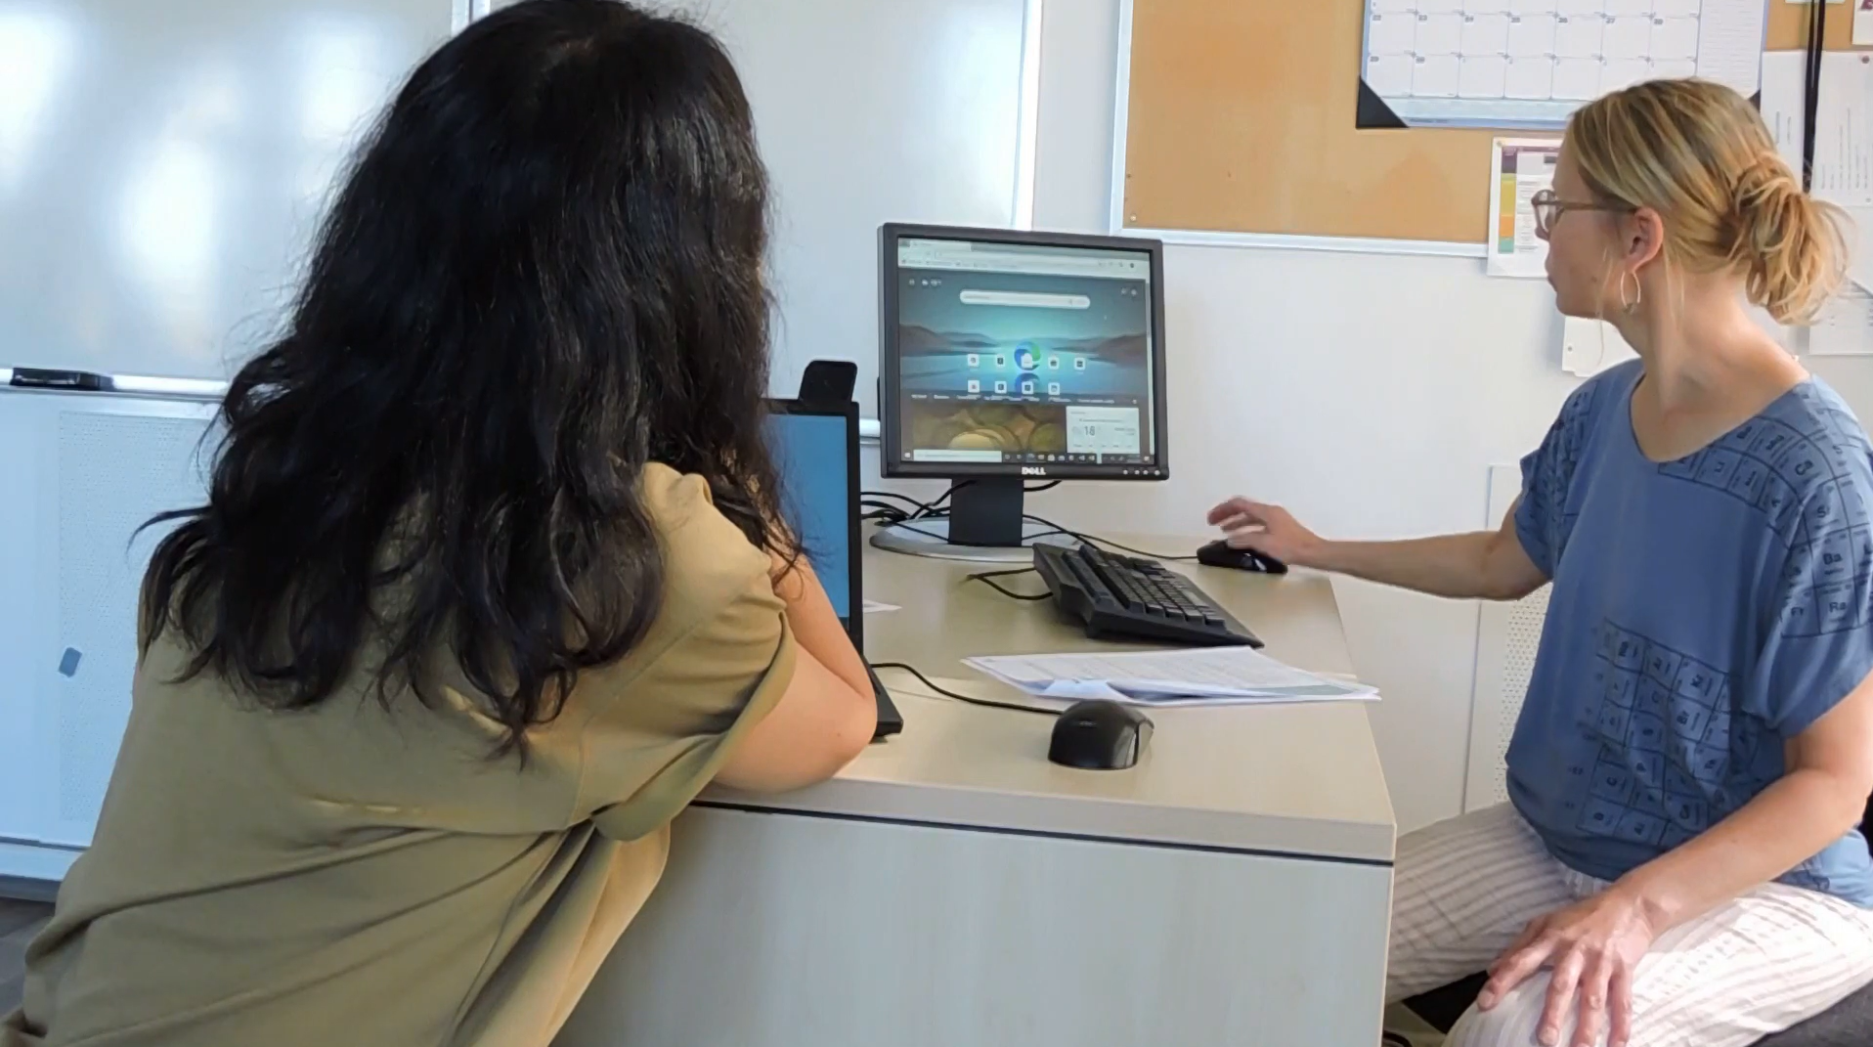
Checklist
Slide hidden from learner
During In-Person Tutoring
Notes:
Slide hidden from the learner.
Information for the Tutor
Refer to:
TUTOR CHECKLIST- During In-Person Tutoring Sessions

Slide 12
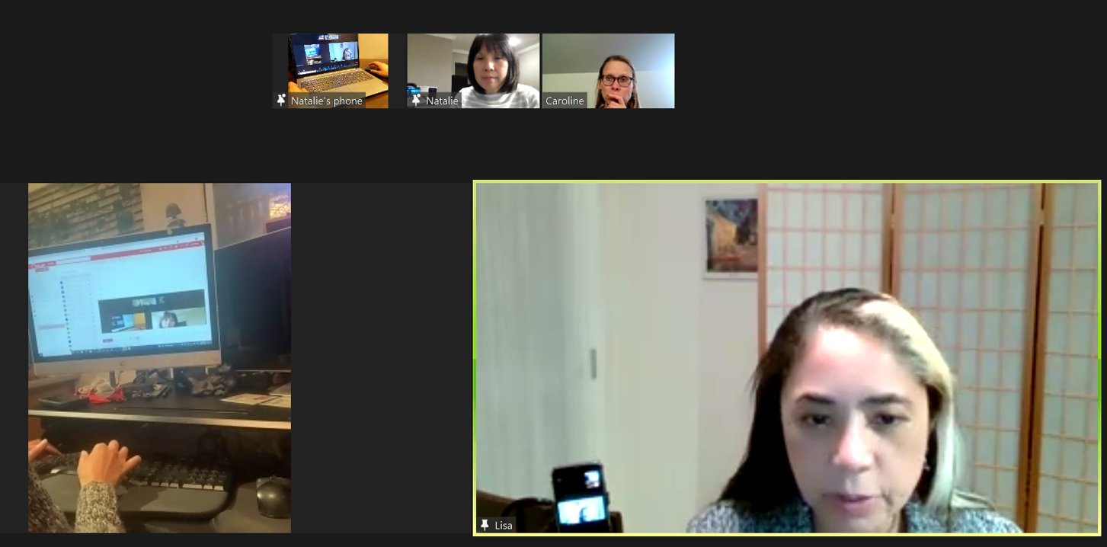
Set Up and Preparation
Slide hidden from learner
Before Remote Tutoring
Notes:
Slide hidden from the learner.
Information for the Tutor.
SET UP
Refer to:
TUTOR CHECKLIST- Set up for Remote Tutoring Session via Zoom, Ms Teams etc.
LEARNER CHECKLIST- Set up for Remote Tutoring Session via Zoom, Ms Teams etc.
IMPORTANT:
Go through the Learner Checklist as well. Then, you will be able to more easily troubleshoot with the learner if they have difficulty in their set up.
Communicate beforehand with the Support Person (if that learner has one):
Email the Learner Checklist listed in #2 above to the Support Person.
Email any instructions for this lesson to the support person (see the notes for specific slides /parts of the lesson):
Have the support person do the preparation for the lesson on the learner’s desktop. Tutor needs to guide them re. how to do this.
Preparation for Remote Tutoring only:
Support person must inform you if the learner has a Gmail account already. If they do not have one, use Module 5 as detailed in the note above under ”Pre-Requisite Skills” (Slide #2).
Have support person make sure the browser icon (or Gmail shortcut if they use that) is easy for the learner to find on the desktop.
If no preparations were made on the learner’s computer before the session by a support person, you could use the Request Remote Control function in Zoom on the learner’s desktop if the learner struggles, and before they get frustrated.
IMPORTANT: Keep in mind the following:
Before using Remote Control, be sure to get permission from your organization first.
It is crucial that the learner understands what it means, and gives you informed consent.
It is somewhat invasive and must be done respectfully and honouring the confidentiality of the learner.
Don’t use the Request Remote Control feature first! It should be a last resort.
First, try your best to teach the learner and the support person how to do things using Share screen and demonstrating.
Use it if other ways do not work and the learner really needs to learn digital skills.
You may want to record the Zoom tutoring session in case of any possible accusations afterwards.
PREPARATION
Preparation specific to each Part of this Gmail Lesson is in the notes of the relevant slides.

Slide 13
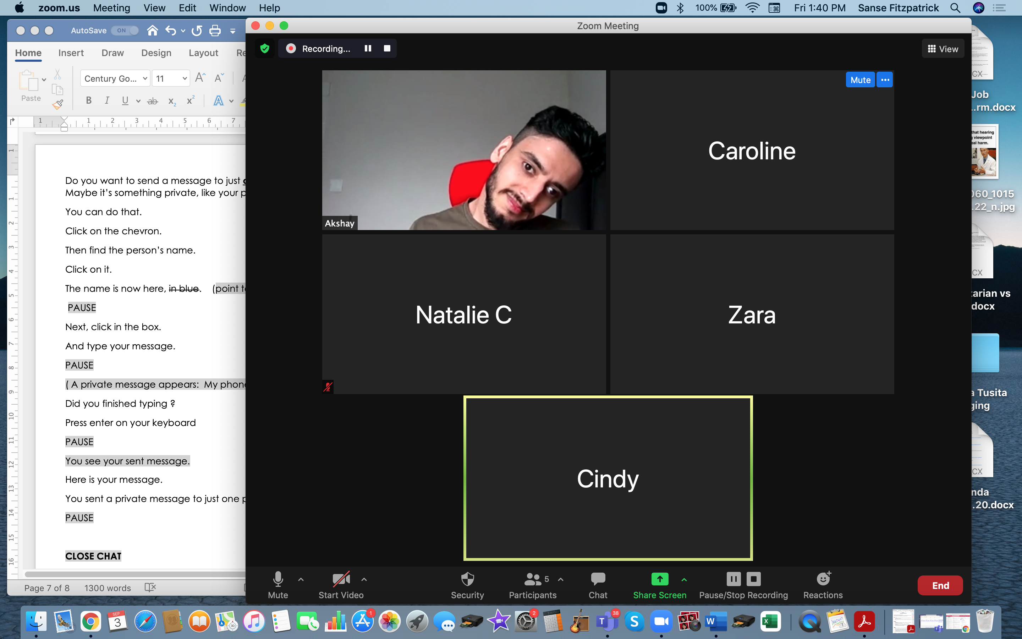
Checklist
Slide hidden from learner
During Remote Tutoring
Notes:
Slide hidden from the learner.
Information for the Tutor.
Refer to:
Tutor Checklist: During Remote Tutoring Session
Learner Instructions: How to let your Tutor have Remote Control of your Computer During a Zoom Session
Be ready to assist learner by using the Requesting Remote Control function (refer to checklists 1 and 2 listed above).
You may have to set up the learner’s desktop for “Practice” activities if the learner needs support and no support person is available to do that beforehand. This is possible to do using Request Remote Control in Zoom.
IMPORTANT: Keep in mind the following:
Before using Remote Control, be sure to get permission from your organization first.
It is crucial that the learner understands what it means, and gives you informed consent.
It is somewhat invasive and must be done respectfully and honouring the confidentiality of the learner.
Don’t use the Request Remote Control feature first! It should be a last resort.
First, try your best to teach the learner and the support person how to do things using Share screen and demonstrating.
Use it if other ways do not work and the learner really needs to learn digital skills.
You may want to record the Zoom tutoring session in case of any possible accusations afterwards.

Slide 14
Employment
Email Skills-Gmail
Part One
Notes:
SHOW THIS SLIDE AND THE REST OF THE SLIDES FROM HERE ONWARD TO THE LEARNER
Say to the learner:
So today, we’re going to review email skills. We’ll use Gmail because it’s a very common email and it’s free.
Basic email skills are important for work, and also for our social needs of course.
So, you already have a Gmail account.
We’re going to review how to move around and find things in Gmail.
Then, we’ll review how to send email.
And after that how to reply to email.
Today, we’ll focus on ........(Parts you intend to cover).

Slide 15
Lesson Objectives-Part One
A. Check your Inbox for New Mail
B. Write and Send an Email to One Person
Notes:
Instructions for the Tutor
These are the skills the learner will master at the end of Part One:
Check your Inbox for New Mail
B. Write and Send an Email to One Person
Total Video length: Part One: 0:04:51 mins
Part A: Check your Inbox for New Mail: 0:00-2:24 mins [2.24 mins]
Part B: Write and Send an Email to One Person: 2.24-4:51 mins/ END [2.27 mins]
Say to the learner:
We’re going to review how to use Gmail.
First, we’ll go over how to check your inbox for new mail
and then how to write and send an email to just one person.

Slide 16
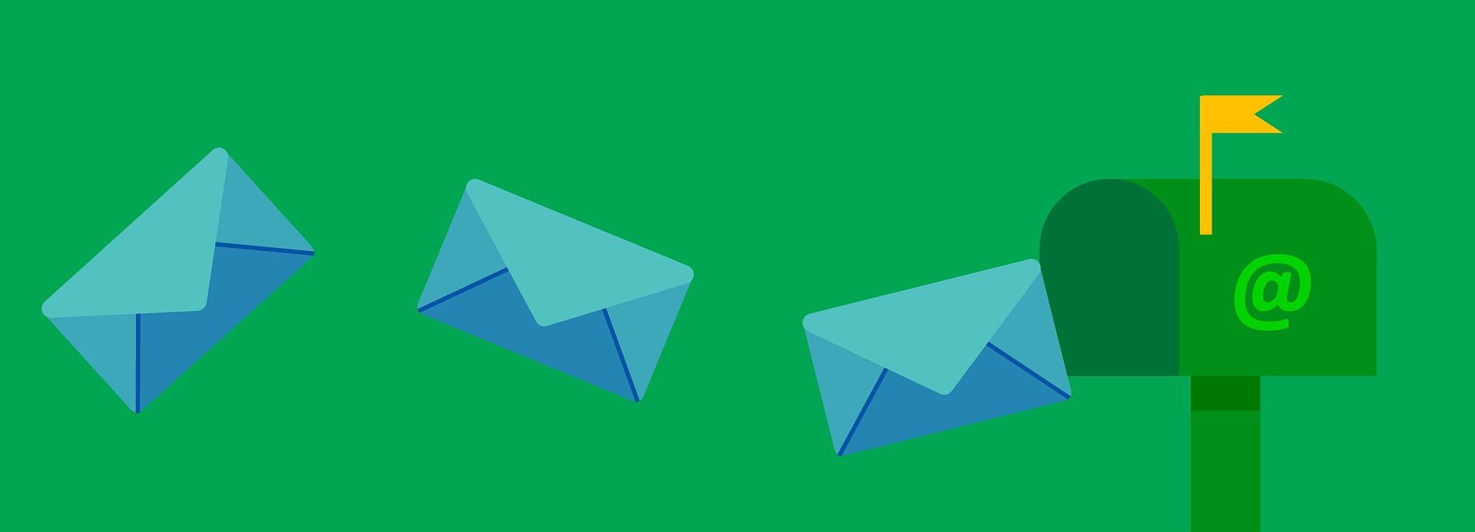


Lesson-Part One-A
Check your Inbox for New Mail
Notes:
Total Video length: Part One: 4:45 mins
Part A: Check your Inbox for New Mail: 00:00-02.24 mins [2.24 mins]
Say to the Learner:
Let’s review how to check if you received / got any new email.
All email goes to your Inbox.
The mail can be from someone we know or someone we don’t know.
We’ll watch a video to review this.
We can watch the video several times. So, don't worry if you don't catch everything the first time.
Instructions for the Tutor:
Do A only [Check your Inbox for New Mail] Stop the video at 2:24 mins.
Play the video several times.
Then ask comprehension check questions to check understanding. [See next slide for comprehension check questions.]
Then have learner do Practice-Part One-A.
After that, repeat the steps for Part One B [Write and Send an Email to One Person.] –These steps are in subsequent slides.
Click on the PLAY icon in the slide to open the video lesson.
Use this link to the YouTube video if the link in the slide doesn’t work:
https://youtu.be/P3VDWoMIl3Q
For remote tutoring, when you share screen to play the video, make sure you have shared the audio.
Play the lesson a bit and check the learner can hear it ok before playing the whole video.

Slide 17

Check Understanding
Notes:
Instructions for the Tutor:
Check understanding
After watching the video lesson, replay the video, pause it and ask questions to check understanding (review and elicit) before moving on to the Practice.
Ask these comprehension check questions or others to check understanding:
Check Inbox for New Mail
Say to the Learner:
We want to check if we got any new email. After we sign in, where do we look? Answer: in our Inbox
New email looks different than other email you already opened. How does it look different ? Answer: It’s in bold print.
To open an email, do we click where there are icons or no icons? Answer: where there are no icons.
Why? Answer: we don’t want to click on delete by mistake!
Before we open any email, what do we do to be safe? Answer: We ask ourselves if we know the person (or company) who sent it.
Show me your inbox.
Show me any new email your received.
Which emails in your inbox are safe to open ? (i.e.. You know the sender)
Instructions for Tutor:
Ask the learner: Do you want to watch the video again?
IMPORTANT
If the learner is struggling, stop the session.
Say to the learner:
Let’s do more work on X...... before we do this.
Instructions to the Tutor:
For example, learner may not be able to find and click on email icons easily.
If so, go to the Digital Literacy Curriculum Resource (DLCR) and use the relevant module before using this video review lesson.
Teach the skills and have the learner practice.
For example, use Module 5 Email, or if needed first: Module 3 Basic Online Skills or Module 1 Mouse and Navigation, depending on learner needs.
Tip: Do the Needs Assessment to determine needs; use the Needs Assessment tools in the DLCR for this.

Slide 18
Practice-Part One-A
Check your Inbox for New Mail
Notes:
Instructions for the Tutor:
PRACTICE-Part One-A Lesson Focus: Check your Inbox for New Mail
PREPARATION
The Learner does NOT have a Gmail account
The learner needs a Gmail account in order to practice the skills.
If they don’t have one, STOP this review lesson.
Instead, do the following:
Go to the DLCR (Digital Literacy Curriculum Resource).
Use Module 5-Email. Teach them how to create an account first.
https://digital-literacy.issbc.org.
Go to the Teachers tab.
Password: Diglit4T
The Learner has a Gmail account
Send the learner four new short emails. Emails that are simple and fast for you to create. Include a subject and simple message.
Tip: prepare these ahead and have them in your drafts folder ready to send right before this Practice.
EXAMPLES:
Message #1
Hi LEARNER NAME
Just checking in. How are you doing?
Regards,
TUTOR’S NAME
Message #2
Hi LEARNER NAME
Did you get the email from Human Resources about paperwork ?
Let me know.
Thanks,
TUTOR’S NAME
Message #3
Hi LEARNER NAME
Appointment in the office with me.
Date: Friday, May 2
Time: 11 am
Please confirm you can come.
Thanks,
TUTOR’S NAME
Message #4
Hi LEARNER NAME
You left your red sweater in my office.
I will keep it until you come next week.
Let me know you got this message.
Thank you.
TUTOR’S NAME
Preparation for Remote Tutoring only:
Support person needs to inform you if the learner has a Gmail account already. If not, use Module 5 as detailed in the note above under ”preparation”.
If the learner has a Gmail account, send the learner four new short emails. Emails that are simple and fast for you to create. Include a subject and simple message. [See above for examples.]
Have support person make sure the browser icon (or Gmail shortcut if they use that) is easy for the learner to find on the desktop.
If no preparations were made on the learner’s computer before the session by a support person, use the Request Remote Control function in Zoom on the learner’s desktop if the learner struggles, and before they get frustrated.
**********************************************************************************************************************************************************
PRACTICE
Instructions for the Tutor:
Demonstrate first, then let the learner practice.
Say to the Learner:
Now it’s time to practice.
We’re going to practice how to check your inbox for new email, like in the video.
[After each of the following steps, wait for the learner to complete the step. Guide the learner as needed.]
IMPORTANT:
If the learner struggles to type, go back to the Digital Literacy Curriculum Resource and do Module 2-Keyboarding first.
[Check your Gmail Inbox for new email. ]
Open the browser and sign into your Gmail account.
It opens automatically to your Inbox. How do you know which are new emails ? Ones you have not yet opened? Answer: they are all in bold/ darker print.
Count how many new emails you have.
How many are from me (tutor)?
How many other new emails did you get? (from other senders)
Are they from people / senders you know?
Are they all safe to open ? Why / why not?
Find the last email you got from me. Open it and read it.
Now go back to the Inbox. (Find Inbox and click on it.)
Now find another email you got from me. Open it and read it.
Go back to the Inbox.
Next, find an email from another sender. Any email. Open it. Don’t read it all now. Just the first line or two.
Go back to the Inbox.
Repeat steps 10 and 13 with a few more new emails the learner got.
Good practice moving around in your Inbox and checking your Inbox for new email.
More Practice:
[Send the learner the last two emails you have ready in your Drafts folder. Then do the following:
Have the learner navigate from the Drafts and Sent folder back to the Inbox. ]
Say to the Learner:
Find ”Sent” / the Sent folder. Click on it to open it
This shows all the emails you have sent. How many sent emails can you see in there?
Now find the Inbox again. Click on Inbox to open it.
Did you get any new emails?
Next, find the Drafts folder. Click on Drafts to open it.
This shows all the emails you wrote but didn’t send yet. How many draft emails can you see in there?
Now find the Inbox again. Open it.
Great! You practiced moving from different folders back to the Inbox. Let’s do that again.
Instructions for the Tutor:
Practice: Have the learner log out of their email, log in again and repeat the above activity and practice as many times as they need (at least three times.)
CHECK THE LEARNER’S SKILLS:
Have the learner show you they can do the skills at least three times without support.

Slide 19


Lesson-Part One-B
Write and Send an Email to One Person
Notes:
Video length: Part One-B.
Write and Send an Email to One Person: 02:24-04:51 mins / END. [2.27 mins]
Say to the Learner:
Let’s review how to write and send an email to just one person.
We’ll watch a video to learn.
We can watch the video several times. So, don't worry if you don't catch everything the first time.
Instructions for the Tutor:
Click on the PLAY icon in the slide to open the video lesson.​
Use this link to the YouTube video if the link in the slide doesn’t work: ​
https://youtu.be/P3VDWoMIl3Q
Cue the video
Play the video segment several times to the end.
Then ask comprehension check questions to check understanding. [See next slide for comprehension check questions.]
Then have the learner do Practice-Part One B.
For remote tutoring, when you share screen to play the video, make sure you have shared the audio.
Play the lesson a bit and check the learner can hear it ok before playing the whole video.

Slide 20
Check Understanding
Notes:
Instructions for the Tutor:
Check understanding
After watching the video lesson, replay the video, pause it and ask questions to check understanding (review and elicit) before moving on to the Practice.
Ask these comprehension check questions or others to check understanding:
[Write and Send an Email to One Person]
Say to the Learner:
You want to send a message to a friend. After you sign into your email, what do you click first? Answer: Compose
Where do you type the address you are sending the email to ? Answer: in the “To” field/ box.
What do you put in the “Subject” box? Answer: the title or subject of your email / What the email is about
Is it good to just send the email or to double check it before you send it? Answer: double check it / check it is complete before sending it.
What should you check before you send it? Answer: Check the following are all correct: email address, subject and the message
How can we know if the message was sent ok? Answer: Go to our “Sent” folder/ Click on the “Sent” icon and see if the message is there.
Show me where the X is ..... [inbox, compose icon, send icon, etc.]
Show me where you type the X .... [subject of the email, address etc.]
Instructions for Tutor:
Ask the learner: Do you want to watch the video again?
IMPORTANT
If the learner is struggling, stop the session.
Say to the learner:
Let’s do more work on X...... before we do this.
For example, learner may not be able to find and click on email icons easily.
If so, go to the Digital Literacy Curriculum Resource (DLCR) and use the relevant module before using this video review lesson.
Teach the skills and have the learner practice.
For example, use Module 5 Email, or if needed first: Module 3 Basic Online Skills or Module 1 Mouse and Navigation, depending on learner needs.
Tip: Do the Needs Assessment to determine needs; use the Needs Assessment tools in the DLCR for this.

Slide 21
Practice-Part One B
Write and Send an Email
to One Person
Notes:
PRACTICE- Part One B: Lesson Focus: Write and Send an Email to One Person.
Instructions for the Tutor:
PREPARATION
Write your email address on a small piece of paper. Try to write it on one line. Have one paper ready for each learner. It’s easier for them to copy from a paper than from the board.
Prepare the following 3 messages on pieces of paper for them to copy from when they do the practice below.
(Or create your own simple emails relevant to the learner.)
Message #1
Hi TUTOR NAME (Your name)
How are you ?
Can we meet tomorrow afternoon at 3 pm?
LEARNER NAME
Message # 2
Hi TUTOR NAME
I can’t come to our meeting on Friday at 2 pm.
Can we meet next Monday at 2 pm?
-LEARNER NAME
Message #3
Hello TUTOR NAME
Can you help me fill out a form ?
I need to send it by Thursday at 4 pm.
Please let me know.
Thank you.
-LEARNER NAME
Preparation for Remote Tutoring only:
Refer to Slides #12 and 13.
Have support person make sure the browser icon (or a Gmail app shortcut if they use that) is easy for the learner to find on the desktop.
Send the 3 messages above in a word document to the learner’s email.
Have the learner / support person print it out for the learner to copy from. Or, have them open it electronically so it is in a window beside the email screen for the learner to copy from.
Have the support person do A. under “Preparation” above.
If no preparations were made on the learner’s computer before the session by a support person, use the Request Remote Control function in Zoom on the learner’s desktop if the learner struggles, and before they get frustrated.
******************************************************************************************************************************************************************
Demonstrate first, then let the learner practice.
Say to the Learner:
Now it’s time to practice.
We’re going to practice how to write and send an email to only one person, like in the video.
[After each of the following steps, wait for the learner to complete the step. Guide the learner as needed.]
IMPORTANT:
If the learner struggles to type, go back to the Digital Literacy Curriculum Resource and do Module 2-Keyboarding first.
[Write an email to one person]
Say to the Learner:
You’re going to write a short email and send it to me for practice.
(If learner doesn’t have your email, share it with them. Give them the small piece of paper (see preparation above) and go over the email address so they are clear.
After you sign into your email, what do you click first? Answer: Click on Compose
So do that now: Find Compose and click on it.
Where do you type the address you are sending the email to? Answer: in the “To” field/ box. Show me that.
Click in the box and enter my email address now. Press “Enter” on the keyboard.
What do you do next? Answer: Enter the Subject ( or the message, it doesn’t matter which one is done first, of course).
Enter a subject. You can put “ Meet Tomorrow?”
Now type a simple message. For example: (give them the paper as per “Preparation” above)
Message #1
Hi TUTOR NAME
How are you ?
Can we meet tomorrow afternoon at 3 pm?
LEARNER NAME
You finished the message. What do you do before you send it? Answer: double check it is complete before sending it.
Check the following are all correct: email address, subject and the message
Now send the message. (click Send)
Let’s check the message was sent ok. How do you do that? Do you remember Show me.
Answer: Go to the “Sent” folder/ Click on the “Sent” icon and see if the message is there.
Is the message there? Great!
REPEAT THE PRACTICE
Repeat the above at least three times.
Have the learner send three different new short messages.
Ideas for other messages: See “Preparation” above.
CHECK THE LEARNER’S SKILLS:
Have the learner show you they can do the skills at least three times without support.

Slide 22
Lesson Objectives – Part Two
Write and Send an Email to More than One Person
Part A: Use “To”
Part B: Use “Cc”
Notes:
Instructions for the Tutor:
These are the skills the learner will master at the end of the lesson.
Total Video length: Write and Send an Email to More than One Person: 5:27 mins
Part A: Use “To”: 0:00-2:17 mins [2:17 mins]
Part B: Use “Cc” : 2:18-5:27 mins [3:09 mins ]
Say to the learner:
Let’s review and practice how to write and send an email to more than one person. Sometimes we need to do that, don’t we?
One way to do it is to use ”To”.
Another way is to use “Cc”
We’ll watch a video to learn/review this.
We can watch the video several times. So, don't worry if you don't catch everything the first time.

Slide 23
Lesson-Part Two-A
Write and Send an Email to More than One Person:
Use “To”
Notes:
Total Video length: Write and Send an Email to More than One Person: Part A and Part B: 5:27 mins
Part A: Use “To”: 0:00-2:17 mins [2:17 mins]
Say to the Learner:
So, first, let’s watch how to write and send an email to more than one person using only “To”.
Instructions for the Tutor:
Click on the PLAY icon in the slide to open the video lesson.​
Use this link to the YouTube video if the link in the slide doesn’t work: ​
https://youtu.be/bTiz3WQkB-k
Play the video segment several times to the end.
Then ask comprehension check questions to check understanding. [See next slide for comprehension check questions.]
Then have learner do Practice-Part Two-Part A.
For remote tutoring, when you share screen to play the video, make sure you have shared the audio.
Play the lesson a bit and check the learner can hear it ok before playing the whole video.

Slide 24
Check Understanding
Notes:
Instructions for the Tutor:
Check understanding
After watching the video lesson, replay the video, pause it and ask questions to check understanding (review and elicit) before moving on to the Practice.
Ask these comprehension check questions or others to check understanding:
Write and Send an Email to More than One Person
Part A: Use “To”
Say to the Learner:
Where do you type all of the email addresses? Answer: all of them go in the “to” box / field
What do you do if you start typing and suddenly the email address shows underneath? Answer: Click on it.
What do you have to press on your keyboard after you type each email address? Answer: Enter (key)
Is it good to type a subject? Answer: Yes
Show me where you click to send the message. Answer: Send (icon)
Is it important to check you sent the message ok? Answer: yes
How do you check you sent it ok? Answer: Click on Sent folder, then see if the message is there.
Instructions for the Tutor:
Then ask the learner: Do you want to watch the video again?
If the learner is struggling, stop the session.
Say to the learner:
Let’s do more work on X before we do this.

Slide 25
Practice-Part Two-A
Write and Send an Email to More than One Person
Use “To”
Notes:
PRACTICE- Part Two-A
Lesson Focus: Write and send an Email to More than One Person: Use “To”
Instructions for the Tutor:
PREPARATION
TIP: Create three different dummy email accounts for you to use as Tutor using Gmail or another email service provider.
Connect each email account to one dummy person. Example: CindyLee64@gmail.com [Cindy] She can be a fake coworker.
Then, the learner can send practice emails there and you can check them.
Choose a simple username and keep a record of your passwords.
Write one fake coworker’s email address on a small piece of paper. Write the entire address on one line.
Do the same with two other email addresses for other fake coworkers.
Have each paper ready for each learner. It’s easier for them to copy from a paper than from the board.
Type 3 messages (using Word) and print them for the learner to copy from when they do the practice activity. Use these examples or create your own simple emails relevant to the learner:
Message #1
Hi NAMES OF THREE PEOPLE (connected to three different emails)
Let’s go for a coffee after work.
How about on Thursday at 4 pm ?
We can go to the Tim Hortons.
Let me know by tomorrow if you can come.
LEARNER NAME
Message #2
Hi NAMES OF THREE PEOPLE (connected to three different emails)
Do you want to help me plan the staff party ?
I need help.
Please let me know before next Monday.
Thank you.
LEARNER NAME
Message #3
Hi NAMES OF THREE PEOPLE (connected to three different emails)
I am making a staff Birthday list.
Then we can remember everyone’s birthday.
Please send me your birthday.
Thank you.
LEARNER NAME
Preparation for Remote Tutoring only:
Refer to Slides #12 and 13.
Have support person make sure the browser icon (or a Gmail app shortcut if they use that) is easy for the learner to find on the desktop.
Send the 3 messages above in a word document to the learner’s email.
Have the learner / support person print it out for the learner to copy from. Or, have them open it electronically so it is in a window beside the email screen for the learner to copy from.
Have the support person do #1 and 2 under Preparation above.
If no preparations were made on the learner’s computer before the session by a support person, use the Request Remote Control function in Zoom on the learner’s desktop if the learner struggles, and before they get frustrated.
************************************************************************************************************************************************
PRACTICE
Say to the Learner:
Now it’s time to practice.
We’re going to practice how to write and send an email to more than one person using “To”, like in the video.
[After each of the following steps, wait for the learner to complete the step. Guide the learner as needed.]
IMPORTANT:
If the learner struggles to type, go back to the Digital Literacy Curriculum Resource and do Module 2-Keyboarding first.
Say to the Learner:
You’re going to write a short email and send it to three coworkers for practice. Here are their email addresses.
[Give them the small pieces of paper. See preparation above and go over the email addresses so they are clear.]
This is the message you are going to send. [Give them the paper with the message to copy as per “Preparation” above. ]
Message #1
Hi NAMES OF THREE PEOPLE
Let’s get together for coffee after work on Thursday at 4 pm.
We can go to the Tim Hortons across the street.
Let me know by tomorrow if you can come.
LEARNER NAME
After you sign into your email, what do you click first? Answer: Click on “Compose”
So do that now: Find Compose and click on it.
You are sending the email to three coworkers. You want each of them to reply. Where do you type each addresses ? Answer: all of them go in the “To” field/ box.
Show me that box.
Now, enter the three email addresses. Press “Enter” on the keyboard after each one.
Next, enter the Subject. You can put “Get together on Thursday after work?”
Now type the message. [Refer them to the paper already given]
You finished the message. What do you do before you send it? Answer: Double check it is complete. Check the following are all correct: email address, subject and the message
Now send the message. (click “Send”)
Let’s check the message was sent ok. How do you do that? Do you remember? Show me.
Answer: Go to the “Sent” folder/ Click on the “Sent” icon and see if the message is there.
Is the message there? Great! You sent it successfully.
REPEAT THE PRACTICE
Repeat the above at least three times.
Have the learner send three different short messages. See “Preparation” above for other messages.
CHECK THE LEARNER’S SKILLS:
Have the learner show you they can do the skills at least three times without support.

Slide 26
Lesson-Part Two-B
Write and Send an Email to More than One Person:
Use “Cc”
Notes:
Total Video length: Write and Send an Email to More than One Person: 5:27 mins
Part B: Use “Cc” : 2:18-5:27 mins [3:09 mins]
Say to the Learner:
So, now, let’s watch another way to write and send an email to more than one person.
This time, using “Cc”.
Instructions for the Tutor:
Click on the PLAY icon in the slide to open the video lesson.​
Use this link to the YouTube video if the link in the slide doesn’t work: ​
https://youtu.be/bTiz3WQkB-k
Cue the video.
Play the video segment several times to the end.
Then ask comprehension check questions to check understanding. [See next slide for comprehension check questions.]
Then have learner do Practice-Part Two B
For remote tutoring, when you share screen to play the video, make sure you have shared the audio.
Play the lesson a bit and check the learner can hear it ok before playing the whole video.

Slide 27
Check Understanding
Notes:
Instructions for the Tutor:
Check understanding
After watching the video lesson, replay the video, pause it and ask questions to check understanding (review and elicit) before moving on to the Practice.
Ask these comprehension check questions or others to check understanding:
Check understanding - ask the learner as you demonstrate on your computer.
Ask these comprehension check questions or others to check understanding:
[Write and Send an Email to More than One Person-Part A: Use “Cc” ]
Say to the Learner:
In the video example, which two people do they send the email to? Answer: the coworker Zara and the boss.
Whose email address goes in the “To” box? Answer: Coworker Zara’s email address
Whose email address goes in the “Cc” box? Answer: The boss’s email address.
Why does the boss’s email address go in the “Cc” box? Answer: you want to let the boss know you emailed your coworker Zara but the boss does not need to reply, only Zara needs to reply.
When do we use Cc? Answer: When we need to send an email to more than one person so both people get it/ read it but only one person needs to reply.
What is the subject of the email in the video? Answer: Change Shifts on Friday?
What is important to do before you send the email? Answer: Check it is complete. To do things correctly but also to look good to the boss.
Show me where you click to send the message. Answer: Send (icon)
Is it important to check you sent the message ok? Answer: yes
How do you check you sent it ok? Answer: Click on the Sent icon/ folder, then see if the message is there.
Or
How do you know if you sent the email successfully? Answer: Check the Sent folder / Click on the Sent icon and check the email is there.
Who do you expect to reply? Both the boss and Zara or just Zara ? Answer: just Zara.
Instructions for the Tutor:
Ask the learner: Do you want to watch the video again?
If the learner is struggling, stop the session.
Say to the learner:
Let’s do more work on X before we do this.

Slide 28
Practice-Part Two-B
Write and Send an email to More than One Person
Use “Cc”
Notes:
PRACTICE-Part Two-B
Lesson Focus: Write and send an email to more than one person. Use “Cc”.
Instructions for the Tutor:
PREPARATION
TIPS:
Create a few different fake email accounts for you to use as Tutor using Gmail or another email service provider. Connect each email to a fake person. Then, the learner can send practice emails there and you can check them easily. Choose short, simple usernames and keep a record of your passwords.
Create one fake email for a fake coworker. For example: CindyLee64@gmail.com [Cindy].
Create one fake email address for “Ms. FakeBoss”, for example: fakeboss2021@gmail.com
For this Practice, the learner sends an email to a fake coworker and Cc’s a fake boss.
Write one email address on a small piece of paper. This is to send to a fake coworker. Write the entire address on one line.
Do the same with one other email address. This is to send to a fake boss.
Have each paper ready for each learner. It’s easier for them to copy from a paper than from the board.
3. Type 2 messages (using Word) and print them for the learner to copy from when they do the practice activity.
Use these examples or create your own simple emails relevant to the learner:
Message #1
Hi NAME OF A FAKE COWORKER
Can I swap shifts with you on Friday?
I can’t work on Friday morning because I have a Dr. appointment. But I can work on Friday afternoon.
Please let me know by tomorrow at noon.
Thank you.
LEARNER NAME
Message #2
Hi NAME OF A FAKE COWORKER
I need to learn how to use the coffee machine.
Can you teach me ?
Ms. Boss told me to email you.
I am working on Tuesday and Thursday afternoons this week.
Please let me know which day and time you can teach me.
Thank you.
LEARNER NAME
Message #3
Hi NAME OF A FAKE COWORKER
Ms. Boss told me to email you.
I can teach you how to do online orders.
How about tomorrow at 10 am? Or Friday at 4 pm?
Let me know if either time works for you.
LEARNER NAME
Preparation for Remote Tutoring only:
Refer to Slides #12 and 13.
Have support person make sure the browser icon (or a Gmail app shortcut if they use that) is easy for the learner to find on the desktop.
Send the 3 messages above in a word document to the learner’s email.
Have the learner / support person print it out for the learner to copy from. Or, have them open it electronically so it is in a window beside the email screen for the learner to copy from.
Have the support person do #1 and 2 under Preparation above.
If no preparations were made on the learner’s computer before the session by a support person, use the Request Remote Control function in Zoom on the learner’s desktop if the learner struggles, and before they get frustrated.
*****************************************************************************************************************************************************************
PRACTICE
Say to the Learner:
Now it’s time to practice. We’re going to practice how to write and send an email to more than one person using Cc. This is like we saw in the video lesson.
[After each of the following steps, wait for the learner to complete the step. Guide the learner as needed.]
IMPORTANT:
If the learner struggles to type, go back to the Digital Literacy Curriculum Resource and do Module 2-Keyboarding first.
Say to the Learner:
You’re going to write a short email and send it to two people: one coworker and your boss/ manager.
Here are their email addresses.
[Give them the small pieces of paper. See preparation above and go over the email addresses so they are clear.]
This is the message you are going to send. [Give them the paper with the message to copy as per “Preparation” above. ]
Message #1
Hi NAME OF A FAKE COWORKER
Can I swap shifts with you on Friday?
I can’t work on Friday morning because I have a Dr. appointment. But I can work on Friday afternoon.
Please let me know by tomorrow at noon.
Thank you.
LEARNER NAME
After you sign into your email, what do you click first? Answer: Click on “Compose”
So, do that now: Find “Compose” and click on it.
You are sending the email to one coworker and to your boss. You want your coworker to reply. Where do you type her / his address ? Answer: in the “To” field/ box.
Show me that box.
Now, enter your coworker’s email address. Press “Enter” on the keyboard.
You also need to send the email to your boss. But, your boss does NOT need to reply. You just want your boss to know you emailed your coworker. Where do you put your boss’s email address? Answer: in the “Cc” box/ field.
Do that now. Press “Enter” on the keyboard.
Next, enter the Subject. You can put: “Swap Shifts on Friday?”
Now type the message. Copy from the paper. [Refer them to the paper already given]
You finished the message. What do you do before you send it? Answer: Double check it is complete. Check the following are all correct: email address, subject and the message
Now send the message. (Click “Send”)
Let’s check the message was sent ok. How do you do that? Do you remember? Show me.
Answer: Go to the “Sent” folder/ Click on the “Sent” icon and see if the message is there.
Is the message there? Great! You sent it successfully.
REPEAT THE PRACTICE
Repeat the above at least three times.
Have the learner send three different short messages. See “Preparation” above for other messages.
CHECK THE LEARNER’S SKILLS:
Have the learner show you they can do the skills at least three times without support.
Extension: Have learners create their own email messages. Be aware however, this will take longer, and they may need spelling and/or other language support.

Slide 29
Lesson Objectives-Part Three
Reply to an Email
            Part A: Reply
            Part B: Reply All
Notes:
Instructions for the Tutor
These are the skills the learner will master at the end of the lesson:
Reply to an Email
Part A: Reply
Part B: Reply All
Total Video length: Part Three: 3:44 mins
Part A: Reply: 0:00-1:46mins [1:46 mins]
Part B: Reply All: 1:47-3:44 mins [1:97 mins ]
Say to the learner:
We’re going to review how to reply to an email we receive. We can reply in two different ways.
We can use “Reply” or “Reply All”.

Slide 30
Lesson-Part Three-A
Reply to an Email
Use “Reply”
Notes:
Total Video length:
Part A: Use “Reply”: 00:00-01:46mins [1:46 mins]
Say to the Learner:
So, first, let’s review how to Use “Reply”.
Maybe you got an email from someone. For example, from me.
But I also sent that email to another person, to Bob for example.
If you want to reply only to me, not to Bob, you use “Reply”.
Let’s watch the video.
Instructions for the Tutor:
Click on the PLAY icon in the slide to open the video lesson.​
Use this link to the YouTube video if the link in the slide doesn’t work: ​
https://youtu.be/bkmHXTHh75s
Play the video segment several times to the end.
Then ask comprehension check questions to check understanding. [See next slide for comprehension check questions.]
Then have learner do Practice-Part Three-A
For remote tutoring, when you share screen to play the video, make sure you have shared the audio.
Play the lesson a bit and check the learner can hear it ok before playing the whole video.

Slide 31
Check Understanding
Notes:
Instructions for the Tutor:
Check understanding
After watching the video lesson, replay the video, pause it and ask questions to check understanding (review and elicit) before moving on to the Practice.
Ask these comprehension check questions or others to check understanding:
[Reply to an Email-Part Three-A: Use “Reply” ]
Say to the Learner:
Where is the reply icon ? Answer: in the top right corner
What does it look like ? Answer: a curved arrow pointing left.
Do you click or double click on the “Reply” icon ? Answer: click
After you click on the “Reply” icon, what do you see in the “To” box ? Answer: the sender’s email address
Who is the sender in the video example ? Answer: Mary Brown
What is the subject of the email in the video ? Answer: Checking in
What is good to do after you send a message ? Answer: check it was actually sent.
Where do you look to check the message was sent ? Answer: in the ”Sent” folder.
OR
How do you know if you sent the email successfully ? Answer: You can see it in the “Sent” folder.
When do we use “Reply” ? Answer: to reply to the sender only.
Show me the reply icon.
Show me where you click to send the message. Answer: Send (icon)
Instructions for the Tutor:
Ask the learner: Do you want to watch the video again?
If the learner is struggling, stop the session.
Say to the learner:
Let’s do more work on X before we do this.

Slide 32
Practice-Part Three-A
Reply to an Email
Use “Reply”
Notes:
PRACTICE- Part Three-A
Lesson Focus: Reply to an email: Use “Reply”.
Instructions for the Tutor:
PREPARATION
Write three simple emails and have them in your Drafts email folder ready to send to the learner just prior to the Practice. Use these examples or create your own simple emails relevant to the learner:
MESSAGE #1
Hi LEARNER NAME
There is a staff meeting next Monday morning.
Time: 10:30-11:30 am.
Please confirm you can come.
Thank you.
-Ms. Boss
MESSAGE #2
Hi LEARNER NAME
The Staff Christmas party is on December 17, 6-9 pm.
Location: Head office
RSVP by Nov 20 to this email.
Hope you can make it.
-Ms. Boss
MESSAGE #3
Hi LEARNER NAME
Please fill out and send back the paperwork I emailed you.
I did not receive it yet.
I need it by Friday before noon.
Thank you.
-Ms. Boss
2. Copy and paste each reply below into a Word doc. These are replies to the above email messages. Print out and give each reply to the learner on a small strip of paper. This is especially helpful if the learner has spelling or other language challenges or needs the support. It also helps you both focus on the digital skills not the language skills.
IMPORTANT:
If the learner struggles to type, go back to the Digital Literacy Curriculum Resource and do Module 2-Keyboarding first.
REPLY TO MESSAGE #1
Hi Ms Boss
Yes, I can come next Monday.
Where is the meeting?
Thank you.
LEARNER NAME
REPLY TO MESSAGE #2
Hi Ms Boss
I would like to attend the Staff Christmas party.
Is there any cost?
Thank you.
LEARNER NAME
REPLY TO MESSAGE #3
Hi Ms Boss
Thank you for the reminder.
I will fill out the paperwork and email it to you today.
Sorry for the delay.
LEARNER NAME
Preparation for Remote Tutoring only:
Refer to Slides #12 and 13.
Have support person make sure the browser icon (or a Gmail app shortcut if they use that) is easy for the learner to find on the desktop.
Send the 3 “Reply to Message”s above in a word document to the learner’s email.
Have the learner / support person print it out for the learner to copy from. Or, have them open it electronically so it is in a window beside the email screen for the learner to copy from.
If no preparations were made on the learner’s computer before the session by a support person, use the Request Remote Control function in Zoom on the learner’s desktop if the learner struggles, and before they get frustrated.
*********************************************************************************************************************************************************************
PRACTICE
Say to the Learner:
Now it’s time to practice. We’re going to practice how to reply to an email using “Reply”. This is like in the video lesson.
[After each of the following steps, wait for the learner to complete the step. Guide the learner as needed.]
IMPORTANT:
If the learner struggles to type, go back to the Digital Literacy Curriculum Resource and do Module 2-Keyboarding first.
Say to the Learner:
In a moment, I am going to send you an email and you’re going to reply to that for practice.
So, log in to your email now and go to your Inbox. While you do that, I’ll send you the email.
[Learner is in their Inbox] Find the email I just sent you. Click on it to open it.
Read the email.
Now, use the “Reply” icon to reply to the email.
Whose email address is in the “To” box ? Answer: the sender’s (or Tutor’s) email address.
Write a short reply.
[Provide the reply on a small strip of paper for the learner to copy. This is especially needed if the learner has spelling or other language challenges. See Preparation above.]
Check the email is ok to send. Did you spell correctly? Did you use periods? Etc. Remember this is to the boss so we want to look good.
Now send the message. (Click “Send”)
Let’s check the message was sent ok. How do you do that? Do you remember? Show me.
Answer: Go to the “Sent” folder/ Click on the “Sent” icon and see if the message is there.
Is the message there? Great! You sent it successfully.
REPEAT THE PRACTICE
Repeat the above at least three times.
Have the learner reply to three different short messages. See “Preparation” above for other messages.
CHECK THE LEARNER’S SKILLS:
Have the learner show you they can do the skills at least three times without support.
Extension: Have learners create their own email messages. Be aware however, this will take longer, and they may need spelling and/or other language support.

Slide 33
Lesson-Part Three-B
Reply to an Email
Use “Reply All”
Notes:
Video length:
Part B: Reply All: 01:47-03:44 mins [1:97 mins ]
Say to the Learner:
Now, let’s review how to Use “Reply All”.
Maybe you got an email from someone. For example, from me.
But I also sent that email to other people.
You want to reply to everyone, not just to me.
Do you think you use “Reply or Reply All” ? Answer: Reply All
Let’s watch the video now.
Instructions for the Tutor:
Click on the PLAY icon in the slide to open the video lesson.​
Use this link to the YouTube video if the link in the slide doesn’t work: ​
https://youtu.be/bkmHXTHh75s
Cue the video to the correct place.
Play the video segment several times to the end.
Then ask comprehension check questions to check understanding. [See next slide for comprehension check questions.]
Then have learner do Practice-Part Three-B
For remote tutoring, when you share screen to play the video, make sure you have shared the audio.
Play the lesson a bit and check the learner can hear it ok before playing the whole video.

Slide 34
Check Understanding
Notes:
Instructions for the Tutor:
Check understanding
After watching the video lesson, replay the video, pause it and ask questions to check understanding (review and elicit) before moving on to the Practice.
Ask these comprehension check questions or others to check understanding:
[Reply to an Email-Part Three-B: Use “Reply All” ]
Say to the Learner:
A sender sent you an email. How can you check if the sender Ccd others ? Answer: Click on the triangle icon next to the email addresses. It shows you the “To” and the “Cc” lists.
You want to reply to an email and send the reply to everyone who got the email. Everyone in the from, the “To” and the “Cc” lists. Do you use “Reply” or “Reply All” ? Answer: Reply All
After you read the email, what do you do first? Answer: Find the “Reply All” icon and click on it.
Where is the “Reply All icon? Answer: In the top right corner, behind the “More Options” icon.
Or
How do you find the “Reply All” icon? Answer: Click on the “More Options” icon, the three vertical dots to find it.
What does the “Reply All” icon look like ? Answer: Two curved arrows pointing left.
After you click on “Reply All”, what do you see in the ”To” box ? Answer: Everyone’s email addresses.
How can you check if the sender Ccd others ? Answer: Click on the triangle icon next to the email addresses. It shows you the “To” and the “Cc” lists.
What do you do next ? Answer: Type the reply message.
How do you send the reply ? Answer: Click “Send”.
Who is the sender in the video example ? Answer: Zara Mahmud
Show me the “Reply All” icon.
Show me where you click to send the message. Answer: Send (icon)
Instructions for the Tutor:
Ask the learner: Do you want to watch the video again?
If the learner is struggling, stop the session.
Say to the learner:
Let’s do more work on X before we do this.

Slide 35
Practice-Part Three-B
Reply to an Email
Use “Reply All”
Notes:
PRACTICE: Part Three-B
Lesson Focus: Reply to an email: Use “Reply All”.
Instructions for the Tutor:
PREPARATION
Use the three simple emails below from Practice-Part Three-A (Or create your own simple emails relevant to the learner.) Have these cued up in your DRAFTS email folder ready to send to the learner.
Put the learner’s email address in the To box, and two other email addresses in the Cc box in each of the emails. They can be two fake coworkers.
(see Tip in Practice-Part Two–A about creating fake email accounts for you as tutor to use.)
Send one of the messages just prior to the Practice:
MESSAGE #1
Hi LEARNER NAME
There is a staff meeting next Monday morning.
Time: 10:30-11:30 am.
Please confirm you can come.
Thank you.
-Ms. Boss
MESSAGE #2
Hi LEARNER NAME
The Staff Christmas party is on December 17, 6-9 pm.
Location: Head office
RSVP by Nov 20 to this email.
Hope you can make it.
-Ms. Boss
MESSAGE #3
Hi LEARNER NAME
Please fill out and send back the paperwork I emailed you.
I did not receive it yet.
I need it by Friday before noon.
Thank you.
-Ms. Boss
2. Copy and paste each reply below into a Word doc. These are replies to the above email messages.. Print out and give each reply to the learner on a small strip of paper. This is especially helpful if the learner has spelling or other language challenges, or needs the support. It also helps you both focus on the digital skills not the language skills.
IMPORTANT:
If the learner struggles to type, go back to the Digital Literacy Curriculum Resource and do Module 2-Keyboarding first.
REPLY TO MESSAGE #1
Hi Ms Boss
Yes, I can come next Monday.
Where is the meeting ?
Thank you.
LEARNER NAME
REPLY TO MESSAGE #2
Hi Ms Boss
I would like to attend the Staff Christmas party.
Is there any cost ?
Thank you.
LEARNER NAME
REPLY TO MESSAGE #3
Hi Ms Boss
Thank you for the reminder.
I will fill out the paperwork and email it to you today.
Sorry for the delay.
LEARNER NAME
Preparation for Remote Tutoring only:
Refer to Slides #12 and 13.
Have support person make sure the browser icon (or a Gmail shortcut if they use that) is easy for the learner to find on the desktop.
Send the 3 “Reply to Message” s above in a word document to the learner’s email.
Have the learner / support person print it out for the learner to copy from. Or, have them open it electronically so it is in a window beside the email screen for the learner to copy from.
If no preparations were made on the learner’s computer before the session by a support person, use the Request Remote Control function in Zoom on the learner’s desktop if the learner struggles, and before they get frustrated.
***************************************************************************************************************************************************************
PRACTICE
Say to the Learner:
Now it’s time to practice. We’re going to practice how to reply to an email using “Reply All”. This is like in the video lesson.
[After each of the following steps, wait for the learner to complete the step. Guide the learner as needed.]
IMPORTANT:
If the learner struggles to type, go back to the Digital Literacy Curriculum Resource and do Module 2-Keyboarding first.
Say to the Learner:
In a moment, I am going to send you and a few other people an email. The other people will be fake coworkers. You’re going to reply to that email for practice.
So, log in to your email now and go to your Inbox. While you do that, I’ll send you the email.
[Learner is in their Inbox] Find the email I just sent you. Click on it to open it.
Read the email.
Who received the email? Answer: Me (learner) and two other people.
Is there anything private in the email? Answer: No.
So, we’re going to use “Reply All”. This sends the reply to everyone who got the email.
Now, find and click on the “Reply All” icon to reply to the email.
Show me the “To” box. Whose email address is in the “To” box ? Answer: the sender’s (or Tutor’s) email address.
Show me the “Cc” box. Whose email address is in the “Cc” box ? Answer: XYX (fake coworkers)
Now, type a short reply.
[Provide the reply on a small strip of paper for the learner to copy. This is especially needed if the learner has spelling or other language challenges. See Preparation above.]
Check the email is ok to send. Did you spell correctly? Did you use periods? Etc. Remember this is to the boss so we want to look good.
Now, send the message. (Click “Send”)
Let’s check the message was sent ok. How do you do that? Do you remember? Show me.
Answer: Go to the “Sent” folder/ Click on the “Sent” icon and see if the message is there.
Is the message there? Great! You sent it successfully.
REPEAT THE PRACTICE
Repeat the above at least three times.
Have the learner reply using “Reply All” to three different short messages. See “Preparation” above for other messages.
CHECK THE LEARNER’S SKILLS:
Have the learner show you they can do the skills at least three times without support.
Extension: Create other emails. Have the learner reply. Be aware however, this will take longer, and they may need spelling and/or other language support on paper to copy from.

Slide 36
Lesson Objectives-Part Four
Use “Forward”
Notes:
Instructions for the Tutor
These are the skills the learner will master at the end of the lesson:
Use “Forward”
Video length:
Part Four: Use Forward: 00:00-01:58 mins [1:58 mins]
Say to the learner:
We’re going to review how to Forward an email.

Slide 37

Lesson-Part Four
Use “Forward”
Notes:
Video length:
Part Four: Use Forward: 00:00-01:58 mins [1:58 mins]
Say to the Learner:
Now, let’s review how and when to use “Forward”.
Maybe you got an email from someone, like from me.
That email has useful information.
You think it may be useful for a friend of yours, or maybe many friends.
So, you want to send that email to them.
You can use “Forward”.
To send an email that we got from one person to another person, or other people, we use “Forward”.
Let’s watch the video now to see how to do that.
Instructions for the Tutor:
Click on the PLAY icon in the slide to open the video lesson.​
Use this link to the YouTube video if the link in the slide doesn’t work: ​
https://youtu.be/2lHLVccyZIo
Play the video segment several times to the end.
Then ask comprehension check questions to check understanding. [See next slide for comprehension check questions.]
Then have learner do Practice-Part Four
For remote tutoring, when you share screen to play the video, make sure you have shared the audio.
Play the lesson a bit and check the learner can hear it ok before playing the whole video.

Slide 38
Check Understanding
Notes:
Instructions for the Tutor:
Check understanding
After watching the video lesson, replay the video, pause it and ask questions to check understanding (review and elicit) before moving on to the Practice.
Ask these comprehension check questions or others to check understanding:
[Part Four: Use “Forward”]
Say to the Learner:
When do you use “Forward”? Answer: You want to send an email you got to another person or other people.
After you read the email, what do you do first? Answer: Find the “Forward” icon and click on it.
When you look for an icon, do you click or hover? Answer: hover
Where is the “Forward” icon? Answer: in the top right corner, behind the “More Options” icon.
Or
How do you find the “Forward” icon? Answer: click on the “More Options” icon, the three vertical dots to find it.
What happens when you click on the ”More Options” icon ? Answer: a menu opens.
What does the “Forward” icon look like ? Answer: an arrow pointing right.
After you click on “Forward”, what do you see in the ”To” box ? Answer: nothing, it is empty. There are no addresses.
What do you type in the “To” box ? Answer: the email address(es) you are sending the email to.
What do you do next? Answer: type the reply message.
What is good to include in the message you write? Answer: Explain why you are forwarding the email.
You are ready to send the email. What do you do next? Answer: click “Send”.
Show me the “Forward ” icon.
Show me where you click to send the message. Answer: Send (icon)
Instructions for the Tutor:
Ask the learner: Do you want to watch the video again?
If the learner is struggling, stop the session.
Say to the learner:
Let’s do more work on X before we do this.

Slide 39
Practice-Part Four
Use “Forward”
Notes:
PRACTICE: Part Four
Lesson Focus: Use “Forward”.
Instructions for the Tutor:
For this Practice, the learner forwards emails to a fake friend and to a fake boss.
PREPARATION
Copy each of the three simple messages below into three separate new emails. Keep them in your Drafts email folder ready to send to the learner just prior to the Practice. [Or create your own simple emails relevant to the learner.]
MESSAGE #1
Hi LEARNER NAME
Here is my resume and cover letter.
I am interested in working at the store where you work.
Can you please send this to the person who hires new staff ?
Thanks for your help with this.
-Best,
Cindy (Or Tutor’s name)
MESSAGE #2
Hi LEARNER NAME
Here is an example resume. (See the attachment.)
Please take a look at it.
It can give you ideas for your own resume.
I’ll help you make your resume next week.
See you on Thursday at 11 am in the office.
-Warm regards,
Joe Helpful (Employment Counsellor) Or Tutor’s Name
MESSAGE #3
Hi LEARNER NAME
Here is some information about a Job Fair.
Many companies will be there.
They are looking for employees.
It’s on January 10.
Let’s go together.
We can ask questions and get information.
-Cheers
Joe Helpful (Employment Counsellor) Or Tutor’s Name
B. Copy and paste the following “Messages to Forward an Email” into a word document. Print the page and have it ready for the learner. The learner can use it to copy when they forward the emails above in A and need to write a short message. This allows the learner to focus on the digital skills instead of writing skills.
IMPORTANT:
If the learner struggles to type, go back to the Digital Literacy Curriculum Resource and do Module 2-Keyboarding first.
MESSAGE TO FORWARD AN EMAIL #1
Hi NAME OF BOSS
This is my friend’s resume and cover letter.
She is interested in working at the store.
Thank you.
-LEARNER’S NAME
MESSAGE TO FORWARD AN EMAIL #2
Hi NAME OF FRIEND
My employment counsellor sent me this.
It’s an example resume.
I thought it may be useful for you too.
Talk soon.
-LEARNER’S NAME
MESSAGE TO FORWARD AN EMAIL #3
Hi NAME OF FRIEND
Joe sent me this.
It’s information about a job fair.
Maybe you want to go too?
Let me know.
-LEARNER’S NAME
C. Create the following three documents and save them on your desktop: a fake resume, a fake cover letter, a fake Job Fair flyer. They can be empty documents but called “Resume-Example”, “Cover letter-Example and “Job Fair-Example”. (or create other fake documents relevant to the learner).
D. Attach the resume and cover letter to email message #1 ; attach the fake resume only to message #2; attach the Job Fair flyer to email message #3.
E. For this Practice, you need the following:
one fake email address for a fake friend. For example: CindyLee64@gmail.com [Cindy].
one fake email address for “Ms. FakeBoss”, for example: fakeboss2021@gmail.com
TIP:
Create a few different fake email accounts for you to use as Tutor using Gmail or another email service provider. Connect each email to a fake person. Then, the learner can send practice emails there and you can check them easily. Choose short, simple usernames and keep a record of your passwords.
F. Write the fake friend’s email address on a small piece of paper. Write the entire address on one line.
G. Do the same with the fake boss’s email address.
H. Have each paper ready for each learner. It’s easier for them to copy from a paper than from the board.
Preparation for Remote Tutoring only:
Refer to Slides #12 and 13.
Have support person make sure the browser icon (or a Gmail app shortcut if they use that) is easy for the learner to find on the desktop.
Send the 3 “Messages to Forward an Email” above in a word document to the learner’s email.
Have the learner / support person print it out for the learner to copy from. Or, have them open it electronically so it is in a window beside the email screen for the learner to copy from.
Have the support person do F and G above.
If no preparations were made on the learner’s computer before the session by a support person, use the Request Remote Control function in Zoom on the learner’s desktop if the learner struggles, and before they get frustrated.
*******************************************************************************************************************************************************
PRACTICE
Say to the Learner:
Now it’s time to practice. We’re going to practice how to forward an email using “Forward”. This is like in the video lesson.
[After each of the following steps, wait for the learner to complete the step. Guide the learner as needed.]
IMPORTANT:
If the learner struggles to type, go back to the Digital Literacy Curriculum Resource and do Module 2-Keyboarding first.
Say to the Learner:
In a moment, I am going to send you an email. You’re going to forward that email to another person for practice.
So, log in to your email now and go to your Inbox. While you do that, I’ll send you the email. [Send Message #1, see Preparation above.]
[Learner is in their Inbox] Find the email I just sent you. Click on it to open it.
Read the email. What does it say?
Now, you are going to forward that email to another person. For practice now, let’s pretend you have a boss. You’re going to forward the email to your boss.
Here is “Ms. Fake Boss’s” email address [Give learner the strip of paper with the email address. [See “Preparation” above]
What do you do next ? Answer: Find and click on the Forward icon.
Show me the “Forward” icon. Click on it.
Next, type in the email address. [refer the learner to the strip of paper] and press “Enter” on the keyboard.
It’s good to double check the address is correct. We want it to go to the correct person. Do that now.
Now, you need to type a short message, so your boss understands why you are forwarding the email.
[Give the learner the paper with “Message to Forward an Email # 1 from ”Preparation” above. ]
Here is a message you can copy. Type that now in the message box.
Check the email is ok to send. This is even more important when it’s the boss. Did you spell correctly? Did you use periods? Etc. Do that now.
Now, send the message. (Click “Send”)
Let’s check the message was sent ok. How do you do that? Do you remember? Show me.
Answer: Go to the “Sent” folder/ Click on the “Sent” icon and see if the message is there.
Is the message there? Great! You sent it successfully.
REPEAT THE PRACTICE
Repeat the above at least three times.
Have the learner forward three different short messages. See “Preparation” above for other messages.
CHECK THE LEARNER’S SKILLS:
Have the learner show you they can do the skills at least three times without support.
Extension: Create other emails. Have the learner Forward them. Be aware however they may need spelling and/or other language support on paper to copy from.

Slide 40
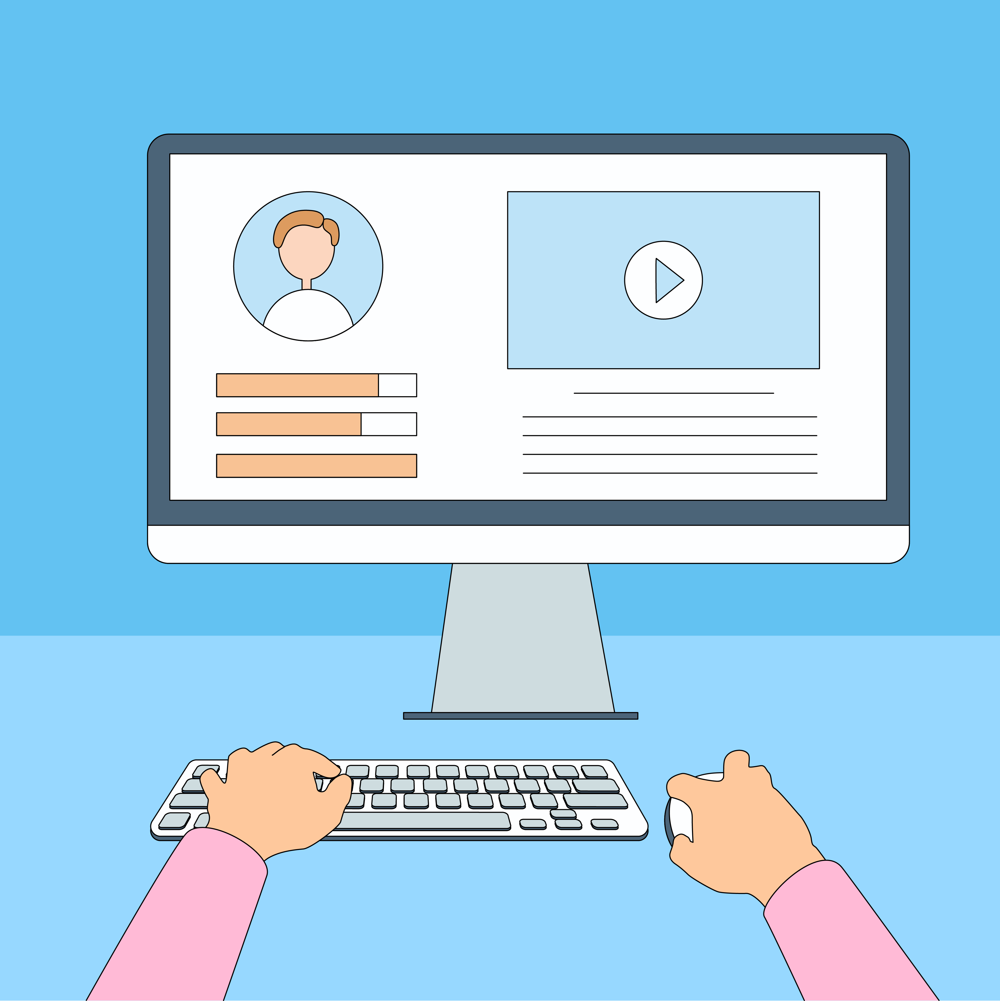
Practice Between Sessions
What did you learn/practice today?
When are you going to practice?
Practice Plan
Notes:
INSTRUCTIONS FOR THE TUTOR:
In-person tutoring and Remote Tutoring:
Make sure the learner knows how to access the video lesson(s) you just used so they can practice between tutoring sessions.
If relevant, make sure the support person at home knows how to access the video(s) too.
Option One
Email the video link to the learner, and if relevant the at-home support person. They can use the link in the email to access the video lesson(s).
Option Two
Put a link to the specific video lesson(s) you did on the learner’s desktop so they can access the video easily.
How:
Open the website address for the lesson in the browser.
In the address bar, click to highlight the lesson address.
Drag the address (link) onto the desktop. It will make an icon on the desktop.
Find the icon on the desktop and check that the link works.
Show the learner where it is. Tell them to just click to access it for practice.
Remote Tutoring Only:
You can do Option Two above by using Request Remote Control in Zoom during the tutoring session.
Refer to the following for the steps on how to do that:
Tutor Checklist-During Remote Tutoring Sessions
Learner Instructions: Let Tutor have Remote Control of your Computer During a Zoom Session
IMPORTANT: Keep in mind the following:
Before using Remote Control, be sure to get permission from your organization first.
It is crucial that the learner understands what it means, and gives you informed consent.
It is somewhat invasive and must be done respectfully and honouring the confidentiality of the learner.
Don’t use the Request Remote Control feature first! It should be a last resort.
First, try your best to teach the learner and the support person how to do things using Share screen and demonstrating.
Use it if other ways do not work and the learner really needs to learn digital skills.
You may want to record the Zoom tutoring session in case of any possible accusations afterwards.
********************************************************************************************************************************************************************
SAY TO THE LEARNER:
You did well today.
So, what did you learn and practice today? →
Today, we learned and practiced how to: [only mention the parts you covered]
Check the Inbox for new email
Write and send an email to one person
Write and send an email to more than one person-Use “To”
Write and send an email to more than one person-Use “Cc”
Reply to an email- Use Reply
Reply to an email- Use Reply All
Reply to an email- Use Forward
It’s really important to review and practice as much as you can! Please do that before our next tutoring session.
Watch the video again, as many times as you need.
I’ve emailed you the link. Let/s make sure you can open it.
(OR)
We’ve put the link on your desktop. Here it is. Just click on it to watch the video.
Let’s make sure it works ok.
[Practice Plan]
Say to the learner:
Practice at least three more times before our next session.
Here is what to practice:
[For example: I will send you a few emails to practice Reply All and Forward.
Or
Send me two emails. Here is a paper with two email messages. Please type each message in an email and send it to these two email addresses.
etc.
You will show me at our next session.
I will email you this Practice Plan. Please reply to the email so I know you got it and have what you need to do the practice.
[Get learner to confirm they will practice and tell you when. Get specific.]
When are you going to do the practice? How many times ? etc.
Instructions for the Tutor:
Email the Practice to the learner, and if relevant to the Support Person.

Slide 41

Confirm Next Session and Support
Notes:
Instructions for the Tutor:
Confirm the next tutoring session.
Clarify any support in-between sessions if you are offering that.
If offering support outside the session time, put boundaries, be clear about when and how you are giving support.
Say to the Learner.
e.g. Great work today! etc.
Let’s meet again on X date at X time. Does that work for you?
Wonderful.
[If offering support before next session:]
If you need support before our next session, please .........
[For remote support:]
I will send you the Zoom link the day before the tutoring session.
etc.

Slide 42
See you!
Keep Practicing
Notes:
Say to the Learner:
Bye and see you on X date at X time.
Keep practicing !

