Slide 1

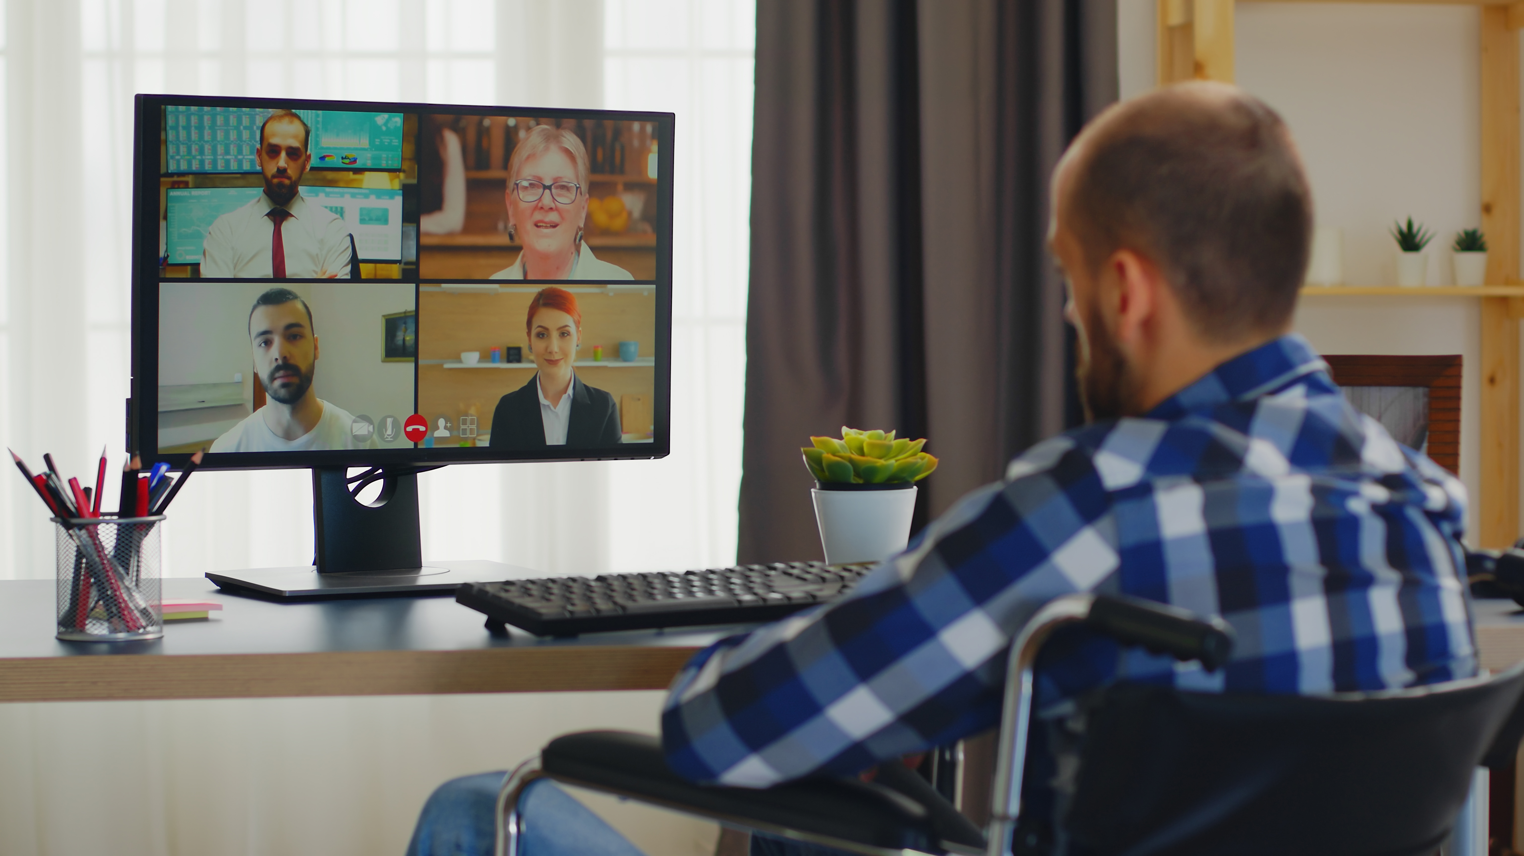
Employment
Slide hidden from learner
Zoom Skills 1
Notes:
Slide hidden from the learner.
Information for the Tutor.
This PowerPoint lesson covers the following Zoom video lessons:
Part One
Join a Zoom meeting
Change your name
Part Two – Basic Zoom Functions
Icons No Icons
Active Speaker View vs Gallery View

Slide 2
Pre-Requisite Skills
Slide hidden from learner
Mouse/trackpad skills: hold mouse/use trackpad; left click, right click, different shapes of the cursor; scroll
Navigation: move the mouse/ use the trackpad to position the cursor in the correct location
Keyboarding: type words, numbers, common symbols; use Shift and Enter keys; one finger typing is ok
Email Skills: Open email app; use inbox; open and read a simple email; recognize & use common icons
LINK to the DLCR:
https://digital-literacy.issbc.org/for-teachers/
Password: Diglit4T
Notes:
Slide hidden from the learner.
Information for the Tutor
Pre-Requisite Skills
Remember: like all lessons in Module 9 – Employment (Review), this is a review lesson of the digital skills, and the learners may not be ready for this lesson.
Make sure the learner has the “Prerequisite Skills” listed in this slide.
These skills are not specifically reviewed in this lesson, but the learner needs to have them to be able to do the lesson.
If the learner struggles, stop the lesson and go to the following modules in the Digital Literacy Curriculum Resource (DLCR) and teach the pre-requisite skills before doing this lesson:
Module 1 Mouse and Navigating
Module 2-Keyboarding
Module 5-Email Skills
IMPORTANT:
The learner needs to have an email account in order to practice joining a Zoom meeting through a Zoom link in an email you the tutor send them. If they don’t have an email account, STOP this review lesson. Instead, do the following:
Go to the Digital Literacy Curriculum Resource.
Use Module 5-Email. Teach them how to create an email account first.
https://digital-literacy.issbc.org.
Go to the Teachers tab.
Password: Diglit4T

Slide 3
Skills Reviewed in this Lesson
Check the Notes of this Slide
Notes:
Slide hidden from the learner.
Information for the Tutor
These skills are specifically reviewed in this lesson.
It is assumed the learner has already learned these skills and is doing this lesson as a review.
Zoom Skills-Part One
Join a Zoom Meeting
Understand when it is safe to open an email you receive.
Open an email message in your inbox
Recognize & use common icons in email app
Read and understand a simple email message
Recognize a Zoom link in an email message
Understand that a meeting is remote in Zoom not in person
Understand that you can click on a Zoom link in an email message to join a Zoom meeting.
Understand you can join a Zoom meeting on your computer or cell phone
Recognize that the cursor changes to a hand when it is on a link
Know how to click on a Zoom link
Understand what happens after you click on the Zoom link: a pop up- window opens, etc.
Know where to click next; recognize common icons: “Open”
Read and understand you need to wait for the host to let you in
How to join with (computer) audio
Change Your Name
Understand when you need to change your name in Zoom
Understand options for your name: first name only, first name a last initial
Change your name: right click on the name, read the pop-up menu, find and click “Rename”, type your name in the box; click ok
Understand when and how to check “Remember my name for future meetings”
Icons No Icons:
Understand what icons in Zoom look like
Understand the function of icons
Understand that sometimes the icons in Zoom disappear
Understand that you can make them appear again anytime
Make icons appear again when using a computer (move your cursor a bit)
Make icons appear again when using a cell phone (tap the screen)
Active Speaker View vs Gallery View
Recognize “Active Speaker View”
Recognize “Gallery View”
Recognize who is the speaker
Recognize who are other participants
Change from “Active Speaker View” to “Gallery View” (Click on “View” icon, read pop-up window, etc. )
Change from “Gallery View” to “Active Speaker View”
Understand when you want to use “Gallery View”
Understand when you want to use “Active Speaker View”
Know you can change the view anytime

Slide 4
Instructions
For Using this PowerPoint Lesson
Slide hidden from learner
Notes:
Slide hidden from learner
This PowerPoint lesson contains everything the tutor needs: the lesson notes, suggested instructional language, the links to the video lesson(s), and also Practice for each part. ​
IMPORTANT
Read through the entire lesson a few days before tutoring so you are clear about what to do and have time to get any questions answered and to do any preparation.
The first 11 slides are hidden from the learner; they contain information and instructions for the tutor.
Green Slides = Lesson Objectives
Blue Slides = The Start of each Part of the Lesson
Yellow Slides = Practice Activities
Instructions specific to each lesson are in the notes pages of each PowerPoint. ​
Identical notes are also available as a separate PDF for tutors who prefer that format. ​See Option B below.
You will NOT be able to copy and paste from this PowerPoint because it is “Read Only”.
In the Practice for each Part of this lesson, you may be asked to copy some text from this lesson and paste it into a Word document to use with the learner.
You will not be able to do that from this PowerPoint lesson. Instead, copy and paste the text from the PDF version of the (same) lesson.
There are different options for using this PowerPoint lesson and /or the PDF version of this (same) lesson:
Lesson Format Options for the Tutor
Option A
Use a printed version of the notes for you as tutor (not for the learner)
plus
Use the PowerPoint slideshow for the learner.
How:
Open the PowerPoint, download and save it.
Click “File” then "Print" ​
Then under “Settings” choose " Notes Pages" .
Print
Now, you can use the printed version for tutoring.
Option B
Use the separate electronic PDF of the PowerPoint slides and notes for you as tutor (if you don’t have PowerPoint on your computer or if you prefer to use a PDF version)
Plus
Use the PowerPoint slideshow for the learner, or the PDF-Slides Only version (if the learner’s computer doesn’t have PowerPoint). ​
You can have the PDF open to use for you as tutor beside the PowerPoint slideshow, or the PDF version of the slides (for the learner).
Option C
Use the PowerPoint slideshow in “Presenter View”.
This lets you show the slideshow to the learner, and also lets you see the notes as well as the slideshow that the learner sees.
This works for remote and in-person tutoring.
However, for in person tutoring for small groups you need a separate monitor or projector to do this: one for you and one for the learners.

Slide 5
Lesson Objectives – Part One
Slide hidden from learner
Join a Zoom Meeting
Change Your Name
Notes:
Slide hidden from learner
Instructions to the Tutor
These are the skills learners will master at the end of the lesson.
Total Video length: Part One: 7:45 mins
Part A: Join a Zoom Meeting: 0:00-2.17 mins [2:17 mins]
Part B: Change Your Name: 2.17-3:46 [1:29 mins]

Slide 6
Lesson Objectives – Part Two
Slide hidden from learner
Basic Zoom Functions
Icons No Icons
Active Speaker View vs Gallery View
Notes:
Slide hidden from learner
Instructions to the Tutor
These are the skills learners will master at the end of the lesson.
Total Video length: Part Two: 7:45 mins
Part Two-A: Icons No Icons: 3:47-5:25 mins [1:38 mins]
Part Two-B: Active Speaker Views vs Gallery View: 5:25- 7:45/end [2 mins]

Slide 7
Keep in Mind
Slide hidden from learner
Only do as much as the learner can absorb in one session.
Do one part of the video lesson at a time.
Check in with the learner after each part.
Notes:
Slide hidden from the learner.
Information for the Tutor.
According to the learner’s pace, do one part of the video lesson, check their understanding, and have the learner practice the skills.
Then, let them show you they can do the skills (at least three times) before proceeding to the next part.
Look for signs of learner fatigue.
Check in with learner after each part.
Is the learner doing any of the following? :
Expressing frustration
Not asking questions, shutting down, not taking in what you are saying
Seeming overwhelmed
Saying, “Are we done yet?” etc.
Lots of yawning etc.
These are clues that it is time to stop the session and resume another day.

Slide 8

Set Up and Preparation
Slide hidden from learner
Before In-Person Tutoring
Notes:
Slide hidden from the learner.
Information for the Tutor.
SET UP
Refer to TUTOR CHECKLIST- Set up for In-Person Tutoring
PREPARATION
Preparation specific to the PRACTICE for each Part of this lesson is in the notes of each “PRACTICE” slide.

Slide 9
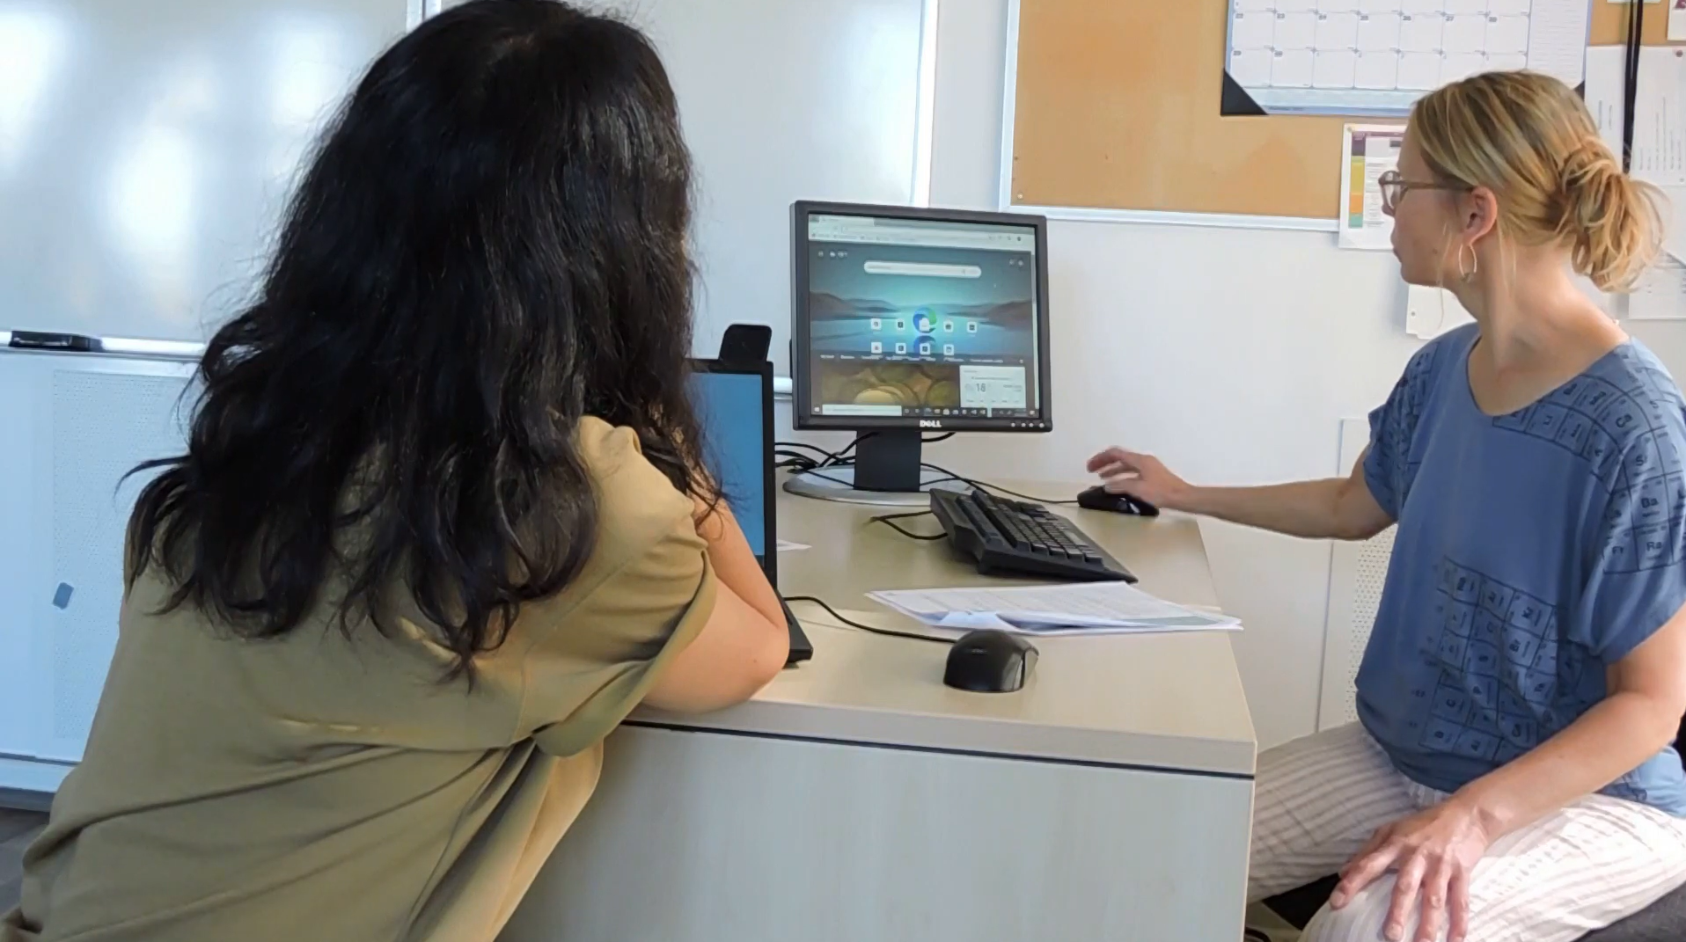
Checklist
Slide hidden from learner
During In-Person Tutoring
Notes:
Slide hidden from the learner.
Information for the Tutor.
Refer to:
TUTOR CHECKLIST- During In-Person Tutoring Sessions

Slide 10
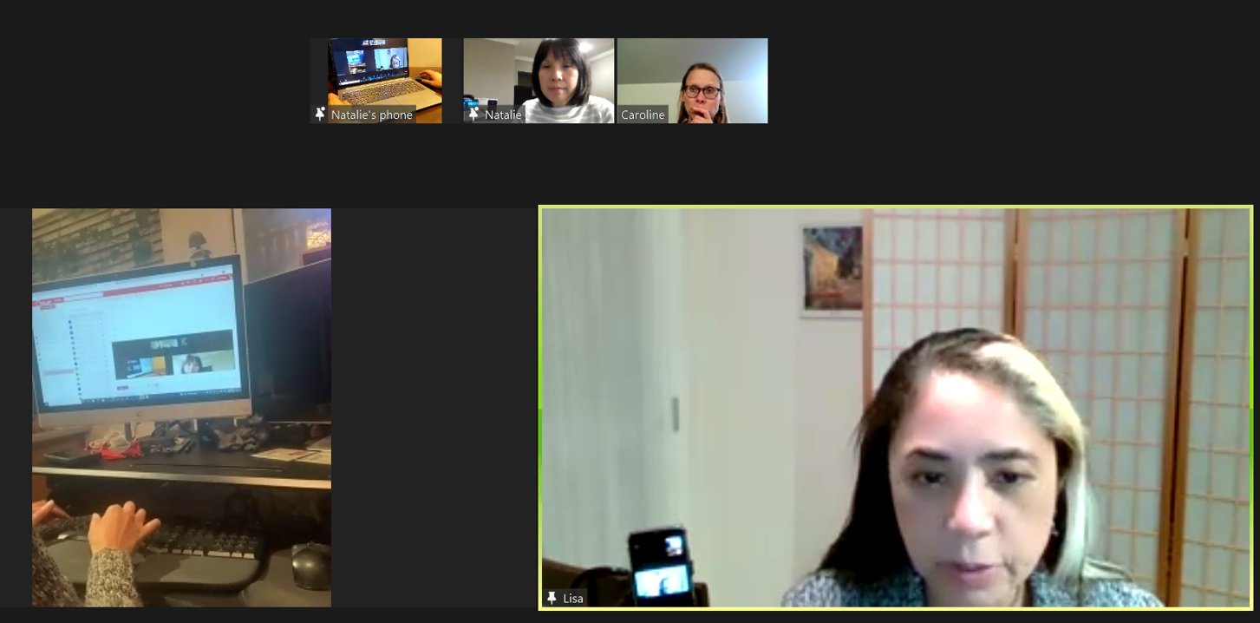
Set Up and Preparation
Slide hidden from learner
Before Remote Tutoring
Notes:
Slide hidden from the learner.
Information for the Tutor.
SET UP
Refer to:
TUTOR CHECKLIST- Set up for Remote Tutoring Session via Zoom, Ms Teams etc.
LEARNER CHECKLIST- Set up for Remote Tutoring Session via Zoom, Ms Teams etc.
Trouble-Shooting -Remote Tutoring
IMPORTANT:
Go through the Learner Checklist as well. Then, you will be able to more easily troubleshoot with the learner if they have difficulty in their set up.
Communicate beforehand with the Support Person (if that learner has one):
Email the Learner Checklist listed in #2 above to the Support Person.
Email any instructions for this lesson to the support person (see the notes for specific slides /parts of the lesson):
Have the support person do the preparation for the lesson on the learner’s desktop. Tutor needs to guide them re. how to do this.
Preparation for Remote Tutoring only:
Have support person make sure the browser icon (or Gmail shortcut if they use that) is easy for the learner to find on the desktop.
If no preparations were made on the learner’s computer before the session by a support person, you could use the Request Remote Control function in Zoom on the learner’s desktop if the learner struggles, and before they get frustrated.
IMPORTANT: Keep in mind the following:
Before using Remote Control, be sure to get permission from your organization first.
It is crucial that the learner understands what it means, and gives you informed consent.
It is somewhat invasive and must be done respectfully and honouring the confidentiality of the learner.
Don’t use the Request Remote Control feature first! It should be a last resort.
First, try your best to teach the learner and the support person how to do things using Share screen and demonstrating.
Use it if other ways do not work and the learner really needs to learn digital skills.
You may want to record the Zoom tutoring session in case of any possible accusations afterwards.
PREPARATION
Preparation specific to each Part of this Zoom Lesson is in the notes of the relevant slides.

Slide 11
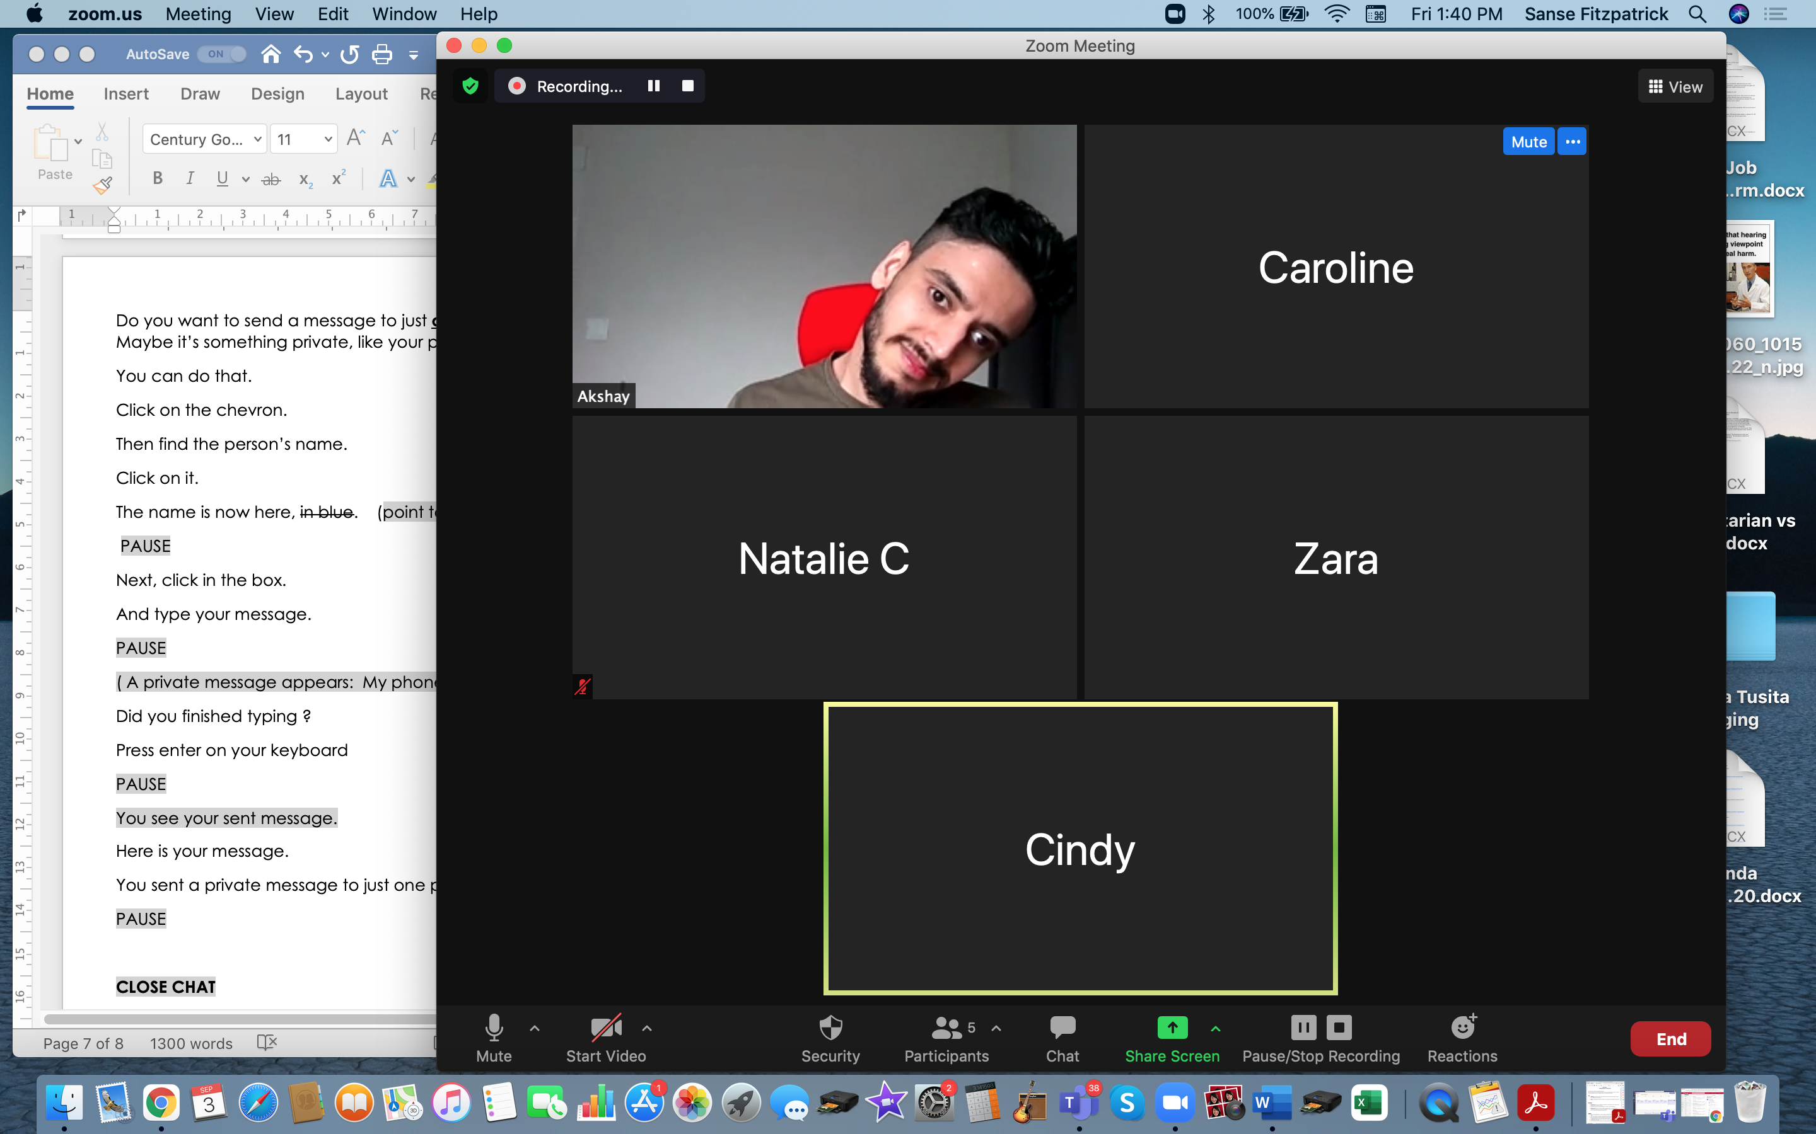
Checklist
Slide hidden from learner
During Remote Tutoring
Notes:
Slide hidden from the learner.
Information for the Tutor.
Refer to:
Tutor Checklist: During Remote Tutoring Session
Learner Instructions: How to let your Tutor have Remote Control of your Computer During a Zoom Session
Trouble-Shooting: Remote Tutoring
Be ready to assist learner by using the Requesting Remote Control function (refer to checklists 1 and 2 listed above).
You may have to set up the learner’s desktop for “Practice” activities if the learner needs support and no support person is available to do that beforehand. This is possible to do using Request Remote Control in Zoom.
IMPORTANT: Keep in mind the following:
Before using Remote Control, be sure to get permission from your organization first.
It is crucial that the learner understands what it means, and gives you informed consent.
It is somewhat invasive and must be done respectfully and honouring the confidentiality of the learner.
Don’t use the Request Remote Control feature first! It should be a last resort.
First, try your best to teach the learner and the support person how to do things using Share screen and demonstrating.
Use it if other ways do not work and the learner really needs to learn digital skills.
You may want to record the Zoom tutoring session in case of any possible accusations afterwards.

Slide 12
Employment
Zoom Skills 1
Notes:
Show slide to the learner
Total Video length: 7:45 mins
Part One A: Join a Zoom Meeting: 0:00-2.17 mins [2.17 mins]
Part One B: Change Your Name: 2.17-3:46 [1.29 mins]
Say to the learner:
Today, we’re going to learn some basic Zoom functions, so we can join and participate in online meetings.

Slide 13
Lesson Objectives-Part One
A. Join a Zoom Meeting
B. Change Your Name
Notes:
Instructions for the Tutor
These are the skills the learner will master at the end of the lesson.
A. Join a Zoom Meeting
B. Change Your Name
Say to the learner:
In Part One, we’re going to review how to join a Zoom meeting from an email link.
Then, we’re going to learn how to change your name in a Zoom meeting.
Note for Remote tutoring only:
Learner may have joined the meeting for this lesson with help from the support person. The goal is that learner can join a Zoom meeting from an email independently.

Slide 14

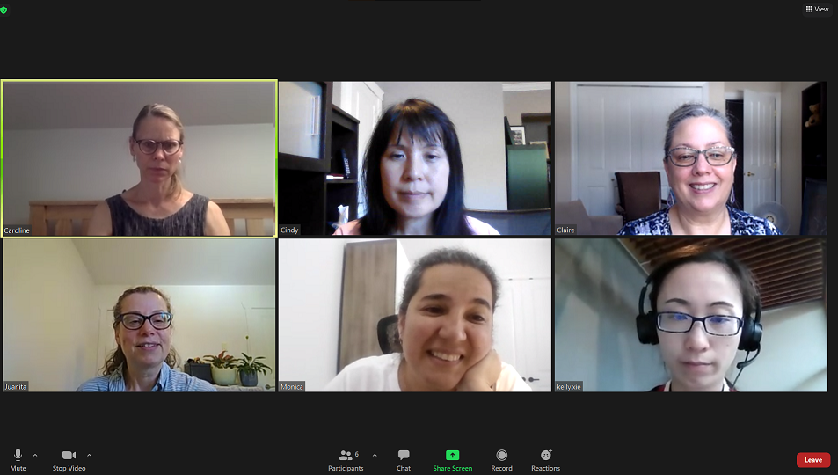
Lesson-Part One A
Join a Zoom Meeting
Notes:
Total Video length: 7:45 mins
Part One A: Join a Zoom Meeting: 0:00-2.17 mins [2.17 mins]
Part One B: Change Your Name: 2.17-3:46 [1.29 mins]
Say to the Learner:
We are going to review how to join a Zoom meeting from an email link on your computer. We will watch a video.
We can watch the video several times. So, don't worry if you don't catch everything the first time.
Instructions for the Tutor:
Do A only [Join a Zoom Meeting] Stop the video at 2:17 mins.
Play the video several times.
Then ask comprehension check questions to check understanding. [See next slide for comprehension check questions.]
Then have learner do Practice-Part One A.
After that, repeat the steps for Part One B [Change Your Name.] –These steps are in subsequent slides.
Click on the PLAY icon in the slide to open the video lesson.
Use this link to the YouTube video if the link in the slide doesn’t work:
https://youtu.be/jRJ4-p1j7cw
For remote tutoring, when you share screen to play the video, make sure you have shared the audio.
Play the lesson a bit and check the learner can hear it ok before playing the whole video.
Note: This is not mentioned in the video lesson; but if a computer doesn’t have the Zoom app installed, the user will be prompted to download the Zoom app. If this is not possible, look for “Having issues with Zoom Client? Join from Your Browser” at the bottom of the screen and click on the link to join from the browser.

Slide 15

Check Understanding
Notes:
Instructions for the Tutor:
After watching the segment of the video lesson, check understanding (review and elicit) before moving on.
Check understanding - ask the learner as you watch the video or as you demonstrate on your computer.
Ask these comprehension check questions, or others, to check understanding:
Join a Zoom meeting
Say to the Learner:
In a Zoom invitation email, where do you click to join the Zoom meeting? Answer: Click on the invitation link
What happens to the cursor when you hover over the invitation link in the email? Answer: The cursor becomes a hand
What do you do after you click on the zoom link in an email? Answer: Click Open Zoom Meetings
Instructions for Tutor:
Ask the learner: Do you want to watch the video again?
IMPORTANT
If the learner is struggling, stop the session.
Say to the learner:
Let’s do more work on X… before we do this.
Instructions to the Tutor:
For example, learner may not know where to click on the Zoom invitation email;
If so, go to the Digital Literacy Curriculum Resource (DLCR) and use the relevant module before using this video review lesson.
Teach the skills and have the learner practice.
For example, use Module 8 Zoom on Computer, or Module 1 Mouse and Navigating, depending on learner needs.
Tip: Do the Needs Assessment to determine needs; use the Needs Assessment tools in the DLCR for this.

Slide 16
Practice-Part One A
Join a Zoom Meeting
Notes:
Instructions for the Tutor:
PRACTICE- Part One-A Lesson Focus: Join a Zoom meeting.
PREPARATION
Email two Zoom invitations to the learner before the lesson.
Open the first Zoom meeting before the lesson: “Staff Meeting”.
Note: If tutoring in-person, learner should not check Join with Audio. Otherwise, there will be audio feedback.
Or
Both tutor and learner should mute their mics.
Also, join the meeting from another device while you demonstrate.
[The following are two example Zoom meeting invitation which you can copy and paste to send to your learner(s).]
Example Email Zoom Invitation 1
Subject: Staff Meeting
Hi all,
Our weekly staff meeting is on ______day, 10 am.
Click on the link to join the meeting:
Insert Zoom meeting link here.
See you soon,
Mary
Team Supervisor
Example Email Zoom Invitation 2
Subject: Brainstorming Session
Hi all,
Brainstorming Session
Click on the link to join in Zoom.
Zara Mahmud is inviting you to a scheduled Zoom meeting.
Topic: Brainstorming Session
Time: Insert Month and Day, 2022 11:00 AM Vancouver
Join Zoom Meeting
Insert Zoom link
Meeting ID: XXXX
Preparation for Remote tutoring only:
Send the Zoom links and instructions for the two practice instructions (below) to the support person.
Support person should give the practice instructions to the learner while the learner opens their email to click on the Zoom invitation link in order to connect with you on Zoom.
_________________________________________________________________________________________________
PRACTICE
Instructions for the Tutor:
Demonstrate first, then let the learner practice.
Say to the Learner:
Now it’s time to practice.
We’re going to review how to join a Zoom meeting.
[After each of the following steps, wait for the learner to complete the step. Guide the learner as needed.
For in-person tutoring, demonstrate on another device.]
I sent you an email that has a Zoom invitation link. The subject line in the email is “Staff Meeting”. Open your email and find that now.
Now, find the Zoom link.
Click on the link.
Then click Open Zoom Meeting.
Wait for the host to let you in.
You’re in the Zoom meeting!
Remote tutoring only:
[Tutor ends meeting for this Zoom lesson and opens “Staff Meeting” link. Support person will give the instructions while the tutor waits for the learner to join the Zoom Staff meeting.]
More Practice:
[Before beginning, remember to “End Meeting for All” for the previous Zoom Staff Meeting, and then open the new meeting: Brainstorming Session.]
Say to the Learner:
Now go back to your email Inbox again.
Click on the email I send you. The subject is “Brainstorming Session”.
Now find the Zoom link in the email and click on it.
Join the Zoom meeting.
Remote tutoring only:
[Tutor ends meeting for “Staff Meeting” and opens “Brainstorming Session” meeting. Support person will give the instructions while the tutor waits for the learner to join the meeting]
Instructions for the Tutor:
Have the learner repeat this activity and practice as many times as they need (at least three times.)
CHECK THE LEARNER’S SKILLS:
Have the learner show you they can do the skills at least three times without support.

Slide 17
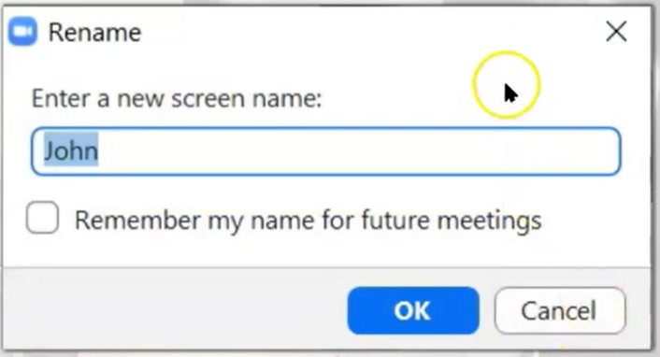
Lesson-Part One B
Change Your Name
Notes:
Video length: Part One B. Change Your Name: 2.17-3:46 [1.29 mins]
Say to the Learner:
We are going to learn how to change your name in a Zoom meeting on your computer. We will watch a video. We can watch the video several times. So, don't worry if you don't catch everything the first time.
Instructions for the Tutor:
Click on the PLAY icon in the slide to open the video lesson.
Play the video segment several times to the end.
Then ask comprehension check questions to check understanding. [See next slide for comprehension check questions.]
Then have learner do Practice One B.
Click on the PLAY icon in the slide to open the video lesson.
Use this link to the YouTube video if the link in the slide doesn’t work:
https://youtu.be/jRJ4-p1j7cw
For remote tutoring, when you share screen to play the video, make sure you have shared the audio.
Play the lesson a bit and check the learner can hear it ok before playing the whole video.

Slide 18
Check Understanding
Notes:
Instructions for the Tutor:
After watching this segment of the video lesson, check understanding (review and elicit) before moving on to the next part.
Check understanding - ask the learner as you watch the video or as you demonstrate on your computer.
Ask these comprehension check questions or others to check understanding:
[Change your name]
Say to the leaner:
How do you open the menu to change your name? Answer: Right click on the name.
What opens when you right click on your name ? Answer: A menu opens
What do you find and click on in the menu ? Answer: Click on “Rename”
Then what do you do ? Answer: Type your name in the blue box.
What do you click on after you type your name ? Answer: OK
If you are not using your own computer, should you check “Remember my name for future meetings?” Answer: No
Should we give our first and last name when we join a Zoom meeting? Answer: No, just the first name is ok; OR, just the first name and the initial of the last name is ok.
Why is it better to just put your first name or your first name and the initial of your last name ? Answer: it helps you stay safe online.
Instructions for Tutor:
Ask the learner: Do you want to watch the video again?
IMPORTANT
If the learner is struggling, stop the session.
Say to the learner:
Let’s do more work on X… before we do this.
For example, learner may have difficulty typing.
If so, go to the Digital Literacy Curriculum Resource (DLCR) and use the relevant module before using this video review lesson.
Teach the skills and have the learner practice.
For example, use Module 8 Zoom on Computer, or if needed first: Module 2 Keyboarding, depending on learner needs.
Tip: Do the Needs Assessment to determine needs; use the Needs Assessment tools in the DLCR for this.

Slide 19
Practice-Part One B
Change Your Name
Notes:
PRACTICE- Part One Lesson Focus: Change Your Name.
Instructions for the Tutor:
PREPARATION
Learner may still be in the Zoom Meeting from doing Practice-Part One A.
If not, email a Zoom invitation to learner before this practice.
Change your name to a different name in the Zoom meeting (so you can demonstrate)
Note: If tutoring in-person, Learner(s) should not check Join with Audio. Otherwise, there will be audio feedback.
Or
Both tutor and learner should mute their mics.
Preparation for Remote tutoring only:
Support person at home should oversee as learner changes name.
************************************************************************************************
Demonstrate first, then let the learner practice.
Say to the Learner:
Now it’s time to practice.
We’re going to practice how to change our name in a Zoom meeting.
[After each of the following steps, wait for the learner to complete the step. Guide the learner as needed.]
We’re in a Zoom meeting.
Is your name correct? Mine is wrong. This is not my name (point to wrong name on your video)
How do you change your name? Yes, right click on the name.
A menu opens. Choose “Rename”.
Click on “Rename”.
Type your name in the blue box.
“Remember my name for future meetings”? Because I’m not using my own computer, I’m not going to check the box. (uncheck box) OR (If this is your own computer, leave the box checked).
Now what do you do ? Yes, click “Ok”.
More Practice:
Say to the Learner:
Let’s practice some more.
Change your name to include your first name and the initial of your last name. For example my first name is ________ and my last name is ______ So I am _______ (tutor gives first name and initial of last name).
Now, let’s change your name to include your first name and initial of your last name.
Finished? Let’s practice some more.
Let’s change our names back to just our first names.
Great! You learned how to change your name on Zoom.
Instructions for the Tutor:
Have the learner repeat this activity and practice as many times as they need (at least three times.)
For remote tutoring only:
Support person should oversee that learner is able to follow the instructions.
Tutor may want learner to share screen. If so, email the support person LEARNER INSTRUCTIONS: HOW TO SHARE YOUR SCREEN DURING A ZOOM SESSION available in Remote Tutoring->Checklists for Remote Tutoring->Learner Checklists
CHECK THE LEARNER’S SKILLS:
Have the learner show you they can do the skills at least three times without support.

Slide 20
Lesson Objectives-Part Two
Basic Zoom Functions
Icons No Icons
Active Speaker View vs Gallery View
Notes:
Instructions for the Tutor:
These are the skills the learner will master at the end of the lesson.
Total Video length: 7:45 mins (Part Two: 03:47 –07:45)
Part Two-A: Icons No Icons: 3:47-5:22 mins [1:35 mins]
Part Two-B: Active Speaker Views vs Gallery View: 5:25- 7:45/end [2:20 mins]
Say to the learner:
In Part Two, we’re going to learn some basic Zoom functions so we can participate in the meeting.
We are going to do the following:
Find Zoom icons when they disappear
Switch between Active Speaker and Gallery views
We’ll watch a video to learn/review this.
We can watch the video several times. So, don't worry if you don't catch everything the first time.

Slide 21
Lesson- Part Two A
Icons No Icons
Notes:
Part Two A: Icons No Icons: 3:47-5:22 mins [1:35 mins]
Say to the Learner:
Now, let’s watch a video on how to find Zoom icons when they disappear. We can watch the video several times. So, don't worry if you don't catch everything the first time.
Instructions for the Tutor:
Click on the PLAY icon in the slide to open the video lesson.
Play the video segment several times to the end.
Then ask comprehension check questions to check understanding. [See next slide for comprehension check questions.]
Then have learner do Practice-Part Two-Part A.
Click on the PLAY icon in the slide to open the video lesson.
Use this link to the YouTube video if the link in the slide doesn’t work:
https://youtu.be/jRJ4-p1j7cw
For remote tutoring, when you share screen to play the video, make sure you have shared the audio.
Play the lesson a bit and check the learner can hear it ok before playing the whole video.

Slide 22
Check Understanding
Notes:
Instructions for the Tutor:
After watching this segment of the video lesson, check understanding (review and elicit) before moving on to the next part.
Check understanding - ask the learner as you watch the video or as you demonstrate on your computer.
Ask these comprehension check questions or others to check understanding:
[Icons no Icons]
Part Two-A:
Say to the Learner:
Can you name some icons in a Zoom meeting that we often use? Answer: Mic, Video, Leave Meeting, Chat etc.
What do we do when the icons disappear and we want to see them again? Answer: Move the mouse or trackpad a bit.
What do we do when the icons disappear on a cell phone? Answer: tap the screen
Instructions for the Tutor:
Then ask the learner: Do you want to watch the video again?
If the learner is struggling, stop the session.
Say to the learner:
Let’s do more work on X before we do this.
Note: New update from Zoom (not shown in the video): Press ALT on your keyboard to make the icons appear. The icons will not disappear until you press ALT again.

Slide 23
Practice Part Two A
Icons No Icons
Notes:
PRACTICE- Part Two A
Lesson Focus: Icons no Icons
Instructions for the Tutor:
PREPARATION
If this practice is done on the same day the learner does Practice Part One, use the same link as Practice Part One. If this practice is done on a separate day from Practice Part One, send a Zoom meeting invitation to the learner before the lesson. This will be also be review of Practice Part One A. Demonstrate to learner first before letting them practice.
Say to the Learner:
Now we’re going to practice what we just saw in the video: what to do when the icons in the zoom meeting disappear.
[Start here if this practice is done on separate days from Practice Part One]:
First, let’s join the Zoom meeting from your email inbox. Find the email I sent you.
Then find the Zoom link.
Remember, do not click on Join Audio. It will be very noisy.
Let’s change our names to our first name and the initial of our last name. Remember how to do that?
If learner does not remember, then say: Right click on the name with your mouse/trackpad to open the menu.
Choose “Rename”.
Type your first name and the initial of your last name in the blue box.
Click Ok.
Continue below.
[Start here if this practice is done on the same day as Practice Part One]:
Method 1 (Shown in video)
We are all in the Zoom meeting. Please do not touch the mouse (or screen or trackpad – depending on the device used).
After a while, the Zoom icons disappear.
Now move your mouse (tap your screen or trackpad). The icons appear again.
Let’s try that again. Wait for the icons to disappear.
Make the icons appear again. What do you do? Yes, move your mouse (or tap your screen or your trackpad).
Method 2 (Optional, not shown in video)
We will learn another method to make the icons appear again that is not shown in the video.
We are all in the Zoom meeting. Do not touch the mouse (or screen or trackpad – depending on the device used).
After a while, the Zoom icons disappear.
Press ALT on your keyboard. Can you find it? It is the button beside the space bar.
The icons will remain and not disappear again.
To make the icons disappear again, press ALT again.
REPEAT THE PRACTICE
Repeat the above at least three times.
Say to the Learner: Let’s practice this again.
CHECK THE LEARNER’S SKILLS:
Have the learner show you they can do the skills at least three times without support.

Slide 24
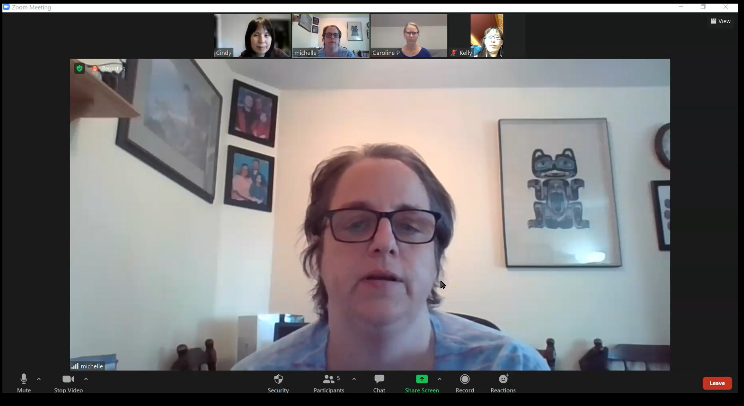
Lesson- Part Two B
Active Speaker View vs Gallery View
Notes:
Part Two B: Active Speaker View vs Gallery View
Video Length: 5:25- 7:44 (end) [2:19 mins]
Say to the Learner:
Now, let’s watch a video on how to switch between Active Speaker View and Gallery View. We can watch the video several times. So, don't worry if you don't catch everything the first time.
Instructions for the Tutor:
Click on the PLAY icon to open the video lesson.
Play the video segment several times to the end.
Then ask comprehension check questions to check understanding. [See next slide for comprehension check questions.]
Then have learner do Practice Part Two B.
Click on the PLAY icon in the slide to open the video lesson.
Use this link to the YouTube video if the link in the slide doesn’t work:
https://youtu.be/jRJ4-p1j7cw
For remote tutoring, when you share screen to play the video, make sure you have shared the audio.
Play the lesson a bit and check the learner can hear it ok before playing the whole video.

Slide 25
Check Understanding
Notes:
Instructions for the Tutor:
After watching this segment of the video lesson, check understanding (review and elicit) before moving on to the next part.
Check understanding - ask the learner as you watch the video or as you demonstrate on your computer.
Ask these comprehension check questions or others to check understanding:
[Active Speaker View vs Gallery View]
Say to the learner:
Who are the people in a meeting called? Answer: Participants
Where is the “View” icon? Answer: in the top right corner.
You want to see every participant clearly. Which view should you choose? Answer: Gallery View
You want to switch from Active Speaker view to Gallery view, what do you do? Show me. Answer: Click on the View icon, choose Gallery. Click on it.
In Gallery view, what colour is the box of the speaker? Answer: Yellow. Yes, the speaker has a yellow box around their video.
You want to switch to Speaker view again, what do you do? Answer: Click on the View icon, choose Speaker. Click on it.
Whose video is the biggest in Speaker view ? Answer: the person who is speaking
Instructions for the Tutor:
Then ask the learner: Do you want to watch the video again?
If the learner is struggling, stop the session.
Say to the learner:
Let’s do more work on X before we do this.

Slide 26
Practice Part Two B
Active Speaker View vs Gallery View
Notes:
PRACTICE-Part Two B
Lesson Focus: Active Speaker View vs Gallery View
Instructions for the Tutor:
PREPARATION
If this practice is done on a separate day from Practice One, send a new Zoom meeting invitation to the learner before the lesson. This will also be review from Practice One. Demonstrate to the learner first before letting them practice.
If there is only one learner, sign into Zoom on another device so there are at least three participants in the meeting.
Say to the Learner:
Now we’re going to practice what we just saw in the video: how to switch between “Active Speaker View” and “Gallery View”.
We can use Gallery view only when there are three or more participants.
When you join the Zoom meeting, the video of the person who is speaking is big. The other participants’ videos are small; this is Active Speaker View.
You want to see the other participants. What do you do? Yes, Click on the “View” icon, choose “Gallery”. Click on it.
Let’s go back to the “Active Speaker” view again. Click on “View”, choose “Speaker”. Click on it.
Now, you try. Let’s switch to “Gallery View”, then to “Active Speaker” view again. And one more time.
REPEAT THE PRACTICE
Repeat the above at least three times.
Say to the Learner: Let’s practice again.
CHECK THE LEARNER’S SKILLS:
Have the learner show you they can do the skill at least three times without support.

Slide 27

Extra Practice
Notes:
Extra Practice
Instructions for the Tutor
Preparation
If you and the learner are still in a Zoom meeting because you were doing practice for Part Two, click on “End Meeting for All”
Start Zoom again and use the Zoom meeting link for “Staff Meeting” from Part One of this lesson.
For Remote Tutoring only:
Ask learner to sign in to Zoom again using the email invitation: “Staff Meeting”.
**********************************************************************************************************************************
Say to the learner:
Let’s practice some more.
Let’s join the Zoom meeting again from the email invitation: “Staff Meeting”. It is in your inbox.
After you join, change your name to only your first name (or change your name to your first name and initial of your last name).
Hey, the Zoom icons disappeared. Make the icons appear again.
Switch from Gallery View to Active Speaker View.
Switch from Active Speaker View to Gallery View.
Instructions for the Tutor:
Have the learner repeat this activity and practice as many times as they need (at least three times.)
Check the Learner's skills. Has the learner shown you they can do the skills at least three times without support?

Slide 28

Practice Between Sessions
What did you learn/practice today?
When are you going to practice?
Practice Plan
Notes:
INSTRUCTIONS FOR THE TUTOR:
In-person tutoring and Remote Tutoring:
Make sure the learner knows how to access the video lesson(s) you just used so they can practice between tutoring sessions.
If relevant, make sure the support person at home knows how to access the video(s) too.
Option One
Email the video link to the learner, and if relevant the at-home support person. They can use the link in the email to access the video lesson(s).
Option Two
Put a link to the specific video lesson(s) you did on the learner’s desktop so they can access the video easily.
How:
Open the website address for the lesson in the browser.
In the address bar, click to highlight the lesson address.
Drag the address (link) onto the desktop. It will make an icon on the desktop.
Find the icon on the desktop and check that the link works.
Show the learner where it is. Tell them to just click to access it for practice.
Remote Tutoring Only:
You can do Option Two above by using Request Remote Control in Zoom during the tutoring session.
Refer to the following for the steps on how to do that:
Tutor Checklist-During Remote Tutoring Sessions
Learner Instructions: Let Tutor have Remote Control of your Computer During a Zoom Session
IMPORTANT: Keep in mind the following:
Before using Remote Control, be sure to get permission from your organization first.
It is crucial that the learner understands what it means, and gives you informed consent.
It is somewhat invasive and must be done respectfully and honouring the confidentiality of the learner.
Don’t use the Request Remote Control feature first! It should be a last resort.
First, try your best to teach the learner and the support person how to do things using Share screen and demonstrating.
Use it if other ways do not work and the learner really needs to learn digital skills.
You may want to record the Zoom tutoring session in case of any possible accusations afterwards.
**********************************************************************************************************************************
SAY TO THE LEARNER:
You did well today.
So, what did you learn and practice today? →
Today, we learned and practiced how to: [only mention the parts you covered]
Join a Zoom meeting
Change your name
Find Zoom icons when they disappear
Switch between “Active Speaker View” and “Gallery view”
It’s really important to review and practice as much as you can! Please do that before our next tutoring session.
Watch the video again, as many times as you need.
I’ve emailed you the link. Let/s make sure you can open it.
(OR)
We’ve put the link on your desktop. Here it is. Just click on it to watch the video.
Let’s make sure it works ok.
[Practice Plan]
Say to the learner:
Practice at least three more times before our next session.
Here is what to practice:
[For example: I will send you three zoom links by email with the date and time to join the meetings.
OR
Your support person will send you three zoom links by email with the date and time to join the meetings.
I will email you this Practice Plan (see below). Please reply to the email so I know you got it and have what you need to do the practice.
[Get learner to confirm they will practice and tell you when. Get specific.]
When are you going to do the practice? How many times? etc.
Instructions for the Tutor:
Email three example Zoom invitations to the learner, and if you are not able to meet them on Zoom in between sessions, the Support Person should email the invitations to the learner and practice with the learner.
Example Zoom Email Invitations
Subject: Quick Meeting 1, 2 and 3
Hi all,
Let’s meet in Zoom for a quick meeting on time and date.
Insert Zoom meeting link here.
See you!
-Tutor’s name
Practice Plan:
Change your name to only your first name (or change your name to your first name and initial of your last name).
Wait until the Zoom icons disappear. Then make them appear again.
Switch from Gallery view to Active Speaker view.
Switch from Active Speaker view to Gallery view.

Slide 29

Confirm Next Session and Support
Notes:
Instructions for the Tutor:
Confirm the next tutoring session.
Clarify any support in-between sessions if you are offering that.
If offering support outside the session time, put boundaries, be clear about when and how you are giving support.
Say to the Learner.
e.g. Great work today! etc.
Let’s meet again on X date at X time. Does that work for you?
Wonderful.
[If offering support before next session:]
If you need support before our next session, please .........
[For remote support:]
I will send you the Zoom link the day before the tutoring session.
etc.

Slide 30
See you!
Keep Practicing
Notes:
Say to the Learner:
Bye and see you on X date at X time.
Keep practicing!

