Slide 1

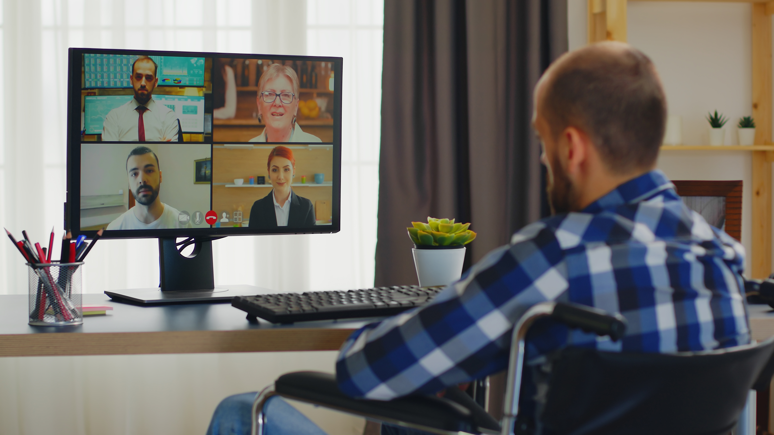
Employment
Slide hidden from learner
Zoom Skills 2
Notes:
Slide hidden from the learner.
Information for the Tutor.
This PowerPoint lesson covers the following Zoom video lessons:
Part One
Turn Mic and Video On/Off
Raise Your Hand
Part Two
Send a Message to Everyone
Send a Message to Just One Person

Slide 2
Pre-Requisite Skills
Slide hidden from learner
Mouse/trackpad skills: hold mouse/use trackpad; left click; right click; different shapes of the cursor; scroll
Navigation: move the mouse/ use the trackpad to position the cursor in the correct location
Keyboarding: type words, numbers, common symbols; use Shift and Enter keys; one finger typing is ok
Email Skills: (For the Practice, if sharing a Zoom invitation with learner via an email ): Open email app; use inbox; open and read a simple email; recognize & use common icons
LINK to the DLCR:
https://digital-literacy.issbc.org/for-teachers/
Password: Diglit4T
Notes:
Slide hidden from the learner.
Information for the Tutor.
Pre-Requisite Skills
Remember: like all lessons in Module 9 – Employment (Review), this is a review lesson of the digital skills, and the learners may not be ready for this lesson.
Make sure the learner has the “Prerequisite Skills” listed in the slide.
These skills are not specifically reviewed in this lesson, but the learner needs to have them to be able to do the lesson.
If the learner struggles, stop the lesson and go to the following modules in the Digital Literacy Curriculum Resource (DLCR) and teach the pre-requisite skills before doing this lesson:
Module 1 Mouse and Navigating
Module 2-Keyboarding
Module 5-Email Skills
IMPORTANT:
To do the Practice parts of this lesson, if you are sharing a Zoom invitation with the learner via an email, the learner needs to have an email account.
If they don’t have an email account, STOP this review lesson. Instead, do the following:
Go to the Digital Literacy Curriculum Resource.
Use Module 5-Email. Teach them how to create an email account first.
https://digital-literacy.issbc.org.
Go to the Teachers tab.
Password: Diglit4T

Slide 3
Skills Reviewed in this Lesson
Check the Notes of this Slide
Notes:
Slide hidden from the learner.
Information for the Tutor
These skills are specifically reviewed in this lesson.
It is assumed the learner has already learned these skills and is doing this lesson as a review.
Zoom Skills-Part Two
Basic Zoom Functions
Turn Mic On/Off
Understand how you can tell if your microphone (mic) is on or off in a Zoom meeting
Understand what it means if your mic is on or off
Recognize the mute and unmute icons
Mute and unmute your mic:
find Mute / Unmute icon
know where to click and where not to click
Video Camera On/Off
Understand how you can tell if your video is on or off in a Zoom meeting
Understand what it means when your video is on or off
Recognize the video icons
Mute and unmute your mic: where to click and where not to click
Take a Break During the Meeting-Turn Off Video and Mic
Understand you may need to take a break during a Zoom meeting
Understand why you need to mute your mic and turn off your video camera before you take a break (for Privacy)
Recognize that your video camera is on/off during a Zoom meeting
Turn off/on your video:
Recognize Stop Video/ Start Video icon
Click on the Stop Video/ Start Video icon
Ask a Question-Raise your Hand
Recognize when a participant raises their hand using the Raise Hand icon
Understand it’s rude to ask a question/make a comment without raising your hand
Understand you need to raise your hand to ask a question / make a comment
Raise your hand using Zoom icons:
Recognize the “Reactions” icon
Open the “Reactions” icon
Find “Raise hand” and click on it
Recognize that you raised your hand using the icon
Understand after you raise your hand you need to wait for the host to ask you to unmute your mic to speak
Unmute your mic
Mute your mic
Recognize what the icon looks like when you are muted / unmuted
Understand you need to lower your hand when you finish talking
Lower your hand using Zoom icons:
Recognize the “Reactions” icon
Open the “Reactions” icon
Find “Lower Hand” and click on it
Recognize when you lowered your hand using the icon
Chat
Understand that you use Chat to read and write messages to other people in the Zoom meeting
Recognize your messages by colour
Recognize other people’s messages by colour
Send a Message to Everyone in a Zoom Meeting
Understand when it’s ok to send a message to everyone
Use Chat:
Recognize the Chat icon
Open the Chat icon
Recognize when Chat is open
Recognize when a message would be seen by everyone
Click in the box
Type a message
Send the message (Press Enter on the keyboard)
Recognize your sent message
Recognize when you get a reply
Reply to a message
Click in the box
Type a reply
Send the reply (Press Enter on the keyboard)
Recognize your reply
Send a Message to Just One Person in a Zoom Meeting
Understand that you can send a message to just one person
Understand when you might want to send a message to just one person
Send a message to just one person:
Open Chat
Find and click on the chevron
Find and click on the person’s name
Recognize when the person’s name has been chosen
Click in the box
Type a message
Send the message (Press Enter on the keyboard)
Recognize your sent message
Close Chat
Close “Chat:
Recognize the chevron
Understand that a chevron opens up a drop-down menu
Find and click on Close
Recognize when Chat is closed
Leave a Meeting
Understand that you need to click on icons in order to leave a Zoom meeting
Leave a meeting:
Find and click on the “Leave” icon
Know that the icon is red
Recognize that the meeting is closed/ you are no longer in the meeting
Close the Zoom app: Click on the X
Recognize that the Zoom app is closed

Slide 4
Instructions
For Using this PowerPoint Lesson
Slide hidden from learner
Notes:
Slide hidden from learner
This PowerPoint lesson contains everything the tutor needs: the lesson notes, suggested instructional language, the links to the video lesson(s), and also Practice for each part. ​
IMPORTANT
Read through the entire lesson a few days before tutoring so you are clear about what to do and have time to get any questions answered and to do any preparation.
The first 11 slides are hidden from the learner; they contain information and instructions for the tutor.
Green Slides = Lesson Objectives
Blue Slides = The Start of each Part of the Lesson
Yellow Slides = Practice Activities
Instructions specific to each lesson are in the notes pages of each PowerPoint. ​
Identical notes are also available as a separate PDF for tutors who prefer that format. ​See Option B below.
You will NOT be able to copy and paste from this PowerPoint because it is “Read Only”.
In the Practice for each Part of this lesson, you may be asked to copy some text from this lesson and paste it into a Word document to use with the learner.
You will not be able to do that from this PowerPoint lesson. Instead, copy and paste the text from the PDF version of the (same) lesson.
There are different options for using this PowerPoint lesson and /or the PDF version of this (same) lesson:
Lesson Format Options for the Tutor
Option A
Use a printed version of the notes for you as tutor (not for the learner)
plus
Use the PowerPoint slideshow for the learner.
How:
Open the PowerPoint, download and save it.
Click “File” then "Print" ​
Then under “Settings” choose " Notes Pages" .
Print
Now, you can use the printed version for tutoring.
Option B
Use the separate electronic PDF of the PowerPoint slides and notes for you as tutor (if you don’t have PowerPoint on your computer or if you prefer to use a PDF version)
Plus
Use the PowerPoint slideshow for the learner, or the PDF-Slides Only version (if the learner’s computer doesn’t have PowerPoint). ​
You can have the PDF open to use for you as tutor beside the PowerPoint slideshow, or the PDF version of the slides (for the learner).
Option C
Use the PowerPoint slideshow in “Presenter View”.
This lets you show the slideshow to the learner, and also lets you see the notes as well as the slideshow that the learner sees.
This works for remote and in-person tutoring.
However, for in person tutoring for small groups you need a separate monitor or projector to do this: one for you and one for the learners.

Slide 5
Lesson Objectives – Part One
Slide hidden from learner
Basic Zoom Functions
Turn Mic On/Off
Turn Off Video and Mic
Raise Your Hand
Notes:
Slide hidden from learner
Instructions to the Tutor
These are the skills learners will master at the end of the lesson.
Total Video length: 8:04 mins
Part One A: Turn Mic On/Off: 0:00-2:11 mins [2:11 mins]
Part One B: Turn Off Video and Mic 2:12 – 4:15 min [2:03 mins]
Part One C: Raise Your Hand: 4:16- 8:04/end [3:20 mins]

Slide 6
Lesson Objectives – Part Two
Slide hidden from learner
Basic Zoom Functions: Chat
- Send a Message to Everyone
- Send a Message to Just One Person
Notes:
Slide hidden from learner
Instructions to the Tutor
These are the skills learners will master at the end of the lesson.
Total Video length: 6:03 mins
Part Two A: Send a Message to Everyone: 0:00-2:58 mins [2:58 mins]
Part Two B: Send a Message to Just One Person: 2:59- 6:03/end [3:04 mins]

Slide 7
Keep in Mind
Slide hidden from learner
Only do as much as the learner can absorb in one session.
Do one part of the video lesson at a time.
Check in with the learner after each part.
Notes:
Slide hidden from the learner.
Information for the Tutor.
According to the learner’s pace, do one part of the video lesson, check their understanding, and have the learner practice the skills.
Then, let them show you they can do the skills (at least three times) before proceeding to the next part.
Look for signs of learner fatigue.
Check in with learner after each part.
Is the learner doing any of the following? :
Expressing frustration
Not asking questions, shutting down, not taking in what you are saying
Seeming overwhelmed
Saying, “Are we done yet?” etc.
Lots of yawning etc.
These are clues that it is time to stop the session and resume another day.

Slide 8

Set Up and Preparation
Slide hidden from learner
Before In-Person Tutoring
Notes:
Slide hidden from the learner.
Information for the Tutor.
SET UP
Refer to TUTOR CHECKLIST- Set up for In-Person Tutoring
PREPARATION
Preparation specific to the PRACTICE for each Part of this lesson is in the notes of each “PRACTICE” slide.

Slide 9
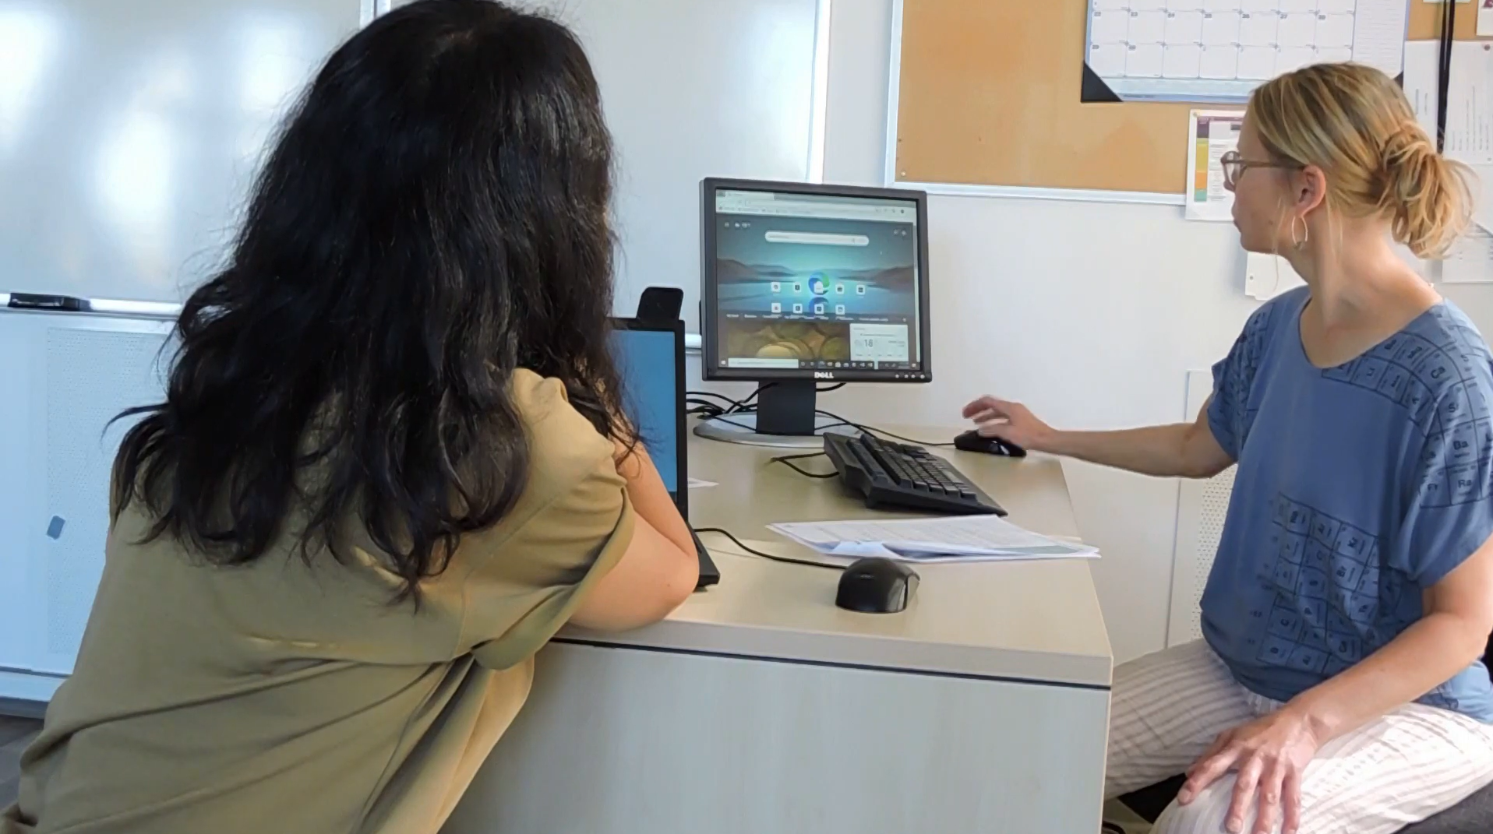
Checklist
Slide hidden from learner
During In-Person Tutoring
Notes:
Slide hidden from the learner.
Information for the Tutor.
Refer to:
TUTOR CHECKLIST- During In-Person Tutoring Sessions

Slide 10
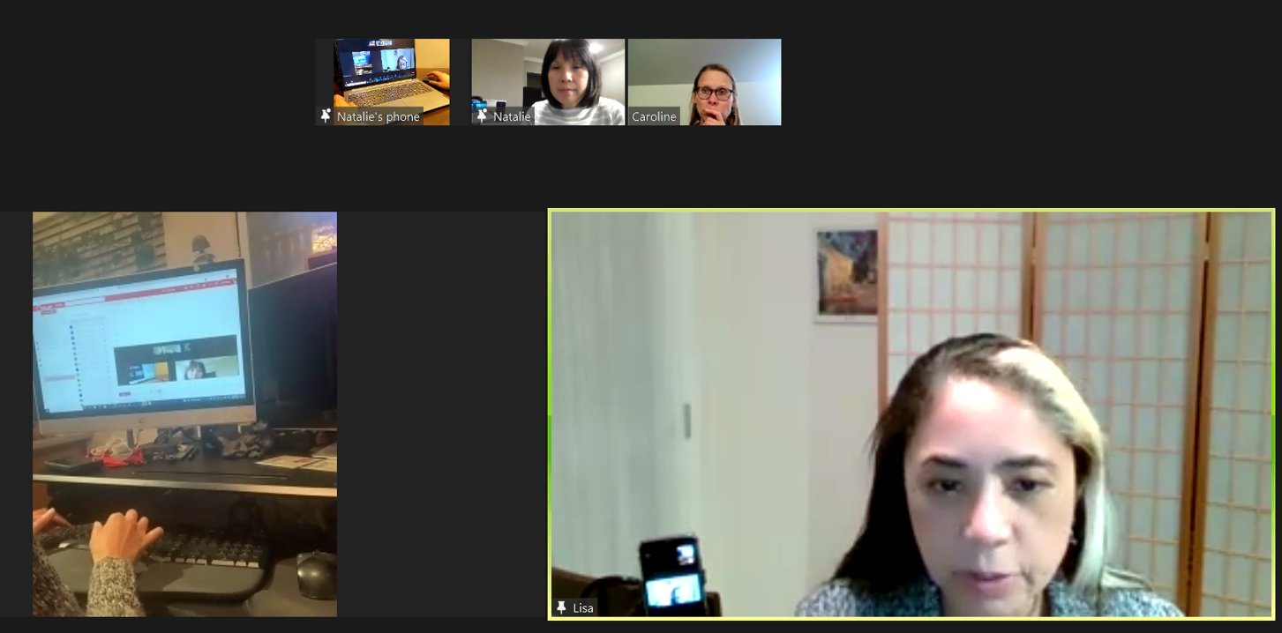
Set Up and Preparation
Slide hidden from learner
Before Remote Tutoring
Notes:
Slide hidden from the learner.
Information for the Tutor.
SET UP
Refer to:
TUTOR CHECKLIST- Set up for Remote Tutoring Session via Zoom, Ms Teams etc.
LEARNER CHECKLIST- Set up for Remote Tutoring Session via Zoom, Ms Teams etc.
Trouble-Shooting -Remote Tutoring
IMPORTANT:
Go through the Learner Checklist as well. Then, you will be able to more easily troubleshoot with the learner if they have difficulty in their set up.
Communicate beforehand with the Support Person (if that learner has one):
Email the Learner Checklist listed in #2 above to the Support Person.
Email any instructions for this lesson to the support person (see the notes for specific slides /parts of the lesson):
Have the support person do the preparation for the lesson on the learner’s desktop. Tutor needs to guide them re. how to do this.
Preparation for Remote Tutoring only:
Have support person make sure the browser icon (or Gmail shortcut if they use that) is easy for the learner to find on the desktop.
If no preparations were made on the learner’s computer before the session by a support person, you could use the Request Remote Control function in Zoom on the learner’s desktop if the learner struggles, and before they get frustrated.
IMPORTANT: Keep in mind the following:
Before using Remote Control, be sure to get permission from your organization first.
It is crucial that the learner understands what it means, and gives you informed consent.
It is somewhat invasive and must be done respectfully and honouring the confidentiality of the learner.
Don’t use the Request Remote Control feature first! It should be a last resort.
First, try your best to teach the learner and the support person how to do things using Share screen and demonstrating.
Use it if other ways do not work and the learner really needs to learn digital skills.
You may want to record the Zoom tutoring session in case of any possible accusations afterwards.
PREPARATION
Preparation specific to each Part of this Zoom Lesson is in the notes of the relevant slides.

Slide 11
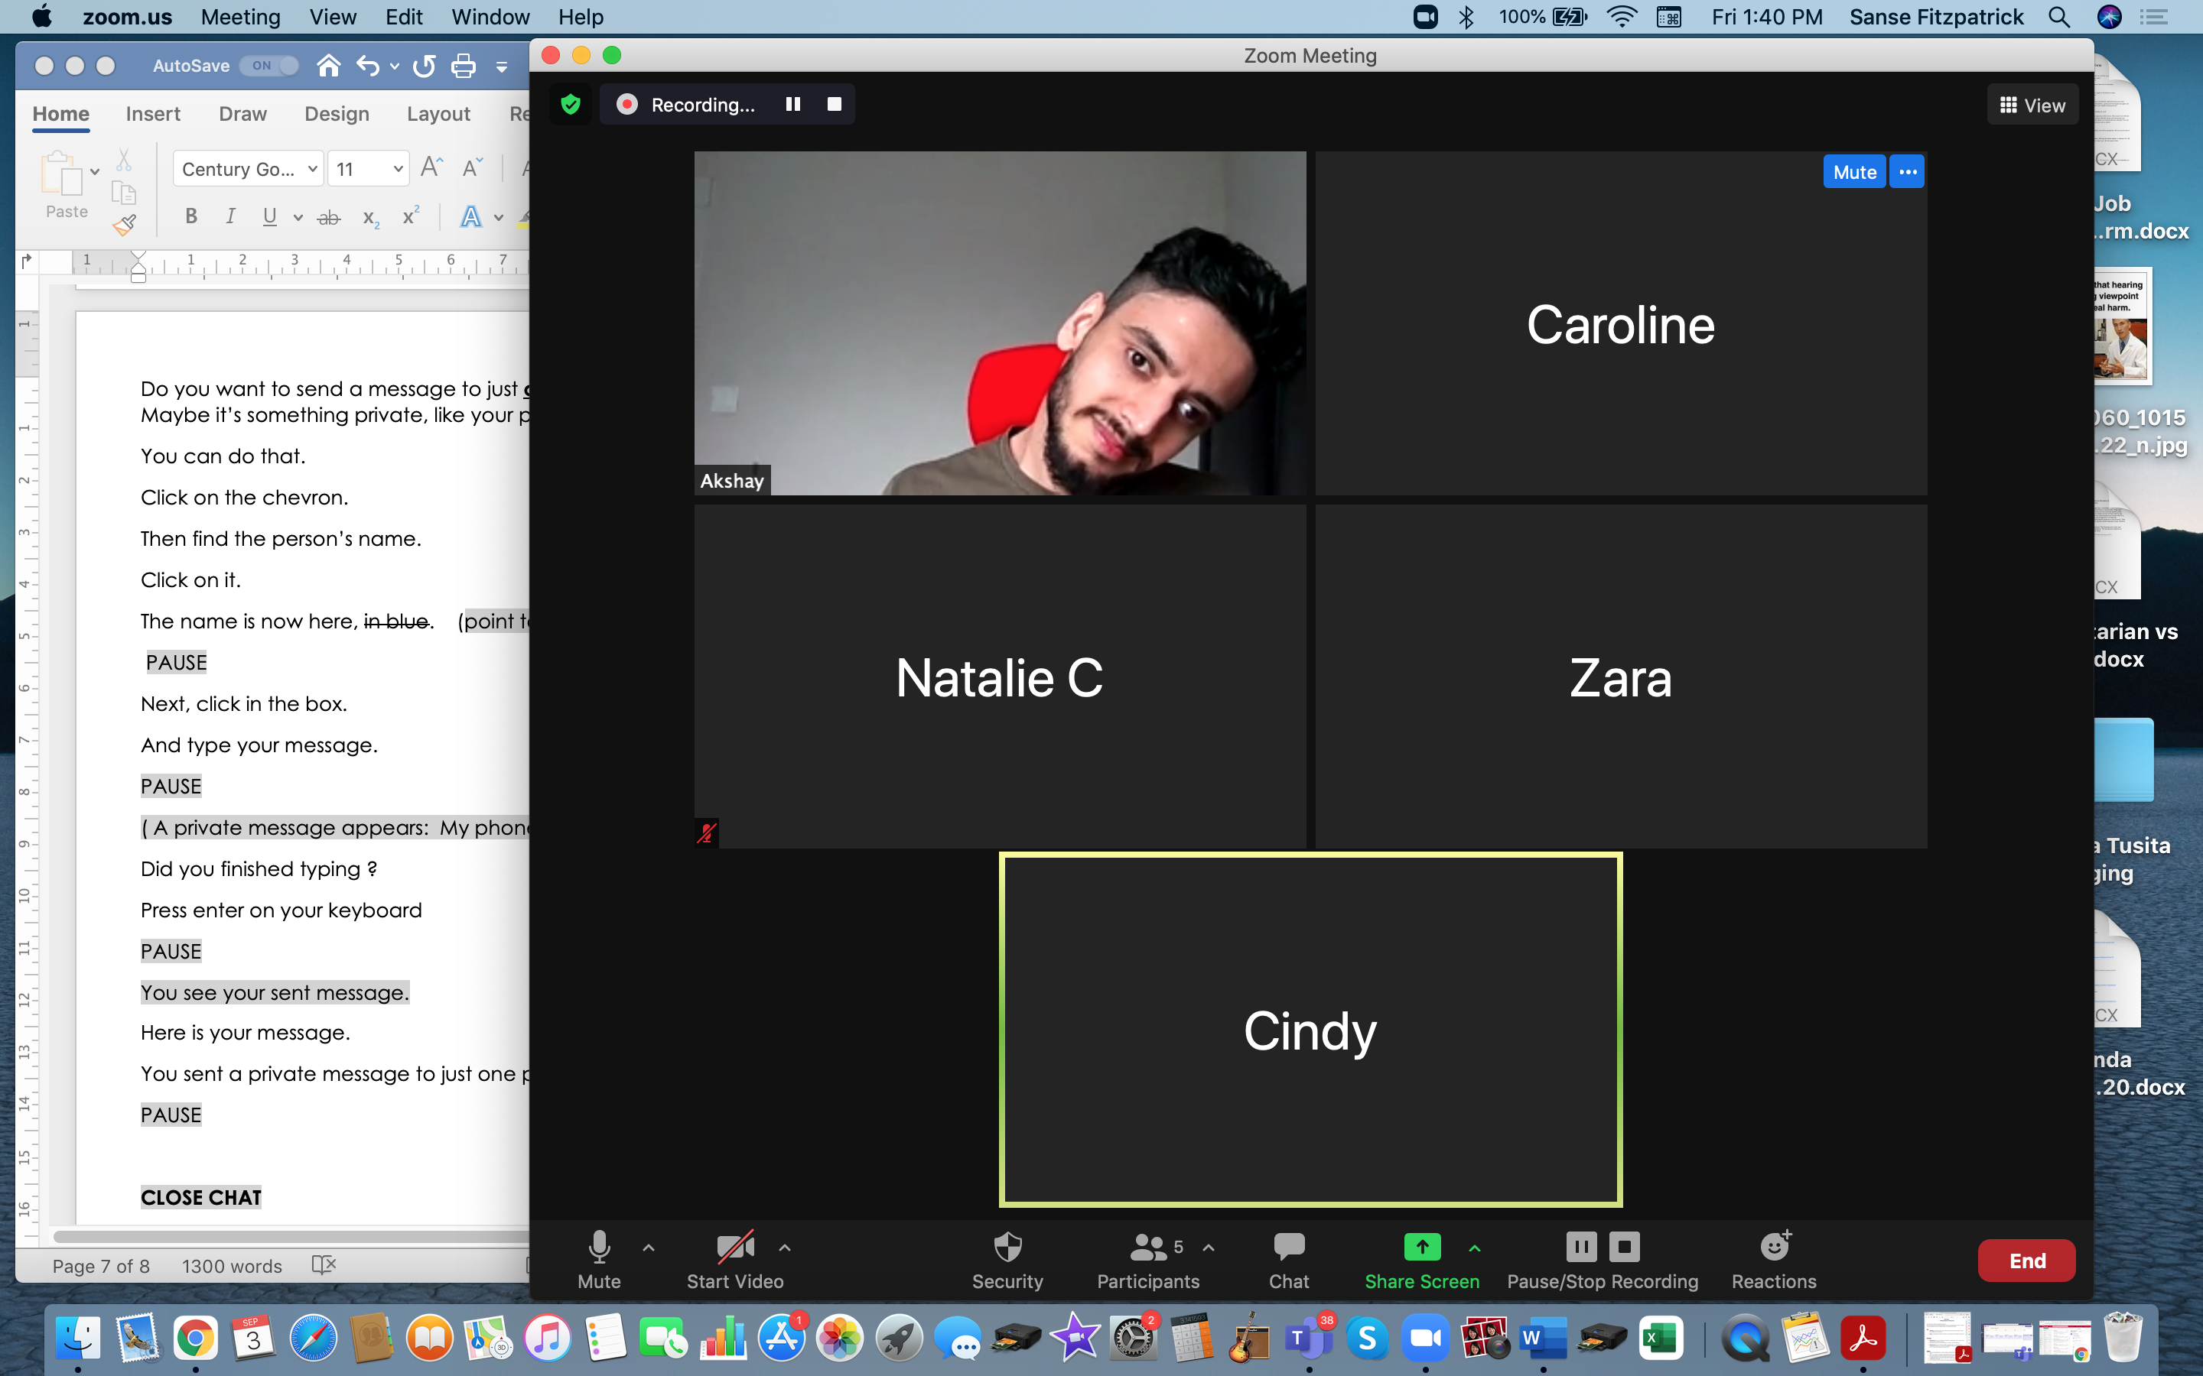
Checklist
Slide hidden from learner
During Remote Tutoring
Notes:
Slide hidden from the learner.
Information for the Tutor.
Refer to:
Tutor Checklist: During Remote Tutoring Session
Learner Instructions: How to let your Tutor have Remote Control of your Computer During a Zoom Session
Trouble-Shooting: Remote Tutoring
Be ready to assist learner by using the Requesting Remote Control function (refer to checklists 1 and 2 listed above).
You may have to set up the learner’s desktop for “Practice” activities if the learner needs support and no support person is available to do that beforehand. This is possible to do using Request Remote Control in Zoom.
IMPORTANT: Keep in mind the following:
Before using Remote Control, be sure to get permission from your organization first.
It is crucial that the learner understands what it means, and gives you informed consent.
It is somewhat invasive and must be done respectfully and honouring the confidentiality of the learner.
Don’t use the Request Remote Control feature first! It should be a last resort.
First, try your best to teach the learner and the support person how to do things using Share screen and demonstrating.
Use it if other ways do not work and the learner really needs to learn digital skills.
You may want to record the Zoom tutoring session in case of any possible accusations afterwards.

Slide 12
Employment
Zoom Skills 2
Notes:
Show slide to the learner
Say to the learner:
Today, we’re going to learn some more basic Zoom functions, so we can participate effectively in online meetings.
Today, we’ll focus on ........(Parts you intend to cover).

Slide 13
Lesson Objectives-Part One
Basic Zoom Functions
Turn Mic On/Off
Turn Off Video and Mic
Raise Your Hand
Notes:
Instructions for the Tutor:
These are the skills the learner will master at the end of the lesson.
Total Video length: 8:04 mins
Part One A: Turn Mic On/Off: 0:00-2:11 mins [2:11 mins]
Part One B: Turn Off Video and Mic 2:12 – 4:15 min [2:03 mins]
Part One C: Raise Your Hand: 4:16- 8:04/end [3:20 mins]
Say to the learner:
In Part One, we’re going to learn some basic Zoom functions so we can participate effectively in the meeting.
We are going to do the following:
Turn your mic on/off
Turn off your video and mic
Use the "Raise Hand" icon
We’ll watch a video to learn/review this.
We can watch the video several times. So, don't worry if you don't catch everything the first time.

Slide 14



Lesson- Part One A
Notes:
Part One A: Turn Mic On/Off : 0:00 – 2:11 [2:11 mins]
Say to the Learner:
Now, let’s watch a video on how to turn your mic on and off while in a Zoom meeting. We can watch the video several times. So, don't worry if you don't catch everything the first time.
Instructions for the Tutor:
Click on the PLAY icon to open the video lesson.
Play the video segment several times to the end.
Then ask comprehension check questions to check understanding. [See next slide for comprehension check questions.]
Then have learner do Practice Part One A.
Click on the PLAY icon in the slide to open the video lesson.
Use this link to the YouTube video if the link in the slide doesn’t work:
https://youtu.be/LfXgZ_d87Gg
For remote tutoring, when you share screen to play the video, make sure you have shared the audio.
Play the lesson a bit and check the learner can hear it ok before playing the whole video.

Slide 15

Check Understanding
Notes:
Instructions for the Tutor:
After watching this segment of the video lesson, check understanding (review and elicit) before moving on to the next part.
Check understanding - ask the learner as you watch the video or as you demonstrate on your computer.
Ask these comprehension check questions or others to check understanding:
[Turn Mic On/Off]
Say to the learner:
Where is the mic icon? Answer: In the bottom left corner.
There’s a red line across the mic icon. Is the mic on or off? Answer: Off.
There’s no line across the mic icon. Is the mic on or off? Answer: On.
Or
(Point to the mic icon) Is this the mic icon? Answer: Yes, it is.
(Point to the video icon) Is this the mic icon? Answer: No, it isn’t.
Instructions for the Tutor:
Then ask the learner: Do you want to watch the video again?
If the learner is struggling, stop the session.
Say to the learner:
Let’s do more work on X before we do this.
Instructions to the Tutor:
For example, learner may not know how to click on the Zoom icons etc.
If so, go to the Digital Literacy Curriculum Resource (DLCR) and use the relevant module before using this video review lesson.
Teach the skills and have the learner practice.
For example, use Module 8 Zoom on Computer, or Module 1 Mouse and Navigating, depending on learner needs.
Tip: Do the Needs Assessment to determine needs; use the Needs Assessment tools in the DLCR for this.

Slide 16
Practice Part One A
Turn Mic On/Off
Notes:
PRACTICE-Part One A
Lesson Focus: Turn Mic On/Off
Instructions for the Tutor:
PREPARATION
Send a Zoom meeting invitation to the learner before the practice.
Both tutor and learner sign in to Zoom meeting before the practice.
Please be aware that there will be audio feedback if both tutor and learner join with audio on.
Keep each other muted before practicing, and if possible, move away from each other before unmuting the mic and speaking, in order to minimize audio feedback. This will not be a problem if tutoring remotely.
Say to the Learner:
Now we’re going to practice what we just saw in the video: how to turn your mic on and off.
Turn your mic on/off
When you want to speak in a meeting, you have to make sure your mic is on.
Find your mic icon. Is there a line across it?
Yes? Click on it to unmute your mic. ‘Unmute’ means ‘turn on’. You can speak now.
OR
No? Your mic is already turned on. You can speak and the other people in the meeting can hear you.
You have finished speaking. You want to turn off your mic. Click on the mic icon. There is now a line across it. You are muted now.
You want to ask the host a question. Turn on your mic.
You finished asking your question. Turn off your mic.
REPEAT THE PRACTICE
Repeat the above at least three times.
Say to the Learner:
Let’s practice again.
CHECK THE LEARNER’S SKILLS:
Have the learner show you they can do the skill at least three times without support.

Slide 17
Lesson- Part One B
Notes:
Part One B: Turn Off Video and Mic: 2:12 – 4:15 min [2:03 mins]
Say to the Learner:
Sometimes we need to take a break during a Zoom meeting. It’s important to turn off your mic and video.
Now, let’s watch a video on how to turn your mic and video on and off when you want to take a break in a Zoom meeting.
We can watch the video several times. So, don't worry if you don't catch everything the first time.
Instructions for the Tutor:
Click on the PLAY icon to open the video lesson.
Play the video segment several times to the end.
Then ask comprehension check questions to check understanding. [See next slide for comprehension check questions.]
Then have learner do Practice Part One B.
Click on the PLAY icon in the slide to open the video lesson.
Use this link to the YouTube video if the link in the slide doesn’t work:
https://youtu.be/LfXgZ_d87Gg
For remote tutoring, when you share screen to play the video, make sure you have shared the audio.
Play the lesson a bit and check the learner can hear it ok before playing the whole video.

Slide 18
Check Understanding
Notes:
Instructions for the Tutor:
After watching this segment of the video lesson, check understanding (review and elicit) before moving on to the next part.
Check understanding - ask the learner as you watch the video or as you demonstrate on your computer.
Ask these comprehension check questions or others to check understanding:
[Turn Off Video and Mic]
Say to the learner:
Where is the video icon? Answer: In the bottom left corner, to the right of the mic icon.
Or
(Point to the mic icon) Is this the Video icon? Answer: No, it isn’t.
(Point to the video icon) Is this the Video icon? Answer: Yes, it is.
When the video is off, what does the video icon look like? Answer: There’s a red line across the icon.
When the video is on, is there a red line across the icon ? Answer: No
Instructions for the Tutor:
Then ask the learner: Do you want to watch the video again?
If the learner is struggling, stop the session.
Say to the learner:
Let’s do more work on X before we do this.

Slide 19
Practice Part One B
Turn Off Video and Mic
Notes:
PRACTICE-Part One B
Lesson Focus: Turn Off Video and Mic
Instructions for the Tutor:
PREPARATION
Send a Zoom meeting invitation to the learner before the practice.
Both tutor and learner sign in to Zoom meeting before the practice.
Please be aware that there will be audio feedback if both tutor and learner join with audio on.
Keep each other muted before practicing, and if possible, move away from each other before unmuting the mic and speaking, in order to minimize audio feedback. This will not be a problem if tutoring remotely.
Say to the Learner:
Now we’re going to practice what we just saw in the video: turn off your video and mic when you want to take a break.
Turn your video on/off
Find your video icon. There is no line across it. Can other people in the meeting see you? Answer: Yes, your video is on.
You want to turn off your video. What do you do? Answer: Click on the video icon.
You want to take a break quietly. What should you do? Answer: Turn off both the video and mic.
Turn off your video and mic. Show me.
Turn on your video only. Show me.
Turn on your video and mic. Show me.
Turn off your video and mic again. Show me.
REPEAT THE PRACTICE
Repeat the above at least three times.
Say to the Learner: Let’s practice some more.
CHECK THE LEARNER’S SKILLS:
Have the learner show you they can do the skill at least three times without support.

Slide 20

Lesson- Part One C
Notes:
Part One C: Raise Your Hand
Video length: 4:16- 8:04/end [3:20 mins]
Say to the Learner:
You’re in a Zoom meeting. Someone is speaking. You want to ask a question. You need to raise your hand in Zoom first.
How? Yes, we can raise our physical hand.
However, sometimes the host will not see you when there are many participants in the meeting. It’s good to use the “Raise Hand” icon.
When we use the “Raise Hand” icon, your video will appear at the top – so the host can see you easily.
Let’s watch a video on how to use the raise hand icon in a Zoom meeting.
We can watch the video several times. So, don't worry if you don't catch everything the first time.
Instructions for the Tutor:
Click on the PLAY icon to open the video lesson.
Play the video segment several times to the end.
Then ask comprehension check questions to check understanding. [See next slide for comprehension check questions.]
Then have learner do Practice Part One C.
Click on the PLAY icon in the slide to open the video lesson.
Use this link to the YouTube video if the link in the slide doesn’t work:
https://youtu.be/LfXgZ_d87Gg
For remote tutoring, when you share screen to play the video, make sure you have shared the audio.
Play the lesson a bit and check the learner can hear it ok before playing the whole video.

Slide 21
Check Understanding
Notes:
Instructions for the Tutor:
After watching this segment of the video lesson, check understanding (review and elicit) before moving on to the next part.
Check understanding - ask the learner as you watch the video or as you demonstrate on your computer.
Ask these comprehension check questions or others to check understanding:
[Raise Your Hand]
Say to the learner:
Why do we need to raise our hands before we speak in a meeting? Answer: It’s not polite if we just speak without raising our hand.
Where is the Raise Hand icon? Answer: It’s under the “Reactions” icon, to the left of the red “Leave” icon, at the bottom of the Zoom screen.
How do we Raise Hand in Zoom? Show me. Answer: Click on the “Reactions” icon, then click on “Raise Hand”.
Do we speak immediately after we clicked on the Raise Hand icon? Answer: No, we should wait for the host to tell us it’s ok to speak.
You have finished speaking. How do you lower your hand in Zoom? Show me. Answer: Click on the “Reactions” icon, then click on “Lower Hand”.
Instructions for the Tutor:
Then ask the learner: Do you want to watch the video again?
If the learner is struggling, stop the session.
Say to the learner:
Let’s do more work on X before we do this.

Slide 22
Practice Part One C
Raise Your Hand
Notes:
PRACTICE-Part One C
Lesson Focus: Raise Your Hand
Instructions for the Tutor:
PREPARATION
Send a Zoom meeting invitation to the learner before the practice.
Make sure both learner and tutor are in the Zoom meeting.
Turn off both your mics so there’s no audio feedback.
Say to the Learner:
Now we’re going to practice what we just saw in the video: how to use the “Raise Hand” icon in Zoom.
Raise your hand
When you want to speak in a meeting, you should raise your hand first. Find the "Raise Hand" icon.
Go to the "Reactions" icon, click on "Raise Hand".
Turn on your mic when the host tells you it’s ok for you to speak.
Lower your hand
You finished speaking. Turn off your mic.
Go to “Reactions” icon, click on Lower Hand.
REPEAT THE PRACTICE
Repeat the above at least three times.
Say to the Learner: Let’s practice again!
CHECK THE LEARNER’S SKILLS:
Have the learner show you they can do the skill at least three times without support.

Slide 23
Lesson Objectives-Part Two
Basic Zoom Functions: Chat
Send a Message to Everyone
Send a Message to Just One Person
Notes:
Instructions for the Tutor:
These are the skills the learner will master at the end of the lesson.
Total Video length: 6:03 mins
Part Two A: Send a Message to Everyone: 0:00-2:58 mins [2:58 mins]
Part Two B: Send a Message to Just One Person: 2:58- 6:03/end [3:05 mins]
Say to the learner:
In Part Two, we’re going to learn how to use “Chat” so we can send and receive messages from each other in the meeting.
We are going to do the following:
Send a message to everyone using "Chat"
Send a message to just one person using "Chat"
We’ll watch a video to learn/review this.
We can watch the video several times. So, don't worry if you don't catch everything the first time.

Slide 24

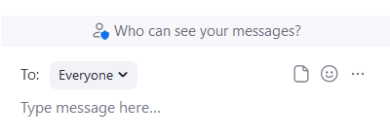
Lesson - Part Two A
Notes:
Part Two A: Send a "Chat" Message to Everyone : 0:00-2:58 mins [2:58 mins]
Say to the Learner:
In "Chat", you can read messages. And you can write messages. Sometimes we want to do this in a Zoom meeting.
Let’s watch a video on how to use "Chat" to send a message to everyone in a Zoom meeting.
We can watch the video several times. So, don't worry if you don't catch everything the first time.
Instructions for the Tutor:
Click on the PLAY icon to open the video lesson.
Play the video segment several times to the end.
Then ask comprehension check questions to check understanding. [See next slide for comprehension check questions.]
Then have learner do Practice Part Two A.
Click on the PLAY icon in the slide to open the video lesson.
Use this link to the YouTube video if the link in the slide doesn’t work:
https://youtu.be/oCtHBdk0j3E
For remote tutoring, when you share screen to play the video, make sure you have shared the audio.
Play the lesson a bit and check the learner can hear it ok before playing the whole video.

Slide 25
Check Understanding
Notes:
Instructions for the Tutor:
After watching this segment of the video lesson, check understanding (review and elicit) before moving on to the next part.
Check understanding - ask the learner as you watch the video or as you demonstrate on your computer.
Ask these comprehension check questions or others to check understanding:
[Send a "Chat" Message to Everyone]
Say to the learner:
Where is the "Chat" icon? Show me. Answer: Between the Participants and Share Screen icons.
How do we open the "Chat" function? Answer: Click on the "Chat" icon.
What is the colour of your message? Answer: It is blue.
What is the colour of other people’s messages? Answer: Grey.
Where do you type your message? Show me. Answer: In the box at the bottom of the "Chat" side bar..
How do you send your message after you finish typing? Answer: Press “Enter” on the keyboard.
When you send a message to everyone, who can see your message? Answer: Everyone in the Zoom meeting.
Instructions for the Tutor:
Then ask the learner: Do you want to watch the video again?
If the learner is struggling, stop the session.
Say to the learner:
Let’s do more work on X before we do this.

Slide 26
Practice Part Two A
Send a Message to Everyone
Notes:
PRACTICE-Part Two A
Lesson Focus: Send a Message to Everyone
Instructions for the Tutor:
PREPARATION
Send a Zoom meeting invitation to the learner before the lesson.
Make sure both learner and tutor are in a Zoom meeting.
Turn off both your mics so there’s no audio feedback.
If there is only one learner, make sure to sign in from another device using a different name, so that the meeting has more participants. You may have to reply from your other device for the demonstration.
Say to the Learner:
Now we’re going to practice what we just saw in the video: how to Send a Message to Everyone in the Zoom meeting.
Send a message to everyone
You want to send a message to everyone. Find the "Chat" icon. Click on it to open the "Chat" function.
Click in the box that says “Type message here”. Type your message: Good morning (afternoon)! How is everyone?
Press Enter on your keyboard to send your message.
Your sent message is blue. You’ve sent a message to everyone in the Zoom meeting!
Reply to your message
You received a reply. It’s grey: Great! It says, “How about you?”
Reply to the message. Type a reply. Maybe “I’m great too. Thank you.” (or another reply)
Press Enter on your keyboard to send the message.
REPEAT THE PRACTICE
Repeat the above at least three times.
Say to the Learner:
Write a message to everyone in "Chat": Tomorrow’s meeting is postponed to 3pm.
Send the message.
Wait for a reply: “Thanks for the reminder.” (to be written by the tutor)
Reply to the message: “You’re welcome.”
Write another message to everyone in "Chat": “Please remember to do the Satisfaction Survey before 6pm today.”
Send the message.
Wait for a reply: “Ok, thanks for reminding us.” (to be written by the tutor)
Reply to the message: “You’re welcome.”
Write a message to everyone in "Chat": “There’s no meeting next week.”
Send the message.
Wait for a reply: “Great! I’m so happy.” (to be written by the tutor)
Reply to the message: “Me too!”
CHECK THE LEARNER’S SKILLS:
Have the learner show you they can do the skill at least three times without support.

Slide 27
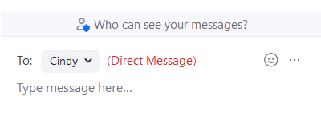
Lesson - Part Two B
Notes:
Part Two B: Send a "Chat" Message to Just One Person: 03:00-06:03(end) [3 mins]
Say to the Learner:
Sometimes during a Zoom meeting, you want to send a private message to just one person using “Chat”.
In "Chat", you can do that.
Let’s watch a video on how to use "Chat" to send a message to only one person in a Zoom meeting.
We can watch the video several times. So, don't worry if you don't catch everything the first time.
Instructions for the Tutor:
Click on the PLAY icon to open the video lesson.
Play the video segment several times to the end.
Then ask comprehension check questions to check understanding. [See next slide for comprehension check questions.]
Then have learner do Practice Part Two B.
Click on the PLAY icon in the slide to open the video lesson.
Use this link to the YouTube video if the link in the slide doesn’t work:
https://youtu.be/oCtHBdk0j3E
For remote tutoring, when you share screen to play the video, make sure you have shared the audio.
Play the lesson a bit and check the learner can hear it ok before playing the whole video.

Slide 28
Check Understanding
Notes:
Instructions for the Tutor:
After watching this segment of the video lesson, check understanding (review and elicit) before moving on to the next part.
Check understanding - ask the learner as you watch the video or as you demonstrate on your computer.
Ask these comprehension check questions or others to check understanding:
[Send a "Chat" Message to Just One Person; Close "Chat"]
Say to the learner:
What does the chevron look like? Answer: It looks like the letter ‘v’.
Where is the chevron? Show me.
To send a direct message to only one person, what do you do? Show me. Answer: Click on the chevron next to “Everyone”. Then, click on the name of the person you want to send the message to.
There are red words beside the person’s name. What are they? Answer: Direct Message. This means the message will only be sent to the person you chose.
How do you close "Chat"? Show me. Answer: Click on the chevron next to "Chat". Click “Close”.
Instructions for the Tutor:
Then ask the learner: Do you want to watch the video again?
If the learner is struggling, stop the session.
Say to the learner:
Let’s do more work on X before we do this.

Slide 29
Practice Part Two B
Send a Message to Just One Person
Close Chat
Notes:
PRACTICE-Part Two B
Lesson Focus: Send a Message to Just One Person
Instructions for the Tutor:
PREPARATION
Send a Zoom meeting invitation to the learner before the lesson.
Make sure both learner and tutor are in a Zoom meeting.
Turn off both your mics so there’s no audio feedback.
If there is only one learner, make sure to sign in from other devices using a different name, so that the meeting has at least 3 participants. You may have to reply from your other device for the demonstration.
Say to the Learner:
Now we’re going to practice what we just saw in the video: how to send a message to only one person in the Zoom meeting.
Send a message to just one person
You want to send a message to me, your tutor only. Find the "Chat" icon. Click on it to open the "Chat" function.
Click on the chevron next to “Everyone”. Find your tutor’s name. Click on it.
Now click in the box that says “Type message here”.
Type your message: “Tutor’s name, can I leave 30 minutes early today?”
Press Enter on your keyboard to send your message.
Do you see your sent message ?
What colour is your sent message ? Answer: blue.
You’ve sent a direct message to your tutor. Only your tutor can see your message.
Reply to your message
You received a reply. It’s grey: “Can I know why you need to leave early?” (Tutor needs to send this)
Check that the recipient is still your tutor. Reply to the message: “I have a doctor’s appointment at 5.30pm. “
Press Enter on your keyboard to send the message.
You received a reply: “Ok. No problem.”
Send a message to your tutor: “Thank you.”
You want to go back to the meeting. Close "Chat".
REPEAT THE PRACTICE
Repeat the above at least three times.
Say to the Learner:
Open "Chat".
Write a message to another participant (co-worker X) in "Chat": “Can you cover my shift from 4.30 to 5pm next Friday? I have a doctor’s appointment.”
Send the message.
Wait for a reply: “Sure!”
Reply to the message: “Thank you.”
Close "Chat".
Open "Chat".
Write a message to co-worker Y in "Chat": “Would you like to go for a walk after work on Saturday?”
Send the message.
Wait for a reply: “Sure, what time and where?”
Check that the recipient is still the same co-worker. Reply to the message: “Let’s meet at the staff parking lot at 1pm.”
Close "Chat".
Open "Chat".
Write a message to the tutor again in "Chat": “Thanks for everything. I need to go now.”
Send the message.
Wait for a reply: “Sure. See you next week.” (to be written by the tutor)
Reply to the message: “Thanks! See you!”
Close "Chat".
CHECK THE LEARNER’S SKILLS:
Have the learner show you they can do the skill at least three times without support.

Slide 30

Extra Practice
Notes:
Instructions for the Tutor
Preparation
Make sure both learner and tutor are in a Zoom meeting.
Turn off both your mics so there’s no audio feedback.
If there is only one learner, make sure to sign in from other devices using a different name, so that the meeting has at least 3 participants. You may have to reply from your other devices for the demonstration.
Extra Practice
Say to the learner:
Let’s practice some more !
You are in a Zoom meeting and listening to the host. Make sure your video is on and your mic is off.
You want to ask a question. Use the "Raise Hand" icon.
The host asks you to speak. Turn on the Mic.
You finished speaking. Turn off the Mic.
Send a chat to everyone in the meeting: “
I need to step away for a moment.”
You need to go to the washroom. Turn off your Video and Mic.
You’re back. Turn on your Video only.
Send a chat to everyone in the meeting: “Hi everybody.”
Send a chat to your tutor only: “I’ll be 30 minutes late on Friday.”
Close "Chat". Go back to the meeting.
Instructions for the Tutor:
Have the learner repeat this activity and practice as many times as they need (at least three times.)
Check the Learner's skills. Has the learner shown you they can do the skills at least three times without support?

Slide 31
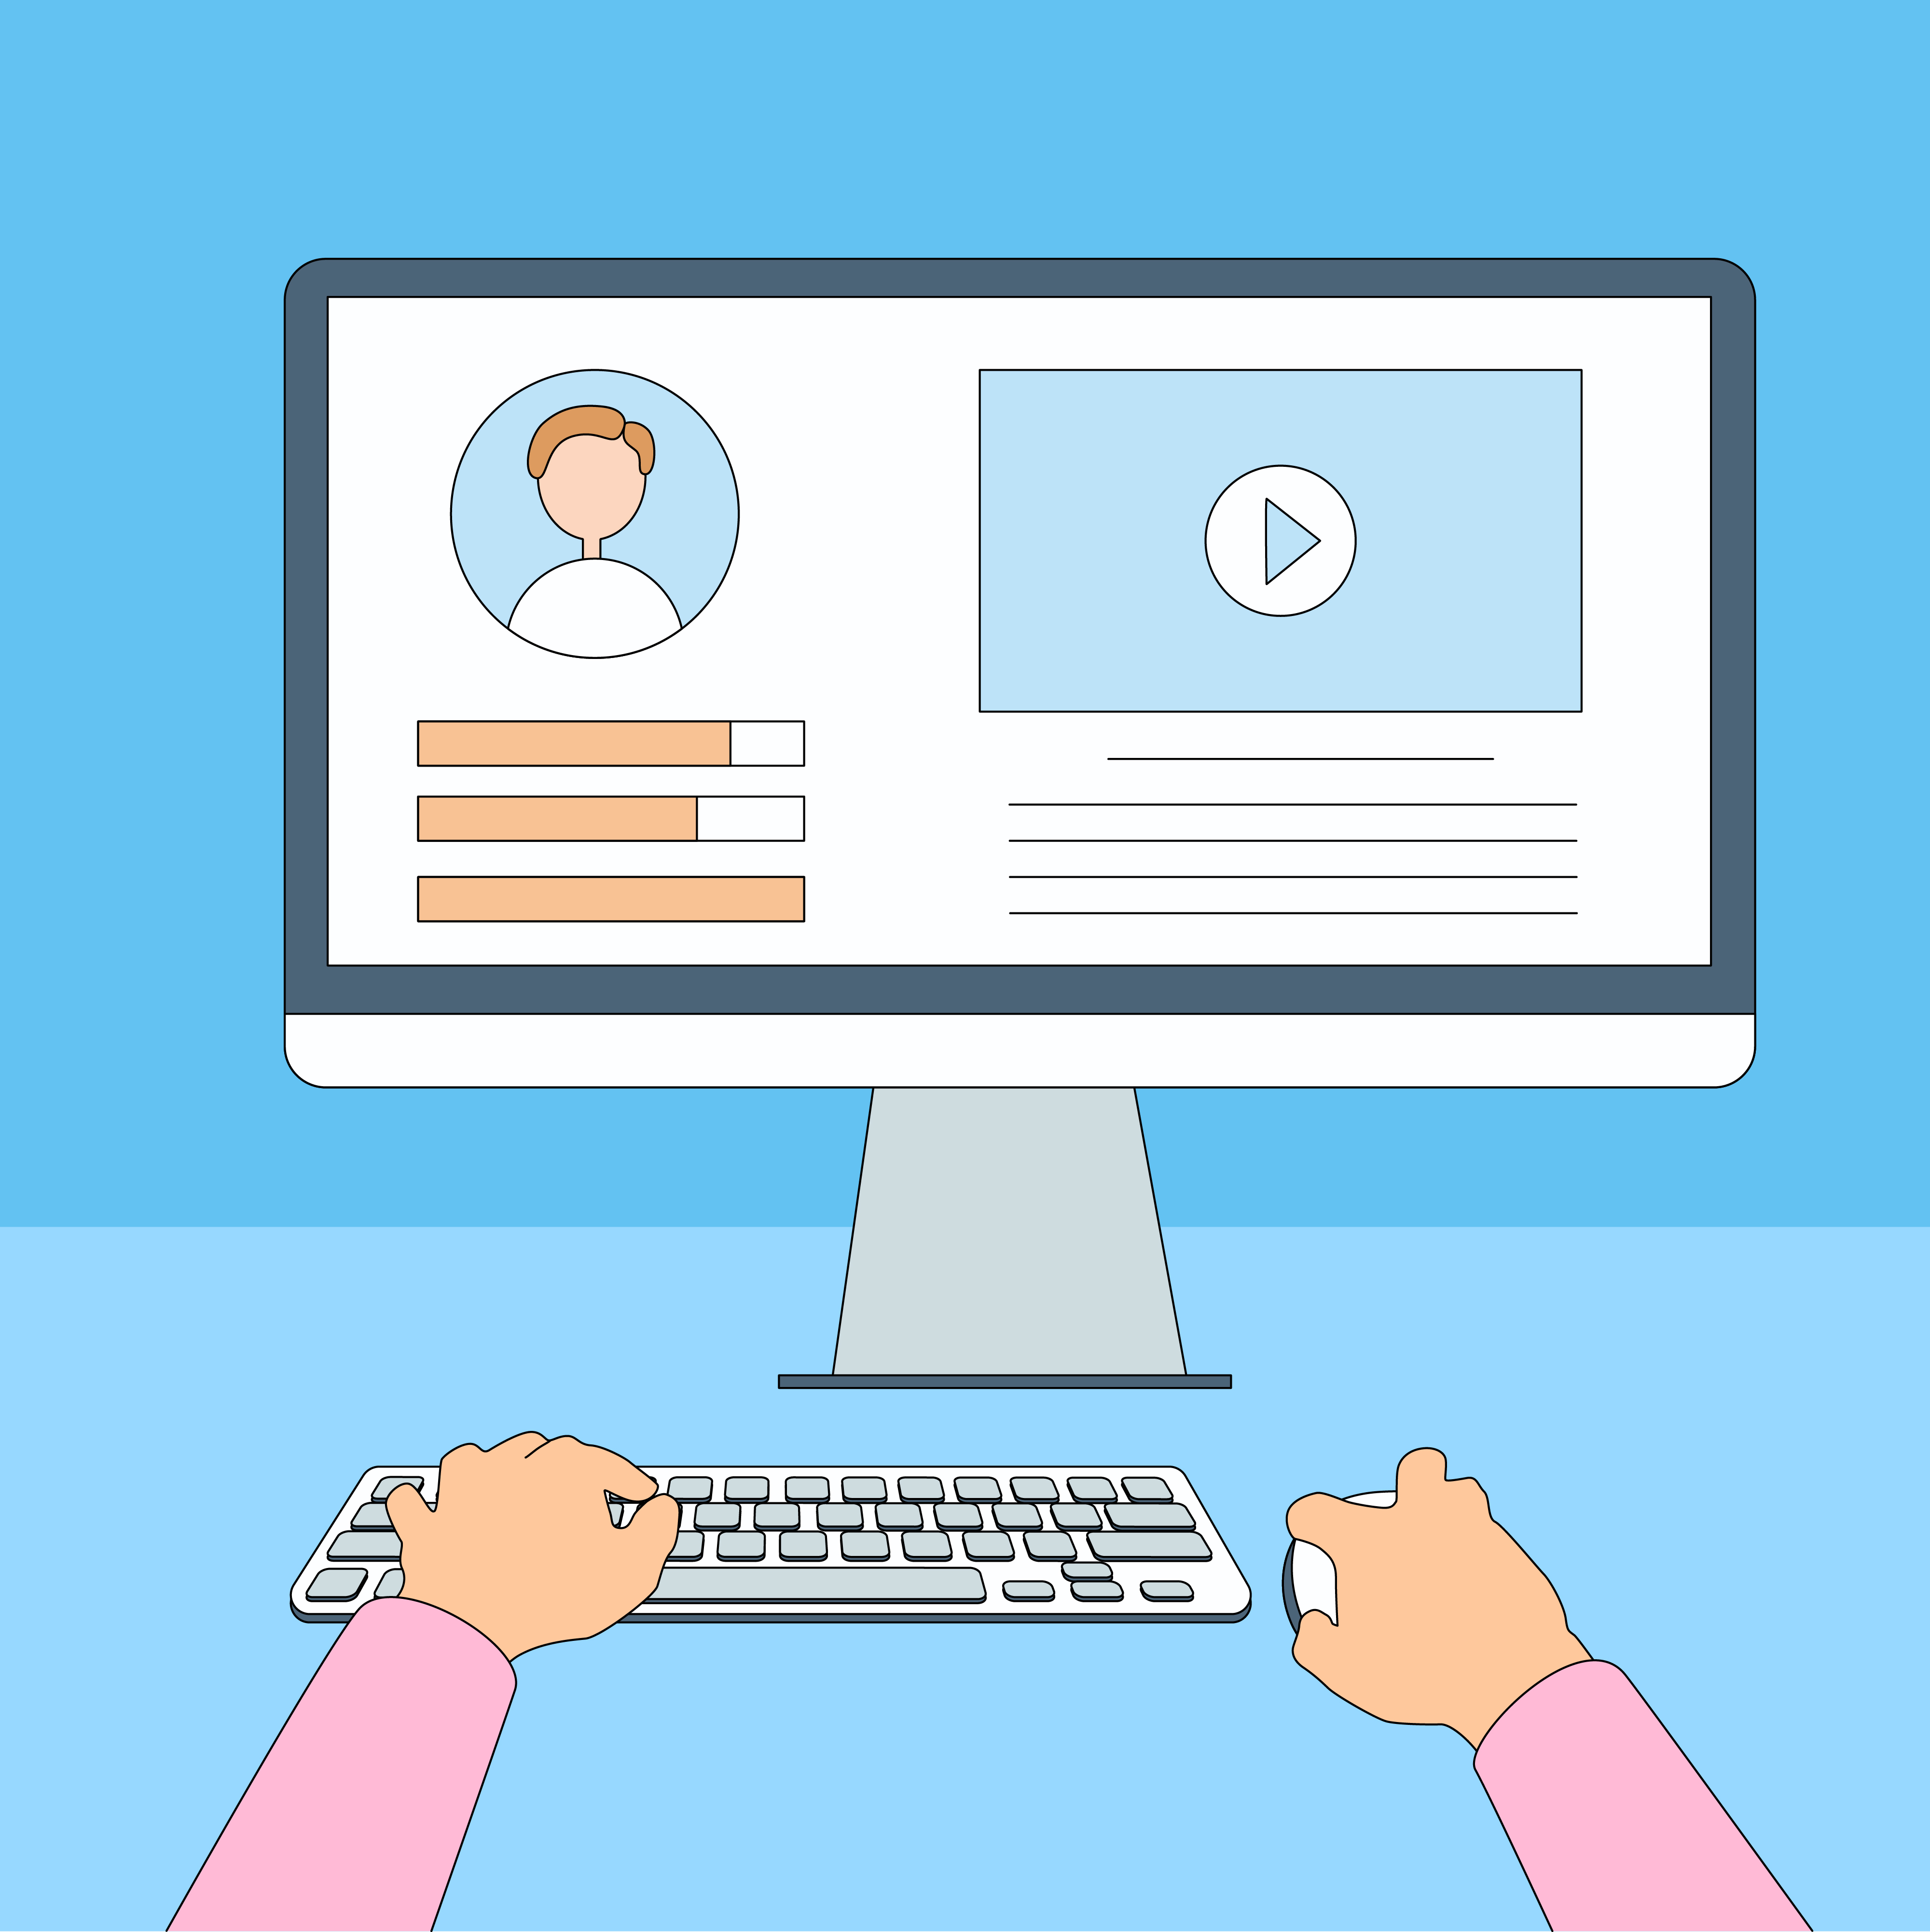
Practice Between Sessions
What did you learn/practice today?
When are you going to practice?
Practice Plan
Notes:
INSTRUCTIONS FOR THE TUTOR:
In-person tutoring and Remote Tutoring:
Make sure the learner knows how to access the video lesson(s) you just used so they can practice between tutoring sessions.
If relevant, make sure the support person at home knows how to access the video(s) too.
Option One
Email the video link to the learner, and if relevant the at-home support person. They can use the link in the email to access the video lesson(s).
Option Two
1. Put a link to the specific video lesson(s) you did on the learner’s desktop so they can access the video easily.
How:
Open the website address for the lesson in the browser.
In the address bar, click to highlight the lesson address.
Drag the address (link) onto the desktop. It will make an icon on the desktop.
Find the icon on the desktop and check that the link works.
Show the learner where it is. Tell them to just click to access it for practice.
Remote Tutoring Only:
You can do Strategy Two by using Request Remote Control in Zoom during the tutoring session.
Refer to the following for the steps on how to do that:
Tutor Checklist-During Remote Tutoring Sessions
Learner Instructions: Let Tutor have Remote Control of your Computer During a Zoom Session
IMPORTANT: Keep in mind the following:
Before using Remote Control, be sure to get permission from your organization first.
It is crucial that the learner understands what it means, and gives you informed consent.
It is somewhat invasive and must be done respectfully and honouring the confidentiality of the learner.
Don’t use the Request Remote Control feature first! It should be a last resort.
First, try your best to teach the learner and the support person how to do things using Share screen and demonstrating.
Use it if other ways do not work and the learner really needs to learn digital skills.
You may want to record the Zoom tutoring session in case of any possible accusations afterwards.
****************************************************************************************************************************
SAY TO THE LEARNER:
You did well today.
So, what did you learn and practice today? →
Today, we learned and practiced how to: [only mention the parts you covered]
Turn your mic on/off
Turn off your video and mic when you want to take a break
Use the "Raise Hand" icon
Use "Chat" to send a message to everyone
Use "Chat" to send a private message to just one person
Close "Chat".
It’s really important to review and practice as much as you can! Please do that before our next tutoring session.
Watch the video again, as many times as you need.
I’ve emailed you the link. Let/s make sure you can open it.
(OR)
We’ve put the link on your desktop. Here it is. Just click on it to watch the video.
Let’s make sure it works ok.
[Practice Plan]
Say to the learner:
Practice at least three more times before our next session.
Here is what to practice:
[For example: I will send you three Zoom links by email with the date and time to join the meetings.
OR
Your support person will send you three Zoom links by email with the date and time to join the meetings.
I will email you this Practice Plan. Please reply to the email so I know you got it and have what you need to do the practice.
[Get learner to confirm they will practice and tell you when. Get specific.]
When are you going to do the practice? How many times? etc.
Instructions for the Tutor:
Email three example Zoom invitations to the learner, and if you are not able to meet them in between sessions, the Support Person should email the invitations to the learner and practice with the learner.
Example Email Zoom Invitations
Subject: Quick Meeting
Hi all,
Let’s meet for a quick meeting on time and date.
Insert Zoom meeting link here.
See you!
-Tutor’s name
Practice Plan:
Your mic and video are on. Turn off your mic only.
You want to ask a question. Use the "Raise Hand" icon.
Turn on your mic to ask the question.
You finished asking your question. Turn off your mic.
Send a chat to everyone in the meeting: Hi everybody.
Send a chat to your tutor only: I’ll be late for 30 minutes on Friday.
Close "Chat". Go back to the meeting.

Slide 32

Confirm Next Session and Support
Notes:
Instructions for the Tutor:
Confirm the next tutoring session.
Clarify any support in-between sessions if you are offering that.
If offering support outside the session time, put boundaries, be clear about when and how you are giving support.
Say to the Learner.
e.g. Great work today! etc.
Let’s meet again on X date at X time. Does that work for you?
Wonderful.
[If offering support before next session:]
If you need support before our next session, please .........
[For remote support:]
I will send you the Zoom link the day before the tutoring session.
etc.

Slide 33
See you!
Keep Practicing
Notes:
Say to the Learner.
Bye and see you on X date at X time.
Keep practicing!

