Slide 1



Employment
Slide hidden from learner
Email Skills-Outlook
Part Two
Send and Download Email Attachments
Notes:
Slide hidden from the learner.
Information for the Tutor.
This PowerPoint lesson covers the following Outlook video lessons:
Part One
Send an attachment
Part Two
Open, Download and Save an attachment
Word Documents
Part Three
Open, Download and Save an attachment-PDF Documents
Part Four
Open, Download and Save an attachment-Pictures

Slide 2
Pre-Requisite Skills
Slide hidden from learner
Mouse/ Trackpad skills: hold mouse / use trackpad; hover; left click; double click; right click
Basic Navigation: scroll; cursor shapes; where and how to place a cursor
Keyboarding: Type words, numbers, some symbols, use Shift and Enter keys (one finger is ok)
Online Skills: Open a browser; use the address bar; search for a website
Email Skills: Open email app; use inbox; recognize & use common icons; write and send an email​
LINK to the DLCR:
https://digital-literacy.issbc.org/for-teachers/
Password: Diglit4T
Notes:
Slide hidden from the learner.
Information for the Tutor
Pre-Requisite Skills
Remember: like all lessons in Module 9 – Employment (Review), this is a review lesson of the digital skills, and the learners may not be ready for this lesson.
Make sure the learner has the “Prerequisite Skills” listed in the slide.
These skills are not specifically reviewed in this lesson, but the learner needs to have them to be able to do the lesson.
If the learner struggles, stop the lesson and go to the following modules in the Digital Literacy Curriculum Resource (DLCR) and teach the pre-requisite skills before doing this lesson:
Module 1 Mouse and Navigating
Module 2-Keyboarding
Module 3-Online Skills Basic
Module 5: Email Skills
IMPORTANT:
The Learner needs to have a Outlook account in order to practice each skill in this lesson. If they don’t have one, STOP this review lesson.
Instead, do the following:
Go to the DLCR (Digital Literacy Curriculum Resource).
Use Module 5-Email. Teach them how to create an account first.
https://digital-literacy.issbc.org.
Go to the Teachers tab.
Password: Diglit4T

Slide 3
Skills Reviewed in this Lesson
Slide hidden from learner
Notes:
Slide hidden from the learner.
Information for the Tutor
These skills are specifically reviewed in this lesson.
It is assumed the learner has already learned these skills and is doing this lesson as a review.
Email Skills-Send an Attachment
Understand when you might need to send an attachment in an email
Understand examples of files you might attach to an email
Recognize & use common icons in email app
Write and send an email
Recognize and use the attach icon
Find the file to attach to the email (in a Desktop folder)
Choose “Browse this computer”
Look and scroll to find the location on your computer
Look and scroll to find the folder that has the file
Open the folder
Find the file
Attach the file to the email
Double click on the file to attach it to the email
Check the file is attached to the email
Send the email
Check the email was sent ok.
Email Skills
-Open, Download and Save an Attachment- Word Documents, PDF Documents and Pictures
Understand when you might get an email that has an attachment
Understand examples of files you might get as attachments in an email sent to you
Understand what to do to open, download and save an attachment
WORD DOCUMENTS
Recognize an email with a Word document attached
Recognize & use common icons in email app
Open the Attachment
Click on file name
Recognize & use the download icon
Find the file in bottom left corner
Click on the file name
Recognize the file/attachment opens
Save the Attachment
Find the Location to Save the attachment in
Understand you need to “Enable editing”: click on the icon
Find “File” in top left corner of screen and click on it
Read the file menu and find “Save As”
Understand you don’t want “Save”
Recognize that the default location for saving is the Downloads” folder
Understand why you want to save the file in another location, not in “Downloads”
Recognize and use the “More Options” menu
Choose a location to save a file in (Desktop etc.)
Understand where to save a file when you use a public computer
Scroll up or down to find the location you want (Desktop etc.)
Understand that the location is highlighted when you click on it
Find the folder to save the file in
Open the folder
Name the File:
Find the file name box
Understand you can either keep the name that appears or change it
Keep the name that appears: click “Save” to save the file
Change the name that appears:
Click in the file name box
Press “Delete” on your keyboard
Type the name you want to give the file
Click “Save”
Close the file
Check the Attachment was Saved Ok
Close the email
Understand why you might minimize the browser window not close it
Recognize and use the minimize icon to minimize windows
Find a folder on the Desktop
Open the folder on the Desktop
Find the file inside the folder
Open the file inside the folder
Close the file
Close the folder
PDF DOCUMENTS
Recognize an email with a PDF document attached
Recognize & use common icons in email app
Open and Download the Attachment
Click on chevron to open the drop down menu
Click on “Download”
Find the file in bottom left corner
Click on the chevron to open the drop down menu
Find “Show in folder” in the menu to open the PDF file
Recognize the file/attachment opens
Save the Attachment
Find the Location to Save the Attachment in
Find “File” in top left corner of screen and click on it
Read the file menu and find “Save As”
Recognize that the default location for saving is the Downloads” folder
Understand why you want to save the file in another location, not in “Downloads”
Recognize and click on “Choose a Different Folder”
Use the “Save as PDF” window
Choose a location to save the file in (Desktop etc.)
[The subsequent skills for saving the file are the same as for Word documents. See above]
Check the Attachment was Saved Ok
Close the downloads folder
Recognize and use the minimize icon to minimize windows
Find a folder on the Desktop
Open the folder on the Desktop
Find the file inside the folder
Close the folder /window
PICTURES
Recognize an email with a picture file attached
Recognize & use common icons in email app
Open the Attachment
Click on chevron on the attached picture to open the drop-down menu
Click on “Download”
Find the file in bottom left corner
Click on the file name to open the attachment
Recognize the attachment opens
Save the Attachment
Recognize and click on the “More Options” icon
Understand it opens a menu
Choose “Save As” in the menu and click on it
Choose a location to save a file in (Pictures, etc. )
Understand where to save a file when you use a public computer
Scroll up or down to find the location you want (Pictures etc.)
Understand that the location is highlighted when you click on it to choose it
Name the File:
Understand you can name the picture file
Find the file name box
Type the name you want to give the file
Click “Save”
Close the picture file
Check the Attachment was Saved Ok
Find “File Explorer” and open it
Find the location you saved the picture file (“Pictures” etc.)
Open the location
Find the file inside the location
Close the location window (”Pictures” etc.)

Slide 4
Instructions
For Using this PowerPoint Lesson
Slide hidden from learner
Notes:
Slide hidden from the learner.
Information for the Tutor.
This PowerPoint lesson contains everything the tutor needs: the lesson notes, suggested instructional language, the links to the video lesson(s), and Practice for each part. ​
IMPORTANT
Read through the entire lesson a few days before tutoring so you are clear about what to do and have time to get any questions answered and to do any preparation.
The first 13 slides are hidden from the learner; they contain information and instructions for the tutor.
Green Slides = Lesson Objectives
Blue Slides = the beginning of each Part of the Lesson
Yellow Slides = Practice
Instructions specific to each lesson are in the notes pages of each PowerPoint. ​
Identical notes are also available as a separate PDF for tutors who prefer that format. ​See Option B below.
You will NOT be able to copy and paste from this PowerPoint because it is “Read Only”.
In the Practice for each Part of this lesson, you may be asked to copy some text from this lesson and paste it into a Word document to use with the learner.
You will not be able to do that from this PowerPoint lesson. Instead, copy and paste the text from the PDF version of the (same) lesson.
There are different options for using this PowerPoint lesson and /or the PDF version of this (same) lesson:
Lesson Format Options for the Tutor
Option A
Use a printed version of the notes for you as tutor (not for the learner)
Plus
Use the PowerPoint slideshow for the learner.
How:
Open the PowerPoint, download and save it.
Click “File” then "Print" ​
Then under “Settings” choose " Notes Pages" .
Print
Now, you can use the printed version for tutoring.
Option B
Use the separate electronic PDF of the PowerPoint slides and notes for you as tutor (if you don’t have PowerPoint on your computer or if you prefer to use a PDF version)
Plus
Use the PowerPoint slideshow for the learner, or the PDF-Slides Only version (if the learner’s computer doesn’t have PowerPoint). ​
You can have the PDF open to use for you as tutor beside the PowerPoint slideshow, or the PDF version of the slides (for the learner).
Option C
Use the PowerPoint slideshow in “Presenter View” in PowerPoint.
This lets you show the slideshow to the learner, and also lets you see the notes as well as the slideshow that the learner sees.
This works for remote and in-person tutoring.
However, for in person tutoring for small groups you need a separate monitor or projector to do this: one for you and one for the learners.

Slide 5
Lesson Objectives-Part One
Slide hidden from learner
  Send Email
  with an Attachment
Notes:
Slide hidden from the learner.
Information for the Tutor.
Instructions to the Tutor
These are the skills learners will master at the end of the lesson.
Total Video length:
Part One: Send an Attachment: 0:00 – 4:04 mins (4:04 mins]
For a list of the discrete skills, see slide 3 “Skills Reviewed in this Lesson”

Slide 6
Lesson Objectives-Part Two
Slide hidden from learner
Open, Download and Save an Attachment
    Word Documents
Notes:
Slide hidden from the learner.
Information for the Tutor.
Instructions to the Tutor
These are the skills learners will master at the end of the lesson.
Total Video length:
Part Two: 8:02 mins
Open, Download and Save an Attachment: 0:00- 0:47 mins [0:47 mins]
Word Documents: 0:48-8:02 mins [7:14 mins]
For a list of the discrete skills in each section listed above, see slide 3 “Skills Reviewed in this Lesson”

Slide 7
Lesson Objectives-Part Three
Slide hidden from learner
Open, Download and Save an Attachment:
    PDF Documents
Notes:
Slide hidden from the learner.
Information for the Tutor.
Instructions to the Tutor
These are the skills learners will master at the end of the lesson.
Total Video length:
Part Three
Open, Download and Save an Attachment: PDF Documents: 0:00-6:13 mins [6:13 mins]
For a list of the discrete skills, see slide 3 “Skills Reviewed in this Lesson”

Slide 8
Lesson Objectives-Part Four
Slide hidden from learner
Open, Download and Save an Attachment:
    Pictures
Notes:
Slide hidden from the learner.
Information for the Tutor.
Instructions to the Tutor
These are the skills learners will master at the end of the lesson.
Total Video length:
Part Four:
Open, Download and Save an Attachment: Pictures: 0:00-3:43 mins [ 3:43mins ]
For a list of the discrete skills, see slide 3 “Skills Reviewed in this Lesson”

Slide 9
Keep in Mind
Slide hidden from learner
Only do as much as the learner can absorb in one session.
Do one part of the video lesson at a time.
Check in with the learner after each part.
Notes:
Slide hidden from the learner.
Information for the Tutor.
According to the learner’s pace, do one part of the video lesson, check their understanding, and have the learner practice the skills.
Then, let them show you they can do the skills (at least three times) before proceeding to the next part.
Look for signs of learner fatigue.
Check in with learner after each part.
Is the learner doing any of the following? :
Expressing frustration
Not asking questions, shutting down, not taking in what you are saying
Seeming overwhelmed
Saying, “Are we done yet?” etc.
Lots of yawning etc.
These are clues that it is time to stop the session and resume another day.

Slide 10

Set Up and Preparation
Slide hidden from learner
Before In-Person Tutoring
Notes:
Slide hidden from the learner.
Information for the Tutor.
SET UP
Refer to TUTOR CHECKLIST- Set up for In-Person Tutoring
PREPARATION
Preparation specific to the PRACTICE for each Part of this lesson is in the notes of each “PRACTICE” slide.

Slide 11
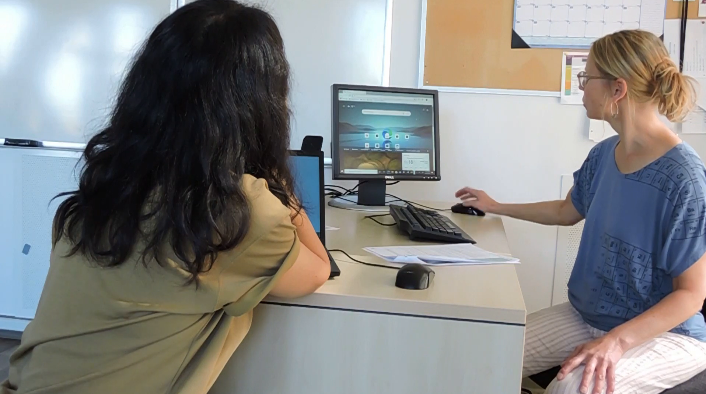
Checklist
Slide hidden from learner
During In-Person Tutoring
Notes:
Slide hidden from the learner.
Information for the Tutor.
Refer to:
TUTOR CHECKLIST- During In-Person Tutoring Sessions

Slide 12
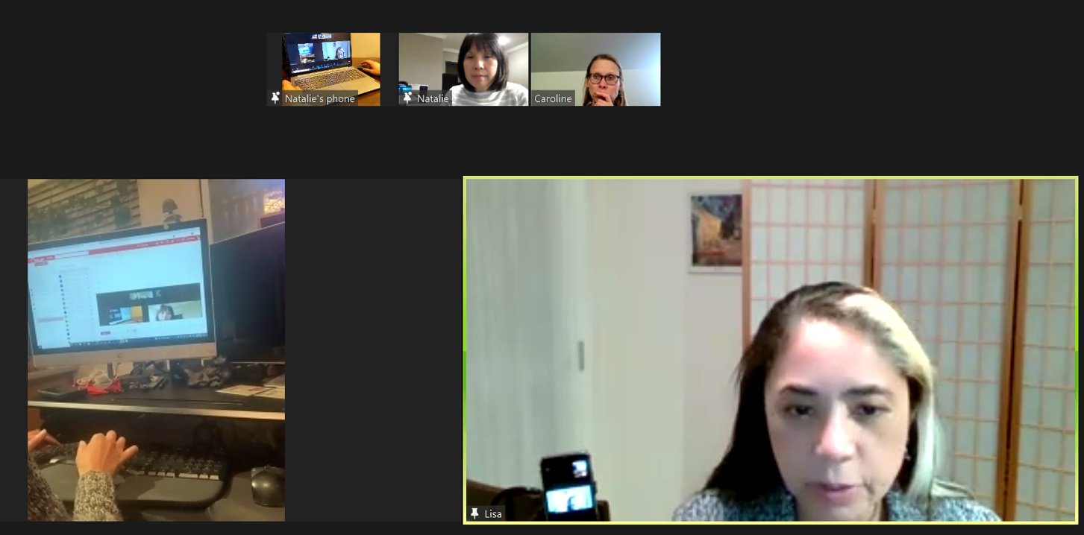
Set Up and Preparation
Slide hidden from learner
Before Remote Tutoring
Notes:
Slide hidden from the learner.
Information for the Tutor.
SET UP
Refer to:
TUTOR CHECKLIST- Set up for Remote Tutoring Session via Zoom, Ms Teams etc.
LEARNER CHECKLIST- Set up for Remote Tutoring Session via Zoom, Ms Teams etc.
Trouble-Shooting -Remote Tutoring
IMPORTANT:
Go through the Learner Checklist as well. Then, you will be able to more easily troubleshoot with the learner if they have difficulty in their set up.
Communicate beforehand with the Support Person (if that learner has one):
Email the Learner Checklist listed in #2 above to the Support Person.
Email any instructions for this lesson to the support person (see the notes for specific slides /parts of the lesson):
Have the support person do the preparation for the lesson on the learner’s desktop. Tutor needs to guide them re. how to do this.
Preparation for Remote Tutoring only:
Support person must inform you if the learner has an Outlook account already. If they do not have one, use Module 5 as detailed in the note above under ”Pre-Requisite Skills” (Slide #2).
Have support person make sure the browser icon (or Outlook shortcut if they use that) is easy for the learner to find on the desktop.
If no preparations were made on the learner’s computer before the session by a support person, you could use the Request Remote Control function in Zoom on the learner’s desktop if the learner struggles, and before they get frustrated.
IMPORTANT: Keep in mind the following:
Before using Remote Control, be sure to get permission from your organization first.
It is crucial that the learner understands what it means, and gives you informed consent.
It is somewhat invasive and must be done respectfully and honouring the confidentiality of the learner.
Don’t use the Request Remote Control feature first! It should be a last resort.
First, try your best to teach the learner and the support person how to do things using Share screen and demonstrating.
Use it if other ways do not work and the learner really needs to learn digital skills.
You may want to record the Zoom tutoring session in case of any possible accusations afterwards.
PREPARATION
Preparation specific to each Part of this Outlook Lesson is in the notes of the relevant slides.

Slide 13
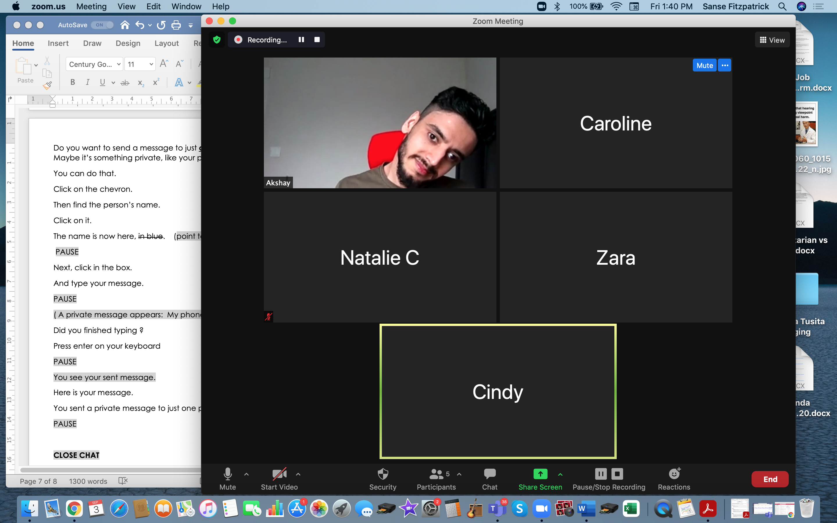
Checklist
Slide hidden from learner
During Remote Tutoring
Notes:
Slide hidden from the learner.
Information for the Tutor.
Refer to:
Tutor Checklist: During Remote Tutoring Session
Learner Instructions: How to let your Tutor have Remote Control of your Computer During a Zoom Session
Trouble-Shooting: Remote Tutoring
Be ready to assist learner by using the Requesting Remote Control function (refer to checklists 1 and 2 listed above).
You may have to set up the learner’s desktop for “Practice” activities if the learner needs support and no support person is available to do that beforehand. This is possible to do using Request Remote Control in Zoom.
IMPORTANT: Keep in mind the following:
Before using Remote Control, be sure to get permission from your organization first.
It is crucial that the learner understands what it means, and gives you informed consent.
It is somewhat invasive and must be done respectfully and honouring the confidentiality of the learner.
Don’t use the Request Remote Control feature first! It should be a last resort.
First, try your best to teach the learner and the support person how to do things using Share screen and demonstrating.
Use it if other ways do not work and the learner really needs to learn digital skills.
You may want to record the Zoom tutoring session in case of any possible accusations afterwards.

Slide 14
Employment
Email Skills-Outlook
Part Two
Send and Download Email Attachments
Notes:
SHOW THIS SLIDE AND THE REST OF THE SLIDES FROM HERE ONWARD TO THE LEARNER
Say to the learner:
Basic email skills are important for work, and for our social needs too of course.
So, you already have an Outlook account and can send a basic email. That’s great !
Together, we’re going to review how to use attachments in Outlook.
We are using Outlook because it’s a very common workplace email and it’s free.
We’ll review how to send an email with an attachment to someone.
This could be a document or a picture.
Sometimes we need to send a document to our manager, or maybe to a friend or someone else.
So we’ll look at how to do that, how to send an attachment.
Have you done that before ? Sent an attachment ? What did you send ? Who did you send it to ?
People might send you an email with an attachment.
Maybe the attachment is a document or a picture.
Do you ever get email that has an attachment ? What kind of attachment ? (maybe documents, photos etc.)
Later, we’ll review how to open, download and save an attachment with three different types of files:
Word Documents
PDF documents
and also Picture files, like photos.
Today, we’ll focus on ........(Parts you intend to cover).

Slide 15
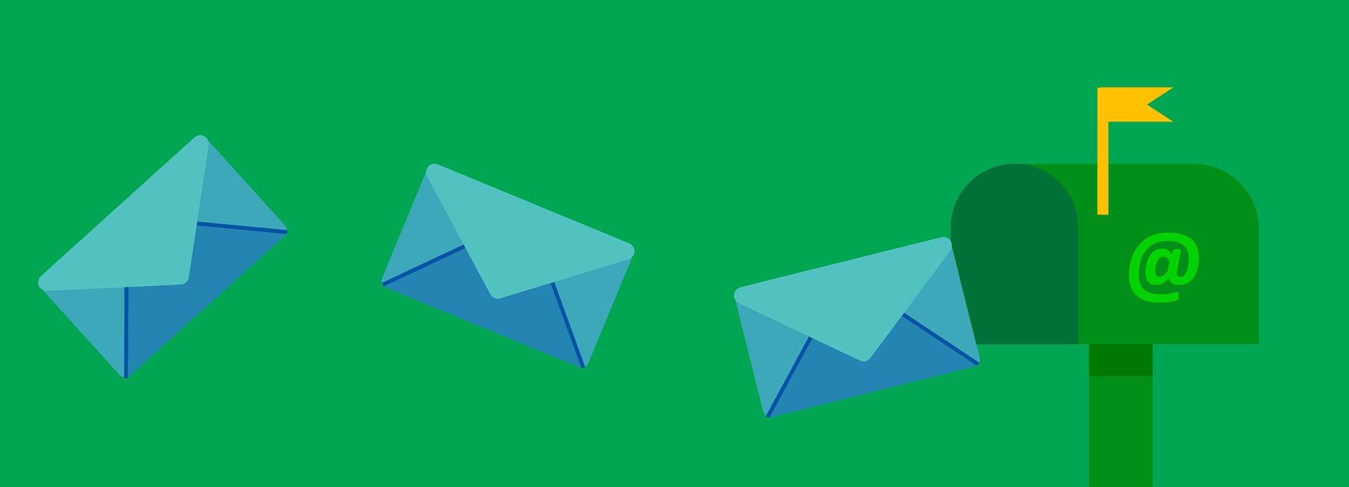
Lesson Objectives-Part One
        Send Email with an Attachment
Notes:
Instructions for the Tutor
These are the skills the learner will master at the end of Part One:
Send email with an attachment
Say to the learner:
We’re going to review how to send email with an attachment now.

Slide 16

Lesson-Part One
Send Email with an Attachment
Notes:
Video length:
Part One: Send an Attachment: 0:00 – 4:04 mins (4:04 mins]
Say to the Learner:
Let’s review now how to send an email with an attachment to someone.
We’ll watch a video to review this.
We can watch the video several times. So, don't worry if you don't catch everything the first time.
Instructions for the Tutor:
Play the video several times.
Then ask comprehension check questions to check understanding. [See next slide for comprehension check questions.]
Then have learner do Practice-Part One.
Click on the PLAY icon in the slide to open the video lesson.​
Use this link to the YouTube video if the link in the slide doesn’t work: ​
https://youtu.be/10kimpvvlw8
For remote tutoring, when you share screen to play the video, make sure you have shared the audio.
Play the lesson a bit and check the learner can hear it ok before playing the whole video.

Slide 17

Check Understanding
Notes:
Instructions for the Tutor:
Check understanding
After watching the video lesson, replay the video, pause it and ask questions to check understanding (review and elicit) before moving on to the Practice.
Ask these comprehension check questions or others to check understanding:
[Send Email with an Attachment ]
Say to the Learner:
What are some things you may need to attach to an email ? Answer: files, maybe a resume or a cover letter or a form you filled out and need to send to the employer.
You are in your email inbox. You want to write an email. What do you click on first ? Answer: “New Message”
After you click on "New Message", what three things do you do ?
Answer: 1. Enter/type the address you are sending the email to
2. Type the subject of the email
3. Type your email message.
Find the File you Want to Attach to the Email
You are ready to add the attachment.
In the video, what attachment does she attach to the email? Answer: “Doctor’s Note Aug 1”
So, to attach a file, what do you do first ? Answer: Click on the paperclip icon.
Where is the paperclip icon ? Show me. Answer: It’s at the bottom, to the right of the blue “Send” and “Discard” icons.
After you click on the paperclip icon, what do you see ? Answer: A menu
What do you click on in the menu ? Answer: “Browse this computer”
What happens when you click on “Browse this computer”? Answer: It opens a window that has a list of places / locations on your computer. The file is in one of those.
What do you do after you click on “Browse this computer”? Answer: Choose the location where the file is; click on it.
Find the file you want to attach.
In the video, what does she attach to her email ? Answer: “Doctor’s Note Aug 1”
Where is the file she wants to attach ? (Prompts: Is it in the Downloads folder or on the Desktop? Answer: On the Desktop, in the “Leave” Folder)
She is looking for her Leave folder. Does she click on Downloads or Desktop ? Answer: “Desktop”
You may not see all the folders. What do you do ? Answer: Scroll down /up
You find the folder that has the file inside that you want to attach. How do you open the folder? Answer: Double click on the folder to open it
Attach the File to the Email
You find the file you want to attach. How do you attach it to the email ? Answer: double click on it
OR (Not shown in the video lesson): Single click on the file and then click on “Open”).
Check the File is Attached to the Email
Does she check the file is attached to the email ? Answer: Yes she does.
Why does she check the file is attached ? Answer: (Not in the video but common sense) It’s good to double check that before sending the email. To be sure it is attached and that you attached the correct file.
After you check the file is attached. What is the last step ? Answer: Click “Send”.
Instructions for Tutor:
Ask the learner: Do you want to watch the video again?
IMPORTANT
If the learner is struggling, stop the session.
Say to the learner:
Let’s do more work on X...... before we do this.
Instructions to the Tutor:
For example, learner may not be able to find and click on email icons easily.
If so, go to the Digital Literacy Curriculum Resource (DLCR) and use the relevant module before using this video review lesson.
Teach the skills and have the learner practice.
For example, use Module 5 Email, or if needed first: Module 3 Basic Online Skills or Module 1 Mouse and Navigation, depending on learner needs.
Tip: Do the Needs Assessment to determine needs; use the Needs Assessment tools in the DLCR for this.

Slide 18

Practice-Part One
Send Email with an Attachment
Notes:
Instructions for the Tutor:
PRACTICE-Part One-A Lesson Focus: Send Email with an Attachment
PREPARATION
The Learner does NOT have an Outlook account
The learner needs an Outlook account in order to practice the skills.
If they don’t have one, STOP this review lesson.
Instead, do the following:
Go to the DLCR (Digital Literacy Curriculum Resource).
Use Module 5-Email. Teach them how to create an account first.
https://digital-literacy.issbc.org.
Go to the Teachers tab.
Password: Diglit4T
The Learner has an Outlook account
Prepare a small strip of paper with your email address for the learner to copy.
Create four folders on the learner’s desktop and name them:
Sick Leave
Benefits
Resume
Cover Letters
Prepare four documents to use as attachments. They can be empty or very simple Word docs or PDFs but save them with these names:
Note from Doctor
Benefits Form
Resume
Cover letter
Save each in the relevant folder you created on the Desktop. (See #2 above)
Prepare three simple emails for the learner to copy. Include a subject and simple message. (See “Examples” below)
Tip: Copy and paste the examples below into a Word Doc.
Print this and provide the paper for the learner to copy from.
Tip: Prepare this ahead and have the paper printed out.
For some learners, especially those with reading challenges: Cut the paper into three strips. with one message on each. Why? Less text on the paper may help the learner be more successful.
EXAMPLES:
Message #1
Email Subject: Note from Doctor
Hi Ms Lee
I was away from work sick last week.
Here is the note from my doctor.
Regards,
LEARNER’S NAME
Message #2
Email Subject: Benefits Form
Mr Brown
Here is the form for my benefits.
Let me know if you got it ok.
Thank you.
LEARNER’S NAME
Message #3
Email Subject: Application to work at your store
Hi Ms Herrera
I am very interested in working at your store.
My resume and cover letter are attached.
I hope you consider me.
LEARNER’S NAME
Preparation for Remote Tutoring only:
Refer to Slides #12 and 13.
Support person needs to inform you if the learner has an Outlook account already. If not, use Module 5 as detailed in the note above under ”preparation”.
If the learner has an Outlook account, send the learner/ support person an email that has a Word document with three short emails (see the examples above).
Have the support person do #1-3 above. Guide as needed.
Have the learner / support person print out the Word document (#4 above) for the learner to copy from. Or, have them open it electronically so it is in a window beside the email window for the learner to copy from.
Have support person make sure the browser icon (or Outlook shortcut if they use that) is easy for the learner to find on the desktop.
If no preparations were made on the learner’s computer before the session by a support person, use the Request Remote Control function in Zoom on the learner’s desktop if the learner struggles, and before they get frustrated.
IMPORTANT: Before using “Request Remote Control” with a learner, refer to the notes in slide #12 above “Set Up and Preparation- Before Remote Tutoring”.
************************************************************************************************************************************
PRACTICE
Instructions for the Tutor:
Demonstrate first, then let the learner practice.
Say to the Learner:
Now it’s time to practice.
We’re going to practice how to send an email with an attachment, like in the video. We’ll do it at least three times.
[After each of the following steps, wait for the learner to complete the step. Guide the learner as needed.]
IMPORTANT:
If the learner struggles to type, go back to the Digital Literacy Curriculum Resource and do Module 2-Keyboarding first.
[Send an Email with an Attachment]
Write an email
You are going to send me a short email with an attachment now.
Here is a paper with three short email messages. (See “Preparation” above).
We’ll use the first message now. What does it say ? (The Learner reads the message).
You are going to send an email with a Note from Doctor attached. The Note from Doctor is in a folder called “Sick Leave”. This folder is on your Desktop.
You can copy this message into the email in a minute. (Email message #1 above: Note from Doctor)
First, go to your email inbox. (Open your email app and sign in if it’s not already open )
This is your email inbox. When you want to write an email, what do you do first? Answer: Yes, click on "New Message".
Now, type the subject of the email. For this message it is “Note from Doctor”
Then type the message. Copy from the paper I gave you.
Finished typing ? Ok, what else do you need to do ?
Answer: Type who you are sending the message to. Put that in the “To” address box.
You can send this email to me. Here is my email address: (Give the learner the small paper with your email address).
Type that in the “To” address box.
Find the File you Want to Attach to the Email
Great. Now you need to attach the Note from Doctor to the email. It’s on the Desktop in the “Leave” folder.
What do you do next ? Answer: Click on the paperclip icon…… Go ahead and do that.
In the menu, choose “Browse this computer”. Click on it.
A window opens. It lists the places on your computer where the file might be,
Look at the window and try to find the location of the file now. Remember it’s in the “Sick Leave” folder that is on the Desktop.
First find “Desktop” and click on it.
Then find the “Sick Leave” folder. You may need to scroll down/up to find it.
Do you click or double click on the folder to open it ? Answer: Double click
Great. It opens. Now find the file “Note from Doctor”.
Attach the File to the Email
When you find the file, how do you attach it to the email ? Answer: Double click on the file.
Did the file “Note from Doctor” attach to the email ? Check.
Great. It’s there! What’s the last step ? Answer: Click “Send” to send the email.
Do that now.
Good practicing !
Optional:
Check the File is Attached to the Email
[This is review from “Email Skills-Outlook-Part One”]
Let’s check the email was sent. Do you remember how to do that ? Answer: Click on the “Sent” folder.
Is the email in the “Sent” folder ? Does it have the “Note from Doctor” attached there ? Yes ? That means it was sent.
Good practicing !
Instructions for the Tutor:
Repeat the steps above but substitute the information for Message #2 and then message #3.
Say to the Learner:
Let’s practice a few more times.
Go back to the Inbox. (Click on Inbox)
Now, let’s use this message: (Message #2: Benefits Form ) etc.
Good practice sending an email with an attachment !
CHECK THE LEARNER’S SKILLS:
Have the learner show you they can do the skills at least three times without support before they do the next part of the lesson.

Slide 19

Lesson Objectives – Part Two
Open, Download and Save an Attachment
    Word Documents
Notes:
Instructions for the Tutor
These are the skills the learner will master at the end of Part Two:
Open, Download and Save an Attachment
-Word Documents
Total Video length:
Part Two: 8:02 mins
Open, Download and Save an Attachment: 0:00- 0:47 mins [0:47 mins]
Word Documents: 0:48-8:02 mins [7:14 mins]
Say to the learner:
Someone may send you an email with a Word document attached. Has that happened to you ?
Maybe you want to save it.
We’re going to review how to Open, Download and Save an Attachment.
We’ll look first at how to do this with Word documents.

Slide 20
Lesson-Part Two
Open, Download and Save an Attachment
    Word Documents
Notes:
Total Video length:
Part Two: 8:02 mins
Open, Download and Save an Attachment: 0:00- 0:47 mins [0:47 mins]
Word Documents: 0:48-8:02 mins [7:14 mins]
Say to the Learner:
Let’s review how to Open, Download and Save an Attachment.
We’ll look now at attachments that are all Word Documents.
We’ll watch a video to learn.
We can watch the video several times. So, don't worry if you don't catch everything the first time.
Instructions for the Tutor:
Click on the PLAY icon in the slide to open the video lesson.​
Use this link to the YouTube video if the link in the slide doesn’t work: ​
https://youtu.be/xJEk0u4BOqs
Play the video segment several times to the end.
Then ask comprehension check questions to check understanding. [See next slide for comprehension check questions.]
Then have learner do Practice-Part Two.
For remote tutoring, when you share screen to play the video, make sure you have shared the audio.
Play the lesson a bit and check the learner can hear it ok before playing the whole video.

Slide 21
Check Understanding
Notes:
Instructions for the Tutor:
Check understanding
After watching the video lesson, replay the video, pause it and ask questions to check understanding (review and elicit) before moving on to the Practice.
Ask these comprehension check questions or others to check understanding:
[Open, Download and Save an Attachment]
Say to the Learner:
What are some examples of attachments you might get in an email ? Answer: a form to fill out for income tax or a form to fill out to get benefits or documents to help with your job search, etc.
How do you know you got an attachment ? Answer: you can see it in the email (point to a few examples)
[Word Documents ]
Open and Download the Attachment
You need to open, download and save the attachment. What do you do first ? Answer: Click on the file name to open the attachment.
In the video, what is the file name of the attached Word document ? Answer: Example Cover Letter
Then what do you do Answer: Find the download icon. Click on it.
What does the download icon look like ? Answer: The word “Download” and an arrow pointing down.
After you click the download icon, what do you see ? Answer: You’ll see the file name in the bottom left corner of your screen.
Should you click on the chevron or the file name ? Answer: the file name
The attachment opens.
[Save the Attachment]
[Find the Location to Save it in]
Now what do you need to do first ? Answer: Click “Enable Editing”
What do you do next ? Answer: Find and click on “File” in the top left corner of the screen
What happens after you click on “File” ? Answer: The file menu opens
Do you click “Save” or “Save As” ? Answer: Save as
What folder does the woman in the video save the file in ? Answer: The Desktop
Why is it good to save it in another folder not in Downloads folder ? Answer: Then it’s easy to find later when you need it.
What do you click on to save the file in another folder, not in Downloads ? Answer: “More Options”.
If you are using a public computer, what should you save the file on ? Answer: a USB Drive or portable storage device.
What happens when you click on the location you want ? Answer: It is highlighted.
If you can’t see a location you want in the list, what might you have to do ? Answer: Scroll up or down to see it.
What can help you be more organized ? Answer: To save the file in a folder.
Why is it helpful to save files in folders ? Answer: You can find it later more easily.
What folder does she choose to save the file in ? Answer: Job Search-Example Documents
Do you click or double click to open the folder ? Answer: Double click
[Name the file]
You see a name in the file name box. You want to keep that name. What do you click ? Answer: Save.
You see a name in the file name box. You want to change that name. What do you do ? Answer: Click in the file name box, then press delete on your keyboard, then type the name you want to call the file.
In the video, what name does she give to the file? Answer: Example Cover Letter-Grocery Clerk
After you type the name of the file, what do you do ? Answer: Click “Save”.
Check the attachment was saved ok
Do you remember how to check if the attachment was saved ok ? What do you remember from the video ?
First, close the file. How do you do that ? Answer: Click on the red X in the top right corner to close the file.
What do you see next ? Answer: The file you just saved still open as the attachment in your email.
What do you do now ? Answer: Click X to close that window.
Now you are back in your email inbox.
In the video she doesn’t close the email app and the browser. What does she do ? Answer:
She minimizes it.
Why ? Answer: We may want to use it again later.
How do you do that ? Answer: Click on the minimize icon.
What does the minimize icon look like ? Answer: It looks like a minus sign.
If there are any other windows open and you want to use them again, what do you do ? Answer: Minimize those too.
After that, you see your desktop. What do you look for ? Answer: The folder you saved the document / file in.
Do you click or double click to open the folder ? Answer: Double click.
Check that the file is inside the folder.
Then open the file to check it is ok. How do you do that ? Answer: Double click on the file to open it.
When you see the file is inside ok, how do you close the file ? Answer: Click on X in the top right corner.
How do you close the folder? Answer: Click on the X (in the top right corner)
Great ! So that is how to Open, Download and Save an attachment that is a Word document.
Instructions for Tutor:
Ask the learner: Do you want to watch the video again?
IMPORTANT
If the learner is struggling, stop the session.
Say to the learner:
Let’s do more work on X...... before we do this.
For example, learner may not be able to find and click on email icons easily.
If so, go to the Digital Literacy Curriculum Resource (DLCR) and use the relevant module before using this video review lesson.
Teach the skills and have the learner practice.
Tip: Do the Needs Assessment to determine needs; use the Needs Assessment tools in the DLCR for this.

Slide 22
Practice-Part Two
Open, Download and Save an Attachment
Word Documents
Notes:
PRACTICE- Part Two: Lesson Focus:
Instructions for the Tutor:
PREPARATION
Send the learner three short emails with a Word Document as an attachment with each one.
For example:
Hi LEARNER’S NAME
Here is a document that may be helpful.
I have attached it.
We can talk about it at your appointment this Thursday.
-TUTOR’S NAME
Examples of Word Documents to attach:
Example Resume-Grocery Clerk
Example Cover Letter-Grocery Clerk
Example email-Job application
etc.
2. Make sure the learner has folders on their desktop to save the attachments in.
For example: “Job Search Example Documents” or “Job Postings-Grocery Stores-2022”, “Job postings-May 2022 etc.
Tips:
Choose Word documents relevant to the learner to build motivation.
Have the three emails written and ready to send but keep them in your “Drafts” folder so you can send them just before or even during the lesson.
Preparation for Remote Tutoring only:
Refer to Slides #12 and 13.
Have support person make sure the browser icon (or an Outlook app shortcut if they use that) is easy for the learner to find on the desktop.
Have support person do #2 above.
If no preparations were made on the learner’s computer before the session by a support person, use the Request Remote Control function in Zoom on the learner’s desktop if the learner struggles, and before they get frustrated.
****************************************************************************************************************************************
Instructions for the Tutor:
Demonstrate first, then let the learner practice.
Say to the Learner:
Now it’s time to practice.
We’re going to practice how to open, download and save an attachment, like in the video.
The attachments will all be Word Documents.
[After each of the following steps, wait for the learner to complete the step. Guide the learner as needed.]
IMPORTANT:
If the learner struggles, go back to the Digital Literacy Curriculum Resource and do the relevant Modules first.
Open, Download and Save an Attachment-Word Documents
[Open and Download an attachment]
I sent you an email with an attachment. Go to your inbox now and find that email.
Did you find it ? Do you see the attachment ? Show me. Great !
So, what do you do first? Do you remember from the video lesson ? Answer: Click on the file name to open the attachment.
Do that now.
The attachment opened. What is it called ? Answer: (The name of the file you attached and sent to the learner.)
Now find the Download icon.
Where do you see the file now ? Answer: In the bottom left corner.
Do you click on the chevron now or the file name ? Answer: the file name
Do that now.
Did the attachment open ? Answer: Yes
[Save an Attachment]
Find “Enable Editing”. It’s in the yellow bar at the top. Click on it. Then you can save the Word document.
Find “File” in the top left corner.
Click on it.
Look in the file menu. Do we want to use “Save” or “Save As “ ? Answer: “Save As”.
Click on “Save As”.
It automatically tries to save the file in “Downloads”. Do we want to save it there ? Answer: No.
Why not ? We want to find it again easily later when we need it.
What do we click on to save it in another place ? Answer: Click on “More Options”.
Let’s choose a place to save the file. Let’s choose “Desktop” like in the video. Click on it now.
Is it highlighted ? Answer: Yes. That means you chose it.
We want to be organized. In the future, we want to find this file easily. So, where is a good place to save it ? Answer: In a folder (with a good name)
Find the folder “Job Search Example Documents” (Or whatever folder name is relevant)
Do we click or double click to open the folder ? Answer: Double click
Show me the file name box.
There is a name there already. But let’s put a different name.
Do you remember what to do first ? Answer: Click in the file name box.
Is the name highlighted in blue ? Answer: Yes
What do you do now ? Answer: Press delete on the keyboard
Now the box is empty. Type the name you want to give this file. Let’s call it “XXX”.
(For example: Example Resume-Grocery Clerk”)
What do you do last ? Answer: Click “Save“
Great ! You opened, downloaded and saved the attachment.
[Check the Attachment was Saved Ok]
It’s important to check that the attachment was saved ok.
Let’s do that now. Like in the video.
[Watch this part of the video again if needed]
What do we do first ? Answer: Close the file. Click on the red X in the top right corner (to close the file.)
Do that now.
Then you see the file you just saved still open as the attachment in your email. Click X to close it.
Now you are back in your email inbox.
Let’s not close your email app or the browser window. We may want to use it again later.
Instead, minimize your email app. How do you do that ? Answer: Click on the minimize icon. It looks like a minus sign.
Are there any other windows open ? Minimize those too.
What do you see now ? Answer: Your/My desktop.
Now, let’s find the folder you saved the document / file in. It is on the Desktop. What was the name of that folder ? Answer: “Job Search Example Documents” (Or whatever folder name you saved it in.)
Did you find the folder ? Show me.
How do you open the folder? Answer: Double click to open it.
Check that the file is inside the folder. Is it there ? Answer: Yes
Open the file to check it is ok. Do you click or double click on the file to open it ? Answer: Double click
Wonderful ! You saved it correctly and you also know where to find it.
Close the file. Click on X in the top right corner.
Close the folder too. How do you do that ? Answer: Click on the X (in the top right corner)
Awesome ! Good practice opening, downloading and saving an attachment !
Instructions for the Tutor:
Repeat the steps above at least two more times.
Send the learner another email with an attachment. (See “PREPARATION” above.)
Say to the Learner:
Let’s practice a few more times.
CHECK THE LEARNER’S SKILLS:
Have the learner show you they can do the skills at least three times without support before they do the next part of the lesson.

Slide 23

Lesson Objectives-Part Three
Open, Download and Save an Attachment
PDF Documents
Notes:
Slide hidden from the learner.
Instructions to the Tutor
These are the skills learners will master at the end of the lesson.
Total Video length:
Part Three
Open, Download and Save an Attachment: PDF Documents: 0:00-6:15 mins [6:15 mins ]
Say to the learner:
Someone may send you an email with a document attached. Has that happened to you ?
Maybe you want to save it.
Let’s review and practice how to Open, Download and Save an Attachment.
This time we’ll look at PDF Documents.
PDF documents are documents that you can not edit/ change.
We’ll watch a video to review this.
We can watch the video several times. So, don't worry if you don't catch everything the first time.

Slide 24
Lesson-Part Three
Open, Download and Save an Attachment
PDF Documents
Notes:
Video length:
Part Three
Open, Download and Save an Attachment: PDF Documents: 0:00-6:15 mins [6:15 mins ]
Say to the Learner:
So, let’s watch how to open, download and save an attachment that is a PDF Document.
Instructions for the Tutor:
Click on the PLAY icon in the slide to open the video lesson.​
Use this link to the YouTube video if the link in the slide doesn’t work: ​
https://youtu.be/k5PIb-oGDG4
Play the video segment several times to the end.
Then ask comprehension check questions to check understanding. [See next slide for comprehension check questions.]
Then have learner do Practice-Part Three.
For remote tutoring, when you share screen to play the video, make sure you have shared the audio.
Play the lesson a bit and check the learner can hear it ok before playing the whole video.

Slide 25
Check Understanding
Notes:
Instructions for the Tutor:
Check understanding
After watching the video lesson, replay the video, pause it and ask questions to check understanding (review and elicit) before moving on to the Practice.
Ask these comprehension check questions or others to check understanding:
Say to the Learner:
[Open and Download the PDF]
In the video, what is the attachment called ? Answer: “Employee Handbook”
How do you open the attachment ? Answer: Click on the chevron in the attachment.
It opens a drop-down menu.
You need to download and save the file. What do you do next? Answer: Find “Download” in the menu. Click on it.
Where do you see the file now ? Answer: In the bottom left corner.
What do you click on now ? The name or the chevron ? Answer: The chevron.
The chevron opens a menu.
What do you click on now in the menu ? Answer: “Show in Folder”
The “Downloads” folder opens.
Find the file in the list.
Do you click or double click to open the file ? Answer: Double click
[Save the Attachment, the PDF]
The PDF file is open. Now you need to save it. What do you do first ? Answer: Click “File”
The file menu opens. Do you click “Save” or “Save As” ? Answer: “Save As”.
Why don’t we save it in “Downloads” ? Answer: It will be hard to find later.
Remember how to save it in another folder, not Downloads ? Answer: Click on “Choose a Different Folder”.
Choose the place you want to save the attachment. In the video, where does she save it ? Answer: On the Desktop.
If you are using a public computer (like in the library or at school), where do you save it ? Answer: On a USB drive (portable storage device).
If you don’t see “Desktop” what do you need to do ? Answer: scroll up or down to find it.
What happens when you click on the location ? Answer: It’ll be highlighted.
Should we save it in a folder on the Desktop ? Why ? Answer: To be organized. So, we can find the file easily later.
What folder does she choose in the video ? Answer: “Work-Important Documents”
To open the folder, do you click or double click ? Answer: Double click
[Name the file]
Find the file name box.
You see a name in the file name box. You want to keep that name. What do you click ? Answer: “Save”.
You see a name in the file name box. You want to change that name. What do you do ? Answer: Click in the file name box, then press “Delete” on your keyboard, then type the name you want to call the file.
In the video, what name does she give to the file? Answer: “Employee Handbook 2021”.
After you type the name of the file, what do you do ? Answer: Click “Save”.
Check the attachment was saved
Do you remember how to check if the attachment was saved ok ? What do you remember from the video ?
First you close the file. How do you do that ? Answer: Click on the red X in the top right corner to close the file.
Close the downloads folder too. How do you do that ? Answer: Click X in the top right corner.
Minimize the browser window and any other windows open. How do you minimize a window ? Answer: Click on the minimize icon.
What does the minimize icon look like ? Answer: It looks like a minus sign.
You see your desktop. Find the folder you saved the PDF document / file in.
Do you click or double click to open the folder ? Answer: Double click.
Check that the file is inside the folder.
How do you close the folder? Answer: Click on the X (in the top right corner)
Instructions for the Tutor:
Then ask the learner: Do you want to watch the video again?
IMPORTANT
If the learner is struggling, stop the session.
Say to the learner:
Let’s do more work on X...... before we do this.
For example, learner may not be able to find and click on email icons easily.
If so, go to the Digital Literacy Curriculum Resource (DLCR) and use the relevant module before using this video review lesson.
Teach the skills and have the learner practice.
Tip: Do the Needs Assessment to determine needs; use the Needs Assessment tools in the DLCR for this.

Slide 26
Practice-Part Three
Open, Download and Save an Attachment
PDF Documents
Notes:
PRACTICE- Part Three
Lesson Focus:
Open, Download and Save an Attachment: PDF Documents
Instructions for the Tutor:
PREPARATION
Send the learner three short emails with a PDF Document as an attachment with each one.
Example Email:
Hi LEARNER NAME
Here is an important document.
It is attached.
Please open, download and save it on your computer.
Let’s talk about it when I see you next.
-YOUR NAME
Examples of PDF Documents to attach:
Employee Handbook
Commercial dishwasher
HR policies
Job Posting
Note: The learner will save these but with another name, for example:
Employee Handbook-BlackSpot Restaurant-2022
Instruction Manual: How to use the Commercial dishwasher
HR policies-Save Nothing Foods-2021
Job Posting-Dishwasher-BlackSpot Restaurant-2022
etc.
2. Make sure the learner has folders on their desktop to save the attachments in.
For example: “BlackSpot Restaurant-Job Documents-2022” or “Save Nothing Foods-HR” or Job Postings-Restaurants-2022” etc.
Tips:
Choose PDF documents relevant to the learner to build motivation.
Have the three emails written and ready to send but keep them in your “Drafts” folder so you can send them just before or even during the lesson.
Preparation for Remote Tutoring only:
Refer to Slides #12 and 13.
Have support person make sure the browser icon (or an Outlook app shortcut if they use that) is easy for the learner to find on the desktop.
Have support person do #2 above.
If no preparations were made on the learner’s computer before the session by a support person, use the Request Remote Control function in Zoom on the learner’s desktop if the learner struggles, and before they get frustrated.
**********************************************************************************************************
PRACTICE
Instructions for the Tutor:
Demonstrate first, then let the learner practice.
Say to the Learner:
Now it’s time to practice.
We’re going to practice how to open, download and save an attachment, like in the video.
The attachments will all be PDF Documents.
[After each of the following steps, wait for the learner to complete the step. Guide the learner as needed.]
IMPORTANT:
If the learner struggles, go back to the Digital Literacy Curriculum Resource and do the relevant Modules first.
[Open, Download and Save an Attachment]
[Open and download an Attachment]
I sent you an email with an attachment. Go to your inbox now and find that email.
Did you find it ? Do you see the attachment ? Show me. Great ! What is it called ? Answer: Employee Handbook
So, what do you do first? Do you remember from the video lesson ? Answer: Click on the chevron. Do that now.
It opens a drop-down menu.
You need to download and save the file. What do you do next? Answer: Find “Download” in the menu. Click on it.
Where do you see the file now ? Answer: In the bottom left corner.
What do you click on now ? The name or the chevron ? Answer: The chevron.
The chevron opens a menu.
What do you click on now in the menu ? Answer: “Show in Folder”
The “Downloads” folder opens.
Find the file in the list.
Do you click or double click to open the file ? Answer: Double click
[Save an Attachment]
The PDF file is open. You need to save it. What do you do first ? Answer: Find “File” in the top left corner.
Click on it.
Look in the file menu. Do we want to use “Save” or “Save As “ ? Answer: “Save As”.
Click on “Save As”.
It automatically tries to save the file in “Downloads”. Do we want to save it there ? Answer: No.
What do we click on to save it in another place ? Answer: Click on “Choose a Different Folder”.
Let’s choose a place to save the file. Let’s choose “Desktop” like in the video. Click on it now.
Is it highlighted ? Answer: Yes. That means you chose it.
We want to be organized. In the future, we want to find this file easily. So, where is a good place to save it ? Answer: In a folder (with a good name)
Find the folder “BlackSpot Restaurant-Job Documents-2022” (Or whatever folder name is relevant to the attachment you sent the learner.)
Do we click or double click to open the folder ? Answer: Double click
Show me the file name box. Good.
There is a name there already. But let’s put a different name.
Do you remember what to do first ? Answer: Click in the file name box.
Is the name highlighted in blue ? Answer: Yes
What do you do now ? Answer: Press “Delete” on the keyboard
Now the box is empty. Type the name you want to give this file. Let’s call it “XXX”.
(For example: Employee Handbook-BlackSpot Restaurant-2022”)
What do you do next ? Answer: Click Save
Great ! You opened, downloaded and saved the PDF attachment.
[Check the PDF Attachment was Saved Ok]
Say to the Learner:
It’s important to check that the attachment was saved ok.
Let’s do that now. Like in the video.
[Watch this part of the video again if needed.]
Say to the Learner:
What do we do first ? Answer: Close the file. Click on the red X in the top right corner (to close the file.)
Then you see the Downloads folder open. Close it. How do you do that ? Answer: Click X
Let’s not close the browser window. We may want to look at more email later. Instead, minimize it. Click on the minimize icon. It looks like a minus sign.
Are there any other windows open ? Minimize those too.
What do you see now ? Answer: Your Desktop.
Now, let’s find the folder you saved the PDF document / file in. It is on the Desktop. What was the name of that folder ? Answer: “BlackSpot Restaurant-Job Documents-2022” (Or whatever folder name you saved it in.)
Did you find the folder ? Show me.
How do you open the folder? Answer: Double click on it to open it.
Check that the file is inside the folder. Is it there ? Answer: Yes
Wonderful ! You saved it correctly and you also know where and how to find it.
Close the folder/window too. How do you do that ? Answer: Click on the X (in the top right corner)
Awesome ! Good practice opening, downloading and saving an attachment !
Instructions for the Tutor:
Repeat the steps above at least two more times.
Send the learner two other emails with attachments. (See “PREPARATION” above.)
Say to the Learner:
Let’s practice a few more times! Then you will remember better how to do this.
CHECK THE LEARNER’S SKILLS:
Have the learner show you they can do the skills at least three times without support before they do the next part of the lesson.

Slide 27
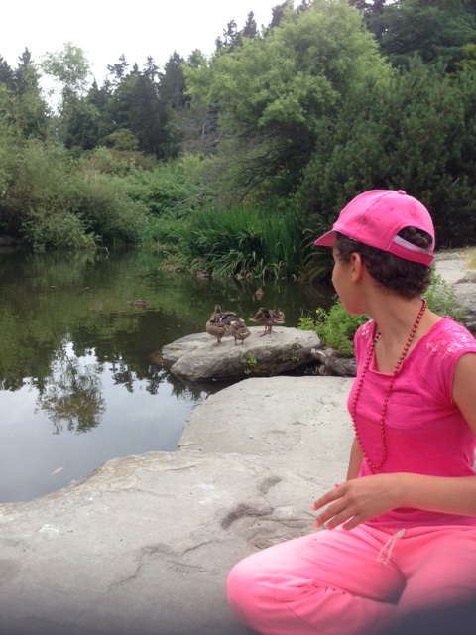
Lesson Objectives-Part Four
Open, Download and Save an Attachment
    Pictures
Notes:
Instructions for the Tutor
These are the skills learners will master at the end of the lesson.
Total Video length:
Part Four:
Open, Download and Save an Attachment: Pictures: 0:00-3:43 mins [ 3:43mins ]
Say to the learner:
Someone may send you an email with a picture attached. Has that happened to you ?
Maybe you want to save it.
Let’s review and practice how to Open, Download and Save and Attachment.
This time we’ll look at attachments that are Pictures.
We’ll watch a video to review this.
We can watch the video several times. So, don't worry if you don't catch everything the first time.

Slide 28
Lesson-Part Four
Open, Download and Save an Attachment
Pictures
Notes:
Video length:
Part Three
Open, Download and Save an Attachment: Pictures: 0:00-3:43 mins [ 3:43mins ]
Say to the Learner:
So, let’s watch how to open, download and save an attachment that is a Picture.
Instructions for the Tutor:
Click on the PLAY icon in the slide to open the video lesson.​
Use this link to the YouTube video if the link in the slide doesn’t work: ​
https://youtu.be/OL8IzcpFPdI
Play the video segment several times to the end.
Then ask comprehension check questions to check understanding. [See next slide for comprehension check questions.]
Then have the learner do Practice-Part Four.
For remote tutoring, when you share screen to play the video, make sure you have shared the audio.
Play the lesson a bit and check the learner can hear it ok before playing the whole video.

Slide 29
Check Understanding
Notes:
Instructions for the Tutor:
Check understanding
After watching the video lesson, replay the video, pause it and ask questions to check understanding (review and elicit) before moving on to the Practice.
Ask these comprehension check questions or others to check understanding:
Say to the Learner:
[Open and Download the Picture file]
In the video, the email she opened at the beginning has two attachments. What are they ? Word docs ? PDFs ? Answer: Pictures
How do you open the attachment ? Answer: Click on the chevron on the picture.
What do you see now ? Answer: A menu
In the menu, do you click on “Preview” or “Download” ? Answer: “Download”
Where do you see the file/attachment you downloaded ? Answer: In the bottom left corner
How do you open the file / attachment ? Answer: Click on the file name.
[Save the Attachment, the Picture]
When you click on the file name, the attachment / picture opens. What do you do next ? Answer: Look for the “More Options” icon in the top right corner.
What does the “More Options” icon look like ? Answer: Three dots
When you click on More Options” (the three dots) icon, what happens ? Answer: A menu opens.
Now, what do you click on in the menu ? Answer: “Save As”
After you click on “Save As” another menu opens on the left side. (the “Save As” box).
Choose the place you want to save the attachment. In the video, where does she save it ? Answer: in “Pictures”.
If you are using a public computer (like in the library or at school), where do you save it ? Answer: On a USB drive (portable storage device).
What do you have to do to see the different locations on your computer where you can save the file/attachment ? Answer: Scroll down/up
What happens when you click on the location ? Answer: It’ll be highlighted.
[Name the file]
Look in the file name box. What do you see there ? Answer: Some letters and numbers. (In the video you see: IMG _0617 (1)
You want to change that and put a name. Then you can find the picture more easily in the future. So, what do you do ? Answer: Click in the file name box, then type the name you want to call the file.
In the video, what name does she give to the picture file? Answer: “Beach Picnic Aug 18 2021”.
After you type the name of the file, what do you do ? Answer: Click “Save”.
Check the picture (attachment) was saved ok
Do you remember how to check if the attachment, the picture, was saved ok ? What do you remember from the video ?
First, close the picture/file. How do you do that ? Answer: Click on the red X in the top right corner to close the picture/file.
(Review from part three lesson) Minimize the browser window and any other windows open. How do you minimize a window ? Answer: Click on the minimize icon.
What does the minimize icon look like ? Answer: It looks like a minus sign.
You see your desktop. Find “File Explorer” and click on it to open it.
Look at the locations and find “Pictures”.
Click on “Pictures” to see what is inside.
Check that the picture file is inside “Pictures”.
It’s there. How do you close the window/ “Pictures”? Answer: Click on the X (in the top right corner)
Instructions for the Tutor:
Then ask the learner: Do you want to watch the video again?
IMPORTANT
If the learner is struggling, stop the session.
Say to the learner:
Let’s do more work on X...... before we do this.
For example, learner may not be able to find and click on email icons easily.
If so, go to the Digital Literacy Curriculum Resource (DLCR) and use the relevant module before using this video review lesson.
Teach the skills and have the learner practice.
Tip: Do the Needs Assessment to determine needs; use the Needs Assessment tools in the DLCR for this.

Slide 30
Practice-Part Four
Open, Download and Save an Attachment
  Pictures
Notes:
PRACTICE- Part Four
Lesson Focus:
Open, Download and Save an Attachment: Pictures
Instructions for the Tutor:
PREPARATION
Send the learner three short emails with a picture as an attachment with each one.
For example:
Hi LEARNER NAME
Here is a picture from our fun picnic last weekend.
It is attached.
I thought you might like to have a copy.
-YOUR NAME
Examples of pictures to use:
Photos of you or other staff at your organization.
A photo of the learner alone or with you.
etc.
Tip:
Have the three emails written and ready to send but keep them in your “Drafts” folder so you can send them just before or even during the lesson.
Preparation for Remote Tutoring only:
Refer to Slides #12 and 13.
Have support person make sure the browser icon (or an Outlook app shortcut if they use that) is easy for the learner to find on the desktop.
If no preparations were made on the learner’s computer before the session by a support person, use the Request Remote Control function in Zoom on the learner’s desktop if the learner struggles, and before they get frustrated.
******************************************************************************************************************************
PRACTICE
Instructions for the Tutor:
Demonstrate first, then let the learner practice.
Say to the Learner:
Now it’s time to practice.
We’re going to practice how to open, download and save an attachment, like in the video.
The attachments will all be pictures.
[After each of the following steps, wait for the learner to complete the step. Guide the learner as needed.]
IMPORTANT:
If the learner struggles, go back to the Digital Literacy Curriculum Resource and do the relevant Modules first.
[Open, and download the attachment]
I sent you an email with an attachment. Go to your inbox now and find that email.
Did you find it ? Do you see the attachment ? Show me. Great !
Open the email. (Click on it)
What kind of attachment is it ? A Word doc ? A PDF file ? A picture ? Answer: A picture
So, what do you do first? Do you remember from the video lesson ? Answer: Click on the chevron in the picture.
Great ! Do that now.
What do you see now ? Answer: A menu
In the menu, do you click on “Preview” or “Download” ? Answer: “Download”
Do that now.
Where do you see the file/attachment you downloaded ? Answer: In the bottom left corner
How do you open the picture file / attachment ? Answer: Click on the file name
Click on the file name now.
[Save the Attachment, the Picture]
When you click on the file name, the picture file/ attachment opens. You want to save it. What do you do next ? Answer: look for the “More Options” icon in the top right corner.
What does the “More Options” icon look like ? Answer: Three dots
Click on More Options” (the three dots) icon now.
Great. Now, what do you see ? Answer: A menu opens.
Now, what do you click on in the menu ? Answer: “Save As”
Do that now.
After you click on “Save As” another menu opens on the left side. (the “Save As” box).
What do you do now ? Answer: Choose the location where you want to save the attachment.
Let’s save it in “Pictures” like she does in the video. So, click on “Pictures”.
Is “Pictures” highlighted ? Answer: Yes. What does that mean ? Answer: It means I chose that location to save the file, the picture.
[Name the file]
Look in the file name box. There are some letters and numbers. (In the video you see: IMG _0617 (1) You want to change that and put a name. That way you can find the picture more easily in the future.
So, what do you do ? Answer: Click in the file name box and type the name for this picture file.
Do that now. How about the name: “BLABLABLA-DATE” (a name relevant to the picture).
After you type the name of the file, what is the last thing to do ? Answer: Click “Save”.
Do that now.
Great practicing how to open download and save a picture file !
[Check the picture file (attachment) was saved ok]
Remember it’s a good idea to check that the attachment was saved ok.
Let’s do that now. Do you remember how to do that? We learned that before.
What do you remember from the video ?
First, close the picture/file. How do you do that ? Answer: Click on the red X in the top right corner to close the picture/file.
Do that now.
(Review from Part Three Lesson) Minimize the browser window and any other windows open. How do you minimize a window ? Answer: Click on the minimize icon.
What does the minimize icon look like ? Answer: It looks like a minus sign.
So, minimize any open windows.
You see your desktop. Find “File Explorer” and click on it to open it.
Look at the locations in File Explorer and find “Pictures”.
Click on “Pictures” to see what is inside.
Check that the picture file is inside “Pictures”.
It’s there. How do you close the window/ “Pictures”? Answer: Click on the X (in the top right corner)
Do that now.
Great practicing how to check the picture file (the attachment) was saved ok !
Instructions for the Tutor:
Repeat the steps above at least two more times.
Send the learner two or more other emails with attachments. (See “PREPARATION” above.)
Say to the Learner:
Let’s practice a few more times! Then you will remember better how to do this.
CHECK THE LEARNER’S SKILLS:
Have the learner show you they can do the skills at least three times without support before they do another lesson.

Slide 31
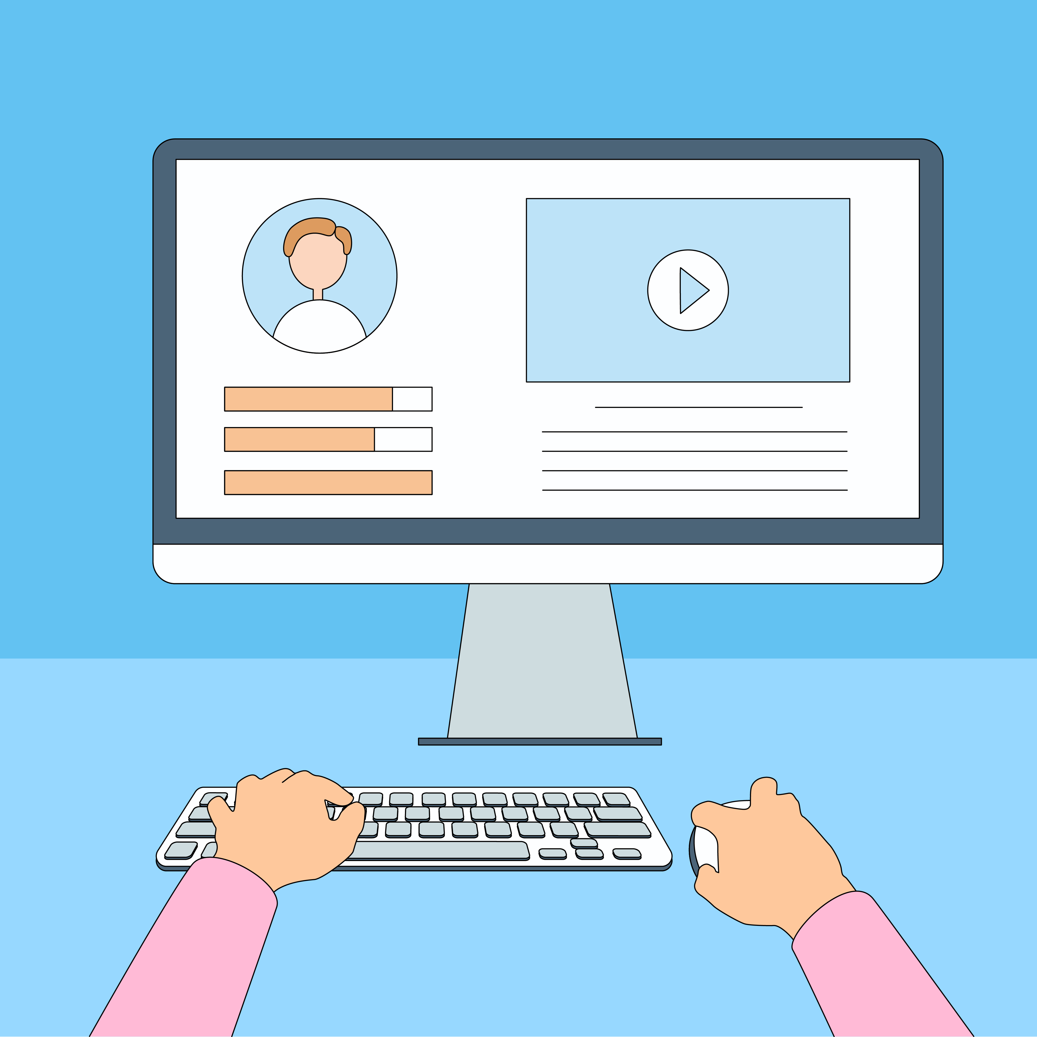
Practice Between Sessions
What did you learn/practice today?
When are you going to practice?
Practice Plan
Notes:
INSTRUCTIONS FOR THE TUTOR:
In-person tutoring and Remote Tutoring:
Make sure the learner knows how to access the video lesson(s) you just used so they can practice between tutoring sessions.
If relevant, make sure the support person at home knows how to access the video(s) too.
Option One
Email the video link to the learner, and if relevant the at-home support person. They can use the link in the email to access the video lesson(s).
Option Two
1. Put a link to the specific video lesson(s) you did on the learner’s desktop so they can access the video easily.
How:
Open the website address for the lesson in the browser.
In the address bar, click to highlight the lesson address.
Drag the address (link) onto the desktop. It will make an icon on the desktop.
Find the icon on the desktop and check that the link works.
Show the learner where it is. Tell them to just click to access it for practice.
Remote Tutoring Only:
You can do Strategy Two by using Request Remote Control in Zoom during the tutoring session.
Refer to the following for the steps on how to do that:
Tutor Checklist-During Remote Tutoring Sessions
Learner Instructions: Let Tutor have Remote Control of your Computer During a Zoom Session
IMPORTANT: Keep in mind the following:
Before using Remote Control, be sure to get permission from your organization first.
It is crucial that the learner understands what it means, and gives you informed consent.
It is somewhat invasive and must be done respectfully and honouring the confidentiality of the learner.
Don’t use the Request Remote Control feature first! It should be a last resort.
First, try your best to teach the learner and the support person how to do things using Share screen and demonstrating.
Use it if other ways do not work and the learner really needs to learn digital skills.
You may want to record the Zoom tutoring session in case of any possible accusations afterwards.
**********************************************************************************************************************************
SAY TO THE LEARNER:
You did well today.
So, what did you learn and practice today? →
Today, we learned and practiced how to: [only mention the parts you covered]
Part One: Send email with an attachment
Part Two: Open, Download and Save an Attachment- Word Documents
Part Three: Open, Download and Save an Attachment-PDF Documents
Part Four: Open, Download and Save an Attachment-Pictures
It’s really important to review and practice as much as you can! Please do that before our next tutoring session.
Watch the video again, as many times as you need.
I’ve emailed you the link. Let’s make sure you can open it.
(OR)
We’ve put the link on your desktop. Here it is. Just click on it to watch the video.
Let’s make sure it works ok.
[Practice Plan]
Say to the learner:
Practice at least three more times before our next session.
Here is what to practice:
For example:
I will send you a few emails with attachments. So, you can practice Open, download and Save an attachment. (Word docs or PDF or Pictures, depending on what you covered in the session.)
Or
Send me two emails with attachments (Word docs or PDF or Pictures, depending on what you covered in the session.)
etc.
We will review this at our next session.
I will email you this Practice Plan. Please reply to the email so I know you got it and have what you need to do the practice.
[Get learner to confirm they will practice and tell you when. Get specific.]
Say to the learner:
When are you going to do the practice? How many times ? etc.
Instructions for the Tutor:
Email the Practice to the learner, and if relevant to the Support Person.

Slide 32

Confirm Next Session and Support
Notes:
Instructions for the Tutor:
Confirm the next tutoring session.
Clarify any support in-between sessions if you are offering that.
If offering support outside the session time, put boundaries, be clear about when and how you are giving support.
Say to the Learner.
e.g. Great work today! etc.
Let’s meet again on X date at X time. Does that work for you?
Wonderful.
[If offering support before next session:]
If you need support before our next session, please .........
[For remote support:]
I will send you the Zoom link the day before the tutoring session.
etc.

Slide 33
See you!
Keep Practicing
Notes:
Say to the learner:
Bye and see you on X date at X time.
Keep practicing !

