Slide 1

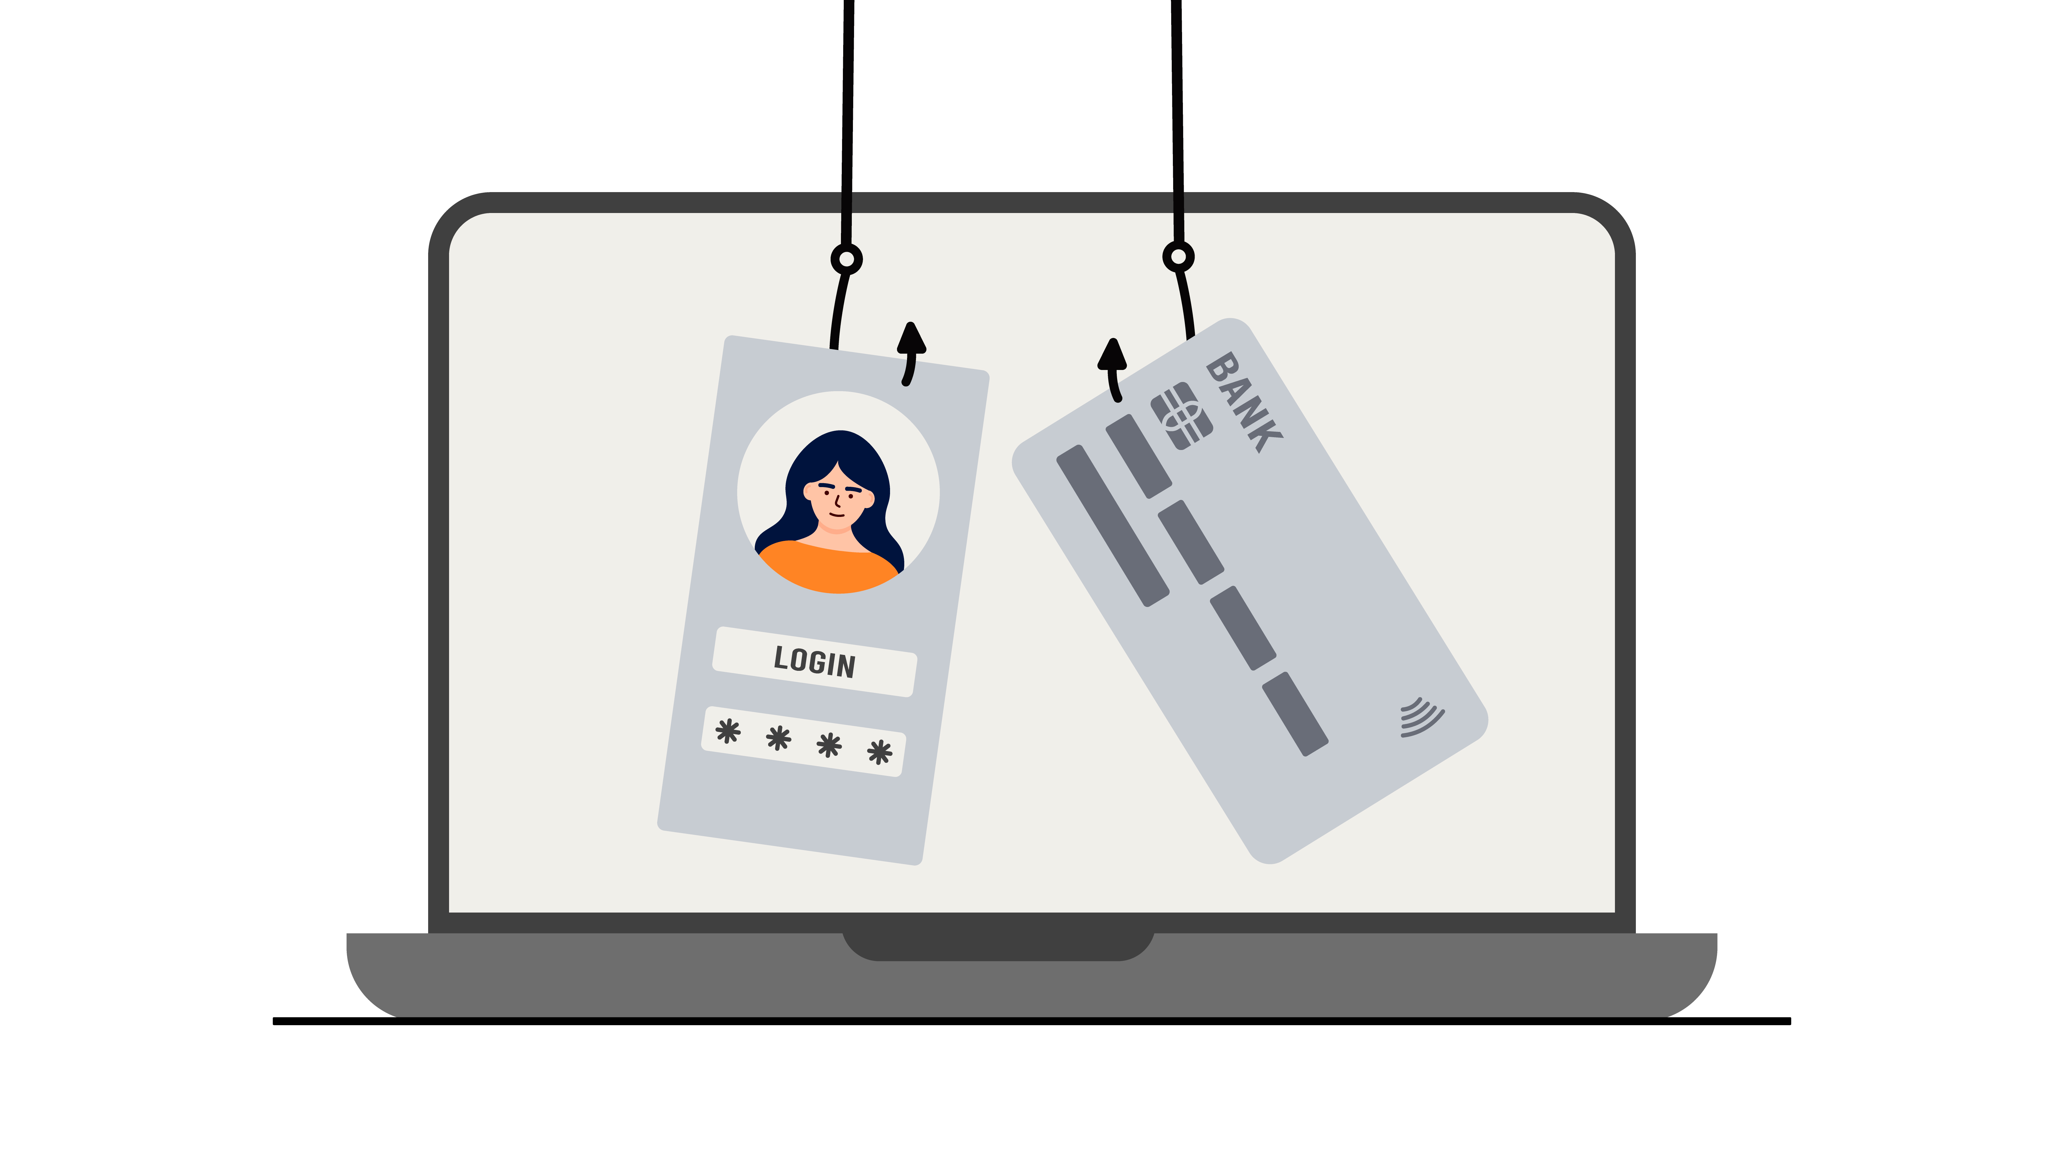
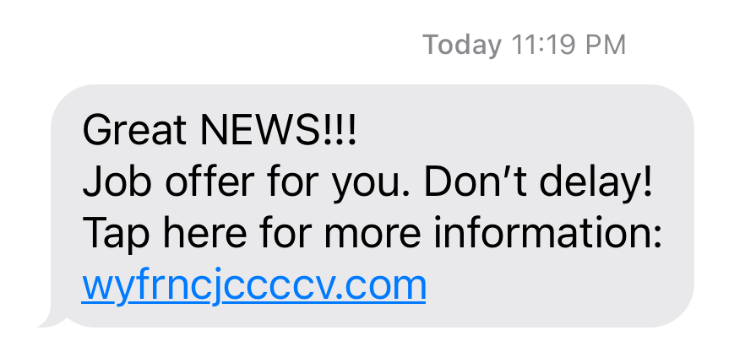
Employment
Slide hidden from learner
Job Scams
Notes:
Slide hidden from learner
Title slide

Slide 2
Pre-Requisite Skills
Slide hidden from learner
Mouse / Trackpad Skills: hold mouse/ use trackpad correctly; hover; click; scroll
Mobile Phone Skills: tap; open text messages app; open a message
Reading: ability to recognize simple symbols; read words and phrases
Keyboarding: Can type letters, common symbols and use Enter key on keyboard (one finger typing is ok)
Basic Navigation: scroll down and up; cursor shapes; where and how to place a cursor
Online Skills: open a browser; recognize icons; recognize text boxes; recognize links; use the search bar; know how and where to place a cursor; use text boxes
Email skills: open email app; use Inbox;
LINK to the DLCR:
https://digital-literacy.issbc.org/for-teachers/
Password: Diglit4T
Notes:
Slide hidden from learner
Pre-Requisite Skills
Remember: like all lessons in Module 9 – Employment (Review), this is a review lesson of the digital skills, and the learners may not be ready for this lesson.
Make sure the learner has the “Prerequisite Skills” listed in the slide.
These skills are not specifically reviewed in this lesson, but the learner needs to have them to be able to do the lesson.
If the learner struggles, go to the following modules in the Digital Literacy Curriculum Resource (DLCR) and teach the pre-requisite skills before doing this lesson:
Module 1 Mouse and Navigating
Module 2 Keyboarding
Module 3 Online Skills Basic
Module 4 Online Skills
Module 6: Mobile Phones

Slide 3
Skills Reviewed in this Lesson
Slide hidden from learner
Check the Notes of this Slide
Notes:
Slide hidden from the learner
Information for the Tutor
These skills are specifically reviewed in this lesson.
It is assumed the learner has already learned these skills and is doing this lesson as a review.
PART ONE
Phishing
Email Phishing
Text Messages Phishing
Understand what is “Phishing”
Recognize clues that a job-related email may be phishing
Recognize clues that a job-related text message may be phishing
Know to be suspicious of emails and text messages
Know not to click/tap on any links
Know not to click on any email attachments
Understand that clicking on links could put a virus in your computer
Understand that clicking on links risks the sender stealing your personal or financial information
Understand not to share/send any information (personal, financial information etc.)
PART TWO
Search Online to Find Out if a Job Ad is Real
Open a new tab
Use the search bar in a browser to find job ad scams connected to the company:
Click in search bar
Type words
Press enter on keyboard
Check the search results for any results about job ad scams and the company
Search Online for the Company’s Phone Number to Call and Ask if a Job Ad is Real
Understand that you can call a company to ask if a job ad is real or fake
Use the search bar in a browser to find a company’s phone number on their website:
Click in search bar,
Type words
Press enter on keyboard
Check the search results for the best result
Click to open the link to the website (best result)
Scroll down on the website to find the contact information
Find the phone number
Understand
not to reply or click on links in a suspicious email or text message.
that it may be phishing; that scammers may be trying to steal personal or financial information
PART THREE
Delete Suspicious Emails
Understand that you should delete suspicious emails
Delete an email:
Move the cursor to the box
Click in the box
Find the delete icon
Click on the delete icon
Recognize that the email was deleted
Delete Suspicious Text Messages
Understand that you should delete suspicious text messages
Delete a text message:
On an Android Phone:
Tap and hold the message
Look at the menu
Tap “Delete”
Tap “Delete” again
You see: “Move this message to the Trash ? Cancel / Move to Trash
Tap on “Move to Trash”
Recognize that the message was deleted
Understand that the steps may differ on different phones
On an iPhone:
Touch and hold the message bubble
Tap “Delete”
Recognize that the message was deleted
PART FOUR
Employment Website Job Scams
Know an example of an employment website (indeed.ca)
Know that indeed.ca and Craigslist have jobs ads/postings
Understand that some job ads on employment websites are fake.
Understand that most job ads on indeed.ca are real.
Know that you can report an ad on indeed if it looks fake
Report an ad on indeed.ca
Find and click on “Report Job” icon
Fill out the report form (Click and type)
Click “Submit”
Never give or receive money for a job applied for
Know to be suspicious if an ad or email asks for money
Understand to never give or receive money or cheques for a job you are applying for

Slide 4
Slide hidden from learner
Instructions
For Using this PowerPoint Lesson
Notes:
Slide hidden from learner
This PowerPoint lesson contains everything the tutor needs: the lesson notes, suggested instructional language, the links to the video lesson(s), and also Practice for each part. ​
IMPORTANT
Read through the entire lesson a few days before tutoring so you are clear about what to do and have time to get any questions answered and to do any preparation.
The first 13 slides are hidden from the learner; they contain information and instructions for the tutor.
Green Slides = Lesson Objectives
Blue Slides = The Start of each Part of the Lesson
Yellow Slides = Practice Activities
Instructions specific to each lesson are in the notes pages of each PowerPoint. ​
Identical notes are also available as a separate PDF for tutors who prefer that format. ​See Option B below.
You will NOT be able to copy and paste from this PowerPoint because it is “Read Only”.
In the Practice for each Part of this lesson, you may be asked to copy some text from this lesson and paste it into a Word document to use with the learner.
You will not be able to do that from this PowerPoint lesson. Instead, copy and paste the text from the PDF version of the (same) lesson.
There are different options for using this PowerPoint lesson and /or the PDF version of this (same) lesson:
Lesson Format Options for the Tutor
Option A
Use a printed version of the notes for you as tutor (not for the learner)
plus
Use the PowerPoint slideshow for the learner.
How:
Open the PowerPoint, download and save it.
Click “File” then "Print" ​
Then under “Settings” choose " Notes Pages" .
Print
Now, you can use the printed version for tutoring.
Option B
Use the separate electronic PDF of the PowerPoint slides and notes for you as tutor (if you don’t have PowerPoint on your computer or if you prefer to use a PDF version)
Plus
Use the PowerPoint slideshow for the learner, or the PDF-Slides Only version (if the learner’s computer doesn’t have PowerPoint). ​
You can have the PDF open to use for you as tutor beside the PowerPoint slideshow, or the PDF version of the slides (for the learner).
Option C
Use the PowerPoint slideshow in “Presenter View”.
This lets you show the slideshow to the learner, and also lets you see the notes as well as the slideshow that the learner sees.
This works for remote and in-person tutoring.
However, for in person tutoring for small groups you need a separate monitor or projector to do this: one for you and one for the learners.

Slide 5
Lesson Objectives – Part One
Slide hidden from learner
Phishing
What is Phishing ?
Email Phishing
Text Messages Phishing
Notes:
Slide hidden from learner
Instructions to the Tutor
These are the skills learners will master at the end of the lesson.
Phishing
What is Phishing?
Email Phishing
Text Messages Phishing
For a list of the discrete skills in each section listed above, see slide 3 “Skills Reviewed in this Lesson”
Total Video Length: 0:00-5:21 minutes [ 5:21 mins]
What is “Phishing”? 0:00-1:10 minutes [1:10 mins]
Email Phishing 1:11-3:54 minutes [2:43 mins]
Text Messages Phishing 3:55-5:21 minutes/END [1:26 mins]

Slide 6
Lesson Objectives – Part Two
Slide hidden from learner
Search Online to Find Out if a Job Ad is Real
Search Online for the Company’s Phone Number to Ask if a Job Ad is Real
Notes:
Slide hidden from learner
Instructions to the Tutor
These are the skills learners will master at the end of the lesson:
Part Two A:
Search Online to Find Out if a Job Ad is Real
Video length: 0:00-1:45 minutes [1:45 mins]
Part Two B:
Search Online for the Company’s Phone Number to Ask if a Job Ad is Real
Video length: 1:46-3:54 minutes [ 3:08 mins]
For a list of the discrete skills, see slide 3 “Skills Reviewed in this Lesson”

Slide 7
Lesson Objectives – Part Three
Slide hidden from learner
Delete Suspicious Emails
Delete Suspicious Text Messages
Notes:
Slide hidden from learner
Instructions to the Tutor
These are the skills learners will master at the end of the lesson:
Delete Suspicious Emails
Video length: 3:57-5:32 minutes [1:34 mins]
Delete Suspicious Text Messages
Video length: 5:33-7:07 minutes [1:34 mins]
For a list of the discrete skills, see slide 3 “Skills Reviewed in this Lesson”

Slide 8
Lesson Objectives – Part Four
Slide hidden from learner
    Employment Website Job Scams
              -Report an ad on indeed.ca
    Never give or receive money for a job applied for
Notes:
Slide hidden from learner
Instructions to the Tutor
These are the skills learners will master at the end of the lesson:
Employment Website Job Scams
Report an ad on indeed.ca
Understand to never give or receive money or cheques for a job you are applying for.
Know to be suspicious if an ad or email asks for money
For a list of the discrete skills, see slide 3 “Skills Reviewed in this Lesson”
Video length: 7:10-9:18 minutes/END [2:08 mins]

Slide 9
Keep in Mind
Slide hidden from learner
Only do as much as the learner can absorb in one session.
Do one part of the video lesson at a time.
Check in with the learner after each part.
Notes:
Slide hidden from learner
Information for the Tutor
According to the learner’s pace, do one part of the video lesson, check their understanding, and have the learner practice the skills. Then, let them show you they can do the skills (at least three times) before proceeding to the next part.
Look for signs of learner fatigue. Check in with learner after each part.
Is the learner is doing any of the following ?
Expressing frustration
Not asking questions, shutting down, not taking in what you are saying
Seeming overwhelmed
Saying, “Are we done yet?” etc.
Lots of yawning etc.
These are clues that it is time to stop the session and resume another day.

Slide 10

Set Up
Slide hidden from learner
Before In-Person Tutoring
Notes:
Slide hidden from learner
Information for the Tutor
Refer to TUTOR CHECKLIST- Set up for In-Person Tutoring
PREPARATION
Preparation specific to the PRACTICE for each Part of this lesson is in the notes of each “PRACTICE” slide.

Slide 11

Checklist
Slide hidden from learner
During In-Person Tutoring
Notes:
Slide hidden from learner
Information for the Tutor
Refer to:
TUTOR CHECKLIST- During In-Person Tutoring Sessions

Slide 12
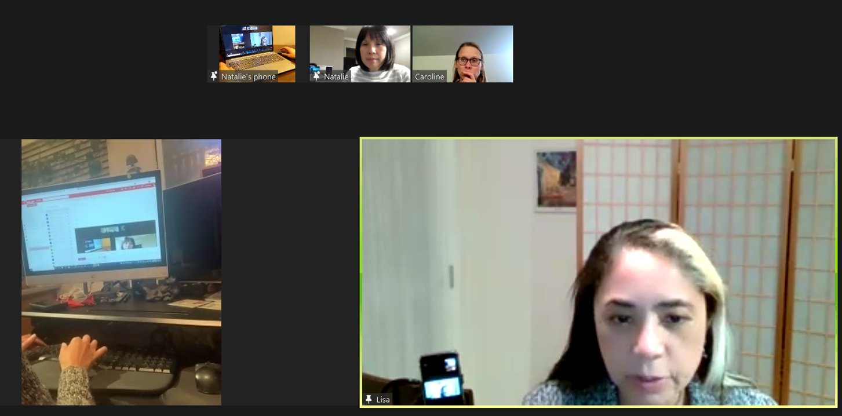
Set Up and Preparation
Slide hidden from learner
Before Remote Tutoring
Notes:
Slide hidden from the learner.
Information for the Tutor.
SET UP
Refer to:
TUTOR CHECKLIST- Set up for Remote Tutoring Session via Zoom, Ms Teams etc.
LEARNER CHECKLIST- Set up for Remote Tutoring Session via Zoom, Ms Teams etc.
IMPORTANT:
Go through the Learner Checklist as well. Then, you will be able to more easily troubleshoot with the learner if they have difficulty in their set up.
Communicate beforehand with the Support Person (if that learner has one):
Email the Learner Checklist listed in #2 above to the Support Person.
Email any instructions for this lesson to the support person (see the notes for specific slides /parts of the lesson):
Have the support person do the preparation for the lesson on the learner’s desktop. Tutor needs to guide them re. how to do this.
Preparation for Remote Tutoring only:
Have support person make sure the browser icon is easy for the learner to find on the desktop.
If no preparations were made on the learner’s computer before the session by a support person, you could use the Request Remote Control function in Zoom on the learner’s desktop if the learner struggles, and before they get frustrated.
IMPORTANT: Keep in mind the following:
Before using Remote Control, be sure to get permission from your organization first.
It is crucial that the learner understands what it means, and gives you informed consent.
It is somewhat invasive and must be done respectfully and honouring the confidentiality of the learner.
Don’t use the Request Remote Control feature first! It should be a last resort.
First, try your best to teach the learner and the support person how to do things using Share screen and demonstrating.
Use it if other ways do not work and the learner really needs to learn digital skills.
You may want to record the Zoom tutoring session in case of any possible accusations afterwards.
PREPARATION
Preparation specific to each part of this lesson is in the notes of the relevant slides.

Slide 13
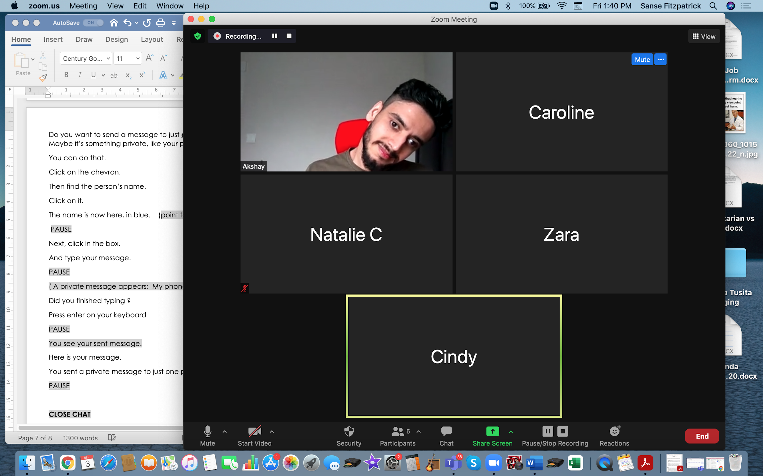
Checklist
Slide hidden from learner
During Remote Tutoring
Notes:
Slide hidden from learner
Refer to:
Tutor Checklist: During Remote Tutoring Session
Learner Instructions: How to let your Tutor have Remote Control of your Computer During a Zoom Session
SET UP SPECIFIC TO THIS LESSON
Be ready to assist learner by using the Requesting Remote Control function (refer to checklists 1 and 2 listed above).
You may have to set up learner’s desktop if no support person is available to do that beforehand. This is possible to do using Request Remote Control in Zoom.
IMPORTANT:
Keep in mind the following:
Before using Remote Control, be sure to get permission from your organization first.
It is crucial that the learner understands what it means, and gives you informed consent.
It is somewhat invasive and must be done respectfully and honouring the confidentiality of the learner.
Don’t use the Request Remote Control feature first! It should be a last resort.
First, try your best to teach the learner and the support person how to do things using Share screen and demonstrating.
Use it if other ways do not work and the learner really needs to learn digital skills.
You may want to record the Zoom tutoring session in case of any possible accusations afterwards.

Slide 14
Employment
Job Scams
Notes:
THIS SLIDE AND THE FOLLOWING SLIDES ARE TO SHOW TO THE LEARNER
Say to the learner:
Do you ever get emails from someone you don’t know and they ask you to send money or to click on a link?
I got one the other day. It was a job ad. It said, “Earn a high salary from home. No experience needed!”
It looked very suspicious to me.
How about text messages ?
Do you ever get text messages from someone you don’t know? Or messages you think might be fake?
I get them at least once a week.
It says it’s from a bank or a company.
But I don’t have an account at that bank.
I didn’t apply for a job at that company.
Often, I’ve never heard of that company.
The message usually tells you to tap on a link.
Sometimes they look real.
So, it’s really important to be careful.
We’re going to review information about Job Scams.
[Part One]
First. we’ll look at “Phishing”, at fake job ads in emails and text messages.
We’ll look at some examples and the clues that tell you they may be fake.
[Part Two]
In another video, we’ll look at how to handle these/ what to do about these.
Also, we’ll look at the employment website indeed and possible fake ads.

Slide 15

Lesson Objectives-Part One
Phishing
What is Phishing ?
Email Phishing
Text Messages Phishing
Notes:
Job Scams-Part One
Instructions for the Tutor
These are the skills the learner will master at the end of the lesson:
What is Phishing ?
Email Phishing
Text Messages Phishing
Say to the learner:
First, we’re going to look at “Phishing”, at what that means.
Then we’ll look at fake job ads you get in emails and in text messages.
We’ll look at some examples and the clues that tell you they may be fake.

Slide 16

Lesson-Part One
Phishing
What is Phishing ?
Email Phishing
Text Messages Phishing
Notes:
Job Scams-Part One
Say to the Learner:
Let’s review “What is “Phishing ?” and then look at some examples of “Email Phishing and Text Messages Phishing.
We’ll watch a video to review this.
We can watch the video several times. So, don't worry if you don't catch everything the first time.
Instructions for the Tutor:
•The icon in the slide with the red triangle is a link to the video on YouTube.
•Just click on that link (in Slideshow mode) to open the video LESSON.
•Here is that link in case the one in the slide doesn’t work:
https://youtu.be/xzLzkyU0PZc
Total Video length: 0:00-5:21 minutes [ 5:21 mins]
What is “Phishing”? 0:00-1:10 minutes [1:10 mins]
Email Phishing 1:11-3:54 minutes [2:43 mins]
Text Messages Phishing 3:55-5:21 minutes/END [1:26 mins]
For remote tutoring when you share screen to play the video, make sure you have shared the audio.
Play the lesson a bit and check the learner can hear it ok.
Play it until the end, then check for understanding. See the next slide for comprehension check questions.

Slide 17

Check Understanding
Notes:
Instructions for the Tutor:
Check understanding
After watching the video lesson, replay the video, pause it and ask questions to check understanding (review and elicit) before moving on to the Practice.
Ask these comprehension check questions or others to check understanding:
[Phishing]
Say to the Learner:
What is “Phishing “ ?
Answer: Emails or text messages that ask you to reply but they are fake. They ask you to click on a link or reply to an email. They try to steal your personal information or financial information. They can put a virus on your computer.
In the video, what is suspicious about the email ? Answer: You did not apply for that job.
In the video, why does the job look great ? Answer: The pay is high; the job is easy.
What does the email ask you to do ? Answer: Reply to the email
What does the text message ask you to do ? Answer: Click /tap on a link
If you click on the link, what can happen ? Answer: It can put a virus on your computer OR They can try to steal your personal or financial information.
[Email Phishing]
Say to the Learner:
In the example job ad, what were the jobs ? Answer: Telephone sales-customer support-data entry.
Are these unusual or common jobs ? Answer: Common jobs
Is the pay high ? How much is the pay ? Answer: Yes. $800-1200 per week
What are some of the good things about the jobs? Answer: flexible schedule, hourly or salary opportunities; work from home, no experience needed; training provided
What is suspicious about the job ? Answer: No experience needed; it doesn’t say the company name.
Should you click on the icon “Click here to apply” ? Why / why not ? Answer: No don’t click. It is suspicious and is probably phishing.
[How do you know if a job is real ?]
Say to the Learner:
What is the job ? Answer: Shelf stocker
What is the company ? Answer: AP Foods
Where is the job ? Answer: in Vernon
Is it an unusual or common job ? Answer: A common job
Is the pay high ? How much is the pay ? Answer: Yes. $30-an hour
What are some of the good things about the job? Answer: Easy job; part time work; high pay; casual dress; onsite parking etc.
What are some things you don’t like about the job ? Answer: (Whatever the learner thinks)
What is suspicious about the job ? Answer: They are asking for personal information (contact number, address and SIN) ; it’s high wage for an easy job
Should you click on the link / send an email with your resume ? Answer: No
Why / why not ? Answer: It is suspicious and is probably phishing.
Does the ad look real ? Answer: Yes
[Text Messages-Phishing]
Say to the Learner:
In the example text message, what was the job ? Answer: Mystery shopper
What was the pay ? Answer: $400 weekly
What is something good about the job? Answer: It sounds fun
What is suspicious about the job ad? Answer: It doesn’t say the company name; it doesn’t say what the job is; it asks you to enter your full name to apply
What should you do ? Answer: Don’t click on the link; Delete the email or text.
Instructions for Tutor:
Then ask the learner: Do you want to watch the video again?
If the learner is struggling, stop the session.
Say to the learner:
Let’s do more work on X before we do this. (so, learner does not feel bad they can’t yet do something)

Slide 18

Practice
Part One A
Email Phishing
Notes:
Practice-Part One
[Identify] Email Phishing
Instructions for the Tutor:
Focus: Show a few job ad phishing emails to the learner.
Have the learner look at them and identify why they think they are phishing.
PREPARATION
Prepare three different job ad phishing emails. (There are a few below that you can copy and paste into an email.)
Send the three emails to the learner.
The learner will open each of them and decide why they might be fake.
Read through the questions below. You will ask these to the learner while they look at the job ad phishing emails.
Both learner and tutor have a laptop or computer.
Preparation for Remote tutoring only:
Refer to Slides #12 and 13.
EXAMPLE PHISHING EMAILS
(Note: The spelling errors are intentional)
Email Phishing Example #1
Subject: You’ve been selected !!!
You’ve been selected !!!
Easy work for top pay.
This offer won’t last !!
Reply today to this email.
Hurry !!
Send your resume to: Blablaconsulting@newspapen.com
Email Phishing Example #2
Subject: Be your own boss!
Once in a lifetime opportunity!
Be your own bossy.
Work form home. Set your own ours.
Act fast!!
Send your application now: Hohoho@funnybusiness.com
Email Phishing Example # 3
Subject: Verify your application
Thank you for your aplication.
Job offer waiting!!
We need to verify your application details.
Click on the link to verify now:
Cstciepc.job.com
________________________________________________________________________________________
PRACTICE
Have the learner open their email app, go to their Inbox and find the email you sent
Ask the learner the questions below.
Guide them to the clues/what to look for to identify if a job ad might be fake, might be “Phishing”.
Say to the Learner:
Now it’s time to practice !
We’re going to look at some job ads that could come by email.
We’ll look at clues that help us guess if the job ad is real or phishing.
I sent you a few emails to practice.
First, sign into your email and go to the Inbox.
Find the email I sent you with the subject “SUBJECT OF EMAIL ” and open it.
Questions to Ask:
Note: the answers will differ for each job ad.
[The subject of the email]
What is the subject of the email ? Answer: “SUBJECT OF EMAIL ” you sent the learner
Does the subject look suspicious ? Answer: Yes / Maybe
Today, we’re going to open the emails to learn how to identify fake job ads.
However, usually you would not open the emails You would delete them.
Another day we’ll review how to delete emails.
[Clues to help guess that the ad is fake]
So, click on the email now to open it.
Let’s look at the job ad.
What is the job ?
Is it an unusual job ?
What is the company ? Does it say ?
Is the pay high ? What is the pay ?
Does the job look good ? Why ? What looks good about it ?
What is suspicious about the job ad ?
The job ad ask you to do something. What ?
Should you do what it asks you to do ? Why not ?
What could happen if you click on a link in the email ? Answer: It could put a virus on your computer. Or they can try to steal your personal or financial information, etc.
What could happen if you reply to the email ? Answer: It could put a virus on your computer. Or, they can try to steal your personal or financial information, etc.
Let’s practice again!
Close that email now and open another one.
Instructions for the Tutor:
Practice: Have the learner repeat the above activity and practice with the other emails you sent. (At least three times.)
CHECK THE LEARNER’S SKILLS:
Has the learner shown you they can do the skills at least three times without support? If so, then they are ready to move on to the next part.

Slide 19
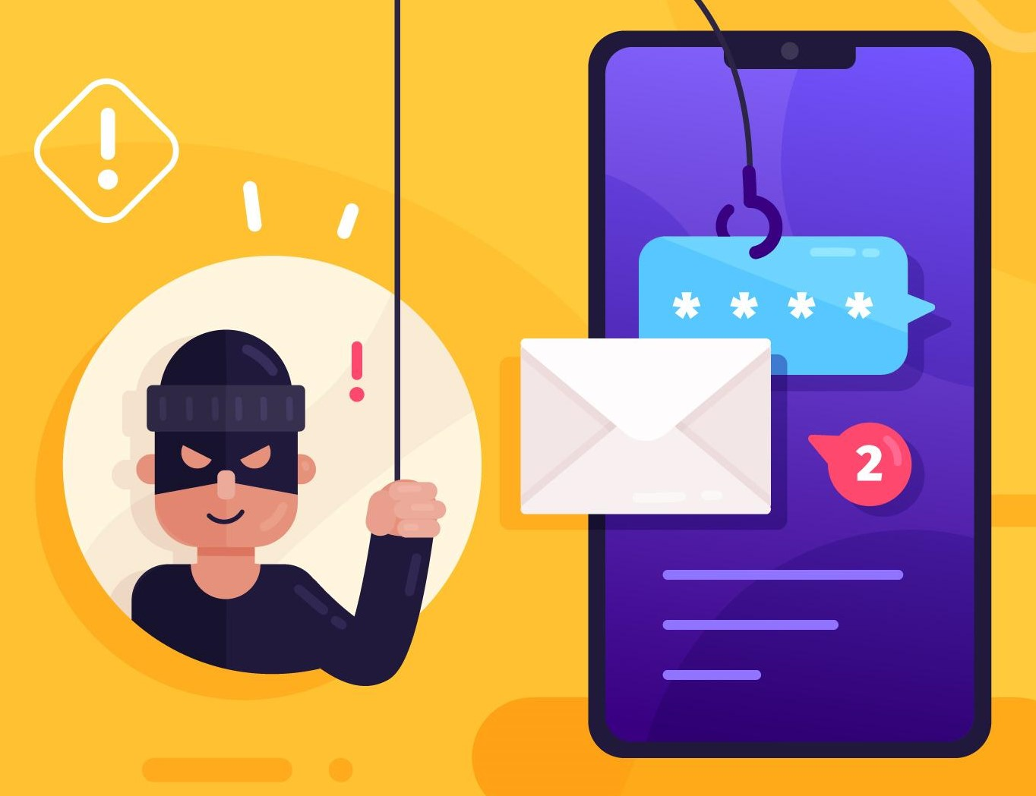
Practice
Part One B
Text Messages-Phishing
Notes:
Practice-Part One
[Identify] Text Messages- Phishing
Instructions for the Tutor:
Focus: Show a few job ad phishing text messages to the learner.
Have the learner look at them and identify why they think they are phishing.
PREPARATION
Prepare at least three different example job ad phishing text messages. (There are a few below that you can copy and paste into a text message.)
Send the text messages to the learner.
The learner will open each of them and decide why they might be fake.
Read through the questions below. You will ask these to the learner while they look at the job ad phishing text messages.
Both learner and tutor have a mobile phone with text message app.
Alternatively: Use a computer. You can show the example text messages to the learner on the computer / laptop and ask the same questions. They won’t appear as they do on a phone, but the information will be the same.
Preparation for Remote tutoring only:
Refer to Slides #12 and 13.
EXAMPLE PHISHING TEXT MESSAGES
Text messages-Phishing Example #1
Great NEWS !!!
Job offer for you. Don’t delay.
Tap here for more information:
Idneihwck.haha.org
Text messages-Phishing Example #2
Love animals ?
Put your skills to work.
For Top pay.
Flexible hours.
Tap here to apply: dgonscm.nop.com
Text messages-Phishing Example #3
Hello your application has been selected
Visit secure site here: http://r.so.com/sidon
for interview date and details.
Include full name, SIN and
street address for our records.
Text messages-Phishing Example #4
You are confirmed to attend TFP company
interview on
6/21 at 1 PM PST
Online via zoom.us
Access code: 894763339399
Text messages-Phishing Example #5
Walmat urgently
Recruiting for part-time jobs,
You can earn 300 $$ every day,
Add Whatsapp: wa.me/
7899040455
PRACTICE
Have the learner open their phone, go to their text messages app and find the first example phishing text message you sent.
Or open and show the example text messages on the computer/ laptop.
Ask the learner the questions below.
Guide them to the clues/what to look for to identify if a job ad might be fake, might be “Phishing”.
Say to the Learner:
Now it’s time to practice !
We’re going to look at some job ads that could come by text message.
We’ll look at clues that help us guess if the job ad is real or phishing.
I sent you a few text messages to practice.
First, open your phone and then open the text messages app.
Find the text message I sent you and open it.
Questions to Ask:
Note: the answers will differ for each text message.
Who is the text message from ?
Do you know that sender ?
Today the sender is me. So you can practice the skills. But if you don’t know the sender, it’s suspicious.
Before you open the text message, look at the words under the sender’s name.
What words do you see ? (Something suspicious)
Does it look suspicious ? Answer: Yes / Maybe
Today, we’re going to open the text message to learn how to identify fake job ads.
However, if a text message looks suspicious, you can delete it without opening it.
Another day we’ll review how to delete text messages.
Let’s look at the message closely.
What is the job ? Is it an unusual job ?
What is the company ? Does it say ?
Is the pay high ? What is the pay ?
Does the job look good ? Why ? What looks good about it ?
What is suspicious about the job ad ?
The job ad ask you to do something. What ?
Should you do what it asks you to do ? Why not ?
What could happen if you tap a link or reply to the message? Answer: It could put malware on your phone. Or they can try to steal your personal or financial information, etc.
Let’s practice again!
Look at the next text message I sent.
Instructions for the Tutor:
Practice: Have the learner repeat the above activity and practice with the other text messages that you sent. (At least three times.)
CHECK THE LEARNER’S SKILLS:
Has the learner shown you they can do the skills at least three times without support? If so, then they are ready to move on to the next part.

Slide 20


More Practice
Part One
Emails and Texts
Good or Phishing ?
Notes:
More Practice-Part One
[Identify] Email Phishing and Text Messages-Phishing
Information for the Tutor:
The following from the “Digital Literacy Curriculum Resource” is a good interactive online activity for the learner to practice how to identify phishing emails and texts. They can do it independently.
In the activity, the learner looks at emails and text messages and decides: “Are they good or are they phishing ?”
The learner also decides where it is safe to click and where it is unsafe to click.
The emails and texts are not specifically job focused but include other common phishing topics:
3 emails: from DHL; RBC; Mortgage notice
3 Text messages: from a friend; RBC ALERT; NETFLIX; Security Alert CIBC; RBC Alert:
Unlike Part Three of this lesson, in the activity the learner doesn’t practice how to delete emails or text messages.
Instead, it shows where it is safe to click or tap: on the email Inbox to close the email, or on the back button to close the text message.
Instructions for the Tutor:
PREPARATION
Both learner and tutor have a laptop or computer.
Demonstrate on the tutor laptop. Have the learner do the activity on their laptop.
Open the browser.
Open the “Digital Literacy Curriculum Resource Website.“
Website address: digital-literacy.issbc.org
Go to the “Students” tab
Find “Literacy-CLB 1”
Find and open the following “Students” activity:
” Module 7-Safety and Security: Phishing Emails and Texts”
Here is the link:
https://www.issbc.org/janis-esl/diglit7.3-4litclb1/story.html
Show the learner how to go to the link and enter the password: Diglit4S
Play the activity so the learner understands the instructions/ how to use it on their own.
Then have the learner do the activity on their own.
Pull back to encourage independence.
However, if the learner is struggling, step in and guide them as needed.
Preparation for Remote tutoring only:
Refer to Slides #12 and 13.
Email the link and password for the Student activity to the learner and or support person.
Say to the Learner:
Now it’s time to practice.
You are going to do an interactive activity.
I’ll show you first then you will open it on your computer and do it.
[Open and play some of the activity so you can demonstrate how to use it.
[Check the learner is clear about what to do. ]
For Remote Tutoring
Say to the Learner:
I sent you an email. In the email there is a link to this activity.
Please do the following:
Go to your email inbox
Find the email from me and open it
Find the link in the email
Find the password in the email
Click on the link and then enter the password
Is it open ? Great.
Now listen and try to follow the instructions.
Practice again.
Close the student activity and reopen it.
Instructions for the Tutor:
Have the learner repeat the above activity and practice as many times as they need (at least three times.)
CHECK THE LEARNER’S SKILLS:
Has the learner shown you they can do the activity without support? If so, then they are ready to move on to the next part.

Slide 21

Lesson Objectives – Part Two
Search Online to Find Out if a Job Ad is Real
Search Online for the Company’s Phone Number to Ask if a Job Ad is Real
Notes:
Job Scams-Part Two
Instructions to the Tutor
These are the skills learners will master at the end of the lesson:
Search Online to Find Out if a Job Ad is Real
Search Online for the Company’s Phone Number to Ask if a Job Ad is Real
Say to the learner:
In part one, we reviewed “Phishing”.
What is “Phishing” ? What do you remember ?
We looked at job ads that might be fake. These were both in emails and in text messages.
You practiced identifying job ads that might be fake, might be phishing.
Now, we’re going to look at what you can do when you get an email or a text message with a job ad that looks suspicious , that you think may be fake.

Slide 22
Lesson-Part Two A
Search Online to Find Out if a Job Ad is Real
Notes:
Job Scams-Part Two A
Search Online to Find Out if a Job Ad is Real
Say to the Learner:
Let’s review what you can do when you get an email or a text message with a job ad that looks suspicious, that you think may be fake.
What do you think you might do ?
One thing you can do is to Search Online to Find Out if a Job Ad is Real.
We’re going to watch a video to review how to do this.
We can watch the video several times. So, don't worry if you don't catch everything the first time.
Instructions for the Tutor:
•The icon in the slide with the red triangle is a link to the video Lesson on YouTube.
•Just click on that link (in Slideshow mode) to open the video Lesson.
•Here is that link in case the one in the slide doesn’t work:
https://youtu.be/MI-qbvoJBH0
Video length: 0:00-1:45 minutes [1:45 mins]
For remote tutoring, when you share screen to play the video, make sure you have shared the audio.
Play the lesson a bit and check the learner can hear it ok.
Play till the end of the video, then check for understanding. See the next slide for comprehension check questions.

Slide 23
Check Understanding
Notes:
Instructions for the Tutor:
Check Understanding
After watching the video lesson, replay the video, pause it and ask questions to check understanding (review and elicit) before moving on to the Practice.
Ask these comprehension check questions or others to check understanding:
[Check on the Internet:
Search Online to Find Out if a Job Ad is Real]
Say to the Learner:
How do you open a new tab in the browser ? Answer: Find the new tabs icon and click on it.
Show me the icon for “New Tab”. (It looks like a cross)
In the browser, show me the search bar. What icon does it have ? Answer: a magnifying glass
How do you use the search bar to search ?
Answer: Find the search bar, click on the box and type
What do you type in the search bar ?
Answer: The company’s name, email address or phone number. Add the words “Job Scam”.
In the video, what company does she search for about job scams?
Answer: London Drugs job scams
What do you do after you type ?
Answer: Press enter on the keyboard
What do you do next ?
Answer: See in the results if there are job scams connected to this company.
In the video, is there a job scam connected to London Drugs ?
Answer: Yes, so it may be a scam job ad.
Instructions for Tutor:
Then ask the learner: Do you want to watch the video again?
If the learner is struggling, stop the session.
Say to the learner:
Let’s do more work on X before we do this. (so, learner does not feel bad they can’t yet do something)

Slide 24

Practice
Part Two-A
Search Online to Find Out if a Job Ad is Real
Notes:
Practice-Part Two A
Search Online to Find Out if a Job Ad is Real
Instructions for the Tutor:
PREPARATION
Both learner and tutor have a laptop or computer each.
Make sure there is one internet browser icon on the desktop and/ or the taskbar on learner’s computer.
Preparation for Remote tutoring only:
Refer to Slides #12 and 13.
Tutor should be able to see learner’s computer screen and hands.
PRACTICE
Demonstrate first, then let the learner practice.
After each of the following steps, wait for the learner to complete the step. Guide the learner as needed.
Say to the Learner:
Now it’s time to practice!
We’re going to practice how to Search Online to Find Out if a Job Ad is Real like we saw in the video.
Open the browser.
Show me the icon for “New Tab”. (It looks like a cross)
Click on it to open a new tab.
Show me the search bar.
How do you use the search bar to search ? Answer: Click on the box and type
Do that now. Type (For Example) “Real Canadian Superstore”
Add the words “Job Scam”.
What do you do after you type ? Answer: Press enter on the keyboard
Do that now.
Now, look at the results.
Scroll down and up to see them
Are there any job scams connected to this company ?
Let’s do another search.
Delete the words in the search box. Click on the X to do that.
Now, type “ Shoppers Drug Mart” and add the words “Job Scam”
Repeat the steps above.
Then have the learner search for a few more and repeat the steps again:
For example,
Tim Hortons job scam
Amazon job scam
Save on Foods job scam
Starbucks job scam
etc.
Instructions for the Tutor:
Have the learner practice as many times as they need (at least three times.)
Check the Learner's skills. Has the learner shown you they can do the skills at least three times without support? If so, then they are ready to move on to the next part.

Slide 25

Lesson-Part Two B
Search Online for the Company’s Phone Number to Ask if a Job Ad is Real
Notes:
Job Scams-Part Two B
Search Online for the Company’s Phone Number to Ask if a Job Ad is Real
Say to the Learner:
Let’s review what you can do when you get an email or a text message with a job ad that looks suspicious, that you think may be fake.
We looked before at how to Search Online to Find Out if a Job Ad is Real.
Another thing you can do is to Search Online for the Company’s Phone Number to Call and Ask if a Job Ad is Real.
We’re going to watch a video to review how to do this.
We can watch the video several times. So, don't worry if you don't catch everything the first time.
Instructions for the Tutor:
•The icon in the slide with the red triangle is a link to the video Lesson on YouTube.
•Just click on that link (in Slideshow mode) to open the video Lesson.
•Here is that link in case the one in the slide doesn’t work:
https://youtu.be/MI-qbvoJBH0
Cue the video:
Video length: 1:46-3:54 minutes [ 3:08 mins]
For remote tutoring, when you share screen to play the video, make sure you have shared the audio.
Play the lesson a bit and check the learner can hear it ok.
Play till the end of the video, then check for understanding. See the next slide for comprehension check questions.

Slide 26
Check Understanding
Notes:
Instructions for the Tutor:
Check Understanding
After watching the video lesson, replay the video, pause it and ask questions to check understanding (review and elicit) before moving on to the Practice.
Ask these comprehension check questions or others to check understanding:
Search Online for the Company’s Phone Number to Ask if a Job Ad is Real]
Say to the Learner:
[Use browser search bar]
Can you call a company to ask if a job ad is real ? Answer: Yes
How can you find the company’s phone number ? Answer: Look/search on the internet.
How do you use the search bar in the browser to search ? Answer: Find the search bar, click on the box and type.
What do you do after you type ? Answer: Press enter on the keyboard.
In the video, what does he type? Answer: “London Drugs Corporate Information”
He sees a search result called “Corporate Information-London Drugs. What does he check before he opens it ? Answer: He checks the web address.
Why does he do that ? Answer: Because it means the website is probably ok (legitimate).
[Open a website and look for the company phone number]
You find a link to a website in the search results. You want to open it. How do you do that ? Answer: Click on the link to open it.
You opened the website. Now search on the website to find the phone number. How do you do that ? Answer: Scroll down.
In the video, where was the phone number on the London Drugs website ? Answer: At the bottom
Now you have the phone number. What can you do ? Answer: You can call and ask if the ad is real or fake.
[What to do]
You think the ad may be fake. Should you reply ? Answer: No.
Should you click on links in the email or text message ? Answer: No. Do not click on links in the email or text message.
Why not ? Answer: It may be phishing. Scammers may be trying to steal your personal or banking information !
Instructions for Tutor:
Then ask the learner: Do you want to watch the video again?
If the learner is struggling, stop the session.
Say to the learner:
Let’s do more work on X before we do this. (so, learner does not feel bad they can’t yet do something)

Slide 27
Practice
Part Two-B
Search Online for the Company’s Phone Number to Ask if a Job Ad is Real
Notes:
Practice-Part Two A
Search Online to Find Out if a Job Ad is Real
Instructions for the Tutor:
PREPARATION
Both learner and tutor have a laptop or computer each.
Make sure there is one internet browser icon on the desktop and/ or the taskbar on learner’s computer.
Preparation for Remote tutoring only:
Refer to Slides #12 and 13.
Tutor should be able to see learner’s computer screen and hands.
PRACTICE
Demonstrate first, then let the learner practice.
After each of the following steps, wait for the learner to complete the step. Guide the learner as needed.
Say to the Learner:
Now it’s time to practice!
We’re going to practice how to Search Online for the Company’s Phone Number to Ask if a Job Ad is Real like we saw in the video.
Let’s search for a company.
First, open the browser.
Show me the search bar.
Now, search for the following: “Real Canadian Superstore”
Remember how to do that ?
Find the search bar
Click on the box
Type
Press enter on the keyboard.
Do that now.
Look at the search results.
Do you see one that looks like the company website ?
What should you check before you click on it ? Answer: That the web address looks ok.
Why? Answer: Because it means the website is probably ok (legitimate).
Open the link now (Click on it)
Look for the phone number. Scroll down.
Where do you think it might be ? Answer: at the bottom or the top
Find the phone number.
Write it down.
Now you have the phone number. What can you do ? Answer: You can call and ask if the ad is real or fake.
We won’t do that now because we are just practicing the digital skills.
Let’s practice again.
Repeat the steps above with other companies /common workplaces in your region:
For example:
Shoppers Drug Mart
Tim Hortons
Amazon
Save on Foods
Starbucks
Instructions for the Tutor:
Have the learner practice as many times as they need (at least three times.)
Check the Learner's skills. Has the learner shown you they can do the skills at least three times without support? If so, then they are ready to move on to the next part.

Slide 28
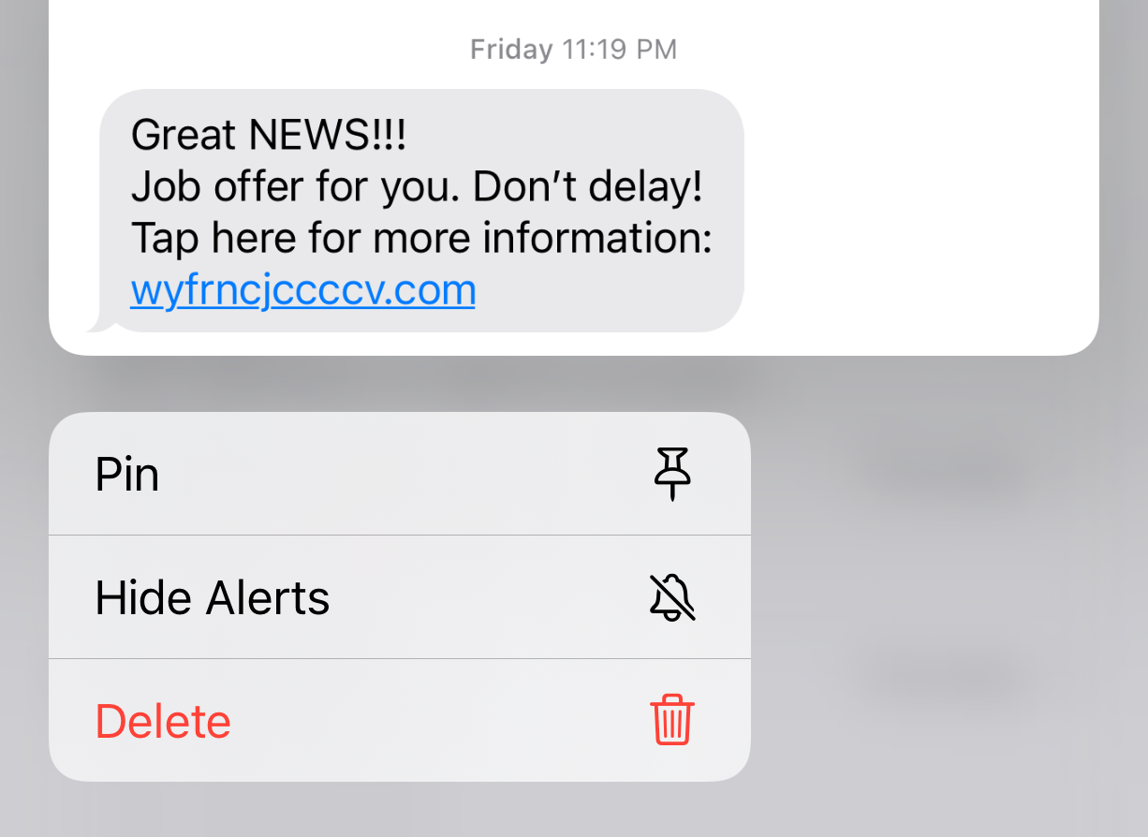

Lesson Objectives – Part Three
    Delete Suspicious Emails
    Delete Suspicious Text Messages
Notes:
Job Scams-Part Three
Instructions to the Tutor
These are the skills learners will master at the end of the lesson:
Delete Suspicious Emails
Say to the learner:
We practiced how to identify suspicious emails in Part One.
Do you remember what the video said to do ?
Answer: Don’t click/tap on any links; don’t open any email attachments. Don’t reply to any suspicious emails or texts.
It also said to delete suspicious emails and texts.
Now, we are going to review how to do that, how to Delete Suspicious Emails and Text Messages.
Have you ever done that ?
Why do you think it’s important to do that ?
Answer: So, you don’t click on it by accident. That risks putting a virus or malware on your computer. It also risks you sending private information to scammers by mistake.

Slide 29
Lesson-Part Three A
    Delete Suspicious Emails
Notes:
Job Scams-Part Three
Say to the Learner:
Let’s review how to Delete Suspicious Emails
We’re going to watch a video to review how to do this.
The video shows how to do it in Gmail.
We can watch the video several times. So, don't worry if you don't catch everything the first time.
Instructions for the Tutor:
•The icon in the slide with the red triangle is a link to the video Lesson on YouTube.
•Just click on that link (in Slideshow mode) to open the video Lesson.
•Here is that link in case the one in the slide doesn’t work:
https://youtu.be/MI-qbvoJBH0
Cue the video
Video length: 3:57-5:32 minutes [1:34 mins]
For remote tutoring, when you share screen to play the video, make sure you have shared the audio.
Play the lesson a bit and check the learner can hear it ok.
Play till the end of the video, then check for understanding. See the next slide for comprehension check questions.

Slide 30
Check Understanding
Notes:
Instructions for the Tutor:
Check Understanding
After watching the video lesson, replay the video, pause it and ask questions to check understanding (review and elicit) before moving on to the Practice.
Ask these comprehension check questions or others to check understanding:
[Delete Suspicious Emails]
Say to the Learner:
You get a suspicious email in your Inbox. What should you do ? Answer: Delete it
Should you click on the email to open it ? Answer: No
How do you delete an email ? Answer:
Look at the emails in your Inbox
Decide which email you want to delete
Move the cursor to the box beside the email
Click in the box
See the checkmark in the box and the email is also highlighted
Move the cursor to the “Delete” icon
Click on the “Delete” icon
The email is deleted !
Show me the box beside the email.
Show me the “Delete” icon.
What does the “Delete” icon look like in Gmail ? Answer: A Trash can
How do you know you deleted the email ? Answer: You see “Conversation Moved to Trash”.
Instructions for Tutor:
Then ask the learner: Do you want to watch the video again?
If the learner is struggling, stop the session.
Say to the learner:
Let’s do more work on X before we do this. (so, learner does not feel bad they can’t yet do something)
For example, the learner may not be able to recognize cursor shapes or where to place a cursor. If so, go to Module 1 Mouse and Navigating and Module 3 Online Skills Basic etc. to practice the skills with the learner.

Slide 31
Practice
Part Three A
    Delete Suspicious Emails
Notes:
Practice-Part Two A
Delete Suspicious Emails
Instructions for the Tutor:
PREPARATION
Have the learner delete the example phishing emails you sent to them in Part One A of this lesson.
Or, if you didn’t send them in Part One A, do that now:
Prepare three different job ad phishing emails. (There are a few below that you can copy and put into an email.)
Send the three emails to the learner.
The learner will delete them in their email Inbox to practice deleting scam (or any) emails.
Both learner and tutor have a laptop or computer each.
Make sure there is one internet browser icon on the desktop and/ or the taskbar on learner’s computer.
EXAMPLE PHISHING EMAILS
(Note: The spelling errors are intentional)
Email Phishing Example #1
Subject: You’ve been selected !!!
You’ve been selected !!!
Easy work for top pay.
This offer won’t last !!
Reply today to this email.
Hurry !!
Send your resume to: Blablaconsulting@newspapen.com
Email Phishing Example #2
Subject: Be your own boss!
Once in a lifetime opportunity!
Be your own bossy.
Work form home. Set your own ours.
Act fast!!
Send your application now: Hohoho@funnybusiness.com
Email Phishing Example # 3
Subject: Verify your application
Thank you for your aplication.
Job offer waiting!!
We need to verify your application details.
Click on the link to verify now:
Cstciepc.job.com
Preparation for Remote tutoring only:
Refer to Slides #12 and 13.
Tutor should be able to see learner’s computer screen and hands.
___________________________________________________________________________________________________________________________
PRACTICE
Demonstrate first, then let the learner practice.
After each of the following steps, wait for the learner to complete the step. Guide the learner as needed.
Say to the Learner:
Now it’s time to practice!
We’re going to practice how to Delete Suspicious Emails like we saw in the video.
I sent you a few emails to practice.
First, go to your email app and open it.
Now, look at the emails in your Inbox
Let’s look at the first one I sent.
What is it called ? Answer: “You’ve been selected !!!”
We looked at this email before. So, we won’t look at it again.
It’s good not to open suspicious emails but just delete them.
Now, let’s just practice deleting it.
What do you do ?
Move the cursor to the box beside the email
Click in the box
See the checkmark in the box and the email is also highlighted
Move the cursor to the “Delete” icon
Click on the “Delete” icon
Do that now.
Is the email deleted ? How do you know ? Answer: You see “Conversation Moved to Trash”.
Show me the box beside the email.
Show me the “Delete” icon.
What does the “Delete” icon look like in Gmail ? Answer: A Trash can
Great ! Let’s practice again.
Repeat the steps above with the other emails.
Instructions for the Tutor:
Have the learner practice as many times as they need (at least three times.)
Check the Learner's skills. Has the learner shown you they can do the skills at least three times without support? If so, then they are ready to move on to Part Three.

Slide 32
Lesson-Part Three B
    Delete Suspicious Text Messages
Notes:
Job Scams-Part Three
Say to the Learner:
So, let’s review how to Delete Suspicious Text Messages.
We’re going to watch a video to review how to do this.
The video shows how to do it on both Android and iPhone.
We can watch the video several times. So, don't worry if you don't catch everything the first time.
Instructions for the Tutor:
•The icon in the slide with the red triangle is a link to the video Lesson on YouTube.
•Just click on that link (in Slideshow mode) to open the video Lesson.
•Here is that link in case the one in the slide doesn’t work:
https://youtu.be/MI-qbvoJBH0
Video length: 5:33-7:07 minutes [1:34 mins]
For remote tutoring, when you share screen to play the video, make sure you have shared the audio.
Play the lesson a bit and check the learner can hear it ok.
Play till the end of the video, then check for understanding. See the next slide for comprehension check questions.

Slide 33
Practice
Part Three B
    Delete Suspicious Text Messages
Notes:
Practice-Part Three B
Delete Suspicious Text Messages
The learner will delete example text messages you send them to practice the skills for deleting scam (or any) text messages.
Instructions for the Tutor:
PREPARATION
Both the learner and tutor have a Mobile Phone.
To do this practice, the learner needs to have a mobile phone and to already use the text messages app.
Tip: Put your email app on your home screen if it’s isn’t already. This makes it easier to demonstrate to the learner. Help the learner do that too if it’s helpful for that learner.
Tip: If a learner doesn’t know how to open and use the text messaging app on their phone, teach them basic mobile phone skills using the “Digital Literacy Curriculum Resource” “Basic Phone Skills for Android OR Basic Phone Skills for iPhone”
The learner will delete the example text messages you sent to them in Part One B of this lesson.
Or, if you didn’t send them to the learner in Part One B, do that now:
Prepare at least three different job ad phishing text messages. (There are a few below that you can copy and put into a text message to send.)
Send the text messages to the learner, one at a time.
Tip: To save time during the session: Prepare the text messages and send them to a coworker / friend (who agrees). That way the messages are already written. Then you can just copy and paste each one to send it to the learner during the session.
EXAMPLE PHISHING TEXT MESSAGES
Text messages-Phishing Example #1
Great NEWS !!!
Job offer for you. Don’t delay.
Tap here for more information:
Idneihwck.haha.org
Text messages-Phishing Example #2
Love animals ?
Put your skills to work.
For Top pay.
Flexible hours.
Tap here to apply: dgonscm.nop.com
Text messages-Phishing Example #3
Hello your application has been selected
Visit secure site here: http://r.so.com/sidon
for interview date and details.
Include full name, SIN and
street address for our records.
Text messages-Phishing Example #4
You are confirmed to attend TFP company
interview on
6/21 at 1 PM PST
Online via zoom.us
Access code: 894763339399
Text messages-Phishing Example #5
Walmat urgently
Recruiting for part-time jobs,
You can earn 300 $$ every day,
Add Whatsapp: wa.me/
7899040455
Preparation for Remote tutoring only:
Refer to Slides #12 and 13.
Tutor should be able to see learner’s computer screen and hands.
PRACTICE
Demonstrate first, then let the learner practice.
After each of the following steps, wait for the learner to complete the step. Guide the learner as needed.
Say to the Learner:
Now it’s time to practice!
We’re going to practice what we saw in the video: Delete Suspicious Text Messages
I sent you a few to practice.
First, open your phone. Do you have an iPhone or Android ?
Open your text messages app
Can you find the text message from me.
Can you see the text ? What does it say ?
Does it look suspicious ?
Now, delete it.
Do you remember what to do ? What steps did you see in the video ?
Your phone may have different steps than in the video. Let’s see.
NOTE: the steps may differ on different phones.
On an Android Phone:
Tap and hold the message
Look at the menu
Tap “Delete”
Tap “Delete” again
You see: “Move this message to the Trash ? Cancel / Move to Trash
Tap on “Move to Trash”
Recognize that the message was deleted
Do that now.
On an iPhone:
Touch and hold the message bubble
Tap “Delete”
Do that now.
Is the text message deleted ? How do you know ? Answer: You see it’s not there.
Great ! Let’s practice again.
Repeat the steps above with the other text messages.
Instructions for the Tutor:
Have the learner practice as many times as they need (at least three times.)
Check the Learner's skills. Has the learner shown you they can do the skills at least three times without support? If so, then they are ready to move on to the next part.

Slide 34


Lesson Objectives – Part Four
    Employment Website Job Scams
              -Report an ad on indeed.ca
    Never give or receive money for a job applied for
Notes:
Job Scams-Part Three
Instructions to the Tutor
These are the skills learners will master at the end of the lesson:
Report an ad on indeed.ca
Understand to never give or receive money for a job applied for
Say to the learner:
Now, we are going to review Employment Website Job Scams.
This includes how to Report an ad on indeed.ca and then we’ll look at some reminders about money and job applications.
Have you used indeed .ca ?
Have you ever seen job ads that might be fake on indeed.ca ?
Report an ad on indeed.ca
Have you ever done that ?
Note to Tutor
If the learner has not used indeed.ca before, use the following lesson with them:
“Online Job Application Form” It reviews how to set up an account on indeed and how to apply for a job posting.

Slide 35
Lesson-Part Four
    Employment Website Job Scams
              -Report an ad on indeed.ca
    Never give or receive money for a job applied for
Notes:
Job Scams-Part Four
Report an ad on indeed.ca
Never give or receive money for a job applied for
Say to the Learner:
So, let’s review how to Report an ad on indeed.ca
We’re going to watch a video to review how to do this.
We can watch the video several times. So, don't worry if you don't catch everything the first time.
Instructions for the Tutor:
•The icon in the slide with the red triangle is a link to the video Lesson on YouTube.
•Just click on that link (in Slideshow mode) to open the video Lesson.
•Here is that link in case the one in the slide doesn’t work:
https://youtu.be/MI-qbvoJBH0
Video length: 7:10-9:18 minutes/END [2:08 mins]
For remote tutoring, when you share screen to play the video, make sure you have shared the audio.
Play the lesson a bit and check the learner can hear it ok.
Play till the end of the video, then check for understanding. See the next slide for comprehension check questions.

Slide 36
Check Understanding
Notes:
Instructions for the Tutor:
Check Understanding
After watching the video lesson, replay the video, pause it and ask questions to check understanding (review and elicit) before moving on to the Practice.
Ask these comprehension check questions or others to check understanding:
[Report an ad on indeed.ca ]
Say to the Learner:
What do many people use to search for jobs every day ? Answer: indeed.ca and Craigslist
Are some jobs on those websites fake ? Answer: Yes
Are most jobs on those websites real ? Answer: Yes
You see a job ad on indeed. You think it may be fake. What can you do ? Answer: Report it to indeed
How do you report the job to indeed ? Answer: In the job posting, click on the “Report job” icon.
Show me the “Report job” icon
Is that all you have to do ? Answer: No, you have to fill out a short form
Look at the example form in the video. What does it say ? Answer: (read through it)
Do you have to fill out “Additional Information” ? Answer: No
What do you do after you fill out the form ? Answer: Click the “Submit” icon
Show me the ““Submit” icon
[Never give or receive money for a job applied for]
Say to the Learner:
Do real jobs ask for money from you before you are hired ? Answer: No
Do real jobs give you money before you are hired ? Answer: No
Do real jobs give you cheques before you are hired ? Answer: No
Is that suspicious ? Answer: Yes
What can you do to stay safe ? Answer: Don’t click on any links or attachments; Delete texts and emails.
Instructions for Tutor:
Then ask the learner: Do you want to watch the video again?
If the learner is struggling, stop the session.
Say to the learner:
Let’s do more work on X before we do this. (so, learner does not feel bad they can’t yet do something)
For example, the learner may not be able to recognize cursor shapes or where to place a cursor. If so, go to Module 1 Mouse and Navigating and Module 3 Online Skills Basic etc. to practice the skills with the learner.

Slide 37

Practice
Part Four
    Report an ad on indeed.ca
Notes:
Practice-Part Four
Report an ad on indeed.ca
Instructions for the Tutor:
PREPARATION
Important:
In order to do this practice, the learner should already know how to use the indeed.ca website.
If the learner doesn’t know how to use the indeed.ca website yet, do the following lesson first: “Online Search Skills”. Part One of that lesson includes Job Search on indeed​
Part One A: Search for indeed Canada Website​
Part One B: Navigate indeed Canada Website
Both learner and tutor have a laptop or computer each.
Make sure there is one internet browser icon on the desktop and/ or the taskbar on the learner’s computer.
Tip: Before the session, go on the indeed.ca website. Choose three job ads that the learner could report for practice. On the website, in the “What” search box type a job title. For example, “Sales work from home”. Add a location, For example, “Vancouver”. Make a note to yourself of the three job ads so you can find them again easily.
Preparation for Remote tutoring only:
Refer to Slides #12 and 13. Tutor should be able to see learner’s computer screen and hands.
PRACTICE
Demonstrate first, then let the learner practice.
After each of the following steps, wait for the learner to complete the step. Guide the learner as needed.
Say to the Learner:
Now it’s time to practice!
We’re going to practice what we saw in the video: Report an ad on indeed.ca
You find a job ad/posting on indeed.ca
The ad looks suspicious. You think it may be phishing.
What can you do ? Answer: Report it on the indeed website
Let’s try now.
Open the browser and go to the indeed.ca website.
Use the search boxes to search for jobs.
In the “What” search box type (For example) “Sales work from home” etc.
In the “Where” search box, type “Vancouver”. (For example)
Here is a job ad. (Read the details)
Hmmm…..I think it could be phishing, it could be fake.
Let’s report it.
What do you remember from the video ? How do you report a job ad ?
In the job posting, find the “Report job” icon.
Show me the “Report job” icon.
Click on it.
Look at the form “Report this job”.
It lists different reasons to report the job.
What are they ? (Go through these so the learner is clear).
Choose “It seems like a fake job”.
Click on the circle beside it to choose it.
You can add other information if you want. Let’s do that:
Find the words “Additional Information”.
Click in the box under that.
Type the information. (For example, the salary looks too high for that job. OR The ad doesn’t have enough details. Or The website looks wrong for that company OR The company doesn’t exist. Etc. )
What is the last step? Answer: Click “Submit”
Show me the ““Submit” icon
Click on it now.
Great! You see this: “Job successfully reported-Thank you for helping us identify suspicious behaviour on Indeed”
You reported the job!
Let’s practice again!
Repeat the above steps.
Instructions for the Tutor:
Have the learner practice as many times as they need (at least three times.)
Check the Learner's skills. Has the learner shown you they can do the skills at least three times without support? If so, then they are ready to learn other skills.

Slide 38

Practice Between Sessions
What did you learn/practice today?
When are you going to practice?
Practice Plan
Notes:
Instructions for the Tutor:
In-person tutoring and Remote Tutoring:
Make sure the learner knows how to access the video lesson(s) you just used so they can practice between tutoring sessions.
If relevant, make sure the support person at home knows how to access the video(s) too.
Option One
Email the video link to the learner, and if relevant the at-home support person. They can use the link in the email to access the video lesson(s).
Option Two
Put a link to the specific video lesson(s) you did on the learner desktop so they can access the video easily.
How:
Open the website address for the lesson in the browser.
In the address bar, click to highlight the lesson address.
Drag the address (link) onto the desktop. It will make an icon on the desktop.
Find the icon on the desktop and check that the link works.
Show the learner where it is. Tell them to just click to access it for practice.
Remote Tutoring Only:
You can do Strategy Two by using Request Remote Control in Zoom during the tutoring session.
Refer to the following for the steps on how to do that:
Tutor Checklist-During Remote Tutoring Sessions
Learner Instructions: Let Tutor have Remote Control of your Computer During a Zoom Session
IMPORTANT: Keep in mind the following:
Before using Remote Control, be sure to get permission from your organization first.
It is crucial that the learner understands what it means, and gives you informed consent.
It is somewhat invasive and must be done respectfully and honouring the confidentiality of the learner.
Don’t use the Request Remote Control feature first! It should be a last resort.
First, try your best to teach the learner and the support person how to do things using Share screen and demonstrating.
Use it if other ways do not work and the learner really needs to learn digital skills.
You may want to record the Zoom tutoring session in case of any possible accusations afterwards.
*********************************************************************************************************************
Say to the Learner:
You did well today.
So, what did you learn and practice today? [only mention the parts you covered]
For example, for Part Three A:
Today, we learned and practiced how to: “Delete suspicious emails”
It’s really important to review and practice as much as you can! Please do that before our next tutoring session.
Watch the video again, as many times as you need.
I’ve emailed you the link. Let/s make sure you can open it.
(OR)
We’ve put the link on your desktop. Here it is. Just click on it to watch the video.
Let’s make sure it works ok.
Practice Plan
Preparation
Adapt the following according to what you reviewed in the session.
For example, for Part Three A of this lesson:
Prepare at least three fake job ad phishing emails. You can use the ones from “Practice Part Three A.
Send them to the learner after the session.
Say to the learner:
Practice at least three more times before our next session.
Here is what to practice:
1. I will email you the link to the video lesson
Open the link and watch the video as many times as you want.
Then practice the skills.
2. I will send you a few emails so you can practice deleting emails.
Open your email app.
Look at the emails in your Inbox.
Find the first one I sent you.
Delete the email:
Move the cursor to the box beside the email
Click in the box
See the checkmark in the box and the email is highlighted
Move the cursor to the “Delete” icon
Click on the “Delete” icon
Check the email was deleted:
Do you see “Conversation Moved to Trash” ?
Is the email gone from the Inbox ?
Repeat the steps above with the other emails I send you.
You can show me at our next session.
I will email you this Practice Plan.
Please reply to the email so I know you got it and have what you need to do the practice.
[Get learner to confirm they will practice and tell you when. Get specific.]
When are you going to do the practice? How many times ? etc.
Instructions for the Tutor:
Email the Practice to the learner, and if relevant to the home support person.

Slide 39

Confirm Next Session and Support
Notes:
Instructions for the Tutor:
Confirm the next tutoring session.
Clarify any support in-between sessions if you are offering that.
If offering support outside the session time, put boundaries, be clear about when and how you are giving support.
Say to the Learner.
e.g. Great work today! etc.
Let’s meet again on X date at X time. Does that work for you?
Wonderful.
[If offering support before next session:]
If you need support before our next session, please .........
[For remote support:]
I will send you the Zoom link the day before the tutoring session.
etc.

Slide 40
See you!
Keep Practicing
Notes:
Bye and see you on X date at X time.
Keep practicing !

