Slide 1

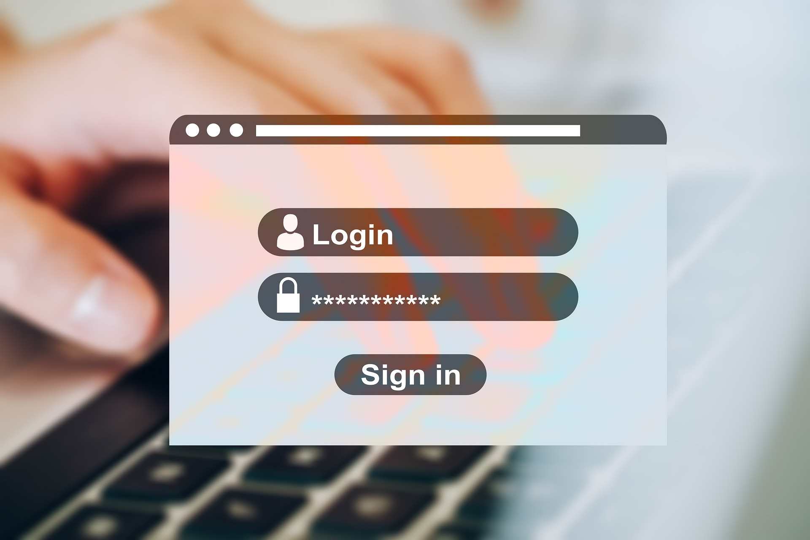
Employment
Slide hidden from learner
Online Safety: Passwords
Notes:
Slide hidden from the learner.
Information for the Tutor.
This PowerPoint lesson covers the following Online Safety video lessons:
Part One: Create a Strong Password
Use a Passphrase
Use a Combination of Random Words
Part Two: Reset Password

Slide 2
Pre-Requisite Skills
Slide hidden from learner
Mouse / Trackpad Skills: hold mouse/ use trackpad correctly; hover; click; scroll
Mobile Phone Skills: tap; open text messages app
Reading: ability to recognize simple symbols; read words and phrases
Keyboarding: Can type letters, common symbols and use Enter key on keyboard (one finger typing is ok)
Basic Navigation: move the mouse around the screen to position the cursor in correct location
Online Skills: open a browser; recognize icons; recognize text boxes; recognize links; use the search bar; search for a website; know how and where to place a cursor; use text boxes
Email skills: open email app; use Inbox; click on hyperlinks
Safety and Security: Understand weak vs. strong passwords; create a strong password; change your email password
LINK to the DLCR:
https://digital-literacy.issbc.org/for-teachers/
Password: Diglit4T
Notes:
Slide hidden from the learner.
Information for the Tutor
Pre-Requisite Skills
Remember: like all lessons in Module 9 – Employment (Review), this is a review lesson of the digital skills, and the learners may not be ready for this lesson.
Make sure the learner has the “Prerequisite Skills” listed in the slide.
These skills are not specifically reviewed in this lesson, but the learner needs to have them to be able to do the lesson.
If the learner struggles, stop the lesson and go to the following modules in the Digital Literacy Curriculum Resource (DLCR) and teach the pre-requisite skills before doing this lesson:
Module 1 Mouse and Navigating
Module 2-Keyboarding
Module 3-Online Skills Basic
Module 5: Email Skills
Module 6: Mobile Phones
Module 7: Safety and Security

Slide 3
Skills Reviewed in this Lesson
Check the Notes of this Slide
Notes:
Slide hidden from the learner.
Information for the Tutor
These skills are specifically reviewed in this lesson.
It is assumed the learner has already learned these skills and is doing this lesson as a review.
Create a Strong Password:
Use a Passphrase
Use a Combination of Random Words
Keyboarding/typing
Understand weak vs. strong passwords
Create a strong password
Enter a keyword in the browser search bar/box
Understand search results
Click in search bar
Type words
Press enter on keyboard
Check the search results
Go to a website
Open email app
Use inbox
Sign in to Indeed.ca using your email address and password:
Know where to click and then type to enter your email and password
Know where to click when you see “I am human”.
Know how to get back to homepage by clicking on the logo.
Recognize common icons on the Indeed website.
Change email password:
Know where to click in text boxes
Recognize common icons on email providers’ websites
Know which buttons to click e.g., Next, Submit etc.
Reset Password
Go to a website
Enter email to sign into account
Recognize common icons on indeed.ca and email provider websites e.g., eye icon, settings icons, apps icons etc.
Recognize and know which buttons to click e.g., Next, Submit etc.
Open email app
Use email inbox
Recognize email hyperlink and click on it to reset password
Open mobile phone text message app to read and copy verification codes

Slide 4
Instructions
For Using this PowerPoint Lesson
Slide hidden from learner
Notes:
Slide hidden from the learner.
Information for the Tutor.
This PowerPoint lesson contains everything the tutor needs: the lesson notes, suggested instructional language, the links to the video lesson(s), and Practice for each part. ​
IMPORTANT
Read through the entire lesson a few days before tutoring so you are clear about what to do and have time to get any questions answered and to do any preparation.
The first 11 slides are hidden from the learner; they contain information and instructions for the tutor.
Green Slides = Lesson Objectives
Blue Slides = the beginning of each Part of the Lesson
Yellow Slides = Practice
Instructions specific to each lesson are in the notes pages of each PowerPoint. ​
Identical notes are also available as a separate PDF for tutors who prefer that format. ​See Option B below.
You will NOT be able to copy and paste from this PowerPoint because it is “Read Only”.
In the Practice for each Part of this lesson, you may be asked to copy some text from this lesson and paste it into a Word document to use with the learner.
You will not be able to do that from this PowerPoint lesson. Instead, copy and paste the text from the PDF version of the (same) lesson.
There are different options for using this PowerPoint lesson and /or the PDF version of this (same) lesson:
Lesson Format Options for the Tutor
Option A
Use a printed version of the notes for you as tutor (not for the learner)
Plus
Use the PowerPoint slideshow for the learner.
How:
Open the PowerPoint, download and save it.
Click “File” then "Print" ​
Then under “Settings” choose " Notes Pages" .
Print
Now, you can use the printed version for tutoring.
Option B
Use the separate electronic PDF of the PowerPoint slides and notes for you as tutor (if you don’t have PowerPoint on your computer or if you prefer to use a PDF version)
Plus
Use the PowerPoint slideshow for the learner, or the PDF-Slides Only version (if the learner’s computer doesn’t have PowerPoint). ​
You can have the PDF open to use for you as tutor beside the PowerPoint slideshow, or the PDF version of the slides (for the learner).
Option C
Use the PowerPoint slideshow in “Presenter View” in PowerPoint.
This lets you show the slideshow to the learner, and also lets you see the notes as well as the slideshow that the learner sees.
This works for remote and in-person tutoring.
However, for in person tutoring for small groups you need a separate monitor or projector to do this: one for you and one for the learners.

Slide 5
Lesson Objectives – Part One
Slide hidden from learner
  Create a Strong Password:
  A. Use a Passphrase
  B. Use a Combination of Random Words
Notes:
Slide hidden from the learner.
Information for the Tutor.
Instructions to the Tutor
These are the skills learners will master at the end of the lesson.
Total Video length: 0:00-5:15 minutes [ 5:15 mins]
Part One: Create a Strong Password
A. Use a Passphrase: 0:00 -0:03:51 mins [3:51 mins]
B. Use a Combination of Random Words: 0:03:52 – 0:05:15/END [1:24 mins]

Slide 6
Lesson Objectives – Part Two
Slide hidden from learner
Reset Password
Notes:
Slide hidden from the learner.
Information for the Tutor.
Instructions to the Tutor
These are the skills learners will master at the end of the lesson.
Total Video length:
Reset Password: 0:00 – 0:04:05 minutes/END

Slide 7
Keep in Mind
Slide hidden from learner
Only do as much as the learner can absorb in one session.
Do one part of the video lesson at a time.
Check in with the learner after each part.
Notes:
Slide hidden from the learner.
Information for the Tutor.
According to the learner’s pace, do one part of the video lesson, check their understanding, and have the learner practice the skills.
Then, let them show you they can do the skills (at least three times) before proceeding to the next part.
Look for signs of learner fatigue.
Check in with learner after each part.
Is the learner doing any of the following? :
Expressing frustration
Not asking questions, shutting down, not taking in what you are saying
Seeming overwhelmed
Saying, “Are we done yet?” etc.
Lots of yawning etc.
These are clues that it is time to stop the session and resume another day.

Slide 8

Set Up and Preparation
Slide hidden from learner
Before In-Person Tutoring
Notes:
Slide hidden from the learner.
Information for the Tutor.
SET UP
Refer to TUTOR CHECKLIST- Set up for In-Person Tutoring
PREPARATION
Preparation specific to the PRACTICE for each Part of this lesson is in the notes of each “PRACTICE” slide.

Slide 9
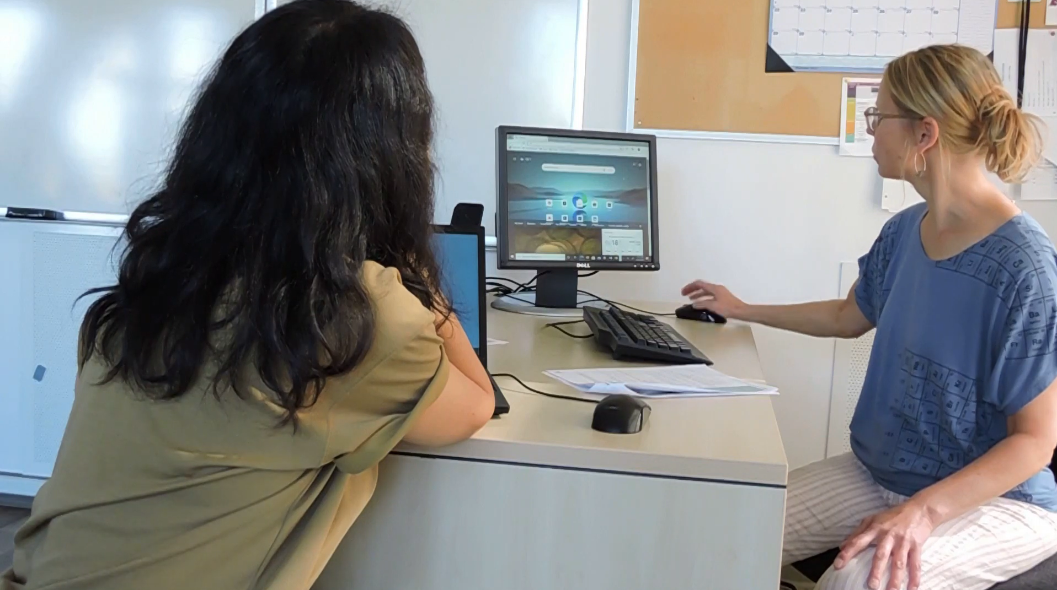
Checklist
Slide hidden from learner
During In-Person Tutoring
Notes:
Slide hidden from the learner.
Information for the Tutor.
Refer to:
TUTOR CHECKLIST- During In-Person Tutoring Sessions

Slide 10
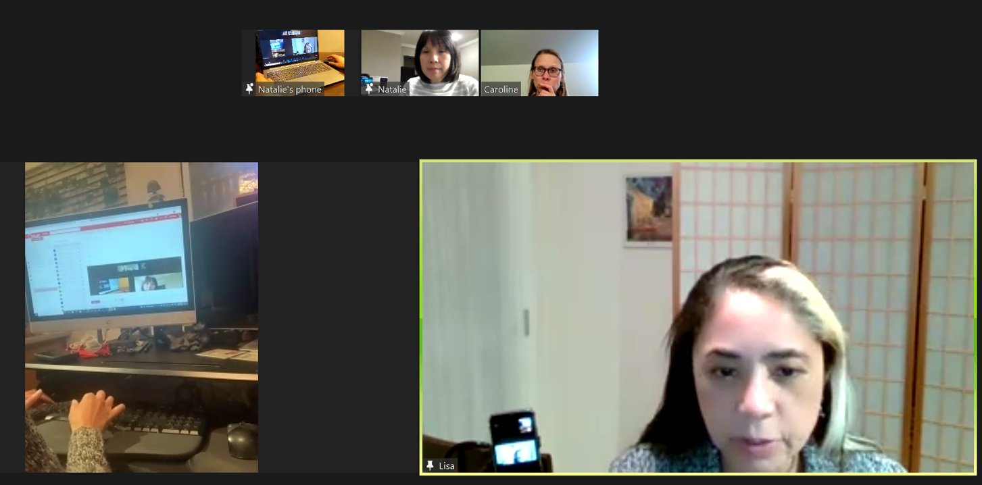
Set Up and Preparation
Slide hidden from learner
Before Remote Tutoring
Notes:
Slide hidden from the learner.
Information for the Tutor.
SET UP
Refer to:
TUTOR CHECKLIST- Set up for Remote Tutoring Session via Zoom, Ms Teams etc.
LEARNER CHECKLIST- Set up for Remote Tutoring Session via Zoom, Ms Teams etc.
Trouble-Shooting -Remote Tutoring
IMPORTANT:
Go through the Learner Checklist as well. Then, you will be able to more easily troubleshoot with the learner if they have difficulty in their set up.
Communicate beforehand with the Support Person (if that learner has one):
Email the Learner Checklist listed in #2 above to the Support Person.
Email any instructions for this lesson to the support person (see the notes for specific slides /parts of the lesson):
Have the support person do the preparation for the lesson on the learner’s desktop. Tutor needs to guide them re. how to do this.
Preparation for Remote Tutoring only:
Have support person make sure the browser icon is easy for the learner to find on the desktop.
If no preparations were made on the learner’s computer before the session by a support person, you could use the Request Remote Control function in Zoom on the learner’s desktop if the learner struggles, and before they get frustrated.
IMPORTANT: Keep in mind the following:
Before using Remote Control, be sure to get permission from your organization first.
It is crucial that the learner understands what it means, and gives you informed consent.
It is somewhat invasive and must be done respectfully and honouring the confidentiality of the learner.
Don’t use the Request Remote Control feature first! It should be a last resort.
First, try your best to teach the learner and the support person how to do things using Share screen and demonstrating.
Use it if other ways do not work and the learner really needs to learn digital skills.
You may want to record the Zoom tutoring session in case of any possible accusations afterwards.
PREPARATION
Preparation specific to each Part of this Lesson is in the notes of the relevant slides.

Slide 11
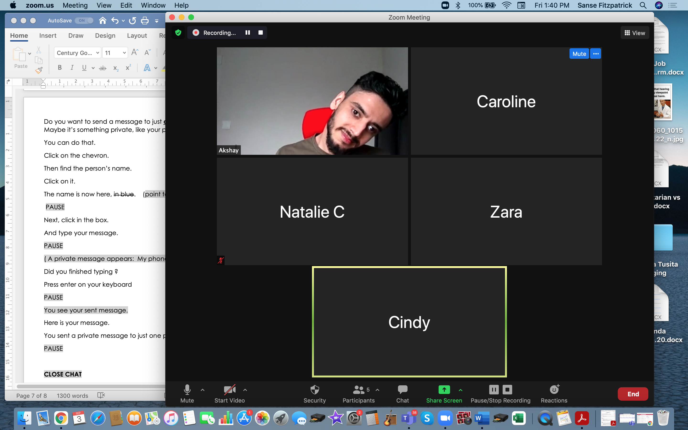
Checklist
Slide hidden from learner
During Remote Tutoring
Notes:
Slide hidden from the learner.
Information for the Tutor.
Refer to:
Tutor Checklist: During Remote Tutoring Session
Learner Instructions: How to let your Tutor have Remote Control of your Computer During a Zoom Session
Trouble-Shooting: Remote Tutoring
Be ready to assist learner by using the Requesting Remote Control function (refer to checklists 1 and 2 listed above).
You may have to set up the learner’s desktop if the learner needs support and no support person is available to do that beforehand. This is possible to do using Request Remote Control in Zoom.
IMPORTANT: Keep in mind the following:
Before using Remote Control, be sure to get permission from your organization first.
It is crucial that the learner understands what it means, and gives you informed consent.
It is somewhat invasive and must be done respectfully and honouring the confidentiality of the learner.
Don’t use the Request Remote Control feature first! It should be a last resort.
First, try your best to teach the learner and the support person how to do things using Share screen and demonstrating.
Use it if other ways do not work and the learner really needs to learn digital skills.
You may want to record the Zoom tutoring session in case of any possible accusations afterwards.

Slide 12
Employment
Online Safety:
Passwords
Notes:
SHOW THIS SLIDE AND THE REST OF THE SLIDES FROM HERE ONWARD TO THE LEARNER
Say to the learner:
Many employment websites require us to create accounts with passwords.
Simple passwords are easy to remember but they are not safe.
Hackers and computers can easily guess simple passwords.
Then they can get into our accounts.
We don’t want that to happen.
We will review how to create strong passwords, and also how to reset a password if we have forgotten it.
Today, we will focus on ... (Parts you intend to cover).

Slide 13
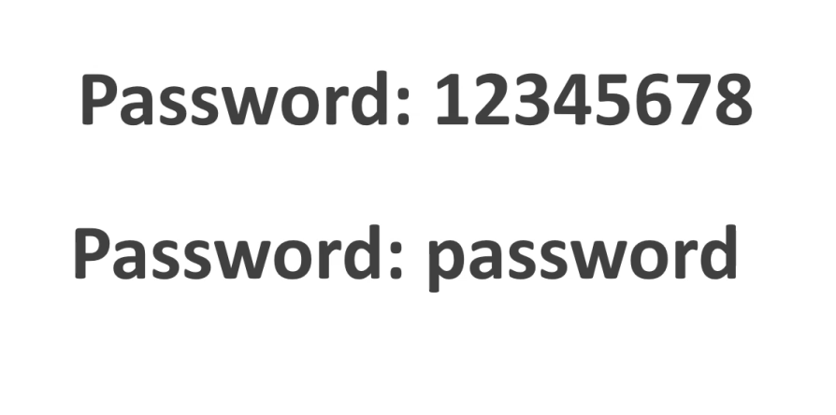
Lesson Objectives-Part One
        Create a Strong Password
X
Notes:
Instructions for the Tutor
These are the skills the learner will master at the end of Part One:
Create a Strong Password: Use a Passphrase
Create a Strong Password: Use a combination of Random Words
Say to the learner:
We’re going to review how to create a strong password.

Slide 14

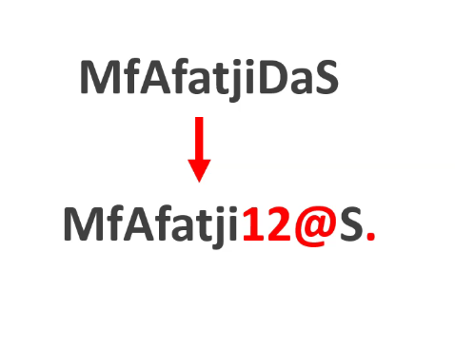
Lesson-Part One A
  Create a Strong Password:
  Use a Passphrase
Notes:
Video length:
Part One A: Create a Strong Password:
Use a Passphrase: 00:00-03:51 mins [3:51 mins]
Say to the Learner:
Let’s review how to create a strong password using a passphrase.
We’ll watch a video to review this.
We can watch the video several times. So, don't worry if you don't catch everything the first time.
Instructions for the Tutor:
Play the video several times.
Then ask comprehension check questions to check understanding. [See next slide for comprehension check questions.]
Then have learner do Practice-Part One.
Click on the PLAY icon in the slide to open the video lesson.​
Use this link to the YouTube video if the link in the slide doesn’t work: ​
https://youtu.be/C3kp3aUJljA
For remote tutoring, when you share screen to play the video, make sure you have shared the audio.
Play the lesson a bit and check the learner can hear it ok before playing the whole video.

Slide 15

Check Understanding
Notes:
Instructions for the Tutor:
After watching the segment of the video lesson, check understanding (review and elicit) before moving on.
Check understanding - ask the learner as you watch the video or as you demonstrate on your computer.
Ask these comprehension check questions, or others, to check understanding:
[Use a Passphrase]
Say to the Learner:
How many characters should a strong password have at least? Answer: At least eight characters.
What kind of letters: upper or lower case, should a strong password have? Answer: A combination of upper and lower case letters
Other than upper and lower case letters, what else does a strong password have? Answer: Numbers and symbols
What is a passphrase? Answer: It is a phrase or sentence that is easy to remember.
How do you create a strong password using a passphrase? Answer: Take the first letters of a phrase or sentence, use upper and lower case, and then replace some of the letters with numbers or symbols.
Instructions for Tutor:
Ask the learner: Do you want to watch the video again?
IMPORTANT
If the learner is struggling, stop the session.
Say to the learner:
Let’s do more work on X...... before we do this.
Instructions to the Tutor:
For example, learner may not be able to type symbols.
If so, go to the Digital Literacy Curriculum Resource (DLCR) and use the relevant module before using this video review lesson.
Teach the skills and have the learner practice.
For example, use Module 2 Keyboarding, or if needed first: Module 1 Mouse and Navigation, depending on learner needs.
Tip: Do the Needs Assessment to determine needs; use the Needs Assessment tools in the DLCR for this.

Slide 16
Practice-Part One A
  Create a Strong Password:
  Use a Passphrase
Notes:
Instructions for the Tutor:
PRACTICE-Part One-A Lesson Focus: Create a Strong Password: Use a Passphrase
PREPARATION
Both learner and tutor have a laptop or computer.
Demonstrate on the tutor laptop. Have the learner do the activity on their laptop.
Preparation for Remote Tutoring only:
Refer to Slides #10 and 11.
Email security.org’s password strength checker website to the learner and/or support person, if needed.
If no preparations were made on the learner’s computer before the session by a support person, use the Request Remote Control function in Zoom on the learner’s desktop if the learner struggles, and before they get frustrated.
IMPORTANT: Before using “Request Remote Control” with a learner, refer to the notes in slide above “Set and Preparation- Before Remote Tutoring”.
*************************************************************************************************************
PRACTICE
Instructions for the Tutor:
Demonstrate first, then let the learner practice.
Say to the Learner:
Now it’s time to practice.
We’re going to practice how to create a strong password using a passphrase, like in the video.
[After each of the following steps, wait for the learner to complete the step. Guide the learner as needed.]
IMPORTANT:
If the learner struggles to type, go back to the Digital Literacy Curriculum Resource and do Module 2-Keyboarding first.
[Create a Strong Password Using a Passphrase]
You are going to learn how to create strong passwords using a passphrase.
Remember, a strong password has at least eight characters, uses upper and lower case letters, and also letters and symbols. The longer the password, the more secure it is.
First, let’s think of a passphrase.
This is my passphrase: Spring is my favourite season now tell me what is yours? Now, you think of one. [Give learner three to five minutes to think of a passphrase; brainstorm with them if needed.].
Write the passphrase in your notebook.
How do we make it into a strong password? First, take the first letter of each word and use some upper and lower case letters → SimFSnTmWiY? Let’s check. Does it have more than 8 characters? Yes. Now, you do the same for your passphrase. [Tutor to check learner’s passphrase].
Let’s check if our passwords are strong at Security.org’s password strength checker.
Let’s find the website on the internet. First, open your browser.
In the google search bar, type how secure is my password.
There are many results. Click on the result that shows: security.org/how-secure-is-my-password.
Type in your password.
Mine will take 12,000 years for a computer to crack this password; what about yours? I think I want to make it stronger. I will change all the ‘i’s to the number 1 and the ‘n’ to the symbol ‘&’: SimFSnTmWiY? → S1mFS&TmW1Y?
Now it will take the computer 400,000 years to crack this password. I think my password is strong enough.
Now look at your password. Does it have upper and lower case letters, numbers and symbols? If no, change some of the letters.
Check your password on the password strength checker. Is your password strong? Update it in your notebook. It is also good to write the date you changed the password, so you know which is the latest password.
Let’s try again. Think of another passphrase.
Change it to a strong password.
Check it in the password strength checker.
Instructions for the Tutor:
Repeat the steps above with a new passphrase.
Say to the Learner:
Let’s practice some more.
Think of another passphrase.
Write it down in your notebook etc.
Good practice creating a strong password using a passphrase!
CHECK THE LEARNER’S SKILLS:
Have the learner show you they can do the skills at least three times without support before they do the next part of the lesson.

Slide 17
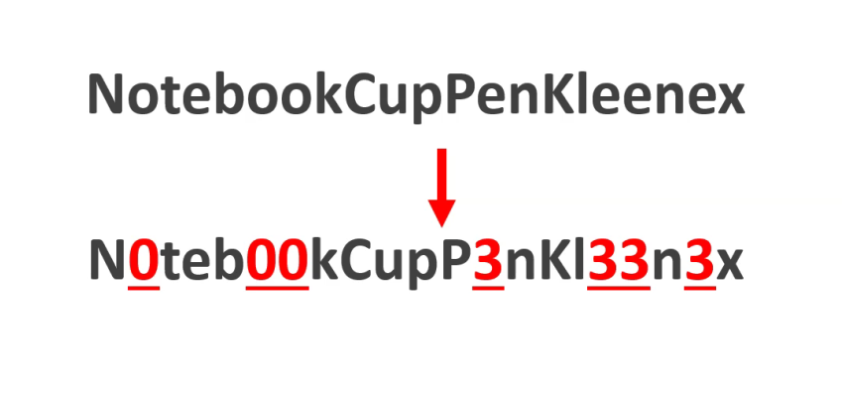
Lesson-Part One B
Create a Strong Password:
Use a Combination of Random Words
Notes:
Video length:
Part One A: Create a Strong Password:
Use a Combination of Random Words 03:52-05:15 [05:53 mins]
Say to the Learner:
Let’s review how to create a strong password by combining random words.
We’ll watch a video to review this.
We can watch the video several times. So, don't worry if you don't catch everything the first time.
Instructions for the Tutor:
Play the video several times.
Then ask comprehension check questions to check understanding. [See next slide for comprehension check questions.]
Then have learner do Practice-Part One B.
Click on the PLAY icon in the slide to open the video lesson.​
Use this link to the YouTube video if the link in the slide doesn’t work: ​
https://www.youtube.com/watch?v=C3kp3aUJljA
For remote tutoring, when you share screen to play the video, make sure you have shared the audio.
Play the lesson a bit and check the learner can hear it ok before playing the whole video.

Slide 18
Check Understanding
Notes:
Instructions for the Tutor:
After watching the segment of the video lesson, check understanding (review and elicit) before moving on.
Check understanding - ask the learner as you watch the video or as you demonstrate on your computer.
Ask these comprehension check questions, or others, to check understanding:
[Use a Combination of Random Words]
Say to the Learner:
How do you make a password stronger if you use a combination of random words? Answer: Change some of the letters to numbers or symbols.
What should you do after you created your password for a website? Answer: Write it down in a notebook and keep it safe.
Instructions for Tutor:
Ask the learner: Do you want to watch the video again?
IMPORTANT
If the learner is struggling, stop the session.
Say to the learner:
Let’s do more work on X...... before we do this.
Instructions to the Tutor:
For example, learner may not be able to type symbols.
If so, go to the Digital Literacy Curriculum Resource (DLCR) and use the relevant module before using this video review lesson.
Teach the skills and have the learner practice.
For example, use Module 2 Keyboarding, or if needed first: Module 1 Mouse and Navigation, depending on learner needs.
Tip: Do the Needs Assessment to determine needs; use the Needs Assessment tools in the DLCR for this.

Slide 19
Practice-Part One B
Create a Strong Password:
Use a Combination of Random Words
Notes:
Instructions for the Tutor:
PRACTICE-Part One-B Lesson Focus: Create a Strong Password: Use a Combination of Random Words
PREPARATION
•Both learner and tutor have a laptop or computer.
•Demonstrate on the tutor laptop. Have the learner do the activity on their laptop.
Preparation for Remote Tutoring only:
Refer to Slides #10 and 11.
Email security.org’s password strength checker website to the learner and/or support person, if needed.
If no preparations were made on the learner’s computer before the session by a support person, use the Request Remote Control function in Zoom on the learner’s desktop if the learner struggles, and before they get frustrated.
IMPORTANT: Before using “Request Remote Control” with a learner, refer to the notes in slide above “Set and Preparation- Before Remote Tutoring”.
*************************************************************************************************************
PRACTICE
Instructions for the Tutor:
Demonstrate first, then let the learner practice.
Say to the Learner:
Now it’s time to practice.
We’re going to practice creating strong passwords by combining random words.
[After each of the following steps, wait for the learner to complete the step. Guide the learner as needed.]
IMPORTANT:
If the learner struggles to type, go back to the Digital Literacy Curriculum Resource and do Module 2-Keyboarding first.
[Use a Combination of Random Words]
First, let’s think of a few random words. ‘Random’ means ‘chosen by chance’; ‘not planned’.
These are my random words: “Worms window rain” Now, you think of a few random words. [Give learner three to five minutes to think of a passphrase; brainstorm with them if needed.].
Write these random words in your notebook.
How do we make them into a strong password? Use some upper and lower case letters → WormsWindowRain Let’s check. Does it have more than 8 characters? Yes. Now, you do the same for your random words. [Tutor to check].
Let’s check if our passwords are strong at Security.org’s password strength checker.
Type in your password.
Mine will take 43 million years for a computer to crack this password; what about yours? That seems like a strong password but wait, it doesn’t have numbers or symbols. I will change some letters to numbers and symbols→ W0rm$Wind0wR@in. Change some letters to numbers and symbols for your random words. Write it down in your notebook.
Now it will take the computer 15 billion years to crack this password. I think my password is strong enough.
Now you check on the password strength checker. Is your password strong? Yes? Write it down in your notebook. Remember to write the date too.
Let’s try again. Think of another combination of random words.
Change it to a strong password.
Check it in the password strength checker.
Instructions for the Tutor:
Repeat the steps above with a new combination of random words.
Say to the Learner:
Let’s practice some more.
Think of another combination of random words.
Write it down in your notebook etc.
Good practice creating a strong password using a combination of random words!
CHECK THE LEARNER’S SKILLS:
Have the learner show you they can do the skills at least three times without support before they do the next part of the lesson.

Slide 20

Extra Practice – Part One
Notes:
Information for the Tutor:
The following from CLB2/3, Module 7 Extra Practice Activity Part 1 of the “Digital Literacy Curriculum Resource” is a good online activity for the learner to practice how to change their password in Yahoo Mail, Gmail or Outlook.
In the activity, the learner looks at how to change their passwords in Yahoo Mail, Gmail and Outlook and then practice on their own email accounts following the step-by-step instructions.
They will be able to change their email passwords into strong passwords.
Instructions for the Tutor:
PREPARATION
Both learner and tutor have a laptop or computer.
Both learner and tutor need to have their email and indeed.ca login information handy, as they will practice changing their email and indeed.ca passwords.
The computers should have two windows or tabs open: one showing the Extra Practice Activity, the other showing the email.
Demonstrate on the tutor laptop. Have the learner do the activity on their laptop.
Open the browser.
Open the “Digital Literacy Curriculum Resource Website.“
Website address: digital-literacy.issbc.org
Go to the “Students” tab
Find “CLB 2/3”
Find and open the following “Students” activity:
” Module 7-Safety and Security Part 1: Change email password”
Here is the link:
https://janis-esl.issbc.org/our-lessons/digital-literacy-clb-2-3-module-7-part-1/
Show the learner how to go to the link and enter the password: Diglit4S
Depending on what email provider they use, play the relevant segment of the video:
Yahoo! Mail: 0:00 – 1:56
Gmail: 1:56 – 3:56
Outlook: 3:57 – 5:37/end
Play the video so the learner understands how to change the password for their email.
Then have the learner do the activity on their own using the passwords they created from Practice Part One A or B.
Pull back to encourage independence.
However, if the learner is struggling, step in and guide them as needed.
For your easy reference, these are the steps to change password for the three different email providers shown in the video. As websites get updated, the steps may change slightly. Please check before sharing with learner.
Yahoo Mail
In your Yahoo Mail inbox, click on your Name, then Account Info.
Click on Account Security.
Click on Next.
Enter your current password.
Click on Change password.
Enter your new password two times.
Click on Continue, then Remind me later.
Gmail
In your Gmail inbox, click on the Settings icon, then click Settings.
Click on Accounts and Import, then click on Change password.
Enter your current password.
Enter your new password two times.
Click Change password.
Click the 3x3 9-dots icon on the top right corner to open up your Google apps
Click on the Gmail app icon to go back to your Gmail inbox.
Outlook
In your Outlook inbox, click My account.
Click More Actions, then Change password.
Enter your current password.
Enter your new password two times.
Click Save.
Click Account, then More Actions and View Inbox to go back to your Inbox.
Preparation for Remote tutoring only:
Refer to Slides #10 and 11.
Email the link and password for the Student activity to the learner and/or support person.
Say to the Learner:
Now it’s time to practice.
You are going to watch a video on how to change your password on your email.
Let’s watch it together, then you change your email’s password, according to the instructions in the video.
Use the strong password you created in Practice Part One A.
[Open and play the video.
[Check the learner is clear about what to do.]
Say to the Learner:
Let’s practice again.
Let’s change our password on indeed.ca to a safer one. [N.B. If learner doesn’t have an indeed account, please go to Employment module : Online Job Application Form – Lesson Part One, for steps to create one, and do this practice on another day.]
Sign in to indeed.ca using your email and indeed password.
Click on the person icon in the top right corner of the homepage.
Click on Settings.
Click Change password.
Enter your current password.
Enter your new password. Use the strong password you created in Practice Part One B. Be careful to type your new password correctly, as you cannot see what you’ve typed.
Click Save password.
You see this: Your password has been updated.
Click on the indeed logo to go back to the homepage.
To sign out, click on the person icon, then click Sign out.

Slide 21
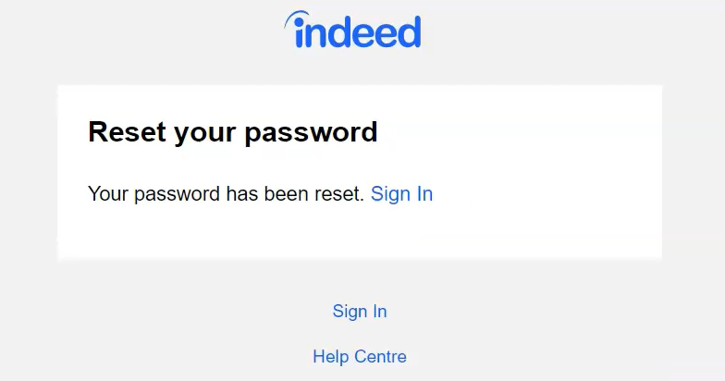
Lesson Objectives – Part Two
Reset Password
Notes:
Instructions for the Tutor
These are the skills the learner will master at the end of Part Two:
Reset Password: 0:00 – 4:05/END
Say to the learner:
What do we do when we forget a password to a website, and we can’t find it anywhere? Don’t worry, we can reset it.
We’ll watch a video to review this.
We can watch the video several times. So, don't worry if you don't catch everything the first time.

Slide 22
Lesson-Part Two
Reset Password
Notes:
Video length:
Part Two Reset Password: 0:00 – 4:05/end [4:05 mins]
Say to the Learner:
Let’s review how to reset a password to a website.
We’ll watch a video to learn.
We can watch the video several times. So, don't worry if you don't catch everything the first time.
Instructions for the Tutor:
Click on the PLAY icon in the slide to open the video lesson.​
Use this link to the YouTube video if the link in the slide doesn’t work: ​
https://youtu.be/MRV_WYq75rQ
Play the video several times to the end.
Then ask comprehension check questions to check understanding. [See next slide for comprehension check questions.]
Then have learner do Practice-Part Two.
For remote tutoring, when you share screen to play the video, make sure you have shared the audio.
Play the lesson a bit and check the learner can hear it ok before playing the whole video.

Slide 23
Check Understanding
Notes:
Instructions for the Tutor:
After watching this video lesson, check understanding (review and elicit) before moving on to the next part.
Check understanding - ask the learner as you watch the video or as you demonstrate on your computer.
Ask these comprehension check questions, or others, to check understanding:
[Open, Download and Save an Attachment]
Say to the Learner:
You’re on the indeed.ca homepage. What do you click if you want to sign in to your indeed.ca account? Show me. Answer: Click on Sign in.
What do you do next? Answer: Enter the email address I used to create my indeed.ca account.
You are on the Enter your password page. What should you click if you forgot your password? Answer: Click on Forgot password?
On the Reset your password page, what do you do after you entered the email address associated with your indeed account? Answer: Click Submit.
Where should you check to get the link to reset your indeed.ca password? Answer: My email inbox.
What is the email subject to reset Indeed password? Answer: Reset your password on Indeed.
How many characters should the password at least have? Answer: 8. It is safer to have longer passwords.
What do you click to see the password you have typed? Answer: Click on the eye icon.
When you click Sign in after you changed your password, do you have to enter your email and new password again? Answer: No, you just click on Sign in and you’re automatically signed in to indeed.ca.
Instructions for Tutor:
Ask the learner: Do you want to watch the video again?
IMPORTANT
If the learner is struggling, stop the session.
Say to the learner:
Let’s do more work on X...... before we do this.
For example, learner may not be able to find and click on email icons easily.
If so, go to the Digital Literacy Curriculum Resource (DLCR) and use the relevant module before using this video review lesson.
Teach the skills and have the learner practice.
Tip: Do the Needs Assessment to determine needs; use the Needs Assessment tools in the DLCR for this.

Slide 24
Practice-Part Two
Reset Password
Notes:
PRACTICE- Part Two: Lesson Focus: Reset Password
Instructions for the Tutor:
PREPARATION
Both learner and tutor have a laptop or computer.
Both learner and tutor should have a strong password ready for this activity. They can use the passwords created in Practice Part One, if they haven’t been used in the Extra Practice – Part One activities.
Demonstrate on the tutor laptop. Have the learner do the activity on their laptop.
Preparation for Remote Tutoring only:
Refer to Slides #10 and 11.
Say to the Learner:
Now it’s time to practice.
We’re going to practice how to reset our password when we forget them.
[After each of the following steps, wait for the learner to complete the step. Guide the learner as needed.]
IMPORTANT:
If the learner struggles, go back to the Digital Literacy Curriculum Resource and do the relevant Modules first.
[Reset password]
Go to indeed.ca.
Sign in to your account.
Enter the email address you used for your indeed.ca account.
Click Continue.
Click on Forgot password?.
Enter the email address you used for your indeed.ca account.
Click Submit.
Check your email inbox. It should be from Indeed Support; subject: Reset your password on Indeed.
Click on the email to open it.
Click Reset password.
Enter your new password. Let’s make sure it’s a strong password with at least 8 characters.
Write it down in a notebook, together with today’s date.
Click on the eye icon to see that you have typed correctly.
Click Submit.
You see this: Your password has been reset. Click Sign in.
You have signed in using your email and new password!
Instructions for the Tutor:
Repeat the steps above at least two more times. You can ask learner to change one character each time, or use the extra passwords created in Practice One. Remember, they should always update the latest password in their notebook, together with the date so they don’t get confused with so many password changes.
Say to the Learner:
Let’s practice a few more times.
CHECK THE LEARNER’S SKILLS:
Have the learner show you they can do the skills at least three times without support before they do the next part of the lesson.

Slide 25
Extra Practice – Part Two
Notes:
Instructions for the Tutor:
Resetting passwords for emails is a little more complicated; tutor to use discretion as to whether learners will be able to follow.
PREPARATION
Both learner and tutor have a laptop or computer.
Both learner and tutor should use the same email provider. Steps have been provided for Yahoo Mail, Gmail and Outlook.
Both learner and tutor should have a few strong passwords ready for use.
Both learner and tutor should have their phones (or recovery email) for verification by the email provider.
Demonstrate on the tutor laptop. Have the learner do the activity on their laptop.
Preparation for Remote tutoring only:
•Refer to Slides #10 and 11.
Say to the Learner:
Let’s practice some more.
We’ve seen how to reset our password on indeed.ca.
Resetting passwords are similar for all websites.
Let’s try to reset our email passwords.
Yahoo Mail
Go to your Yahoo! Mail sign-in page.
Enter your email, then click Next.
Click in the box beside Prove you’re not a robot, then click Continue.
Click on Forgot password?
Click on the missing digits of your phone number, then click Submit.
Enter the verification code sent to your phone, then click Verify.
Enter your new password. Click on the eye icon to check your spelling.
Click Continue.
You will see ‘Success! You’ve successfully created a new password.” Click Continue.
If yahoo! wants you to add an email or recovery no., click Remind me later.
You are back in your Inbox.
Remember to update your new password in your notebook, together with today’s date.
Gmail
Go to the gmail sign-in page.
Enter your gmail address, then click Next.
Click Forgot password?
Enter the last password you remember using with this Google Account.
Click Text for Google to send a verification code to your phone number.
Enter the code, then click Next
Create your new password.
Enter your new password again to confirm.
Click Show password to make sure you typed everything correctly.
Click Save password.
Go to the 9-dots icon on the top right of your screen, select the gmail app.
You’re in your gmail inbox.
Remember to update your new password in your notebook, together with today’s date.
[N.B.: Gmail has several ways to reset password; the steps outlined here only pertains to gmail accounts that were signed up using a phone number as a verification method. You may want to refer to this YouTube video for phone verification: https://www.youtube.com/watch?v=d3U9CG6mjDM]
Outlook
Go to the Outlook sign-in page.
Enter your email address; click Next.
Click on Forgot password?
Click on the radio button beside: “Text **********” (your phone number)
Enter the last four digits of your phone number, then click Get code.
Enter the verification code you received on your phone; click Next.
Enter your new password two times; click on the eye icon to check your typing.
Click Next.
Click Sign in.
You’re back on the sign-in page.
Enter your email and your new password.
Click Sign in.
Click No thanks to break free from password. [for now].
You’re in your Outlook inbox!

Slide 26

Practice Between Sessions
What did you learn/practice today?
When are you going to practice?
Practice Plan
Notes:
INSTRUCTIONS FOR THE TUTOR:
In-person tutoring and Remote Tutoring:
Make sure the learner knows how to access the video lesson(s) you just used so they can practice between tutoring sessions.
If relevant, make sure the support person at home knows how to access the video(s) too.
Option One
Email the video links to the learner, and if relevant the at-home support person. They can use the links in the email to access the video lesson(s) and the DLCR Extra Practice Activity:
https://janis-esl.issbc.org/our-lessons/digital-literacy-clb-2-3-module-7-part-1/
Option Two
1. Put a link to the specific video lesson(s) you did on the learner’s desktop so they can access the video easily.
How:
Open the website address for the lesson in the browser.
In the address bar, click to highlight the lesson address.
Drag the address (link) onto the desktop. It will make an icon on the desktop.
Find the icon on the desktop and check that the link works.
Show the learner where it is. Tell them to just click to access it for practice.
Remote Tutoring Only:
You can do Strategy Two by using Request Remote Control in Zoom during the tutoring session.
Refer to the following for the steps on how to do that:
Tutor Checklist-During Remote Tutoring Sessions
Learner Instructions: Let Tutor have Remote Control of your Computer During a Zoom Session
IMPORTANT: Keep in mind the following:
Before using Remote Control, be sure to get permission from your organization first.
It is crucial that the learner understands what it means, and gives you informed consent.
It is somewhat invasive and must be done respectfully and honouring the confidentiality of the learner.
Don’t use the Request Remote Control feature first! It should be a last resort.
First, try your best to teach the learner and the support person how to do things using Share screen and demonstrating.
Use it if other ways do not work and the learner really needs to learn digital skills.
You may want to record the Zoom tutoring session in case of any possible accusations afterwards.
*********************************************************************************************************************
SAY TO THE LEARNER:
You did well today.
So, what did you learn and practice today? →
Today, we learned and practiced how to: [only mention the parts you covered]
Part One A: Create a strong password by using a passphrase
Part One B: Create a strong password by using a combination of random words.
Part Two: How to reset your password.
It’s really important to review and practice as much as you can! Please do that before our next tutoring session.
Watch the video again, as many times as you need.
I’ve emailed you the link. Let’s make sure you can open it.
(OR)
We’ve put the link on your desktop. Here it is. Just click on it to watch the video.
Let’s make sure it works ok.
[Practice Plan]
Say to the learner:
Practice at least three more times before our next session.
Here is what to practice:
Part One: Create Strong Passwords
Create three strong passwords using a passphrase or a combination of random words. Make sure they have at least 8 characters; and use upper and lower case letters, numbers and symbols.
Write them down in your notebook.
Change the password for your email, indeed.ca and your email again.
Remember to update them in your notebook, together with the date, each time you change your password.
Part Two: Reset Password
Go to indeed.ca and sign in to your account.
Enter the email address you used for your indeed.ca account.
Click Continue
Click on Forgot password?.
Enter the email address you used for your indeed.ca account.
Click Submit.
Check your email inbox. It should be from Indeed Support; subject: Reset your password on Indeed.
Click on the email to open it.
Click Reset password.
Enter your new password. Let’s make sure it’s a strong password with at least 8 characters.
Write it down in your notebook.
Click on the eye icon to see that you have typed correctly.
Click Submit.
You see this: Your password has been reset. Click Sign in.
You have signed in using your email and new password!
Change your passwords two more times. Remember to update them in your notebook.
I will email you this Practice Plan. Please reply to the email so I know you got it and you have what you need to do the practice.
[Get learner to confirm they will practice and tell you when. Get specific.]
Say to the learner:
When are you going to do the practice? How many times ? etc.
Instructions for the Tutor:
Email the Practice to the learner, and if relevant to the Support Person.

Slide 27

Confirm Next Session and Support
Notes:
Instructions for the Tutor:
Confirm the next tutoring session.
Clarify any support in-between sessions if you are offering that.
If offering support outside the session time, put boundaries, be clear about when and how you are giving support.
Say to the Learner.
e.g. Great work today! etc.
Let’s meet again on X date at X time. Does that work for you?
Wonderful.
[If offering support before next session:]
If you need support before our next session, please .........
[For remote support:]
I will send you the Zoom link the day before the tutoring session.
etc.

Slide 28
See you!
Keep Practicing
Notes:
Say to the learner:
Bye and see you on X date at X time.
Keep practicing !

