Slide 1


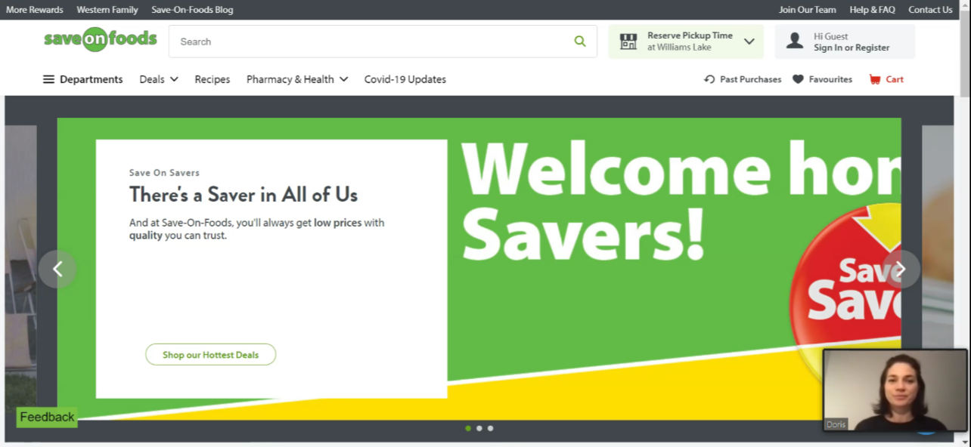
Employment
Slide hidden from learner
Online Search Skills
Notes:
Slide hidden from the learner.
Information for the Tutor.
This PowerPoint lesson covers the following Online Search video lessons:
Part One: Job Search on Indeed
Search for indeed Canada Website
Navigate indeed Canada Website
Part Two: Navigate Websites

Slide 2
Pre-Requisite Skills
Slide hidden from learner
Mouse skills: hold the mouse, left click, double click, scroll, hover, different shapes of the cursor
Navigating: opening/closing a program, cursor placement, highlighting
Keyboarding: basic typing, Enter key
Basic Online Skills: browsers, using the address bar, web address format, using keywords to search for information
Navigate websites
LINK to the DLCR:
https://digital-literacy.issbc.org/for-teachers/
Password: Diglit4T
Notes:
Slide hidden from the learner.
Information for the Tutor.
Pre-Requisite Skills
Remember: like all lessons in Module 9 – Employment (Review), this is a review lesson of the digital skills, and the learners may not be ready for this lesson.
Make sure the learner has the “Prerequisite Skills” listed in the slide.
If the learner struggles, stop the lesson and go to the following modules in the Digital Literacy Curriculum Resource (DLCR) and teach the pre-requisite skills before doing this lesson:
Module 1-Mouse and Navigating
Module 2-Keyboarding
Module 3-Online Skills Basics
Module 4-Online Skills
https://digital-literacy.issbc.org.
Go to the Teachers tab.
Password: Diglit4T

Slide 3
Skills Reviewed in this Lesson
Slide hidden from learner
Check the Notes of this Slide
Notes:
Slide hidden from the learner.
Information for the Tutor
These skills are specifically reviewed in this lesson.
It is assumed the learner has already learned these skills and is doing this lesson as a review.
Job Search on indeed – Search for indeed Canada Website
Mouse skills: hold the mouse, left click, double click, scroll, hover, different shapes of the cursor
Identify and open a browser
Differentiate between the address bar and a search bar/box
Enter a keyword in the browser search bar/box
Understand search results
Go to a website
Job Search on indeed – Navigate indeed Canada Website
Search for information on a website
Locate and use the website search bar on the home page
Identify and use:
website menus
links
Navigate Websites
Mouse skills: hold the mouse, left click, double click, scroll, hover, different shapes of the cursor
Identify and open a browser
Differentiate between the address bar and a search bar/box
Enter a keyword in the browser search bar/box
Understand search results
Go to a website
Search for information on a website
Locate and use the website search bar on the home page
Identify and use:
website menus
links
Identify common browser commands:
return to the previous page
Open and close a new tab
Identify and use the Play and Pause buttons in online video players

Slide 4
Slide hidden from learner
Instructions
For Using this PowerPoint Lesson
Notes:
Slide hidden from learner
This PowerPoint lesson contains everything the tutor needs: the lesson notes, suggested instructional language, the links to the video lesson(s), and also Practice for each part. ​
IMPORTANT
Read through the entire lesson a few days before tutoring so you are clear about what to do and have time to get any questions answered and to do any preparation.
The first 11 slides are hidden from the learner; they contain information and instructions for the tutor.
Green Slides = Lesson Objectives
Blue Slides = The Start of each Part of the Lesson
Yellow Slides = Practice Activities
Instructions specific to each lesson are in the notes pages of each PowerPoint. ​
Identical notes are also available as a separate PDF for tutors who prefer that format. ​See Option B below.
You will NOT be able to copy and paste from this PowerPoint because it is “Read Only”.
In the Practice for each Part of this lesson, you may be asked to copy some text from this lesson and paste it into a Word document to use with the learner.
You will not be able to do that from this PowerPoint lesson. Instead, copy and paste the text from the PDF version of the (same) lesson.
Option A
Use a printed version of the notes for you as tutor (not for the learner)
plus
Use the PowerPoint slideshow for the learner.
How:
Open the PowerPoint, download and save it.
Click “File” then "Print" ​
Then under “Settings” choose " Notes Pages" .
Print
Now, you can use the printed version for tutoring.
Option B
Use the separate electronic PDF of the PowerPoint slides and notes for you as tutor (if you don’t have PowerPoint on your computer or if you prefer to use a PDF version)
Plus
Use the PowerPoint slideshow for the learner, or the PDF-Slides Only version (if the learner’s computer doesn’t have PowerPoint). ​
You can have the PDF open to use for you as tutor beside the PowerPoint slideshow, or the PDF version of the slides (for the learner).
Option C
Use the PowerPoint slideshow in “Presenter View”.
This lets you show the slideshow to the learner, and also lets you see the notes as well as the slideshow that the learner sees.
This works for remote and in-person tutoring.
However, for in person tutoring for small groups you need a separate monitor or projector to do this: one for you and one for the learners.

Slide 5
Lesson Objectives – Part One
Slide hidden from learner
Job Search on indeed
  Search for indeed Canada Website
  Navigate indeed Canada Website
Notes:
Slide hidden from learner
Instructions to the Tutor
These are the skills learners will master at the end of the lesson.
Job Search on indeed
Part One A: Search for indeed Canada Website
Part One B: Navigate indeed Canada Website
Total Video length: 0:05:29 mins
Part One A: Search for indeed Canada website: 0:00-1:45 mins [1:45 mins]
Part One B: Navigate indeed Canada website: 1:45- 5:29/END [3:44 mins]
‘What’ and ‘Where’ Boxes 1:45 – 2:45 [1 min]
Filters: 2:46 – 4:21 mins [1:35 mins]
Job Postings: 4:22 – 5:26 mins [1:04 mins]

Slide 6
Lesson Objectives – Part Two
Slide hidden from learner
Navigate Websites
Navigate Websites
Notes:
Instructions to the Tutor
These are the skills learners will master at the end of the lesson.
Part Two A:
Navigate Websites
Total Video length: 7:38 mins
Search for Save-on-Foods website: 0:00-1:45 mins [1.45 mins]
Explore the Save on Foods Homepage: 1:46 – 4:42 [2.56 min]
Navigate About Us Page: 4:43 – 7:38 /End mins [2.55 mins]
Part Two B:
Navigate Websites
Total Video length: 4:02 mins
Navigate Join Our Team Page: 0:00 – 04:02 mins [4.02 min]

Slide 7
Keep in Mind
Slide hidden from learner
Only do as much as the learner can absorb in one session.
Do one part of the video lesson at a time.
Check in with the learner after each part.
Notes:
Slide hidden from the learner.
Information for the Tutor.
According to the learner’s pace, do one part of the video lesson, check their understanding, and have the learner practice the skills.
Then, let them show you they can do the skills (at least three times) before proceeding to the next part.
Look for signs of learner fatigue.
Check in with learner after each part.
Is the learner doing any of the following? :
Expressing frustration
Not asking questions, shutting down, not taking in what you are saying
Seeming overwhelmed
Saying, “Are we done yet?” etc.
Lots of yawning etc.
These are clues that it is time to stop the session and resume another day.

Slide 8

Set Up and Preparation
Slide hidden from learner
Before In-Person Tutoring
Notes:
Slide hidden from the learner.
Information for the Tutor.
SET UP
Refer to TUTOR CHECKLIST- Set up for In-Person Tutoring
PREPARATION
Preparation specific to the PRACTICE for each Part of this lesson is in the notes of each “PRACTICE” slide.

Slide 9
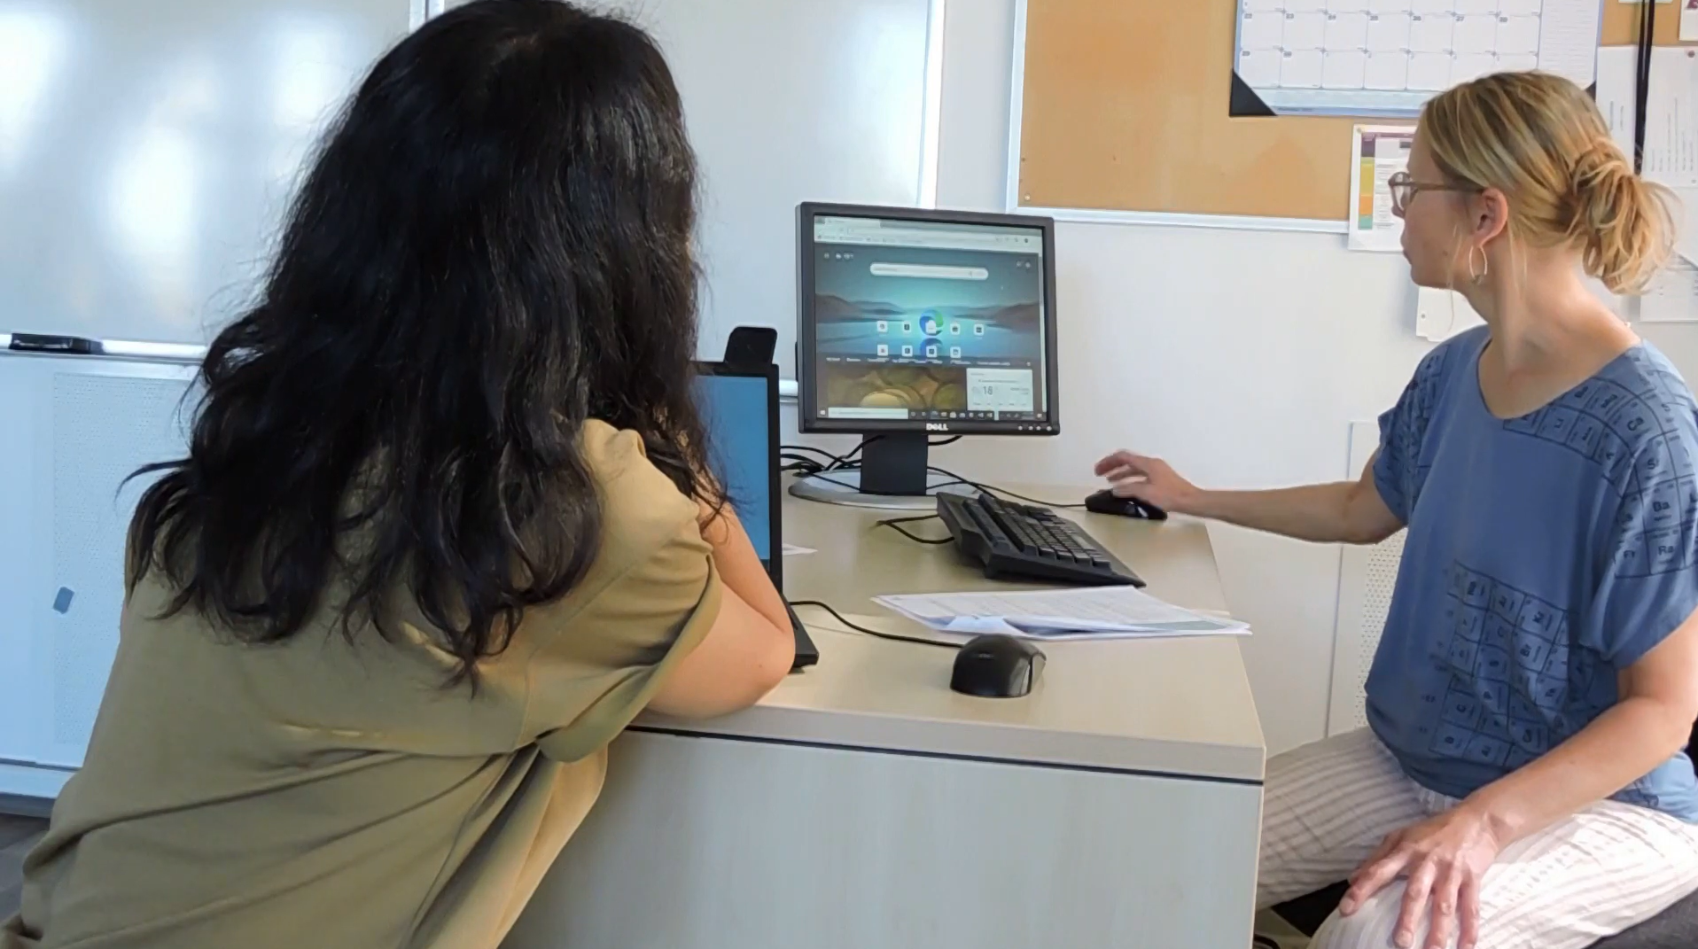
Checklist
Slide hidden from learner
During In-Person Tutoring
Notes:
Slide hidden from the learner.
Information for the Tutor.
Refer to:
TUTOR CHECKLIST- During In-Person Tutoring Sessions

Slide 10
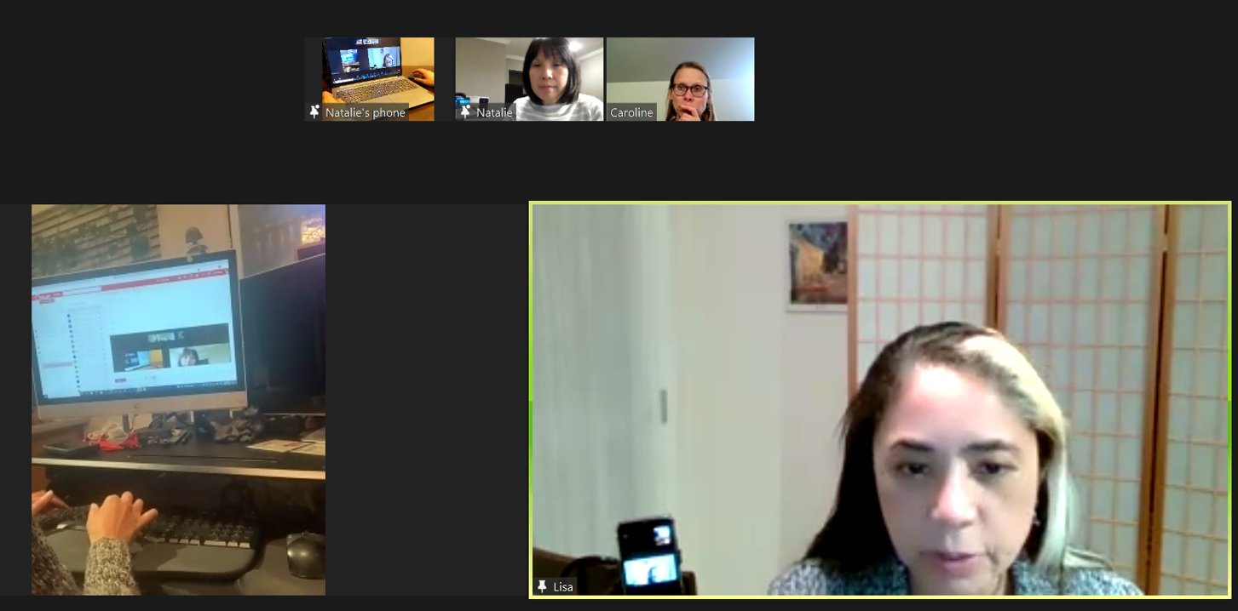
Set Up and Preparation
Slide hidden from learner
Before Remote Tutoring
Notes:
Slide hidden from the learner.
Information for the Tutor.
SET UP
Refer to:
TUTOR CHECKLIST- Set up for Remote Tutoring Session via Zoom, Ms Teams etc.
LEARNER CHECKLIST- Set up for Remote Tutoring Session via Zoom, Ms Teams etc.
Trouble-Shooting -Remote Tutoring
IMPORTANT:
Go through the Learner Checklist as well. Then, you will be able to more easily troubleshoot with the learner if they have difficulty in their set up.
Communicate beforehand with the Support Person (if that learner has one):
Email the Learner Checklist listed in #2 above to the Support Person.
Email any instructions for this lesson to the support person (see the notes for specific slides /parts of the lesson):
Have the support person do the preparation for the lesson on the learner’s desktop. Tutor needs to guide them re. how to do this.
Preparation for Remote Tutoring only:
Have support person make sure the browser icon is easy for the learner to find on the desktop.
If no preparations were made on the learner’s computer before the session by a support person, you could use the Request Remote Control function in Zoom on the learner’s desktop if the learner struggles, and before they get frustrated.
IMPORTANT: Keep in mind the following:
Before using Remote Control, be sure to get permission from your organization first.
It is crucial that the learner understands what it means, and gives you informed consent.
It is somewhat invasive and must be done respectfully and honouring the confidentiality of the learner.
Don’t use the Request Remote Control feature first! It should be a last resort.
First, try your best to teach the learner and the support person how to do things using Share screen and demonstrating.
Use it if other ways do not work and the learner really needs to learn digital skills.
You may want to record the Zoom tutoring session in case of any possible accusations afterwards.
PREPARATION
Preparation specific to each Part of this Lesson is in the notes of the relevant slides.

Slide 11
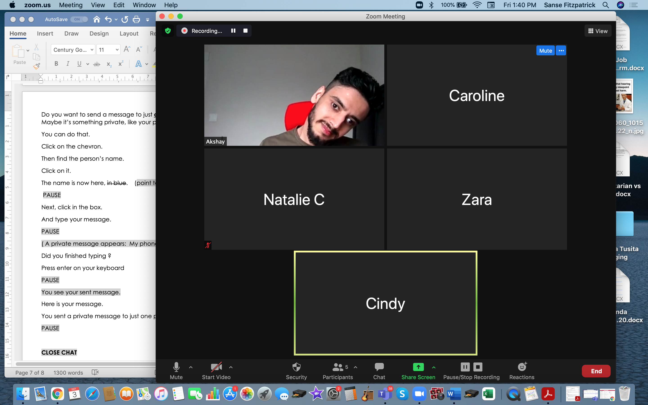
Checklist
Slide hidden from learner
During Remote Tutoring
Notes:
Slide hidden from the learner.
Information for the Tutor.
Refer to:
Tutor Checklist: During Remote Tutoring Session
Learner Instructions: How to let your Tutor have Remote Control of your Computer During a Zoom Session
Trouble-Shooting: Remote Tutoring
Be ready to assist learner by using the Requesting Remote Control function (refer to checklists 1 and 2 listed above).
You may have to set up the learner’s desktop for “Practice” activities if the learner needs support and no support person is available to do that beforehand. This is possible to do using Request Remote Control in Zoom.
IMPORTANT: Keep in mind the following:
Before using Remote Control, be sure to get permission from your organization first.
It is crucial that the learner understands what it means, and gives you informed consent.
It is somewhat invasive and must be done respectfully and honouring the confidentiality of the learner.
Don’t use the Request Remote Control feature first! It should be a last resort.
First, try your best to teach the learner and the support person how to do things using Share screen and demonstrating.
Use it if other ways do not work and the learner really needs to learn digital skills.
You may want to record the Zoom tutoring session in case of any possible accusations afterwards.

Slide 12
Employment
Online Search Skills
Notes:
SHOW THIS SLIDE AND THE REST OF THE SLIDES FROM HERE ONWARD TO THE LEARNER
Say to the learner:
Today, we’re going to learn how to search for a job posting on the Indeed Canada website.

Slide 13
Lesson Objectives – Part One
Job Search on indeed
Search for indeed Canada Website
Navigate indeed Canada Website
Notes:
Instructions to the Tutor
These are the skills learners will master at the end of the lesson.
A. Search for indeed Canada Website
B. Navigate indeed Canada Website
Say to the learner:
Today, we’re going to review how to search for information online.
First, we’ll go over how to search for the indeed Canada website and then how to navigate the indeed Canada website.

Slide 14
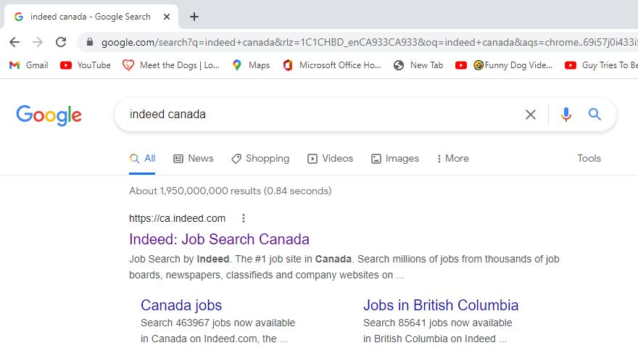

Lesson – Part One A
Search for indeed Canada Website
Notes:
Total Video length of Part One: 5:29 mins
Part One A
Search for indeed Canada website: 0:00-1:45 mins [1:45 mins]
Say to the Learner:
We are going to learn how to search for a job on the indeed.ca website. We will watch a video.
We can watch the video several times. So, don't worry if you don't catch everything the first time.
Instructions for the Tutor:
Do A only [Search for indeed Canada Website] Stop the video at 1:45 mins.
Play the video several times.
Then ask comprehension check questions to check understanding. [See next slide for comprehension check questions.]
Then have learner do Practice-Part One A.
After that, repeat the steps for Part One B [Navigate indeed Canada Website.] –These steps are in subsequent slides.
Click on the PLAY icon in the slide to open the video lesson.
Use this link to the YouTube video if the link in the slide doesn’t work:
https://youtu.be/A9P1QzwxyPE
For remote tutoring, when you share screen to play the video, make sure you have shared the audio.
Play the lesson a bit and check the learner can hear it ok before playing the whole video.

Slide 15

Check Understanding
Notes:
Instructions for the Tutor:
Check understanding
After watching the video lesson, replay the video, pause it and ask questions to check understanding (review and elicit) before moving on to the Practice.
Ask these comprehension check questions or others to check understanding:
Search for indeed Canada website
Say to the Learner:
In the video lesson, which browser did she use to get on the internet? Answer: Google Chrome
What browser do you usually use? Answer: Answers vary… Google Chrome, Microsoft Edge, Apple Safari, Mozilla Firefox
What icon does the search bar have? Show me. Answer: Magnifying glass
What do you press on the keyboard after you type your search in the search bar? Answer: Press Enter
What does ‘ca’ in a website address mean? Answer: It’s a Canadian website.
Where is the address bar on a browser? Show me. Answer: Top of the page. [Optional-not in video: you can also enter your search there in the address bar.]
Instructions for Tutor:
Ask the learner: Do you want to watch the video again?
IMPORTANT
If the learner is struggling, stop the session.
Say to the learner:
Let’s do more work on X… before we do this.
Instructions to the Tutor:
For example, learner may not know where to click on the google search homepage.
If so, go to the Digital Literacy Curriculum Resource (DLCR) and use the relevant module before using this video review lesson.
Teach the skills and have the learner practice.
For example, use Module 3 Online Skills Basics, or Module 4 Online Skills, depending on learner needs.
Tip: Do the Needs Assessment to determine needs; use the Needs Assessment tools in the DLCR for this.

Slide 16
Practice – Part One A
Search for indeed Canada Website
Notes:
Instructions for the Tutor:
PRACTICE Lesson Focus: Search for indeed Canada Website
PREPARATION
Both learner and tutor have a laptop or computer each.
Place one or more internet browser icons on the desktop and pin one or two icons to the taskbar on learner’s computer.
Go through the practice before the session to make sure there are enough job postings that come up, after the filters are used.
Preparation for Remote tutoring only:
Have support person make sure the browser icon is easy for the learner to find on the desktop.
Refer to Slides #10 and 11. Tutor should be able to see learner’s computer screen and hands.
If no preparations were made on the learner’s computer before the session by a support person, use the Request Remote Control function in Zoom on the learner’s desktop if the learner struggles, and before they get frustrated.
_________________________________________________________________________________________________
PRACTICE
Instructions for the Tutor:
Demonstrate first, then let the learner practice.
Say to the Learner:
Now it’s time to practice.
We’re going to learn how to find a job posting on Indeed Canada.
[After each of the following steps, wait for the learner to complete the step. Guide the learner as needed.]
Search for indeed Canada Website
Open your browser.
Find the search bar.
Click in the box and type Indeed Canada or Indeed.ca
Press enter on your keyboard.
Choose the ca.indeed.com website.
Click on the name or the website address. You are in the indeed Canada website!
Instructions for the Tutor:
Have the learner repeat this activity and practice as many times as they need (at least three times.)
Remote tutoring only:
[Support person would have to make sure the learner is following all the steps.
It would also be good if the tutor can see the learner’s screen and hands to make sure the learner is following.]
CHECK THE LEARNER’S SKILLS:
Has the learner shown you they can do the skills at least three times without support? If so, then they are ready to move on to the next part.

Slide 17
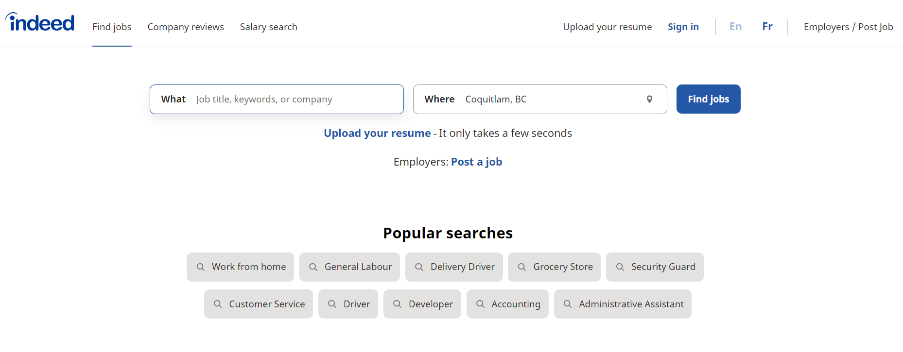
Lesson – Part One B
Navigate indeed Canada Website
Notes:
Total Video length of Part One: 5:29 mins
Part One B:
Navigate indeed Canada website: 1:45- 5:29/END [3:44 mins]
‘What’ and ‘Where’ Boxes 1:45 – 2:45 [ 1 min ]
Filters: 2:46 – 4:21 mins [1:35 mins]
Job Postings: 4:22 – 5:29 mins /End [1:04 mins]
Say to the Learner:
We are going to learn how to navigate the indeed Canada website to find job postings. We will watch a video.
We can watch the video several times. So, don't worry if you don't catch everything the first time.
Instructions for the Tutor:
Part One B video lesson starts at 1:46 mins in the video. Cue the video before the session.
Depending on the level of your learner, you may want to play the video from start to finish or stop at each segment as outlined above.
Play the video several times.
Then ask comprehension check questions to check understanding. [See next slide for comprehension check questions.]
Then have learner do Practice Part Two B.
After that, learner can continue with the Extra Practice.
Click on the PLAY icon in the slide to open the video lesson.
Use this link to the YouTube video if the link in the slide doesn’t work:
https://youtu.be/A9P1QzwxyPE
For remote tutoring, when you share screen to play the video, make sure you have shared the audio.
Play the lesson a bit and check the learner can hear it ok before playing the whole video.

Slide 18
Check Understanding
Notes:
Instructions for the Tutor:
After watching the segment of the video lesson, check understanding (review and elicit) before moving on.
Check understanding
After watching the video lesson, replay the video, pause it and ask questions to check understanding (review and elicit) before moving on to the Practice.
Ask these comprehension check questions or others to check understanding:
Navigating indeed Canada website:
‘What’ and ‘Where’ Boxes
Say to the Learner:
What kind of words can you enter in the ‘What’ search box? Answer: Job Title, Keywords or Company
What kind of words can you enter in the ‘Where’ search box? Answer: Location of the job you want
What button do you click after you enter the ‘What’ and ‘Where’ search boxes? Answer: Find jobs.
Filters
Say to the Learner:
These help us narrow down our search results (point to filters). What are they called? Answer: Filters.
Give three examples of the filters you see on the Indeed.ca website. Answer: Remote, Date posted, Salary estimate, Job type, Location, Company etc.
What happens when we click on a filter? Answer: It opens a drop-down menu. Show me the drop down menu.
Are the filters we use lighter or darker? Answer: The filters we use are darker.
Job Postings
Say to the Learner:
There are quite a few job postings in the results page. How do you go through quickly to see the job postings farther down the page? Answer: Scroll down.
Where do you click on the job posting to open it? Show me. Answer: Anywhere inside the box of the job posting.
How do you read through all the information in the job posting? Answer: Use the scroll bar to scroll through the job posting. Show me the scroll bar
Instructions for Tutor:
Ask the learner: Do you want to watch the video again?
IMPORTANT
If the learner is struggling, stop the session.
Say to the learner:
Let’s do more work on X… before we do this.
Instructions to the Tutor:
For example, learner may not know how to scroll.
If so, go to the Digital Literacy Curriculum Resource (DLCR) and use the relevant module before using this video review lesson.
Teach the skills and have the learner practice.
For example, use Module 3 Online Skills Basics, or Module 4 Online Skills, or Module 1 Mouse and Navigation, depending on learner needs.
Tip: Do the Needs Assessment to determine needs; use the Needs Assessment tools in the DLCR for this.

Slide 19
Practice – Part One B
Navigate indeed Canada Website
Notes:
Instructions for the Tutor:
PRACTICE
Lesson Focus: Navigate indeed Canada Website
PREPARATION
Both learner and tutor have a laptop or computer each.
Place one or more internet browser icons on the desktop and pin one or two icons to the taskbar on learner’s computer.
Go through the practice before the session to make sure there are enough job postings that come up in the search results, after the filters are used.
Preparation for Remote tutoring only:
Have support person make sure the browser icon is easy for the learner to find on the desktop.
Refer to Slides #10 and 11. Tutor should be able to see learner’s computer screen and hands.
If no preparations were made on the learner’s computer before the session by a support person, use the Request Remote Control function in Zoom on the learner’s desktop if the learner struggles, and before they get frustrated.
_________________________________________________________________________________________________
PRACTICE
Instructions for the Tutor:
Demonstrate first, then let the learner practice.
Say to the Learner:
Now it’s time to practice.
We’re going to learn how to find a job posting on Indeed Canada.
[After each of the following steps, wait for the learner to complete the step. Guide the learner as needed.]
Navigating indeed Canada Website
In the “What” search box, type Grocery Clerk.
In the ‘Where’ search box, type Vancouver, BC [or the region the learner lives in].
Let’s use filters to narrow our search. Click on Location and choose Burnaby [or the city learner lives in; omit this if the learner lives in a small city-there may not be enough job postings for filtering].
Click on “Job type” and choose “Permanent”.
This looks interesting. Let’s click on this job posting. [Choose a job posting]
Scroll through to read all the information in the job posting.
Instructions for the Tutor:
Have the learner repeat this activity and practice as many times as they need (at least three times.)
Remote tutoring only:
[Support person would have to make sure the learner is following all the steps.
It would also be good if the tutor can see the learner’s screen and hands to make sure the learner is following.]
CHECK THE LEARNER’S SKILLS:
Have the learner show you they can do the skills at least three times without support. If so, then they are ready to move on to the next part.

Slide 20

Extra Practice – Part One
Notes:
Instructions for the Tutor
Preparation
Both learner and tutor have a laptop or computer each.
Place one or more internet browser icons on the desktop and pin one or two icons to the taskbar on learner’s computer.
Make sure learner’s computer’s browser is closed.
Go through the practice before the session to make sure there are enough job postings that come up, after the filters are used.
For Remote tutoring only:
Refer to Slides #10 and 11. Tutor should be able to see learner’s computer screen and hands.
Extra Practice
Say to the learner:
Let’s practice some more.
You are in your desktop. Let’s open Google Chrome [or any other browser learner uses].
Search for indeed Canada.
You’re in indeed Canada. Look for ‘Warehouse Worker’ in location [city where learner lives]
Let’s use some filters. Find only Part-time jobs.
Find jobs that pay $15+/hour.
Click on the second posting [or whichever tutor sees fit].
Scroll to read the job posting. Scroll up again.
Does it say how much it pays? If yes, how much?
Instructions for the Tutor:
Have the learner repeat this activity and practice as many times as they need (at least three times.)
You can change the job searched each time. For example, cleaner, security guard, carpenter etc.
You can also change the filters used.
CHECK THE LEARNER’S SKILLS:
Has the learner shown you they can do the skills at least three times without support? If so, then they are ready to move on to the next part.

Slide 21
Lesson Objectives – Part Two
A. Navigate Websites
B. Navigate Websites
Notes:
Instructions to the Tutor
These are the skills learners will master at the end of the lesson.
Total Video length: Navigate Websites Part A: 7:38 mins
Navigate Websites Part B: 4:02 mins
Say to the Learner:
We are going to learn how to navigate a company website to find useful information for a job interview.
We will watch two videos.
We can watch the videos several times. So, don't worry if you don't catch everything the first time.

Slide 22
Lesson – Part Two A
Navigate Websites
Notes:
Total Video length: 7:38 mins
Navigate Websites Part A
Search for Save-on-Foods website: 0:00-2:07 mins [2:07 mins]
Explore the Save on Foods Homepage: 2:08 – 4:43 [2:35 min]
Navigate About Us Page: 4:43 – 7:38 /End mins [2:55 mins]
Say to the Learner:
Let’s watch how to navigate the Save-on-Foods website to find useful information for a job interview.
Instructions for the Tutor:
Play the video and stop at each segment as outlined above.
Play the video several times.
Then ask comprehension check questions to check understanding. [See next slide for comprehension check questions.]
Then have learner do Practice Part Two A.
After that, repeat the steps for Part Two B [Navigate Websites Part B] –These steps are in subsequent slides.
Click on the PLAY icon in the slide to open the video lesson.
Use this link to the YouTube video if the link in the slide doesn’t work:
https://youtu.be/arBQ6f72Ujc
For remote tutoring, when you share screen to play the video, make sure you have shared the audio.
Play the lesson a bit and check the learner can hear it ok before playing the whole video.

Slide 23
Check Understanding
Notes:
Instructions for the Tutor:
After watching the segment of the video lesson, check understanding (review and elicit) before moving on.
Check understanding
After watching the video lesson, replay the video, pause it and ask questions to check understanding (review and elicit) before moving on to the Practice.
Ask these comprehension check questions or others to check understanding:
Search for Save-on-Foods website
Say to the Learner:
What icon does the search bar have? Show me. Answer: Magnifying glass
What do you press on the keyboard after you type in your search in the search bar? Answer: Press Enter
What does it mean when the cursor changes from an arrow to a hand? Answer: It’s a hyperlink; you can click on the link to bring you to another page.
Explore the Save on Foods Homepage
Say to the Learner:
What is the first page of a website called? Answer: Homepage
Where is the main menu? Show me. Answer: At the top: the menu that shows Department, Deals, Recipes etc.
How do you open the Departments menu? Answer: Click on Departments – the drop-down menu opens up.
How do you close the Departments menu? Answer: Find the X. Click on it. Show me the X.
How do you go down the page? Answer: Scroll down – Hover over the scroll bar. Left click, hold and drag the scroll bar downwards. Or, use the scroll wheel to scroll downwards. Show me the scroll bar.
How do you hover over a link? Answer: Move the mouse over a link or button but don’t click.
When you hover over the Shop Now button, what color does it change to? Answer: Green.
Where is the company information about Save on Foods located on the home page? Show me. Answer: At the bottom of the page under Our Company.
What are the three main categories you can find at the bottom of the page? Answer: Our company, Customer Service and Quick Links.
Navigate About Us Page
Say to the Learner:
What happens when you click on “Read More” under “Get to Know Us”? Answer: It shows the full text of the “Get to Know Us” section.
What happens when you click on “Meet our Leadership Team” under “Darrell’s Story”? Answer: It brings you to the “Leadership team” page.
How do you go back to the “About Us” page from the Leadership team page? Answer: Click on the back button at the top left corner of the page. Show me the back button.
You’re back at the “Get to Know Us” page. How do you see further down the page? Answer: Scroll down. Show me the scroll bar.
How do you get back to the top of the page? Answer: Scroll up.
Instructions for Tutor:
Ask the learner: Do you want to watch the video again?
IMPORTANT
If the learner is struggling, stop the session.
Say to the learner:
Let’s do more work on X… before we do this.
Instructions to the Tutor:
For example, learner may not know how to use the back button to go back to the previous page.
If so, go to the Digital Literacy Curriculum Resource (DLCR) and use the relevant module before using this video review lesson.
Teach the skills and have the learner practice.
For example, use Module 3 Online Skills Basics, or Module 4 Online Skills, depending on learner needs.
Tip: Do the Needs Assessment to determine needs; use the Needs Assessment tools in the DLCR for this.

Slide 24
Practice – Part Two A
Navigate Websites
Notes:
Instructions for the Tutor:
PRACTICE Lesson Focus: Navigate Websites Part Two A
PREPARATION
Both learner and tutor have a laptop or computer each.
Place one or more internet browser icons on the desktop and pin one or two icons to the taskbar on learner’s computer.
Websites often update and change. Navigate the website before the lesson, to make sure it is still the same or take note of the changes and adapt accordingly.
Preparation for Remote tutoring only:
Refer to Slides #10 and 11. Tutor should be able to see learner’s computer screen and hands.
_________________________________________________________________________________________________
PRACTICE
Instructions for the Tutor:
Demonstrate first, then let the learner practice.
Say to the Learner:
Now it’s time to practice.
We’re going to learn how to navigate the Save-on-Foods website.
[After each of the following steps, wait for the learner to complete the step. Guide the learner as needed.]
Explore the Save-on-Foods Homepage
Open your browser.
In the search bar, type “Save on foods.”
Press enter on your keyboard.
Choose the Save-on-Foods website.
Click on the name or the website address. You are in the Save-on-Foods website homepage.
Hover over some links in the main menu: “Departments, Deals, Recipes, Pharmacy & Health” etc… Don’t click.
Hover over “Departments”. Click on it. A drop-down menu opens.
Hover over some links…”Fruits and Vegetables, Baby Care, Meat & Seafood.” But don’t click.
These are not about the company. Click X to close this menu.
Scroll down slowly. Is there any information about the company? No… not really, it looks like this website is for online shopping.
Scroll down to the bottom of the page.
Here’s information about the company! “Find Our company.”
Hover over “About Us, Join Our Team, Retail Careers”…etc.
Navigate About Us Page
Move the cursor over “About Us.” Click on it.
Find “Get to Know Us” and read a bit about the company. Click on “Read More” to read all the text.
Scroll down to “Darrell’s Story”…Read the information.
Then click on the button “Meet our leadership team”
Scroll down to see who is in the leadership team.
Scroll up again.
Now, let’s go back...
To go back, find the Back button in the top left corner. Click on it.
You are back to where you were before.
Let’s continue exploring this page. Scroll down some more. “Supporting Local, Community Support”…
Click on “Learn More”. More information.
Let’s go back again. Click on the back button.
Scroll down some more.
Join Our Team….
Click “Learn More”.
Instructions for the Tutor:
Have the learner repeat this activity and practice as many times as they need (at least three times.)
Remote tutoring only:
[Support person would have to make sure the learner is following all the steps.
It would also be good if the tutor can see the learner’s screen and hands to make sure the learner is following.]
CHECK THE LEARNER’S SKILLS:
Has the learner shown you they can do the skills at least three times without support? If so, then they are ready to move on to the next part.

Slide 25
Lesson – Part Two B
Navigate Websites
Notes:
Total Video length: 4:18 mins
Navigate Websites Part Two B
Navigate Join Our Team Page: 0:00 – 04:18 mins [4.18 mins]
Say to the Learner:
Let’s continue to watch how to navigate the Save-on-Foods website to find useful information for a job interview.
Instructions for the Tutor:
Play the video several times.
Then ask comprehension check questions to check understanding. [See next slide for comprehension check questions.]
Then have learner do Practice Part Two B.
After that, learner can continue with the Extra Practice.
Click on the PLAY icon in the slide to open the video lesson.
Use this link to the YouTube video if the link in the slide doesn’t work:
https://youtu.be/OmTosAnmisk
For remote tutoring, when you share screen to play the video, make sure you have shared the audio.
Play the lesson a bit and check the learner can hear it ok before playing the whole video.

Slide 26
Check Understanding
Notes:
Instructions for the Tutor:
After watching the segment of the video lesson, check understanding (review and elicit) before moving on.
Check understanding
After watching the video lesson, replay the video, pause it and ask questions to check understanding (review and elicit) before moving on to the Practice.
Ask these comprehension check questions or others to check understanding:
Navigate Join our Team Page:
Say to the Learner:
There’s a video on this page. How do you play the video? Answer: Click on the play button in the middle of the video; it looks like a triangle pointing right in a red box.
How do you pause the video? Answer: Click on the video again or click on the pause button; it looks like two vertical lines. Show me the pause button.
How do you go back to the home page? Answer: Click on the Save-on-Foods logo at the top left corner of the page.
Instructions for Tutor:
Ask the learner: Do you want to watch the video again?
IMPORTANT
If the learner is struggling, stop the session.
Say to the learner:
Let’s do more work on X… before we do this.
Instructions to the Tutor:
For example, learner may not know how to use the back button to go back to the previous page.
If so, go to the Digital Literacy Curriculum Resource (DLCR) and use the relevant module before using this video review lesson.
Teach the skills and have the learner practice.
For example, use Module 3 Online Skills Basics, or Module 4 Online Skills, depending on learner needs.
Tip: Do the Needs Assessment to determine needs; use the Needs Assessment tools in the DLCR for this.

Slide 27
Practice – Part Two B
Navigate Websites
Notes:
Instructions for the Tutor:
PRACTICE Lesson Focus: Navigate Websites Part Two B
PREPARATION
Both learner and tutor have a laptop or computer each.
Place one or more internet browser icons on the desktop and pin one or two icons to the taskbar on learner’s computer.
Websites often update and change. Navigate the website before the lesson, to make sure it is still the same or take note of the changes and adapt accordingly.
Preparation for Remote tutoring only:
Refer to Slides #10 and 11. Tutor should be able to see learner’s computer screen and hands.
_________________________________________________________________________________________________
PRACTICE
Instructions for the Tutor:
Demonstrate first, then let the learner practice.
Say to the Learner:
Now it’s time to practice.
We’re going to learn how to navigate the Save-on-Foods website.
[After each of the following steps, wait for the learner to complete the step. Guide the learner as needed.]
Navigate Join our Team Page
You are in the “About Us” page.
Scroll down to find “Join our Team”. Click Learn more.
You see “Join our Team” again.
Hover over “View Current Opportunities and “Apply Here”. Don’t click.
Scroll down some more to “Why join the Save-on-Foods team?”
Click Learn more. There’s a lot of information here !
“Community…. Diversity…”
Let’s go back to the previous page.
Find the video on the right of the screen. Click on it to play the video a bit.
Click pause to pause the video.
Scroll down slowly. There is a lot of useful information on this page.
Now, let’s go back to the homepage. Find the Save-on-Foods logo. Click on it.
You’re back at the homepage!
Instructions for the Tutor:
Have the learner repeat this activity and practice as many times as they need (at least three times.)
Remote tutoring only:
[Support person would have to make sure the learner is following all the steps.
It would also be good if the tutor can see the learner’s screen and hands to make sure the learner is following.]
CHECK THE LEARNER’S SKILLS:
Has the learner shown you they can do the skills at least three times without support? If so, then they are ready to move on to the next part.

Slide 28
Extra Practice – Part Two
Notes:
Instructions for the Tutor
Preparation
Both learner and tutor have a laptop or computer each.
Place one or more internet browser icons on the desktop and pin one or two icons to the taskbar on learner’s computer.
Make sure learner’s computer’s browser is closed.
Do the practice before the lesson so you know the steps.
For Remote tutoring only:
Refer to Slides #10 and 11. Tutor should be able to see learner’s computer screen and hands.
Extra Practice
Say to the learner:
Let’s practice some more.
We’re at the Save-on-Foods homepage. Let’s explore the links at the top of the page. Like the main menu, these links also appear on every page of the Save-on-Foods website.
Hover over the links at the top of the homepage… “More Rewards, Western Family, Save-on-Foods blog.”
Let’s click on “More Rewards”. Oh, an invitation to join “More Rewards”? No, not now. Find the X. Click on it.
Scroll through the information on this page. Oh… this is about the Save-on-Foods rewards program.
Let’s go back to the previous page. Wait! The back arrow button is greyed out. We can’t go back that way.
Oh! This page opened in a new tab. Sometimes, a link will open in a new tab. To go back to the previous page, click on the Save-on-Foods tab. Or you can click on the X on the “More Rewards” tab to close it.
You’re back at the Save-on-Foods homepage.
Let’s go to the top right links: “Join our Team, Help & FAQ, Contact Us…”
Click on “Join our Team”. Oh! This is the same page that we visited before. Sometimes, websites put important pages in more than one place, so it’s easy for people to find.
Let’s click on “Help & FAQ”, then click on “Contact Us”.
Let’s scroll down to the bottom of the page. Find “Help & FAQ” and “Contact Us” at the bottom of the page. Click on them. They are the same pages.
There’s more than one way to go to these important pages.
Instructions for the Tutor:
Have the learner repeat this activity and practice as many times as they need (at least three times.)
CHECK THE LEARNER’S SKILLS:
Has the learner shown you they can do the skills at least three times without support? If so, then they are ready to move on to the next part.

Slide 29

Practice Between Sessions
What did you learn/practice today?
When are you going to practice?
Practice Plan
Notes:
INSTRUCTIONS FOR THE TUTOR:
In-person tutoring and Remote Tutoring:
Make sure the learner knows how to access the video lesson(s) you just used so they can practice between tutoring sessions.
If relevant, make sure the support person at home knows how to access the video(s) too.
Option One
Email the video link to the learner, and if relevant the at-home support person. They can use the link in the email to access the video lesson(s).
Option Two
Put a link to the specific video lesson(s) you did on the learner’s desktop so they can access the video easily.
How:
Open the website address for the lesson in the browser.
In the address bar, click to highlight the lesson address.
Drag the address (link) onto the desktop. It will make an icon on the desktop.
Find the icon on the desktop and check that the link works.
Show the learner where it is. Tell them to just click to access it for practice.
Remote Tutoring Only:
You can do Option Two above by using Request Remote Control in Zoom during the tutoring session.
Refer to the following for the steps on how to do that:
Tutor Checklist-During Remote Tutoring Sessions
Learner Instructions: Let Tutor have Remote Control of your Computer During a Zoom Session
IMPORTANT: Keep in mind the following:
Before using Remote Control, be sure to get permission from your organization first.
It is crucial that the learner understands what it means, and gives you informed consent.
It is somewhat invasive and must be done respectfully and honouring the confidentiality of the learner.
Don’t use the Request Remote Control feature first! It should be a last resort.
First, try your best to teach the learner and the support person how to do things using Share screen and demonstrating.
Use it if other ways do not work and the learner really needs to learn digital skills.
You may want to record the Zoom tutoring session in case of any possible accusations afterwards.
********************************************************************************************************************************
SAY TO THE LEARNER:
You did well today.
So, what did you learn and practice today? →
Today, we learned and practiced how to search for information online: [only mention the parts you covered]
Use the browser to search for the indeed Canada website
Navigate the indeed Canada website to look for job postings. You
Used the ‘what’ and ‘where’ boxes;
Used filters to look for job postings;
Read job postings.
Navigate the Save-on-Foods website
Explore the Save on Foods Homepage
Navigate About Us Page
Navigate Join our Team Page
It’s really important to review and practice as much as you can! Please do that before our next tutoring session.
Watch the video again, as many times as you need.
I’ve emailed you the link. Let’s make sure you can open it.
(OR)
We’ve put the link on your desktop. Here it is. Just click on it to watch the video. Let’s make sure it works ok.
Practice Plan
Adapt the following according to what you reviewed in the session.
Say to the learner:
Practice at least three more times before our next session.
Here is what to practice:
I will email you this Practice Plan (see below). Please reply to the email so I know you got it and have what you need to do the practice.
[Get learner to confirm they will practice and tell you when. Get specific.]
When are you going to do the practice? How many times? etc.
Instructions for the Tutor:
Email the practice plans to the support person and learner. Please go through Practice Plans beforehand to make sure the website has not had recent updates. Please adapt Practice Plans accordingly if website has been updated.
Practice Plan Part One:
Use the browser to search for indeed Canada.
You’re in indeed Canada. Look for three jobs using filters:
‘Grocery Clerk’ in location (city where learner lives)
Filters: permanent jobs; posted in the last 7 days; pays $15+/hour
b. Warehouse worker in location (city where learner lives)
Filters: full-time job; posted in the last 14 days; pays $15+/hour
c. Cleaner in location (city where learner lives)
Filters: part-time jobs; posted in the last 14 days; pays $20+/hour
3. Click on the first job posting for each job. Scroll to read the job posting.
Practice Plan Part Two:
You may email “Practice – Part Two” and “Extra Practice – Part Two” as part of the Practice Plan.
Below is another Practice Plan:
Open your browser.
In the Google search bar, enter “Save on Foods”
Click on the Save-on-Foods link.
You’re on the Save-on-Foods homepage.
Scroll down to the bottom of the page.
Look for “Retail Careers”. It is under “Our Company” in the left column
Click on “Retail Careers”.
Read “Benefits & Perks” in the middle of the page.
Scroll down to the bottom of the page.
Look for “In the News” in the middle column, under “Customer Service”.
Click on it.
Click on the latest news/media release.
Click ‘X’ to close the news/media release.
On the “In the News” page, click the back button to go back to the previous page.
You’re back at the “Retail Careers” page. Click on the Save-on-Foods logo to go back to the homepage.

Slide 30

Confirm Next Session and Support
Notes:
Instructions for the Tutor:
Confirm the next tutoring session.
Clarify any support in-between sessions if you are offering that.
If offering support outside the session time, put boundaries, be clear about when and how you are giving support.
Say to the Learner.
e.g. Great work today! etc.
Let’s meet again on X date at X time. Does that work for you?
Wonderful.
[If offering support before next session:]
If you need support before our next session, please .........
[For remote support:]
I will send you the Zoom link the day before the tutoring session.
etc.

Slide 31
See you!
Keep Practicing
Notes:
Bye and see you on X date at X time.
Keep practicing!

