Slide 1


Employment
Slide hidden from learner
YouTube Video Search
Notes:
Slide hidden from learner
Title slide

Slide 2
Pre-Requisite Skills
Slide hidden from learner
Mouse / Trackpad Skills: hold mouse/ use trackpad correctly; hover; click; double click; scroll
Reading: ability to recognize simple symbols; read words and phrases
Keyboarding: Can type letters, common symbols and use Enter key on keyboard (one finger typing is ok)
Basic navigation: scroll down and up; cursor shapes; where and how to place a cursor
Online Skills: open a browser; find a website; recognize icons; recognize text boxes; recognize links; know how and where to place a cursor
LINK to the DLCR:
https://digital-literacy.issbc.org/for-teachers/
Password: Diglit4T
Notes:
Slide hidden from learner
Pre-Requisite Skills
Remember: like all lessons in Module 9 – Employment (Review), this is a review lesson of the digital skills, and the learners may not be ready for this lesson.
Make sure the learner has the “Prerequisite Skills” listed in the slide.
These skills are not specifically reviewed in this lesson, but the learner needs to have them to be able to do the lesson.
If the learner struggles, go to the following modules in the Digital Literacy Curriculum Resource (DLCR) and teach the pre-requisite skills before doing this lesson:
Module 1 Mouse and Navigating
Module 2 Keyboarding
Module 3 Online Skills Basic
Module 4 Online Skills

Slide 3
Skills Reviewed in this Lesson
Slide hidden from learner
Check the Notes of this Slide
Notes:
Slide hidden from the learner
Information for the Tutor
These skills are specifically reviewed in this lesson.
It is assumed the learner has already learned these skills and is doing this lesson as a review.
PART ONE
Search for YouTube in the browser
Use the search bar
Click in the box
Type the name
Press enter on your keyboard
Scroll down to see search results
Choose from the search results
Open a link from the search results:
Recognize the name or website address is a link
Click on the link to open it
Search for videos on YouTube
Use the search bar
Click in the box
Type the name
Press enter on your keyboard
Scroll down to see search results
Recognize which videos on YouTube are posted by the company and which are posted by other people
Recognize links
Open a link in the search results:
Recognize the name or website address is a link
Click on the link to open it
PART TWO
Navigate on a YouTube Channel
Recognize a YouTube channel
Pause a video ( Click on icon or on video image)
Use a menu
See all Videos on a YouTube Channel
Use the menu and find “Videos”
Scroll to see all videos
Choose a video
Play a video ( Click on icon or on video image)
Recognize an ad
Skip ads (Click on icon after 5 seconds)
Scroll down
Go back to the YouTube channel homepage
Recognize the logo/ name
Click on it
Recognize links
PART THREE
Search by Playlist Topics on a YouTube Channel
Understand what a “Playlist” is
Find and open “Playlists” in the menu
Scroll to see all playlists
Recognize links
Open and view one playlist; “View Full Playlist”
Understand how many videos are in one playlist
Go back to the homepage (use the back icon/button)
See all Videos on a YouTube Channel
Use the menu and find “Videos”
Scroll to see all videos
Choose and open a video
Skips Ads
Use the Skip ads icon
Play a Video and Pause a Video
Click on the name or video picture to pause or play it
Use the “Play” icon
PART FOUR
Make the Video Full Screen
Understand you can make the video full screen
Use the full screen feature:
Recognize the full screen icon
Click on it
Understand that the icons may disappear
Get the icons to appear again (move the cursor a bit)
Exit full screen:
Recognize the icon and click on it
OR
Press ESC on keyboard
Volume- Turn up/down
Understand that YouTube has a volume function
Turn up / down the volume
Find volume icon
Click along volume bar
Turn on/ off Closed Captions
Understand that you can read what the speaker says while they speak
Understand this is called “Closed Captions” (CC for short)
Turn on/off Closed Captions (CC)
Find CC icon
Click on it

Slide 4
Slide hidden from learner
Instructions
For Using this PowerPoint Lesson
Notes:
Slide hidden from learner
This PowerPoint lesson contains everything the tutor needs: the lesson notes, suggested instructional language, the links to the video lesson(s), and also Practice for each part. ​
IMPORTANT
Read through the entire lesson a few days before tutoring so you are clear about what to do and have time to get any questions answered and to do any preparation.
The first 13 slides are hidden from the learner; they contain information and instructions for the tutor.
Green Slides = Lesson Objectives
Blue Slides = The Start of each Part of the Lesson
Yellow Slides = Practice Activities
Instructions specific to each lesson are in the notes pages of each PowerPoint. ​
Identical notes are also available as a separate PDF for tutors who prefer that format. ​See Option B below.
You will NOT be able to copy and paste from this PowerPoint because it is “Read Only”.
In the Practice for each Part of this lesson, you may be asked to copy some text from this lesson and paste it into a Word document to use with the learner.
You will not be able to do that from this PowerPoint lesson. Instead, copy and paste the text from the PDF version of the (same) lesson.
There are different options for using this PowerPoint lesson and /or the PDF version of this (same) lesson:
Lesson Format Options for the Tutor
Option A
Use a printed version of the notes for you as tutor (not for the learner)
plus
Use the PowerPoint slideshow for the learner.
How:
Open the PowerPoint, download and save it.
Click “File” then "Print" ​
Then under “Settings” choose " Notes Pages" .
Print
Now, you can use the printed version for tutoring.
Option B
Use the separate electronic PDF of the PowerPoint slides and notes for you as tutor (if you don’t have PowerPoint on your computer or if you prefer to use a PDF version)
Plus
Use the PowerPoint slideshow for the learner, or the PDF-Slides Only version (if the learner’s computer doesn’t have PowerPoint). ​
You can have the PDF open to use for you as tutor beside the PowerPoint slideshow, or the PDF version of the slides (for the learner).
Option C
Use the PowerPoint slideshow in “Presenter View”.
This lets you show the slideshow to the learner, and also lets you see the notes as well as the slideshow that the learner sees.
This works for remote and in-person tutoring.
However, for in person tutoring for small groups you need a separate monitor or projector to do this: one for you and one for the learners.

Slide 5
Lesson Objectives – Part One
Slide hidden from learner
Search for YouTube in the browser
Search for Videos on YouTube
Notes:
Slide hidden from learner
Instructions to the Tutor
These are the skills learners will master at the end of the lesson.
Search for YouTube in the browser
Search for Videos on YouTube
For a list of the discrete skills in each section listed above, see slide 4 “Skills Reviewed in this Lesson”
Video length: 0:00-4:24 minutes [ 4:24 mins]

Slide 6
Lesson Objectives – Part Two
Slide hidden from learner
Navigate on a YouTube Channel
Notes:
Slide hidden from learner
Instructions to the Tutor
These are the skills learners will master at the end of the lesson:
Navigate on a YouTube Channel
For a list of the discrete skills, see slide 4 “Skills Reviewed in this Lesson”
Video length: 0:00- 3:50 minutes [ 3:50 mins]

Slide 7
Lesson Objectives – Part Three
Slide hidden from learner
Search by Playlist Topics on a YouTube Channel
Notes:
Slide hidden from learner
Instructions to the Tutor
These are the skills learners will master at the end of the lesson:
Search by Playlist Topics on a YouTube Channel
For a list of the discrete skills, see slide 4 “Skills Reviewed in this Lesson”
Video length: 0:00-4:43 minutes [ 4:43 mins]

Slide 8
Lesson Objectives – Part Four
Slide hidden from learner
Make the Video Full Screen
Volume- Turn up/down
Closed Captions- Turn on/ off
Notes:
Slide hidden from learner
Instructions to the Tutor
These are the skills learners will master at the end of the lesson:
Make the Video Full Screen
Volume- Turn up/down
Closed Captions-Turn on/off
For a list of the discrete skills in each section listed above, see slide 4 “Skills Reviewed in this Lesson”
Video length: 0:00-3:39 minutes [ 3:39 mins]

Slide 9
Keep in Mind
Slide hidden from learner
Only do as much as the learner can absorb in one session.
Do one part of the video lesson at a time.
Check in with the learner after each part.
Notes:
Slide hidden from learner
Information for the Tutor
According to the learner’s pace, do one part of the video lesson, check their understanding, and have the learner practice the skills. Then, let them show you they can do the skills (at least three times) before proceeding to the next part.
Look for signs of learner fatigue. Check in with learner after each part.
Is the learner is doing any of the following ?
Expressing frustration
Not asking questions, shutting down, not taking in what you are saying
Seeming overwhelmed
Saying, “Are we done yet?” etc.
Lots of yawning etc.
These are clues that it is time to stop the session and resume another day.

Slide 10

Set Up
Slide hidden from learner
Before In-Person Tutoring
Notes:
Slide hidden from learner
Information for the Tutor
Refer to TUTOR CHECKLIST- Set up for In-Person Tutoring
PREPARATION
Preparation specific to the PRACTICE for each Part of this lesson is in the notes of each “PRACTICE” slide.

Slide 11

Checklist
Slide hidden from learner
During In-Person Tutoring
Notes:
Slide hidden from learner
Information for the Tutor
Refer to:
TUTOR CHECKLIST- During In-Person Tutoring Sessions

Slide 12
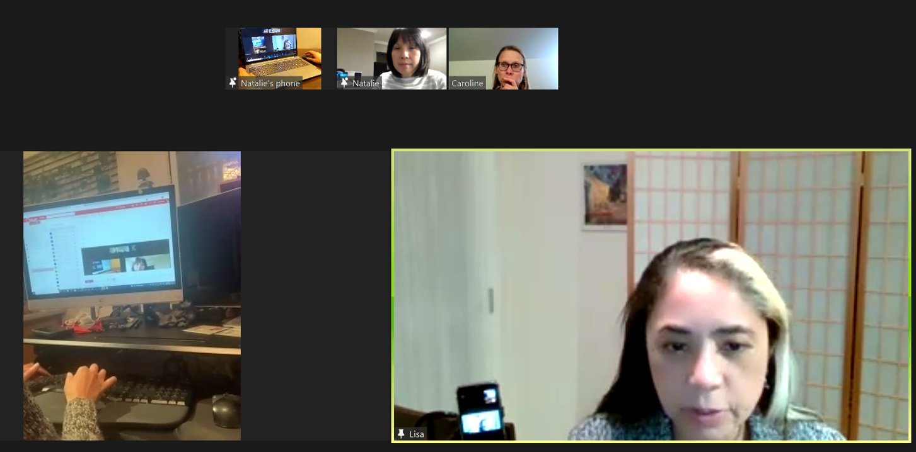
Set Up and Preparation
Slide hidden from learner
Before Remote Tutoring
Notes:
Slide hidden from the learner.
Information for the Tutor.
SET UP
Refer to:
TUTOR CHECKLIST- Set up for Remote Tutoring Session via Zoom, Ms Teams etc.
LEARNER CHECKLIST- Set up for Remote Tutoring Session via Zoom, Ms Teams etc.
IMPORTANT:
Go through the Learner Checklist as well. Then, you will be able to more easily troubleshoot with the learner if they have difficulty in their set up.
Communicate beforehand with the Support Person (if that learner has one):
Email the Learner Checklist listed in #2 above to the Support Person.
Email any instructions for this lesson to the support person (see the notes for specific slides /parts of the lesson):
Have the support person do the preparation for the lesson on the learner’s desktop. Tutor needs to guide them re. how to do this.
Preparation for Remote Tutoring only:
Have support person make sure the browser icon is easy for the learner to find on the desktop.
If no preparations were made on the learner’s computer before the session by a support person, you could use the Request Remote Control function in Zoom on the learner’s desktop if the learner struggles, and before they get frustrated.
IMPORTANT: Keep in mind the following:
Before using Remote Control, be sure to get permission from your organization first.
It is crucial that the learner understands what it means, and gives you informed consent.
It is somewhat invasive and must be done respectfully and honouring the confidentiality of the learner.
Don’t use the Request Remote Control feature first! It should be a last resort.
First, try your best to teach the learner and the support person how to do things using Share screen and demonstrating.
Use it if other ways do not work and the learner really needs to learn digital skills.
You may want to record the Zoom tutoring session in case of any possible accusations afterwards.
PREPARATION
Preparation specific to each part of this Lesson is in the notes of the relevant slides.

Slide 13
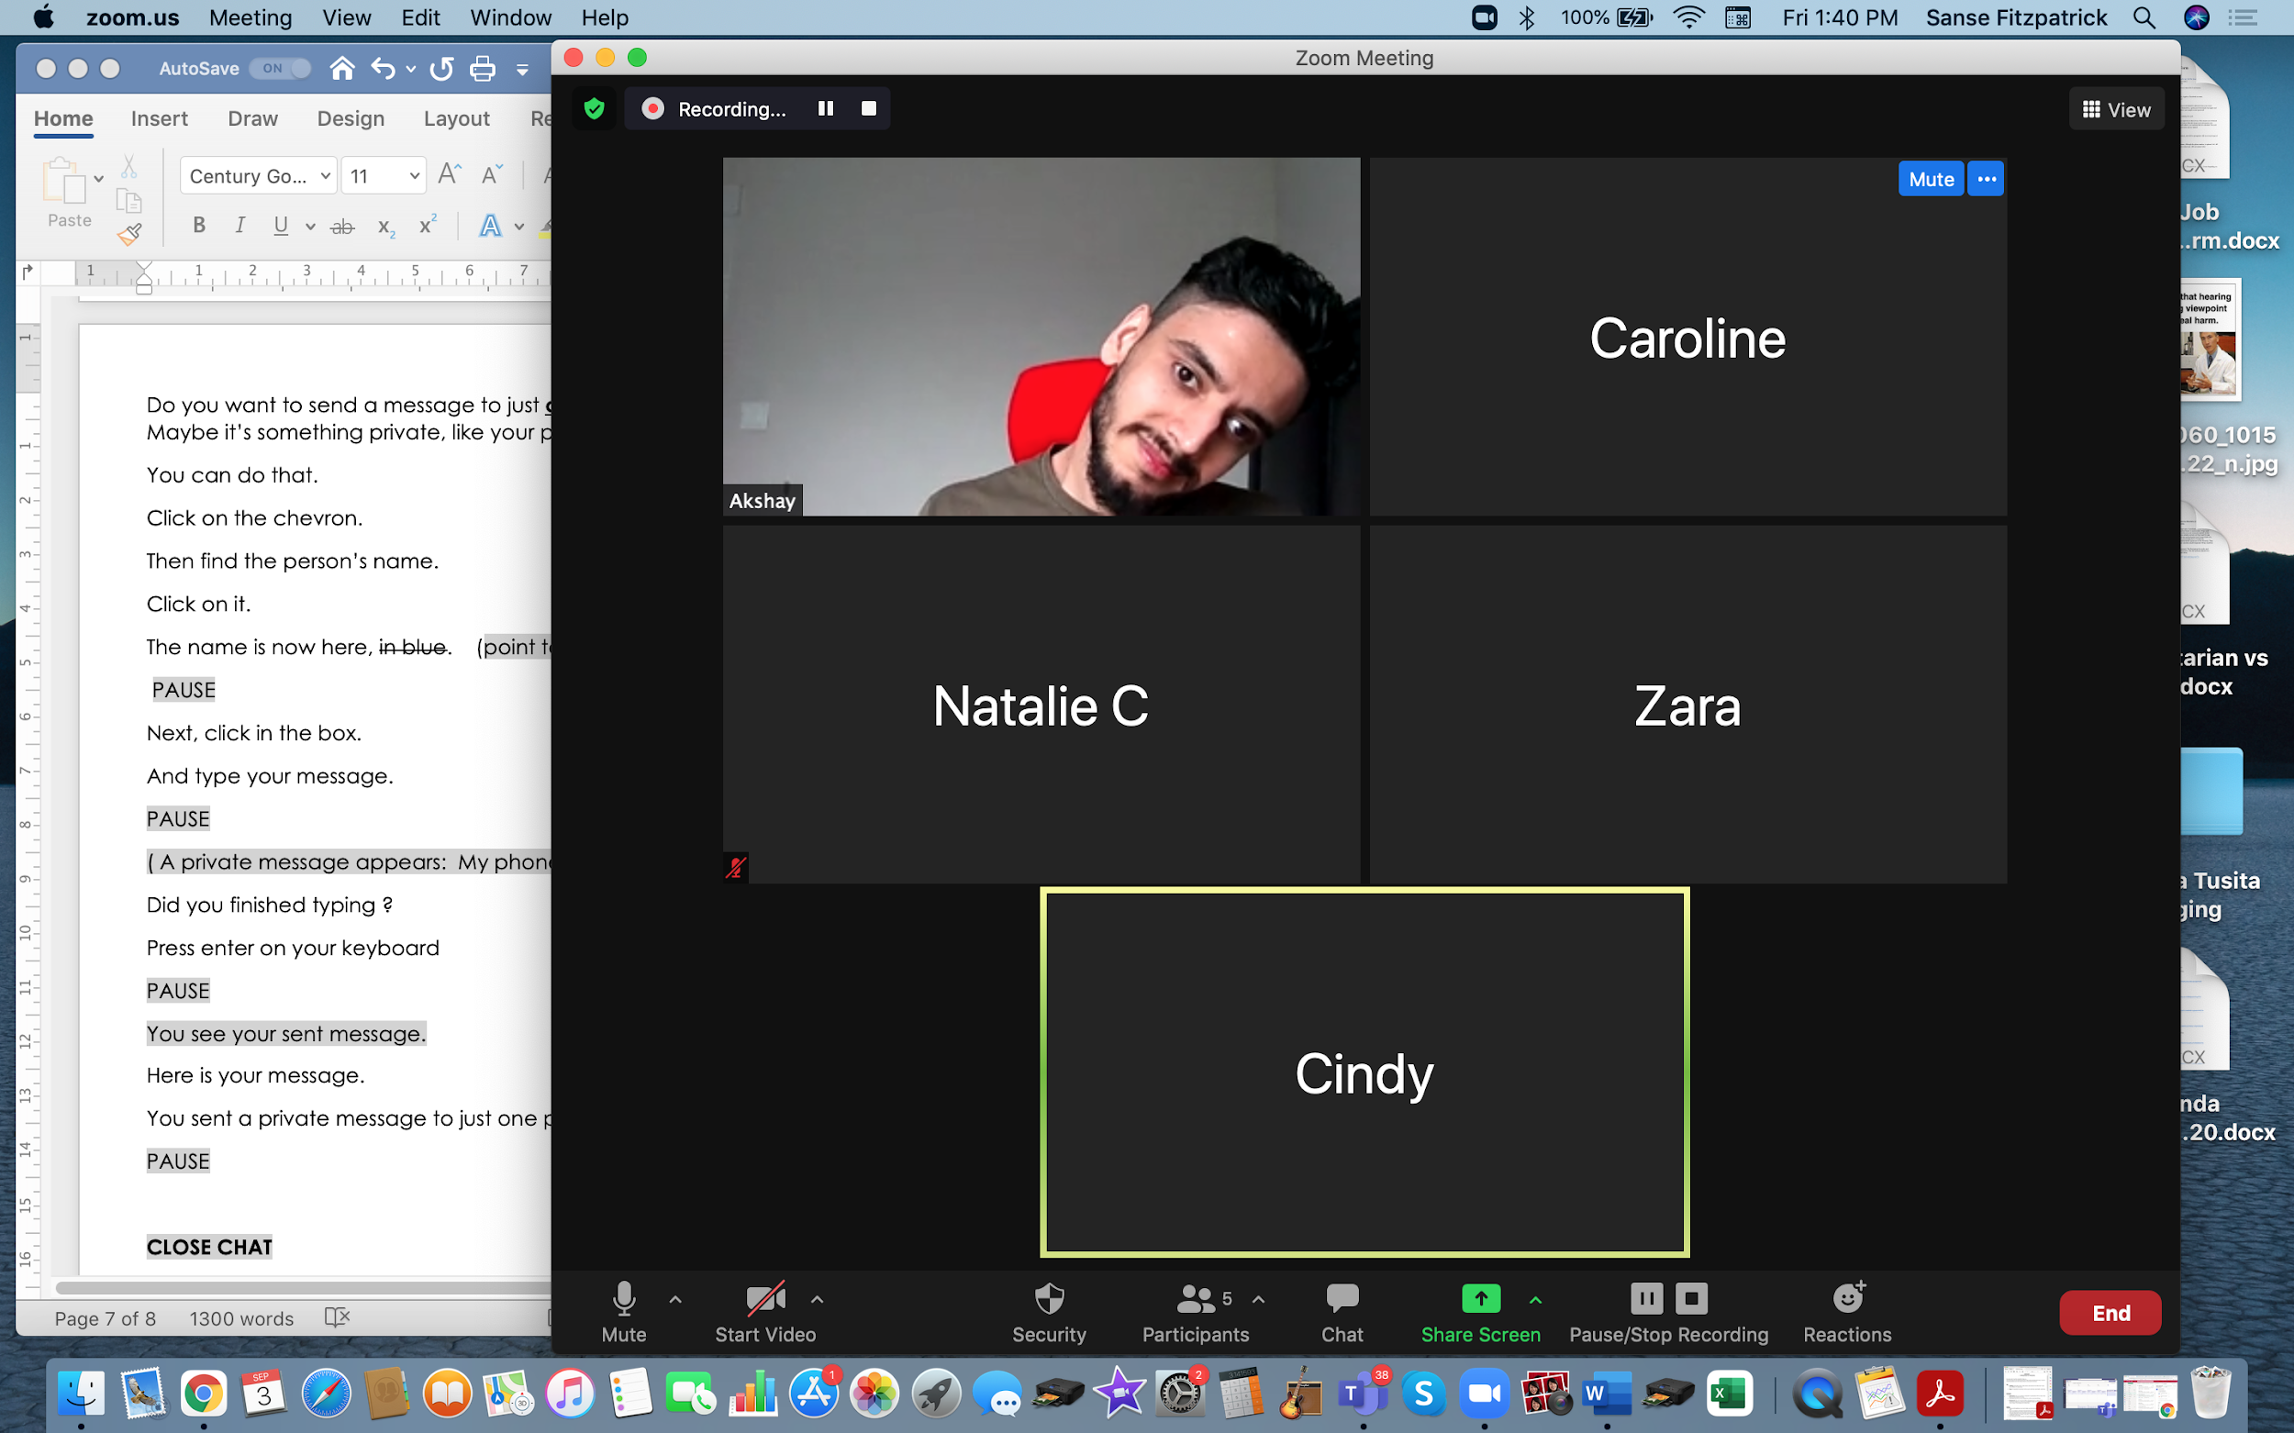
Checklist
Slide hidden from learner
During Remote Tutoring
Notes:
Slide hidden from learner
Refer to:
Tutor Checklist: During Remote Tutoring Session
Learner Instructions: How to let your Tutor have Remote Control of your Computer During a Zoom Session
SET UP SPECIFIC TO THIS LESSON
Be ready to assist learner by using the Requesting Remote Control function (refer to checklists 1 and 2 listed above).
You may have to set up learner’s desktop if no support person is available to do that beforehand. This is possible to do using Request Remote Control in Zoom.
IMPORTANT:
Keep in mind the following:
Before using Remote Control, be sure to get permission from your organization first.
It is crucial that the learner understands what it means, and gives you informed consent.
It is somewhat invasive and must be done respectfully and honouring the confidentiality of the learner.
Don’t use the Request Remote Control feature first! It should be a last resort.
First, try your best to teach the learner and the support person how to do things using Share screen and demonstrating.
Use it if other ways do not work and the learner really needs to learn digital skills.
You may want to record the Zoom tutoring session in case of any possible accusations afterwards.

Slide 14
Employment
Video Search
Notes:
THIS SLIDE AND THE FOLLOWING SLIDES ARE TO SHOW TO THE LEARNER
Say to the learner:
Before applying for a job, it’s good to learn a bit about the company.
You can do that by watching videos on YouTube.
Many companies have videos on YouTube.
So, we’re going to review how to use YouTube.
[Part One]
First, we’re going to review how to search for YouTube in the browser
Then, how to search for videos on YouTube
[Part Two]
Later we’ll look at how to navigate on a YouTube channel.
To “Navigate on a website” means to move around on the website to find different things.
[Part Three]
And another day, we’ll look at how to use “Playlists” as well as to search for all the videos on a YouTube channel
[Part Four]
We’ll also look at different functions in YouTube like turning up the volume, making the video full screen and using closed captions.
Do you use YouTube ? Have you ever used it ?
What do you like to look for on YouTube ?

Slide 15
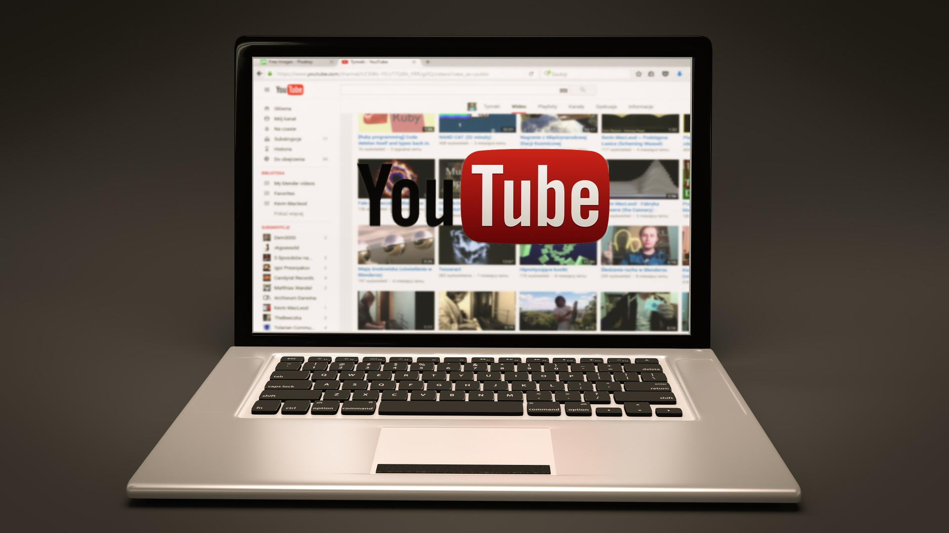
Lesson Objectives-Part One
Search for YouTube in the browser
Search for Videos on YouTube
Notes:
YouTube Video Search-Part One
Instructions for the Tutor
These are the skills the learner will master at the end of the lesson:
Search for YouTube in the browser
Search for Videos on YouTube
Say to the learner:
First, we’re going to review how to search for YouTube in the browser
Then, how to search for videos on YouTube

Slide 16

Lesson-Part One
Search for YouTube in the browser
Search for Videos on YouTube
Notes:
YouTube Video Search-Part One
Say to the Learner:
Let’s review how to Search for YouTube in the browser and then how to Search for videos on YouTube.
We’ll watch a video to review how to do this.
We can watch the video several times. So, don't worry if you don't catch everything the first time.
Instructions for the Tutor:
•The icon in the slide with the red triangle is a link to the video on YouTube.
•Just click on that link (in Slideshow mode) to open the video LESSON.
•Here is that link in case the one in the slide doesn’t work:
https://youtu.be/hj22wLTzzRI
Video length: 0:00-4:24 minutes [ 4:24 mins]
For remote tutoring when you share screen to play the video, make sure you have shared the audio.
Play the lesson a bit and check the learner can hear it ok.
Play it until the end, then check for understanding. See the next slide for comprehension check questions.

Slide 17

Check Understanding
Notes:
Instructions for the Tutor:
Check understanding
After watching the video lesson, replay the video, pause it and ask questions to check understanding (review and elicit) before moving on to the Practice.
Ask these comprehension check questions or others to check understanding:
Say to the Learner:
[Why use YouTube when looking for a Job]
You want to work for a certain company. What can you find on YouTube to help you ?
Answer: Videos about the company, for example, Save on Foods. They can help you learn about the company.
[Find YouTube]
What do you do first when you want to go on YouTube ? Answer: Open the browser
After opening the browser, what do you do next to find YouTube/ the YouTube website ?
Answer: Use the search bar or address bar
Can you use the search bar or the address bar to look for YouTube (and other websites) using Google?
Answer: Yes, you can use either.
Show me the search bar.
Show me the icon / symbol of the search bar
[Use the Search Bar in the Browser]
How do you use the search bar ?
Answer:
Click in the search box
Type the name (or words for what you are looking for)
Press Enter on the keyboard (or click on the search icon)
[Choose from the Search Results in the Browser]
What do you have to do to see all the results? Answer: Scroll down and up
You chose one of the results. Now, how do you go to that website ? What do you click on?
Answer: Click on either the name or on the website address
How do you know where to click to go to that website ?
Answer: The cursor changes to a hand where it is a link.
How do you know you are on the YouTube website ? Answer: You see the YouTube logo and name at the top. (and the website address in the address bar)
[Search for Videos in YouTube]
How do you search for videos on YouTube?
Answer:
Find the search bar
Click in the box
Type the words “Save on Foods” ,or whatever you are looking for
Press Enter on your keyboard, or click on the Search icon
Show me the search bar in YouTube.
What do you need to do to see all the results ? Answer: Scroll down (and up)
In the video, are there many results or a few ? Answer: many results
Show me three different search results. Point to them (on the image in the video lesson)
[Identify who Posted a Video]
Are videos about Save on Foods only made by the company ? Or are some made by other people ?
Answer: Some are made by the company and some are made by other people
How do you know which videos are made by the company ?
Answer: you see the logo and name of the company
You only want to look at the company videos. For example, the videos made by Save on Foods not made by other people. What do you click on ?
Answer: Click on the logo /company name
How do you know where to click, what is a link ?
Answer: When the cursor becomes a hand, that means it’s a link.
Instructions for Tutor:
Then ask the learner: Do you want to watch the video again?
If the learner is struggling, stop the session.
Say to the learner:
Let’s do more work on X before we do this. (so, learner does not feel bad they can’t yet do something)
For example, the learner may not be able to recognize cursor shapes or where to place a cursor. If so, go to Module 1 Mouse and Navigating and Module 3 Online Skills Basic etc. to practice the skills with the learner.

Slide 18
Practice
Part One
Search for YouTube in the browser
Search for Videos on YouTube
Notes:
Practice-Part One
Instructions for the Tutor:
PREPARATION
Both learner and tutor have a laptop or computer each.
Make sure there is one internet browser icon on the desktop and/ or the taskbar on learner’s computer.
Preparation for Remote tutoring only:
Refer to Slides #12 and 13. Tutor should be able to see learner’s computer screen and hands.
IMPORTANT:
Like all live websites, YouTube is constantly changing. So, the steps to do things on the live YouTube website may be different than those in this video lesson.
They many be different than the steps in Practice below.
Before the tutoring session, check on YouTube to see if the videos used in this lesson (Save on Foods) are available. If not, or if you prefer, find another video channel relevant to the learner.
If the learner’s focus is employment, find one related to that.
If the learner’s focus is not employment, find out what the learner is interested in. Look for a good video channel on that topic.
Check also if the steps to do things are the same as in the video lesson.
Be sure to do the above before the tutoring session !
PRACTICE
Demonstrate first, then let the learner practice.
After each of the following steps, wait for the learner to complete the step. Guide the learner as needed.
[Search for YouTube in the browser]
Say to the Learner:
Now it’s time to practice.
First, we’re going to practice how to Search for YouTube in the browser, like in the video.
Open the browser.
Now, find YouTube. Do you remember how to do that ? Answer: Use the search bar or address bar
Show me the icon / symbol of the search bar
[Use the Search Bar in the Browser]
Now, use the search bar. How do you search for YouTube ?
Answer:
Click in the search box
Type “YouTube
Press Enter on the keyboard (or click on the search icon)
Do that now.
[Choose from the Search Results in the Browser]
You can see many results. Scroll down to see more.
Now scroll up again.
Find the result for YouTube.com
What do you click on to go to that website ? Answer: Click on either the name or the website address
How do you know where to click ? Answer: The cursor changes to a hand where it is a link.
Do that now.
Are you on the YouTube website now ? How do you know ? Answer: Yes, because you see the YouTube logo and name at the top. (and the website address in the address bar)
Show that to me.
[Search for Videos in YouTube]
Do you remember how to search for videos on YouTube?
Answer:
Find the search bar
Click in the box
Type the words “Save on Foods” (or whatever you are looking for)
Press Enter on your keyboard, or click on the Search icon
Do that now.
Can you see all the results ? If not, scroll down (and up again)
Show me three different search results. Point to them
[Identify who Posted a Video]
Let’s look only for videos that were made by Save on Foods (or whatever you are focusing on) What do you look for ? Answer: The logo and name of the company
Now, go to the YouTube Channel for Save on Foods (or whatever you are focusing on)
Click on the logo /company name
How do you know where to click, what is a link ? Answer: When the cursor becomes a hand, that means it’s a link.
Now you are in the Save on Foods YouTube channel (or whatever channel you are focusing on)
Great ! You practiced how to go to YouTube and started practicing how to search for videos.
Practice again. Close the website and the browser.
Now. Start again. Show me how to go to YouTube in the browser…..
Instructions for the Tutor:
Practice: Have the learner repeat the above activity and practice as many times as they need (at least three times.)
CHECK THE LEARNER’S SKILLS:
Has the learner shown you they can do the skills at least three times without support? If so, then they are ready to move on to Part Two.

Slide 19

Lesson Objectives – Part Two
Navigate on a YouTube Channel
Notes:
YouTube Video Search-Part Two
Instructions to the Tutor
These are the skills learners will master at the end of the lesson:
Navigate on a YouTube Channel
Say to the learner:
You practiced how to go to YouTube and how to search for a video on YouTube.
Now, we’re going to review how to navigate on a YouTube channel.
To “navigate on a website” like YouTube, means to know how to move around and find what you want.

Slide 20
Lesson-Part Two
Navigate on a YouTube Channel
Notes:
YouTube Video Search-Part Two
Say to the Learner:
Let’s review how to Navigate on a YouTube channel.
We’re going to watch a video to review how to do this.
We can watch the video several times. So, don't worry if you don't catch everything the first time.
Instructions for the Tutor:
•The icon in the slide with the red triangle is a link to the video Lesson on YouTube.
•Just click on that link (in Slideshow mode) to open the video Lesson.
•Here is that link in case the one in the slide doesn’t work:
https://youtu.be/kF85QxLpqDs
Video length: 0:00- 3:50 minutes [ 3:50 mins]
For remote tutoring, when you share screen to play the video, make sure you have shared the audio.
Play the lesson a bit and check the learner can hear it ok.
Play till the end of the video, then check for understanding. See the next slide for comprehension check questions.

Slide 21
Check Understanding
Notes:
Instructions for the Tutor:
Check Understanding
After watching the video lesson, replay the video, pause it and ask questions to check understanding (review and elicit) before moving on to the Practice.
Ask these comprehension check questions or others to check understanding:
Say to the Learner:
[Navigate on a YouTube Channel]
What is a YouTube channel ? Answer: (Not in the video) It’s a place on YouTube where a person or a company uploads their videos for others to watch
You click on a video link. What may happen automatically ? Answer: A video may play
[Pause a Video]
If a video plays automatically, can you pause it ? Answer: Yes, you can
How can you pause the video ? Answer: Click on the video screen (or on the pause button) to pause the video
What does the pause button look like ? Answer: Two short vertical lines
Show me the pause button (on the lesson video image)
How can you see all of the video results ? Answer: Scroll down and up
[Use the menu]
What is at the top of the YouTube Channel ? Answer: A menu
What words are in the menu ? Answer: Home, Videos, Playlists, Community, Channels, About
Are the words in the menu links ? Answer: Yes they are
How do you know the words in the menu are links ? Answer: The cursor changes to a hand
[See all Videos on a YouTube Channel]
You want to see all of the videos on one channel. What do you click on ? Answer: Click on “Videos” in the menu
Can you see all of them or do you need to scroll down to see them all ? Answer: You need to scroll down
[Play a video]
You chose a video you want to watch. How do you play the video ? Answer: Click on the name or the (video) picture
What is good to do while you watch ? Answer: Take notes (if it is for a job search etc.)
[Skip Ads]
What often plays before the video ? Answer: An ad or Ads
Do you have to watch the ad or can you skip it ? Answer: You can skip it
Can you skip it right away ? Answer: No, usually you can skip it after 5 seconds
Show me the “Skip Ad” icon
What happens after you click “Skip Ad” ? Answer: The video plays
How do you pause the video ? Answer: Click on the pause icon (or on the video picture)
[Go back to the (Save on Foods) YouTube Channel Homepage-Use the Logo/name to go back]
You can’t see the information under the video. What do you do so you can see it ?
Answer: Scroll down a bit
You want to go back to the Homepage of the (Save on Foods) YouTube Channel. What do you do ?
Answer:
Find the (Save on Foods) logo or name (under the video)
Click on it
You are back at the Homepage of the (Save on Foods) YouTube Channel
Show me the Save on Foods logo on the Homepage

Slide 22
Practice
Part Two
Navigate on a YouTube Channel
Notes:
Practice-Part Two
Instructions for the Tutor:
PREPARATION
Both learner and tutor have a laptop or computer each.
Make sure there is one internet browser icon on the desktop and/ or the taskbar on learner’s computer.
Preparation for Remote tutoring only:
Refer to Slides #12 and 13. Tutor should be able to see learner’s computer screen and hands.
IMPORTANT:
The steps on the live YouTube website may be different than in the video lesson and different than the steps in Practice below. This is because websites are constantly changing.
Before the tutoring session, check on YouTube to see if the videos used in this lesson (Save on Foods) are available.
If not, or if you prefer, find another video channel relevant to the learner.
If the learner’s focus is employment, find one related to that.
If the learner’s focus is not employment, find out what the learner is interested in. Look for a good video channel on that topic.
Check also if the steps to do things are the same as in the video lesson.
Be sure to do the above before the tutoring session !
PRACTICE
Demonstrate first, then let the learner practice.
After each of the following steps, wait for the learner to complete the step. Guide the learner as needed.
Say to the Learner:
Now it’s time to practice! We’re going to practice how to navigate on a YouTube channel, like we saw in the video.
[Go to YouTube]
Let’s start by going to YouTube.
Now, search for Save on Foods. You did that before. Show me how you do that.
[Find the Save on Foods (or another) Channel]
Ok. Now find a video made by the company, Save on Foods. Show me one. Remember you know it’s one if you see the company logo and name
Great. Now, find the link. What does the cursor look like if it’s a link ? Answer: A hand
Click on that link (Hint: the logo and name). It will take you to the Save on Foods channel. Do that now.
Is this the Save on Foods channel ? How do you know ? Answer: the logo and name are at the top, also there is the menu under that
[Pause a video]
Let’s see if a video plays automatically. If it does, pause it.
Show me how to pause the video (Hint: Click on the video screen (or on the pause button) to pause the video
Show me the pause button
Great. We won’t look at the video now. We need to practice the digital skills.
Can you see all of the video results ? Answer: No
Scroll down and up to see all the results.
[Use the menu]
Find the menu. (Hint: At the top of the YouTube Channel)
What words are in the menu ? Answer: Home, Videos, Playlists, Community, Channels, About
Are the words in the menu links ? Answer: Yes they are
How do you know the words in the menu are links ? Answer: The cursor changes to a hand
[See all Videos on a YouTube Channel]
You want to see all of the videos on this channel. Do you remember how to do that ? (Hint: Click on “Videos” in the menu)
Can you see all of them or do you need to scroll down to see them all ?
Scroll down now.
Then scroll up.
[Play a video]
Choose a video to watch.
How do you play the video ? Answer: Click on the name or the (video) picture
Do that now.
[Skip Ads]
If an ad plays, pause the video.
Do you have to watch the ad or can you skip it ? Answer: You can skip it after 5 seconds
Show me how to skip the ad. (Hint: Click on “Skip Ad” icon)
The video is playing now.
Pause the video. (Hint: Click on the pause icon/button (or on the video picture)
[Go back to the (Save on Foods) YouTube Channel Homepage-Use the logo/name to go back]
You want to see the information under the video. What do you do so you can see it ?
Answer: Scroll down a bit
Do that now.
Go back to the Homepage of the (Save on Foods) YouTube Channel now:
Find the (Save on Foods) logo or name (under the video)
Click on it
You are back at the Homepage of the (Save on Foods) YouTube Channel
Practice again. Close the website and the browser.
Now. Start again. Show me how to go to YouTube in the browser…..
Instructions for the Tutor:
Have the learner practice as many times as they need (at least three times.)
Check the Learner's skills. Has the learner shown you they can do the skills at least three times without support? If so, then they are ready to move on to Part Three.

Slide 23
Lesson Objectives – Part Three
    Search by Playlist Topics on a YouTube Channel
PLAYLISTS
Notes:
YouTube Video Search-Part Three
Instructions to the Tutor
These are the skills learners will master at the end of the lesson:
Search by Playlist Topics on a YouTube Channel
Say to the learner:
We practiced how to Navigate on a YouTube channel before.
Now, we are going to review how to Search by Playlist Topics on a YouTube Channel
Have you ever done that ?
What is a “Playlist”?
Answer: A group / list of videos about one topic (For example: Videos about Online shopping, Videos about Healthy Snacks etc.
It’s a good way to find videos because they are organized by topic. All the videos about Healthy Snacks are together in one playlist. All the videos about Online shopping are together in one playlist. Etc.
Most YouTube channels have playlists.

Slide 24
Lesson-Part Three
Search by Playlist Topics on a YouTube Channel
PLAYLISTS
Notes:
YouTube Video Search-Part Three
Say to the Learner:
So, let’s review how to Search by Playlist Topics on a YouTube Channel.
We’re going to watch a video to review how to do this.
We can watch the video several times. So, don't worry if you don't catch everything the first time.
Instructions for the Tutor:
•The icon in the slide with the red triangle is a link to the video Lesson on YouTube.
•Just click on that link (in Slideshow mode) to open the video Lesson.
•Here is that link in case the one in the slide doesn’t work:
https://youtu.be/z71cmPEruBY
Video length: 0:00-4:43 minutes [ 4:43 mins]
For remote tutoring, when you share screen to play the video, make sure you have shared the audio.
Play the lesson a bit and check the learner can hear it ok.
Play till the end of the video, then check for understanding. See the next slide for comprehension check questions.

Slide 25
Check Understanding
Notes:
Instructions for the Tutor:
Check Understanding
After watching the video lesson, replay the video, pause it and ask questions to check understanding (review and elicit) before moving on to the Practice.
Ask these comprehension check questions or others to check understanding:
[Search by Playlist Topics on a YouTube Channel]
Say to the Learner:
What is a “Playlist” Answer: A group / list of videos about one topic (For example: Videos about Online shopping, videos about Healthy Snacks etc.
Most YouTube channels have playlists.
[Find Playlists]
You are on the Save on Foods YouTube Channel, or another channel. How do you find “Playlists” ?
Answer:
Go to the Menu
Find “Playlists”
Click on “Playlists”
“Playlists” opens and you can see the different playlists
If you can’t see all of the playlists. What do you need to do ? Answer: Scroll down
[View a Full Playlist]
How do you open a Playlist/ View a Full Playlist to see the videos inside ? Answer: Click on the link. The link is the name or the video
In the example we watched, she opened one playlist. It was called “Ready-Set-Refresh”. How many videos were in that playlist ? Answer: 5 videos
[Go Back-Use the Back Icon/Button]
You want to go back. How do you do that ? Answer: Click on the back icon/button (or click on the company logo and name (For example, Save on Foods)
Show me where to find the back icon / button.
[See all Videos on a Channel]
How do you see all the videos that are on one YouTube Channel (Example, Save on Foods)?
Answer:
Go to the Channel Homepage
Look at the menu
Find “Videos” in the menu
Click on it
Then you can the videos
Can you see all the videos on your screen, or do you have to scroll down to see them all ?
Answer: You may need to scroll down (if there are many videos)
[Play a Video, Pause a Video and Skip Ads on YouTube]
You choose a video to watch. How do you play it ? Answer: Click on the name or the video picture
It may play automatically. How can you pause it ? Answer: Click on the video picture
An ad may play. How can you skip it ? Answer: Click on “Skip Ad”
You paused a video. How can you play it again ?
Answer: Click on the “Play” icon (or on the video picture)
Where is the “Play” icon ? Answer: In the bottom left corner
What does the “Play” icon look like ? Answer: A triangle pointing to the right
Instructions for Tutor:
Then ask the learner: Do you want to watch the video again?
If the learner is struggling, stop the session.
Say to the learner:
Let’s do more work on X before we do this. (so, learner does not feel bad they can’t yet do something)
For example, the learner may not be able to recognize cursor shapes or where to place a cursor. If so, go to Module 1 Mouse and Navigating and Module 3 Online Skills Basic etc. to practice the skills with the learner.

Slide 26
Practice
Part Three A
    Search by Playlist Topics on a YouTube Channel
PLAYLISTS
Notes:
Practice-Part Three A
Instructions for the Tutor:
PREPARATION
Both learner and tutor have a laptop or computer each.
Make sure there is one internet browser icon on the desktop and/ or the taskbar on learner’s computer.
Preparation for Remote tutoring only:
Refer to Slides #12 and 13. Tutor should be able to see learner’s computer screen and hands.
IMPORTANT:
The steps on the live YouTube website may be different than in the video lesson and different than the steps in Practice below. This is because websites are constantly changing.
Before the tutoring session, check on YouTube to see if the videos used in this lesson (Save on Foods) are available.
If not, or if you prefer, find another video channel relevant to the learner.
If the learner’s focus is employment, find one related to that.
If the learner’s focus is not employment, find out what the learner is interested in. Look for a good video channel on that topic.
Check also if the steps to do things are the same as in the video lesson.
Be sure to do the above before the tutoring session !
PRACTICE
Demonstrate first, then let the learner practice.
After each of the following steps, wait for the learner to complete the step. Guide the learner as needed.
Say to the Learner:
Now it’s time to practice! We’re going to practice what we saw in the video:
Search by Playlist Topics on a YouTube Channel
[Open YouTube]
Let’s start by going to YouTube. Remember how to do that ?
Now, search for “Save on Foods”. You did that before. Show me how you do that.
[Go to the Company’s YouTube channel]
Ok. Now find a video made by the company, Save on Foods.
Show me one. Remember, you know it’s one if you see the company logo and name
Great. Now, find the link. What does the cursor look like if it’s a link ? Answer: A hand
Click on that link, the logo and name. It will take you to the Save on Foods channel. Do that now.
Is this the Save on Foods channel ? How do you know ? Answer: the logo and name are at the top, also there is the menu under that.
[Pause the video]
A video may play automatically. If it does, pause it.
Show me how to pause the video (Hint: Click on the video screen (or on the pause button) to pause the video)
Show me the pause button
Great. We won’t look at the video now. We need to practice the digital skills.
[Find Playlists]
So, you are on the YouTube Channel. Now, find and open “Playlists”.
Hint: Remember you need to:
Go to the Menu
Find “Playlists”
Click on “Playlists”
“Playlists” opens and you can see the different playlists
What do you do if you can’t see all of the playlists ? Answer: Scroll down
Do that now, Scroll down.
Then scroll up again.
[View a Full Playlist]
Let’s practice how to open a Playlist to see the videos inside. This is called, “View a Full Playlist”.
In the video we watched, she opened one playlist. It was called “Ready-Set-Refresh”.
Choose a playlist now to open.
What’s the name of the playlist you want to open ?
Click on the link to open it (Hint: the video picture or the name/ “View Full Playlist “)
If a video plays automatically, pause it. (Hint: Click on the video or on the pause icon)
How many videos are in that playlist ? Scroll down to the bottom to see the full list.
Then scroll up again.
Now choose one of the videos to play. How do you play it ? Answer: Click on the name, or the video picture. Do that now.
Great ! Let’s just watch a few seconds then pause it.
You can watch it later. Remember we are practicing digital skills in YouTube now.
[Go back]
Let’s go back to the homepage of the Save on Foods channel now.
Use the back icon/button. Show me how to do that.
(If the learner opened a few videos, they will need to click the “Back” icon a few times to get back to the homepage. Guide them to do that)
Great! Now you are back at the “Playlists” homepage.
Choose another playlist and practice again.
(Repeat the above steps)
Instructions for the Tutor:
Have the learner practice as many times as they need (at least three times.)
Check the Learner's skills. Has the learner shown you they can do the skills at least three times without support? If so, then they are ready to move on to Part Four.

Slide 27

Practice
Part Three B
    Search for all Videos
    Play and Pause a Video and Skip Ads
Notes:
Practice-Part Three B
Instructions for the Tutor:
PREPARATION
Both learner and tutor have a laptop or computer each.
Make sure there is one internet browser icon on the desktop and/ or the taskbar on learner’s computer.
Preparation for Remote tutoring only:
Refer to Slides #12 and 13. Tutor should be able to see learner’s computer screen and hands.
IMPORTANT:
The steps on the live YouTube website may be different than in the video lesson and different than the steps in Practice below. This is because websites are constantly changing.
Before the tutoring session, check on YouTube to see if the videos used in this lesson (Save on Foods) are available.
If not, or if you prefer, find another video channel relevant to the learner.
If the learner’s focus is employment, find one related to that.
If the learner’s focus is not employment, find out what the learner is interested in. Look for a good video channel on that topic.
Check also if the steps to do things are the same as in the video lesson.
Be sure to do the above before the tutoring session !
PRACTICE
Demonstrate first, then let the learner practice.
After each of the following steps, wait for the learner to complete the step. Guide the learner as needed.
Say to the Learner:
Now it’s time to practice! We’re going to practice what we saw in the video: Search for all Videos on a YouTube Channel
[Open YouTube]
Let’s start by going to YouTube. Remember how to do that ?
Now, search for “Save on Foods”. You did that before. Show me how you do that.
[Go to the company YouTube channel]
Ok. Now find a video made by the company, Save on Foods.
Show me one. Remember, you know it’s one if you see the company logo and name
Great. Now, find the link. What does the cursor look like if it’s a link ? Answer: A hand
Click on that link, the logo and name. It will take you to the Save on Foods channel. Do that now.
Is this the Save on Foods channel ? How do you know ? Answer: the logo and name are at the top, also there is the menu under that.
[Pause the video]
A video may play automatically. If it does, pause it.
Show me how to pause the video (Click on the video screen (or on the pause button) to pause the video)
Show me the pause button
Great. We won’t look at the video now. We need to practice the digital skills.
[Search for all Videos on a YouTube Channel]
So, you are on the YouTube Channel. Now, go to the menu and find “Videos”
Can you see all the videos ? Remember what to do if you can’t see them all ? Answer: Scroll down
Do that now, Scroll down
Then scroll up again.
[Play a video, Pause a Video and Skip Ads]
Choose a video to watch.
Do you remember how to play it ? Answer: Click on the name or the video picture
It may play automatically. Pause it. (Click on the video or on the pause icon)
An ad may play. How can you skip it ? Answer: Click on “Skip Ad”
Do that now.
So, you paused a video. How can you play it again ?
Answer: Click on the “Play” icon (or on the video picture)
Show me the “Play” icon.
What does the “Play” icon look like ? Answer: A triangle pointing to the right
Click on it now to play the video.
Now pause the video again.
Now play it again.
Great ! Remember you can click on either the pause icon or on the video picture to pause and play the video.
(Tip: For those who prefer keyboards: You can also press the spacebar on your keyboard.)
Practice again! Repeat the above steps.
Instructions for the Tutor:
Have the learner practice as many times as they need (at least three times.)
Check the Learner's skills. Has the learner shown you they can do the skills at least three times without support? If so, then they are ready to move on to Part Three.

Slide 28


Lesson Objectives – Part Four
Make the Video Full Screen
Volume-Turn up/down
Closed Captions- Turn on/ off
CC
Notes:
YouTube Video Search-Part Four
Instructions to the Tutor
These are the skills learners will master at the end of the lesson:
Make the Video Full Screen
Volume-Turn up/down
Turn on/ off Closed Captions
Say to the learner:
We practiced how to Search for Videos by Playlist Topics, how to Search for all Videos on a YouTube Channel. We also practices how to play and pause a video and how to skip ads.
Now, we are going to review how to do a few other functions in YouTube.
We’ll look at three things:
How to Make the Video Full Screen
How to Turn the Volume Up and Down
and
3. How to Turn Closed Captions On and Off
Have you done these things before in YouTube ?
They are all very useful. It’s good to know how to do them.

Slide 29
Lesson-Part Four
Make the Video Full Screen
Volume- Turn up/down
Closed Captions- Turn on/ off
CC
Notes:
YouTube Video Search-Part Four
Say to the Learner:
So, let’s review how to do a few functions in YouTube:
Make the Video Full Screen
Volume- Turn up/down
Turn on/ off Closed Captions
We’re going to watch a video to review how to do these.
We can watch the video several times. So, don't worry if you don't catch everything the first time.
Instructions for the Tutor:
•The icon in the slide with the red triangle is a link to the video Lesson on YouTube.
•Just click on that link (in Slideshow mode) to open the video Lesson.
•Here is that link in case the one in the slide doesn’t work:
https://youtu.be/E1H3pi6tt3E
Video length: 0:00-3:39 minutes [ 3:39 mins]
For remote tutoring, when you share screen to play the video, make sure you have shared the audio.
Play the lesson a bit and check the learner can hear it ok.
Play till the end of the video, then check for understanding. See the next slide for comprehension check questions.

Slide 30
Check Understanding
Notes:
Instructions for the Tutor:
PART FOUR
Check Understanding
After watching the video lesson, replay the video, pause it and ask questions to check understanding (review and elicit) before moving on to the Practice.
Ask these comprehension check questions or others to check understanding:
[Make the Video Full Screen]
Can you make the video large so it covers all of your screen ? Answer: Yes, you can
How do you make a video cover all of your screen ? Answer: Use the “Full Screen” function: Find the “Full Screen” icon. Click on it
Where is the “Full Screen” icon ? Answer: In the bottom right corner of the video screen
What does the “Full Screen” icon look like ? Answer: A square with holes on each side
Sometimes the icons disappear. How can you get the icons again ? Answer: Move the cursor a bit. Then the icons appear again.
[Volume-Turn up / down]
Can you turn the volume up and down in YouTube ? Answer: Yes, you can
How do you turn up the volume in YouTube ? Answer: Find the “Volume” icon and click along the bar
What do you do if you can’t see the “Volume” icon ? Answer: Scroll down to find it
How do you turn down the volume ? Answer: Click along the bar
[Turn on Closed Captions-CC]
What is “CC” ? Answer: It is when the script shows on the screen, and you can read what the speaker says as they are talking.
How do you show the script ? How do you turn on CC ?
Answer:
First pause the video
Find the CC icon and click on it
Then click on the play icon
Where is the CC icon ? Answer: In the bottom right corner of the video
[Exit Full Screen]
You are watching a video in full screen. How do you turn off “Full Screen” ? Answer: Find the “Exit Full Screen” icon and click on it
Where is the “Exit Full Screen “ icon ?Answer: In the bottom right corner of the video
What is another way you can exit full screen ? Answer: Press ESC (Escape) on your keyboard
Instructions for Tutor:
Then ask the learner: Do you want to watch the video again?
If the learner is struggling, stop the session.
Say to the learner:
Let’s do more work on X before we do this. (so, learner does not feel bad they can’t yet do something)
For example, the learner may not be able to recognize cursor shapes or where to place a cursor. If so, go to Module 1 Mouse and Navigating and Module 3 Online Skills Basic etc. to practice the skills with the learner.

Slide 31
Practice
Part Four
Make the Video Full Screen
Volume- Turn up/down
Closed Captions- Turn on/ off
CC
Notes:
Practice-Part Four
Instructions for the Tutor:
PREPARATION
Both learner and tutor have a laptop or computer each.
Make sure there is one internet browser icon on the desktop and/ or the taskbar on learner’s computer.
Preparation for Remote tutoring only:
Refer to Slides #12 and 13. Tutor should be able to see learner’s computer screen and hands.
IMPORTANT:
The steps on the live YouTube website may be different than in the video lesson and different than the steps in Practice below. This is because websites are constantly changing.
Before the tutoring session, check on YouTube to see if the videos used in this lesson (Save on Foods) are available.
If not, or if you prefer, find another video channel relevant to the learner.
If the learner’s focus is employment, find one related to that.
If the learner’s focus is not employment, find out what the learner is interested in. Look for a good video channel on that topic.
Check also if the steps to do things are the same as in the video lesson.
Be sure to do the above before the tutoring session !
PRACTICE
Demonstrate first, then let the learner practice.
After each of the following steps, wait for the learner to complete the step. Guide the learner as needed.
Say to the Learner:
Now it’s time to practice! We’re going to practice how to do those functions, like we saw in the video.
Make the Video Full Screen
Volume- Turn up/down
Turn on/ off Closed Captions
[Go to YouTube]
Let’s start by going to YouTube.
Now, search for Save on Foods (or another company or group). You did that before. Show me how you do that. (Hint: Use the “Search Bar” at the top)
[Find the Save on Foods (or another) Channel]
Ok. Now find a video made by the company and click on it.
Show me how to do that.
Great. Now you are in the Save on Foods channel.
Let’s see if a video plays automatically. If it does, pause it.
How do you pause it ? (Hint: Click on the video or on the pause icon)
Great. We won’t look at the video now. We need to practice the digital skills.
[Choose a video in “Videos”]
Now, Go to the menu and choose “Videos”.
Choose a video. Any video is fine. Scroll down if you want to see all of them.
Play the video. How do you do that ? (Hint: Click on the name or the (video) picture)
Do that now.
If an ad plays, pause the video.
Do you remember how to skip the ad ? (Hint: Click on “Skip Ad” icon)
The video is playing now.
Pause the video. (Hint: Click on the pause icon/button (or on the video picture)
Now, let’s practice what we saw in the video lesson, how to make the video full screen.
[Make the Video Full Screen]
Right now, is the video full screen ? No.
Let’s make it full screen. How do you do that ? Answer: Click on the “Full Screen” icon.
Where is the “Full Screen” icon ? Answer: In the bottom right corner of the video screen
Show me how to do that.
Great !
Sometimes the icons disappear. How can you get the icons again ? Answer: Move the cursor a bit. Then the icons appear again.
Let’s see if that happens..... Yes, they disappeared. So, move the cursor now to see the icons again.
Now you see them again.
[Exit Full Screen]
So, you are watching the video in full screen now.
How do you turn off “Full Screen” ? Show me.
(Hint: Find the “Exit Full Screen” icon and click on it)
Where is the “Exit Full Screen “ icon ? Answer: In the bottom right corner of the video
Great.
What is another way you can exit full screen ? Answer: Press ESC (Escape) on your keyboard
Let’s practice that again!
(Have the learner repeat the steps a few times to make the video full screen then exit full screen)
[Volume-Turn up / down]
So we saw in the video how you can turn the volume up and down in YouTube.
How do you turn up the volume in YouTube ? Answer: Find the “Volume” icon and click along the bar
What do you do if you can’t see the “Volume” icon ? Answer: Scroll down to find it
Show me how to do that now.
How do you turn down the volume ? Answer: Click along the bar
Do that now.
Let’s practice that again!
(Have the learner repeat the steps a few times)
[Turn on Closed Captions-CC]
In the video we saw how to use CC.
What is “CC” ? Answer: It is when the script shows on the screen, and you can read what the speaker says as they are talking.
How do you use CC to show the script ?
Answer:
First pause the video
Find the CC icon and click on it
Then click on the play icon
Where is the CC icon ? Answer: In the bottom right corner of the video
Do that now. Show me how to do it.
Let’s practice that again !
(Have the learner repeat the steps a few times)
Instructions for the Tutor:
Have the learner practice as many times as they need (at least three times.)
Check the Learner's skills. Has the learner shown you they can do the skills at least three times without support? If so, then they are ready to use the skills on their own!

Slide 32
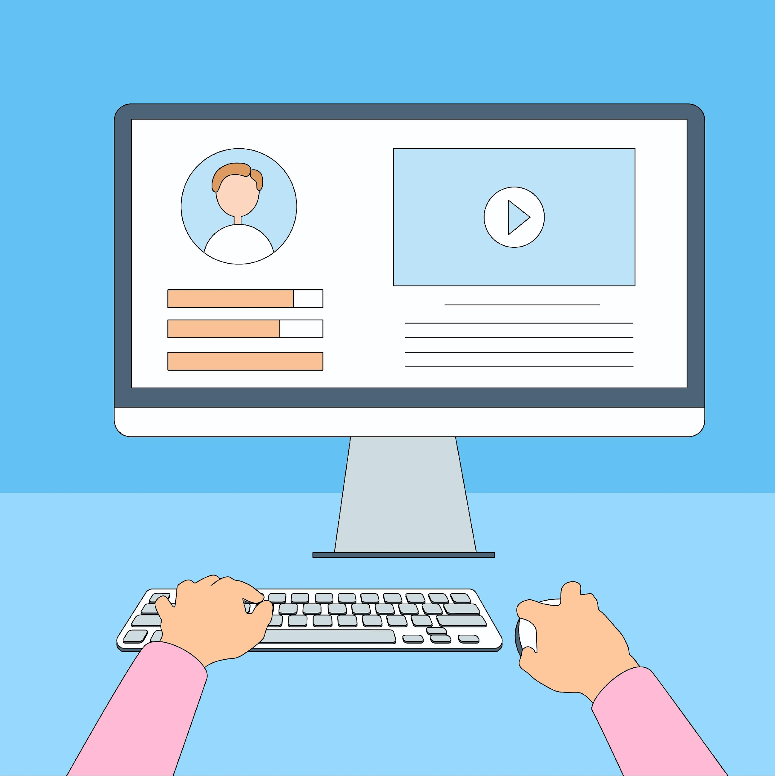
Practice Between Sessions
What did you learn/practice today?
When are you going to practice?
Practice Plan
Notes:
Instructions for the Tutor:
In-person tutoring and Remote Tutoring:
Make sure the learner knows how to access the video lesson(s) you just used so they can practice between tutoring sessions.
If relevant, make sure the support person at home knows how to access the video(s) too.
Option One
Email the video link to the learner, and if relevant the at-home support person. They can use the link in the email to access the video lesson(s).
Option Two
Put a link to the specific video lesson(s) you did on the learner desktop so they can access the video easily.
How:
Open the website address for the lesson in the browser.
In the address bar, click to highlight the lesson address.
Drag the address (link) onto the desktop. It will make an icon on the desktop.
Find the icon on the desktop and check that the link works.
Show the learner where it is. Tell them to just click to access it for practice.
Remote Tutoring Only:
You can do Strategy Two by using Request Remote Control in Zoom during the tutoring session.
Refer to the following for the steps on how to do that:
Tutor Checklist-During Remote Tutoring Sessions
Learner Instructions: Let Tutor have Remote Control of your Computer During a Zoom Session
IMPORTANT: Keep in mind the following:
Before using Remote Control, be sure to get permission from your organization first.
It is crucial that the learner understands what it means, and gives you informed consent.
It is somewhat invasive and must be done respectfully and honouring the confidentiality of the learner.
Don’t use the Request Remote Control feature first! It should be a last resort.
First, try your best to teach the learner and the support person how to do things using Share screen and demonstrating.
Use it if other ways do not work and the learner really needs to learn digital skills.
You may want to record the Zoom tutoring session in case of any possible accusations afterwards.
*********************************************************************************************************************
Say to the Learner:
You did well today.
So, what did you learn and practice today? [only mention the parts you covered]
[For example: ]
Today, we learned and practiced how to:
Search for YouTube in the browser
Search for Videos on YouTube
It’s really important to review and practice as much as you can! Please do that before our next tutoring session.
Watch the video again, as many times as you need.
I’ve emailed you the link. Let/s make sure you can open it.
(OR)
We’ve put the link on your desktop. Here it is. Just click on it to watch the video.
Let’s make sure it works ok.
[Practice Plan]
Preparation
Adapt the following according to what you reviewed in the session.
For example, for Part One of this lesson:
Say to the learner:
Practice at least three more times before our next session.
Here is what to practice
I will email you the link to the video lesson
Open the link and watch the video as many times as you want
Then practice the skills.
Open the browser and go to the YouTube website.
Search for Save on Foods (Or, if you prefer, another company or group that has a YouTube Channel) Use the search bar in YouTube to search.
Find only the company videos.
Click on one video to go to the company YouTube channel.
Check you are in the company YouTube channel.
Pause a video if one plays.
Then close the browser window.
Practice that three times.
You can show me at our next session.
I will email you this Practice Plan.
Please reply to the email so I know you got it and have what you need to do the practice.
[Get learner to confirm they will practice and tell you when. Get specific.]
When are you going to do the practice? How many times ? etc.
Instructions for the Tutor:
Email the Practice to the learner, and if relevant to the home support person.

Slide 33

Confirm Next Session and Support
Notes:
Instructions for the Tutor:
Confirm the next tutoring session.
Clarify any support in-between sessions if you are offering that.
If offering support outside the session time, put boundaries, be clear about when and how you are giving support.
Say to the Learner.
e.g. Great work today! etc.
Let’s meet again on X date at X time. Does that work for you?
Wonderful.
[If offering support before next session:]
If you need support before our next session, please .........
[For remote support:]
I will send you the Zoom link the day before the tutoring session.
etc.

Slide 34
See you!
Keep Practicing
Notes:
Bye and see you on X date at X time.
Keep practicing !

