Slide 1

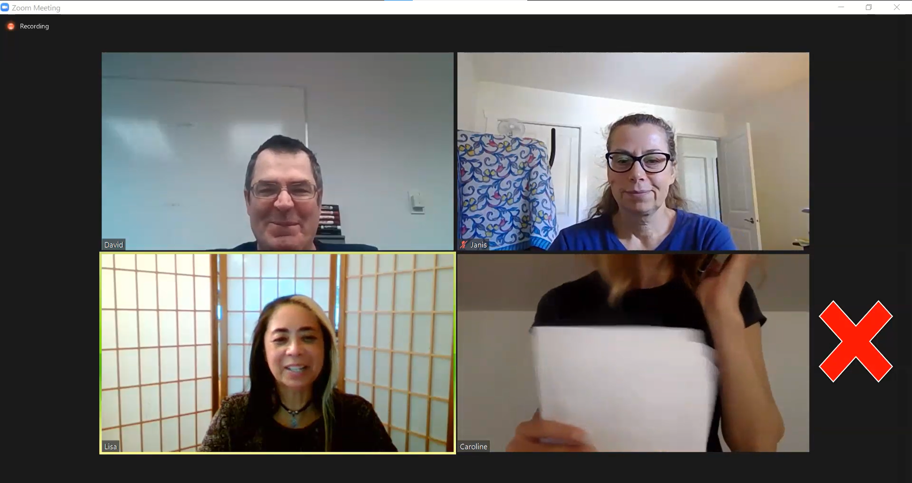

Employment
Slide hidden from learner
Zoom Etiquette
Notes:
Slide hidden from the learner.
Title Slide
Information for the Tutor.
This PowerPoint lesson covers the following Zoom Etiquette video lessons:
Part One:
Video Tips
Mic Tips
Mic & Video Tips
Part Two: Communicating in Zoom
Use The Raise Hand Icon If You Want To Speak
B. Chat Etiquette

Slide 2
Pre-Requisite Skills
Slide hidden from learner
Mouse skills: hold the mouse, left click, right click, different shapes of the cursor; scroll
Navigation: move the mouse around the screen to position the cursor in correct location
Keyboarding: type words, numbers, common symbols; use Shift and Enter keys; one finger typing is ok
Email skills: open email app; open an email message in Inbox
LINK to the DLCR:
https://digital-literacy.issbc.org/for-teachers/
Password: Diglit4T
Notes:
Slide hidden from the learner.
Information for the Tutor.
Pre-Requisite Skills
Remember: like all lessons in Module 9 – Employment (Review), this is a review lesson of the digital skills, and the learners may not be ready for this lesson.
Make sure the learner has the “Prerequisite Skills” listed in the slide.
If the learner struggles, stop the lesson and go to the following modules in the Digital Literacy Curriculum Resource (DLCR) and teach the pre-requisite skills before doing this lesson:
Module 1 Mouse and Navigating
Module 2-Keyboarding
Module 5-Email Skills
https://digital-literacy.issbc.org.
Go to the Teachers tab.
Password: Diglit4T

Slide 3
Skills Reviewed in this Lesson
Slide hidden from learner
Check the Notes of this Slide
Notes:
Slide hidden from the learner.
Information for the Tutor
This lesson is about etiquette and does not review how to do the digital skills, except how to “Blur your Background”
If your learner doesn’t know how to do the skills mentioned in the lesson, do the following lessons with them:
Zoom Parts One and Zoom Part Two.
These skills are specifically reviewed in this lesson.
It is assumed the learner has already learned these skills and is doing this lesson as a review.
Zoom Etiquette
What “etiquette” means.
What “Zoom etiquette” means.
Video Tips
Understand the following:
how you can tell if your video is on or off in a Zoom meeting
what it means when your video is on or off
the importance of showing your whole face
the importance of good lighting
the importance of a clean, uncluttered background
Know how to blur your background in Zoom:
Click on chevron beside video icon
Choose virtual background
Choose blur
Click X to close the window
Mic Tips
Understand the following:
how you can tell if someone’s microphone (mic) is on or off in a Zoom meeting
what it means if your mic is muted or unmuted
the importance of muting your mic:
When not speaking
When talking to someone in the room
When there’s noise in the room
When coming late to a Zoom meeting
Mic & Video Tips
Understand the importance of muting mic and video:
When taking a break
When listening to a presentation
Recognize the video off and mic muted icons
Understand what it means if your mic and video are muted
Communicating in Zoom:
Use the Raise Hand Icon If You Want To Speak
Recognize when a participant raises their hand using the Raise Hand icon
Understand the following:
it’s rude to ask a question/make a comment without raising your hand
you need to raise your hand to ask a question / make a comment
it’s ok to raise the physical hand to indicate you want to speak
after you raise your hand, you need to wait for the host to ask you to unmute your mic to speak
you need to lower your hand when you finish talking
Chat: Do not use all CAPS
Understand that you use Chat to read and write messages to other people in the Zoom meeting
Understand it is rude to use all CAPS when writing a message in Chat.
Chat: Do not send a private message to everyone
Understand the importance of not sending a private message to everyone in the Zoom meeting; send it to just one person

Slide 4
Slide hidden from learner
Instructions
For Using this PowerPoint Lesson
Notes:
Slide hidden from learner
This PowerPoint lesson contains everything the tutor needs: the lesson notes, suggested instructional language, the links to the video lesson(s), and also Practice for each part. ​
IMPORTANT
Read through the entire lesson a few days before tutoring so you are clear about what to do and have time to get any questions answered and to do any preparation.
The first 11 slides are hidden from the learner; they contain information and instructions for the tutor.
Green Slides = Lesson Objectives
Blue Slides = The Start of each Part of the Lesson
Yellow Slides = Practice Activities
Instructions specific to each lesson are in the notes pages of each PowerPoint. ​
Identical notes are also available as a separate PDF for tutors who prefer that format. ​See Option B below.
You will NOT be able to copy and paste from this PowerPoint because it is “Read Only”.
In the Practice for each Part of this lesson, you may be asked to copy some text from this lesson and paste it into a Word document to use with the learner.
You will not be able to do that from this PowerPoint lesson. Instead, copy and paste the text from the PDF version of the (same) lesson.
Option A
Use a printed version of the notes for you as tutor (not for the learner)
plus
Use the PowerPoint slideshow for the learner.
How:
Open the PowerPoint, download and save it.
Click “File” then "Print" ​
Then under “Settings” choose " Notes Pages" .
Print
Now, you can use the printed version for tutoring.
Option B
Use the separate electronic PDF of the PowerPoint slides and notes for you as tutor (if you don’t have PowerPoint on your computer or if you prefer to use a PDF version)
Plus
Use the PowerPoint slideshow for the learner, or the PDF-Slides Only version (if the learner’s computer doesn’t have PowerPoint). ​
You can have the PDF open to use for you as tutor beside the PowerPoint slideshow, or the PDF version of the slides (for the learner).
Option C
Use the PowerPoint slideshow in “Presenter View”.
This lets you show the slideshow to the learner, and also lets you see the notes as well as the slideshow that the learner sees.
This works for remote and in-person tutoring.
However, for in person tutoring for small groups you need a separate monitor or projector to do this: one for you and one for the learners.

Slide 5
Lesson Objectives – Part One
Slide hidden from learner
Video Tips
Mic Tips
Mic & Video Tips
Notes:
Slide hidden from learner
Instructions to the Tutor
These are the skills learners will master at the end of the lesson.
Total Video length: 8:00 mins
A. Video Tips:
Position Your Camera So It Shows Your Whole Face: 0:00-1:08 mins [1:08 mins]
Make Sure There Is Good Lighting: 1:09 – 1:41 mins [0:30 mins]
Choose A Good Background: 1:42 – 3:48 mins [2:06 mins]
B. Mic Tips: Turn off / Mute Your Mic:
When You’re Not Speaking: 3:49 – 3:59 mins [0:10 mins]
When You’re Talking To Someone In The Room You’re In: 4:00 – 4:25 [0:25 mins]
If There’s Noise In the Room You’re In: 4:26 – 5:29 mins [1:03 mins]
When You Come Late To A Meeting: 5:30 – 6:43 mins [1:13 mins]
C. Mic & Video Tips: Turn off / Mute Your Mic and Video:
When You Take A Break: 6:44 – 7:02 mins [0:18 mins]
When You’re Listening To A Presentation: 7:03 – 8:00 mins/END [0:56 mins]

Slide 6
Lesson Objectives – Part Two
Slide hidden from learner
Communicating in Zoom:
A. Use The Raise Hand Icon If You Want To Speak
B. Chat Etiquette
Notes:
Slide hidden from learner
Instructions to the Tutor
These are the skills learners will master at the end of the lesson.
Total Video length: 03:19 mins
Part Two A: Use the Raise Hand Icon If You Want To Speak 0:00 – 1:58 min [1:58 min]
Part Two B: Chat Etiquette: 1:59 – 3:19/END [1:20 min]
- Do Not Use All Caps 1:59 – 2.20 [0:21 min]
- Do Not Send A Private Message
To Everyone: 2:21 – 3:19/END [0:58 min]

Slide 7
Keep in Mind
Slide hidden from learner
Only do as much as the learner can absorb in one session.
Do one part of the video lesson at a time.
Check in with the learner after each part.
Notes:
Slide hidden from the learner.
Information for the Tutor.
According to the learner’s pace, do one part of the video lesson, check their understanding, and have the learner practice the skills.
Then, let them show you they can do the skills (at least three times) before proceeding to the next part.
Look for signs of learner fatigue.
Check in with learner after each part.
Is the learner doing any of the following? :
Expressing frustration
Not asking questions, shutting down, not taking in what you are saying
Seeming overwhelmed
Saying, “Are we done yet?” etc.
Lots of yawning etc.
These are clues that it is time to stop the session and resume another day.

Slide 8

Set Up and Preparation
Slide hidden from learner
Before In-Person Tutoring
Notes:
Slide hidden from the learner.
Information for the Tutor.
SET UP
Refer to TUTOR CHECKLIST- Set up for In-Person Tutoring
PREPARATION
Preparation specific to the PRACTICE for each Part of this lesson is in the notes of each “PRACTICE” slide.

Slide 9
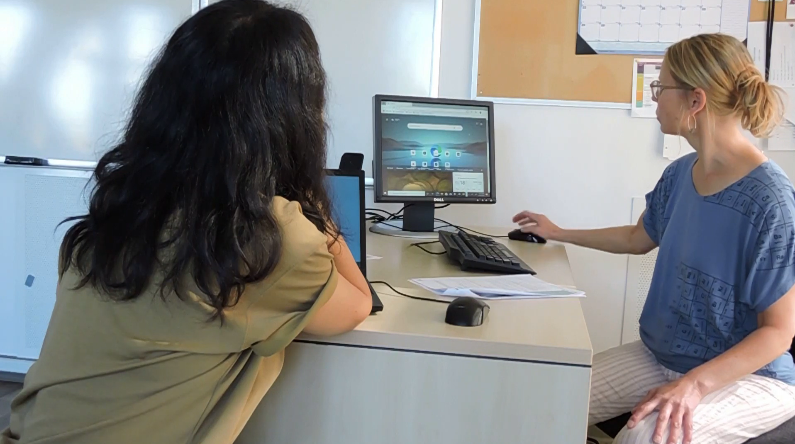
Checklist
Slide hidden from learner
During In-Person Tutoring
Notes:
Slide hidden from the learner.
Information for the Tutor.
Refer to:
TUTOR CHECKLIST- During In-Person Tutoring Sessions

Slide 10
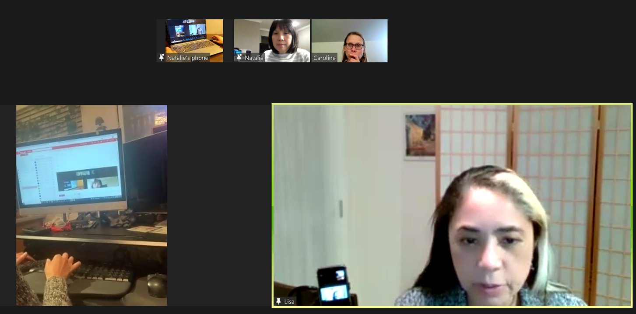
Set Up and Preparation
Slide hidden from learner
Before Remote Tutoring
Notes:
Slide hidden from the learner.
Information for the Tutor.
SET UP
Refer to:
TUTOR CHECKLIST- Set up for Remote Tutoring Session via Zoom, Ms Teams etc.
LEARNER CHECKLIST- Set up for Remote Tutoring Session via Zoom, Ms Teams etc.
Trouble-Shooting -Remote Tutoring
IMPORTANT:
Go through the Learner Checklist as well. Then, you will be able to more easily troubleshoot with the learner if they have difficulty in their set up.
Communicate beforehand with the Support Person (if that learner has one):
Email the Learner Checklist listed in #2 above to the Support Person.
Email any instructions for this lesson to the support person (see the notes for specific slides /parts of the lesson):
Have the support person do the preparation for the lesson on the learner’s desktop. Tutor needs to guide them re. how to do this.
Preparation for Remote Tutoring only:
Have support person make sure the browser icon is easy for the learner to find on the desktop.
If no preparations were made on the learner’s computer before the session by a support person, you could use the Request Remote Control function in Zoom on the learner’s desktop if the learner struggles, and before they get frustrated.
IMPORTANT: Keep in mind the following:
Before using Remote Control, be sure to get permission from your organization first.
It is crucial that the learner understands what it means, and gives you informed consent.
It is somewhat invasive and must be done respectfully and honouring the confidentiality of the learner.
Don’t use the Request Remote Control feature first! It should be a last resort.
First, try your best to teach the learner and the support person how to do things using Share screen and demonstrating.
Use it if other ways do not work and the learner really needs to learn digital skills.
You may want to record the Zoom tutoring session in case of any possible accusations afterwards.
PREPARATION
Preparation specific to each Part of this Lesson is in the notes of the relevant slides.

Slide 11
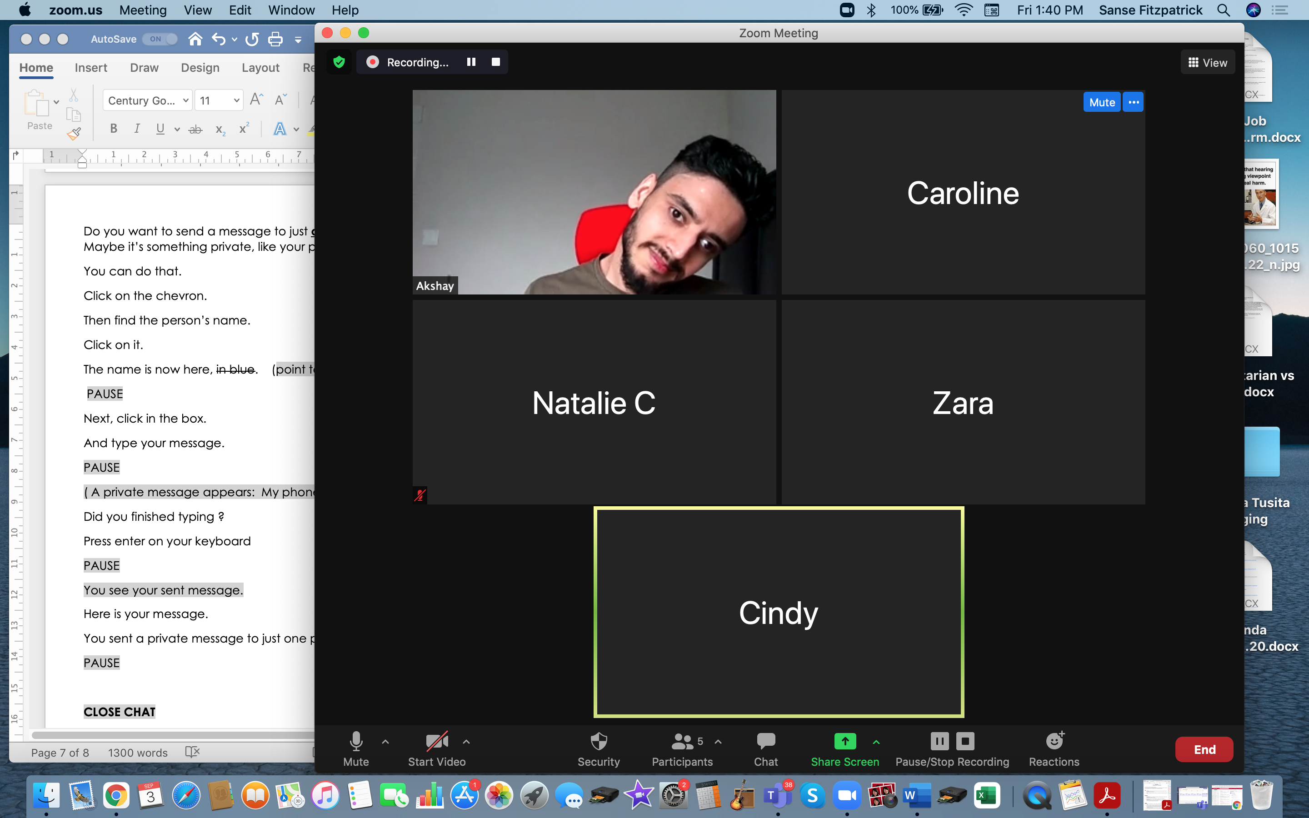
Checklist
Slide hidden from learner
During Remote Tutoring
Notes:
Slide hidden from the learner.
Information for the Tutor.
Refer to:
Tutor Checklist: During Remote Tutoring Session
Learner Instructions: How to let your Tutor have Remote Control of your Computer During a Zoom Session
Trouble-Shooting: Remote Tutoring
Be ready to assist learner by using the Requesting Remote Control function (refer to checklists 1 and 2 listed above).
You may have to set up the learner’s desktop for “Practice” activities if the learner needs support and no support person is available to do that beforehand. This is possible to do using Request Remote Control in Zoom.
IMPORTANT: Keep in mind the following:
Before using Remote Control, be sure to get permission from your organization first.
It is crucial that the learner understands what it means, and gives you informed consent.
It is somewhat invasive and must be done respectfully and honouring the confidentiality of the learner.
Don’t use the Request Remote Control feature first! It should be a last resort.
First, try your best to teach the learner and the support person how to do things using Share screen and demonstrating.
Use it if other ways do not work and the learner really needs to learn digital skills.
You may want to record the Zoom tutoring session in case of any possible accusations afterwards.

Slide 12
Employment
Zoom Etiquette
Notes:
SHOW THIS SLIDE AND THE REST OF THE SLIDES FROM HERE ONWARD TO THE LEARNER
Say to the learner:
Today, we’re going to learn about Zoom etiquette – being polite in a Zoom meeting.
Today, we’ll focus on ........(Parts you intend to cover).

Slide 13
Lesson Objectives – Part One
Video Tips
Mic Tips
Mic & Video Tips
Notes:
Instructions to the Tutor
These are the tips learners will master at the end of the lesson.
A. Video Tips:
Position Your Camera So It Shows Your Whole Face
Make Sure There Is Good Lighting
Choose A Good Background
B. Mic Tips
Mute Your Mic:
When You’re Not Speaking
When You’re Talking To Someone In The Room You’re In
If There’s Noise In the Room You’re In
When You Come Late To A Meeting
C. Mic & Video Tips
Mute Your Mic and Video:
When You Take A Break
When You’re Listening To A Presentation
Say to the learner:
We are going to look at some tips on how to have a successful, professional meeting on Zoom.

Slide 14

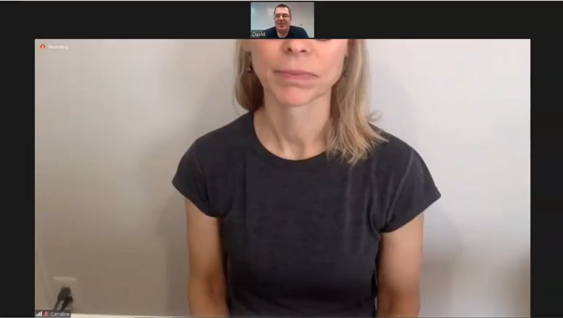
Lesson – Part One A
Video Tips
Notes:
Total Video length: Video Tips: 8:00 mins
Zoom Etiquette 1
A. Video Tips:
Position Your Camera So It Shows Your Whole Face: 0:00-1:08 mins [1:08 mins]
Make Sure There Is Good Lighting: 1:09 – 1:41 mins [0:30 min]
Choose A Good Background: 1:42 – 3:48 mins [2:06 min]
Say to the Learner:
When we are in a Zoom meeting, it is important to follow these video tips.
We will watch a video. We can watch the video several times. So, don't worry if you don't catch everything the first time.
Instructions for the Tutor:
Depending on the level of your learner, you may want to play the video from start to finish, or stop at each segment as outlined above.
Stop the video at 3:48 mins.
Play the video several times.
Then ask comprehension check questions to check understanding. [See next slide for comprehension check questions.]
Then have learner do Practice-Part One A.
After that, repeat the steps for Part One B [Mic Tips] –These steps are in subsequent slides.
Click on the PLAY icon in the slide to open the video lesson.
Use this link to the YouTube video if the link in the slide doesn’t work:
https://www.youtube.com/watch?v=gsKUV2VugcA
For remote tutoring, when you share screen to play the video, make sure you have shared the audio.
Play the lesson a bit and check the learner can hear it ok before playing the whole video.

Slide 15

Check Understanding
Notes:
Instructions for the Tutor:
After watching the segment of the video lesson, check understanding (review and elicit) before moving on to the next part.
Check understanding - ask the learner as you watch the video and pause it, or as you demonstrate on your computer.
Ask these comprehension check questions or others to check understanding:
[Video Tips]
Say to the Learner:
What does the video icon look like when it is off? Answer: There is a red line across it.
There are three video tips in the video lesson. Can you remember what they are? Answer: Show your whole face; make sure there is good lighting; choose a good background
Is it ok to show part of your face only in Zoom? Answer: No, we should show our whole face.
Is it ok to have a bright window open behind you when your video is on? Answer: No, it may be too bright and the face will be dark.
Is it ok to have a cute border around your video in a work Zoom meeting? Answer: No, it is not professional. It’s also too busy and distracting.
Is it ok to have a blurred background in a work Zoom meeting? Answer: Yes, it is.
How do you open the menu to blur your background? Show me. Answer: Click on the chevron next to the video icon.
What do you do after you opened the menu? Show me. Answer: Click on Virtual Background, then click on Blur.
Why is it not ok to have many things in your background in a work Zoom meeting? Answer: It will not look professional; it gives a bad impression.
Instructions for Tutor:
Ask the learner: Do you want to watch the video again?
IMPORTANT
If the learner is struggling, stop the session.
Say to the learner:
Let’s do more work on X… before we do this.
For example, learner may have difficulty in clicking.
If so, go to the Digital Literacy Curriculum Resource (DLCR) and use the relevant module before using this video review lesson.
Teach the skills and have the learner practice.
For example, use Module 1 Mouse & Navigating depending on learner needs.
Tip: Do the Needs Assessment to determine needs; use the Needs Assessment tools in the DLCR for this.

Slide 16
Practice – Part One A
Video Tips
Notes:
Instructions for the Tutor:
PRACTICE- Lesson Part One A: Lesson Focus: Video Tips
PREPARATION
Email a Zoom invitation to the learner before the lesson.
Both tutor and learner should be in the Zoom meeting before the lesson.
Note: If tutoring in-person, learner should not check Join with Audio; otherwise there will be audio feedback.
Or
Both tutor and learner should mute their mics.
Preparation for Remote tutoring only:
Support person at home should support as requested by the tutor.
Refer to Slides #10 and 11. Tutor should be able to see learner’s computer screen and hands.
_________________________________________________________________________________________________
PRACTICE
Instructions for the Tutor:
Demonstrate first, then let the learner practice.
Say to the Learner:
Now it’s time to practice.
We’re going to practice the video tips, like what we saw in the video.
[After each of the following steps, wait for the learner to complete the step. Guide the learner as needed.]
Video Tips
Let’s review how to turn your video on and off.
Find your video icon. There is no line across it. Can other people in the meeting see you? Answer: Yes, your video is on.
You want to turn off your video. What do you do? Answer: Click on the video icon. Do that now.
Let’s practice how to blur our background.
Turn on your video [if it is already on, omit this step.]
Find the Video icon.
Click on the chevron next to the icon.
Now, find “Choose Virtual Background”. Click on it.
Then find “Blur” and click on it.
Check to see if your background is blurred now.
Click X to exit the window.
Instructions for the Tutor:
Have the learner repeat as many times as they need (at least three times.)
Remote tutoring only:
Support person at home should support as requested by the tutor.
CHECK THE LEARNER’S SKILLS:
Has the learner shown you they can do the skills at least three times without support? If so, then they are ready to move on to the next part.

Slide 17

Lesson – Part One B
Mic Tips
Notes:
Total Video length: 8:00 mins
Zoom Etiquette 1
B. Mute Your Mic:
When You’re Not Speaking: 3:49 – 3:59 min [0:10 min]
When You’re Talking To Someone
In The Room You’re In: 4:00 – 4:25 [0:25 min]
If There’s Noise In the Room You’re In: 4:26 – 5:29 [1:03 min]
When You Come Late To A Meeting: 5:30 – 6:43 [1:13 min]
Say to the Learner:
We are going to learn some mic tips to make sure we have a successful Zoom meeting. We will watch a video.
We can watch the video several times. So, don't worry if you don't catch everything the first time.
Instructions for the Tutor:
Depending on the level of your learner, you may want to play the video from start to finish, or stop at each segment as outlined above.
Play the video several times.
Then ask comprehension check questions to check understanding. [See next slide for comprehension check questions.]
Then have learner do Practice Part One B.
After that, learner can continue with the Extra Practice.
Click on the PLAY icon in the slide to open the video lesson.
Use this link to the YouTube video if the link in the slide doesn’t work:
https://www.youtube.com/watch?v=gsKUV2VugcA
For remote tutoring, when you share screen to play the video, make sure you have shared the audio.
Play the lesson a bit and check the learner can hear it ok before playing the whole video.

Slide 18
Check Understanding
Notes:
Instructions for the Tutor:
After watching the segment of the video lesson, check understanding (review and elicit) before moving on to the next part.
Check understanding - ask the learner as you watch the video and pause it, or as you demonstrate on your computer.
Ask these comprehension check questions or others to check understanding:
[Mic Tips]
Say to the Learner:
What does the mic icon look like when it is off? Answer: There is a red line across it.
There are four situations in the video where we need to turn off our mics. Can you remember them?
Answer: When you’re not speaking; when you’re talking to someone in the room you’re in; if there’s noise in the room you’re in; when you come late to a meeting.
Why is it important to turn off our mics in these situations? Answer: To be polite; so we do not disturb others in the meeting
Instructions for Tutor:
Ask the learner: Do you want to watch the video again?

Slide 19
Practice – Part One B
Mic Tips
Notes:
PRACTICE- Part One B: Lesson Focus: Mic Tips
Instructions for the Tutor:
PREPARATION
Email a Zoom invitation to the learner before the lesson.
Both tutor and learner should be in the Zoom meeting before the lesson.
Note: If tutoring in-person, learner should not check “Join with Audio”; otherwise there will be audio feedback.
Or
Both tutor and learner should mute their mics.
Preparation for Remote tutoring only:
Support person at home should support as requested by the tutor.
Refer to Slides #10 and 11. Tutor should be able to see learner’s computer screen and hands.
_________________________________________________________________________________________________
PRACTICE
Instructions for the Tutor:
Demonstrate first, then let the learner practice. Skip this practice if you think your learner already knows how to do this.
Say to the Learner:
Now it’s time to practice.
We’re going to practice what we saw in the video.
[After each of the following steps, wait for the learner to complete the step. Guide the learner as needed.]
Mic Tips
Let’s review how to turn our mic on and off.
Find your mic icon. Is there a line across it?
Yes? Click on it to unmute your mic. ‘Unmute’ means ‘turn on’. You can speak now.
OR
No? Your mic is already turned on. You can speak and the other people in the meeting can hear you.
Instructions for the Tutor:
Have the learner repeat as many times as they need (at least three times.)
Remote tutoring only:
CHECK THE LEARNER’S SKILLS:
Has the learner shown you they can do the skills at least three times without support? If so, then they are ready to move on to the next part.

Slide 20


Lesson – Part One C
Mic & Video Tips
Notes:
Total Video length: 8:00 mins
Zoom Etiquette 1
C. Mute Your Mic and Video:
When You Take A Break: 6:44 – 7:02 [0:18 min]
When You’re Listening To A Presentation: 7:03 – 8:00 /END [0:56 min]
Say to the Learner:
We are going to look at some more mic and video tips on how to be polite on Zoom.
We’ll watch a video to review how to do this.
We can watch the video several times. So, don't worry if you don't catch everything the first time.
Instructions for the Tutor:
Play the video segment as outlined above.
Play the video several times.
Then ask comprehension check questions to check understanding. [See next slide for comprehension check questions.]
Then have learner do Practice Part Two C.
Click on the PLAY icon in the slide to open the video lesson.
Use this link to the YouTube video if the link in the slide doesn’t work:
https://www.youtube.com/watch?v=gsKUV2VugcA
For remote tutoring, when you share screen to play the video, make sure you have shared the audio.
Play the lesson a bit and check the learner can hear it ok before playing the whole video.

Slide 21
Check Understanding
Notes:
Instructions for the Tutor:
After watching the segment of the video lesson, check understanding (review and elicit) before moving on to the next part.
Check understanding - ask the learner as you watch the video and pause it, or as you demonstrate on your computer.
Ask these comprehension check questions or others to check understanding:
[Mic & Video Tips]
Say to the Learner:
Why is it important to turn off your mic and video when you’re taking a break?
Answer: So you won’t disturb others in the meeting, and you have privacy.
Why is it important to turn off your mic and video when you’re listening to a presentation?
Answer: So others in the meeting will not be distracted by anything you do.
Instructions for Tutor:
Ask the learner: Do you want to watch the video again?
Please note: There is no Practice – Part One C, as there are no new skills taught in the video. Instead, proceed to Extra Practice – Part One.

Slide 22

Extra Practice – Part One
Notes:
Instructions for the Tutor
PREPARATION
Email a Zoom invitation to the learner before the lesson.
Both tutor and learner should be in the Zoom meeting before the lesson.
Note: If tutoring in-person, learner should not check Join with Audio; otherwise there will be audio feedback.
Or
Both tutor and learner should mute their mics.
Preparation for Remote tutoring only:
Support person at home should support as requested by the tutor.
Refer to Slides #10 and 11. Tutor should be able to see learner’s computer screen and hands.
Extra Practice
Say to the learner:
Let’s practice some more.
First, turn on your mic and video.
I cannot see your whole face. What should you do? Show me.
Your face looks dark. What should you do? Show me.
Your background has many things. What should you do? Show me.
Please blur your background. Show me.
You want to take a break. What should you do? Show me.
Someone came into your room to talk to you. What should you do? Show me.
Someone is giving a presentation on Zoom. What should you do? Show me.
You are hungry and want to eat something during the Zoom meeting. What should you do? Show me.
Your phone rang and you want to answer it during the Zoom meeting. What should you do? Show me.
You came into a meeting late. What should you do? Show me.
You are listening to someone talk in a meeting. What should you do? Show me.
Instructions for the Tutor:
Have the learner repeat this activity and practice as many times as they need (at least three times.)
Check the Learner's skills. Has the learner shown you they can do the skills at least three times without support? If so, then they are ready to move on to the next part.

Slide 23
Lesson Objectives – Part Two
Communicating in Zoom:
A. Use The Raise Hand Icon If You Want To Speak
B. Chat Etiquette
  Do Not Use All Caps
  Do Not Send A Private Message To Everyone
Notes:
Instructions to the Tutor
These are the skills learners will master at the end of the lesson.
Total Video length: Communicating in Zoom: : 03:19 mins
Use The Raise Hand Icon If You Want To Speak:
Chat Etiquette:
Do Not Use All Caps
Do Not Send A Private Message To Everyone
Say to the Learner:
We are going to review when to use the raise hand icon, and also learn some tips when using the Chat function on Zoom.
We can watch the video several times. So, don't worry if you don't catch everything the first time.

Slide 24

Lesson – Part Two A
Use the Raise Hand Icon If You Want To Speak
Notes:
Video length: 03:19 min
Zoom Etiquette 2
Part Two A: Use the Raise Hand Icon If You Want To Speak 0:00 – 1:58 min [1:58 min]
Say to the Learner:
Let’s review when to use the Raise Hand icon.
We’ll watch a video to review how to do this.
We can watch the video several times. So, don't worry if you don't catch everything the first time.
Instructions for the Tutor:
Play the video segment as outlined above.
Play the video several times.
Then ask comprehension check questions to check understanding. [See next slide for comprehension check questions.]
Then have learner do Practice Part Two. A
After that, repeat the steps for Part One B [Chat Etiquette] –These steps are in subsequent slides.
Click on the PLAY icon in the slide to open the video lesson.
Use this link to the YouTube video if the link in the slide doesn’t work:
https://youtu.be/vYbavzhWJ9Q
For remote tutoring, when you share screen to play the video, make sure you have shared the audio.
Play the lesson a bit and check the learner can hear it ok before playing the whole video.

Slide 25
Check Understanding
Notes:
Instructions for the Tutor:
After watching this segment of the video lesson, check understanding (review and elicit) before moving on to the next part.
Check understanding - ask the learner as you watch the video and pause it, or as you demonstrate on your computer.
Ask these comprehension check questions or others to check understanding:
Say to the Learner:
You are in a Zoom meeting. Is it ok to just speak whenever you have a question? Answer: No, it is not polite. You should raise your hand first.
Is it ok to use raise your actual hand to signal you want to speak? Answer: Yes, it is good. However, please take note that if there are many people in the Zoom meeting, the host may not see your video nor your hand.
What do you do if the icons in the Zoom meeting disappear? Answer: Move the mouse or trackpad a bit; the icons appear again.
How do you find the Raise Hand icon? Answer: Click on Reactions icon, then Raise Hand.
What do you do after you’ve asked your question? Answer: Lower your hand. Click on Reactions, then Lower Hand.
Instructions for Tutor:
Ask the learner: Do you want to watch the video again?
IMPORTANT
If the learner is struggling, stop the session.
Say to the learner:
Let’s do more work on X… before we do this.
Instructions to the Tutor:
For example, learner may not know where to find the Raise Hand icon.
If so, go to the Digital Literacy Curriculum Resource (DLCR) and use the relevant module before using this video review lesson.
Teach the skills and have the learner practice.
For example, use Module 8 Zoom on Computer, or Employment module Zoom Skills 1 and 2, depending on learner needs.
Tip: Do the Needs Assessment to determine needs; use the Needs Assessment tools in the DLCR for this.

Slide 26
Practice – Part Two A
Use the Raise Hand Icon If You Want To Speak
Notes:
PRACTICE- Part Two A: Lesson Focus: Use The Raise Hand Icon If You Want To Speak
Instructions for the Tutor
PREPARATION
Email a Zoom invitation to the learner before the lesson.
Both tutor and learner should be in the Zoom meeting before the lesson.
Note: If tutoring in-person, learner should not check Join with Audio; otherwise there will be audio feedback.
Or
Both tutor and learner should mute their mics.
If there is only one learner, make sure to sign in from another device using a different name, so that the meeting has more participants. You may have to reply from your other device for the demonstration.
Preparation for Remote tutoring only:
Support person at home should support as requested by the tutor.
Refer to Slides #10 and 11. Tutor should be able to see learner’s computer screen and hands.
Instructions for the Tutor:
Demonstrate first, then let the learner practice.
Say to the Learner:
Now it’s time to practice.
You want to ask a question. Raise your physical hand
OR Use the raise hand icon.
First, move your mouse or trackpad, or tap your screen if your icons disappeared.
Then, find Reactions icon. Click on it.
Click on Raise hand.
Wait for the host to ask you to speak.
The host asked you to speak.
Unmute your mic.
You finished speaking. Mute your mic.
Go to Reactions icon again.
Click ‘Lower Hand’.
Instructions for the Tutor:
Have the learner repeat this activity and practice as many times as they need (at least three times.)
Remote tutoring only:
[Support person would have to make sure the learner is following all the steps.
It would also be good if the tutor can see the learner’s screen and hands to make sure the learner is following.]
CHECK THE LEARNER’S SKILLS:
Has the learner shown you they can do the skills at least three times without support? If so, then they are ready to move on to the next part.

Slide 27

Lesson – Part Two B
Chat Etiquette
Notes:
Video length: 3:19 min
Zoom Etiquette 2
Part Two B:
Chat Etiquette: 1:59 – 3:19/END [1:20 min]
Do Not Use All Caps: 1:59 – 2.19 [0:20 min]
Do Not Send A Private Message
To Everyone: 2:20 – 3:19/END [0:59 min]
Say to the Learner:
Let’s learn some Chat etiquette tips.
We’ll watch a video to review how to do this.
We can watch the video several times. So, don't worry if you don't catch everything the first time.
Instructions for the Tutor:
Play the video and stop at each segment as outlined above.
Play the video several times.
Then ask comprehension check questions to check understanding. [See next slide for comprehension check questions.]
Then have learner do Practice Part Two B.
Click on the PLAY icon in the slide to open the video lesson.
Use this link to the YouTube video if the link in the slide doesn’t work:
https://youtu.be/vYbavzhWJ9Q
For remote tutoring, when you share screen to play the video, make sure you have shared the audio.
Play the lesson a bit and check the learner can hear it ok before playing the whole video.

Slide 28
Check Understanding
Notes:
Instructions for the Tutor:
After watching this segment of the video lesson, check understanding (review and elicit) before moving on to the next part.
Check understanding - ask the learner as you watch the video and pause it, or as you demonstrate on your computer.
Ask these comprehension check questions or others to check understanding:
Say to the Learner:
Why is it not ok to use all CAPS in Chat? Answer: It is not polite; it is like shouting.
You want to use Chat to send your phone number to your co-worker. How do you do it? Show me. Answer: Click Chat; in the To: field, click on the chevron, then choose your co-worker’s name; click in the blue box to enter your phone number; press enter to send your message.
Instructions for Tutor:
Ask the learner: Do you want to watch the video again?
IMPORTANT
If the learner is struggling, stop the session.
Say to the learner:
Let’s do more work on X… before we do this.
Instructions to the Tutor:
For example, learner may not know where to find the Raise Hand icon.
If so, go to the Digital Literacy Curriculum Resource (DLCR) and use the relevant module before using this video review lesson.
Teach the skills and have the learner practice.
For example, use Module 8 Zoom on Computers, or Employment module Zoom Skills 1 and 2, depending on learner needs.
Tip: Do the Needs Assessment to determine needs; use the Needs Assessment tools in the DLCR for this.

Slide 29
Practice – Part Two B
Chat Etiquette
Notes:
PRACTICE- Part Two B: Chat Etiquette:
Instructions for the Tutor
PREPARATION
Email a Zoom invitation to the learner before the lesson.
Both tutor and learner should be in the Zoom meeting before the lesson.
Note: If tutoring in-person, learner should not check Join with Audio; otherwise there will be audio feedback.
Or
Both tutor and learner should mute their mics.
If there is only one learner, make sure to sign in from another device using a different name, so that the meeting has more participants. You may have to reply from your other device for the demonstration.
Preparation for Remote tutoring only:
Support person at home should support as requested by the tutor.
Refer to Slides #10 and 11. Tutor should be able to see learner’s computer screen and hands.
Instructions for the Tutor:
Demonstrate first, then let the learner practice.
Say to the Learner:
Now it’s time to practice.
Send a Chat to everyone using upper and lower cases
Click on Chat.
Check that in the To: field, it says ‘everyone’
Type your message in the blue box that says “Type message here”. Type your message: Hi all! Remember to use upper and lower cases. This is polite.
Press Enter on your keyboard.
You sent a message to everyone in the meeting.
Send a private message to one person
Click on Chat.
Click on the chevron next to “Everyone”.
Find your tutor’s name. Click on it.
Type your message in the blue box that says “Type message here”. Type your message: I can’t have the lesson next week. I’m going on vacation.
Press Enter on your keyboard.
You sent a message to your tutor.
Instructions for the Tutor:
Have the learner repeat this activity and practice as many times as they need (at least three times.)
Remote tutoring only:
[Support person would have to make sure the learner is following all the steps.
CHECK THE LEARNER’S SKILLS:
Has the learner shown you they can do the skills at least three times without support? If so, then they are ready to move on to the next part.

Slide 30
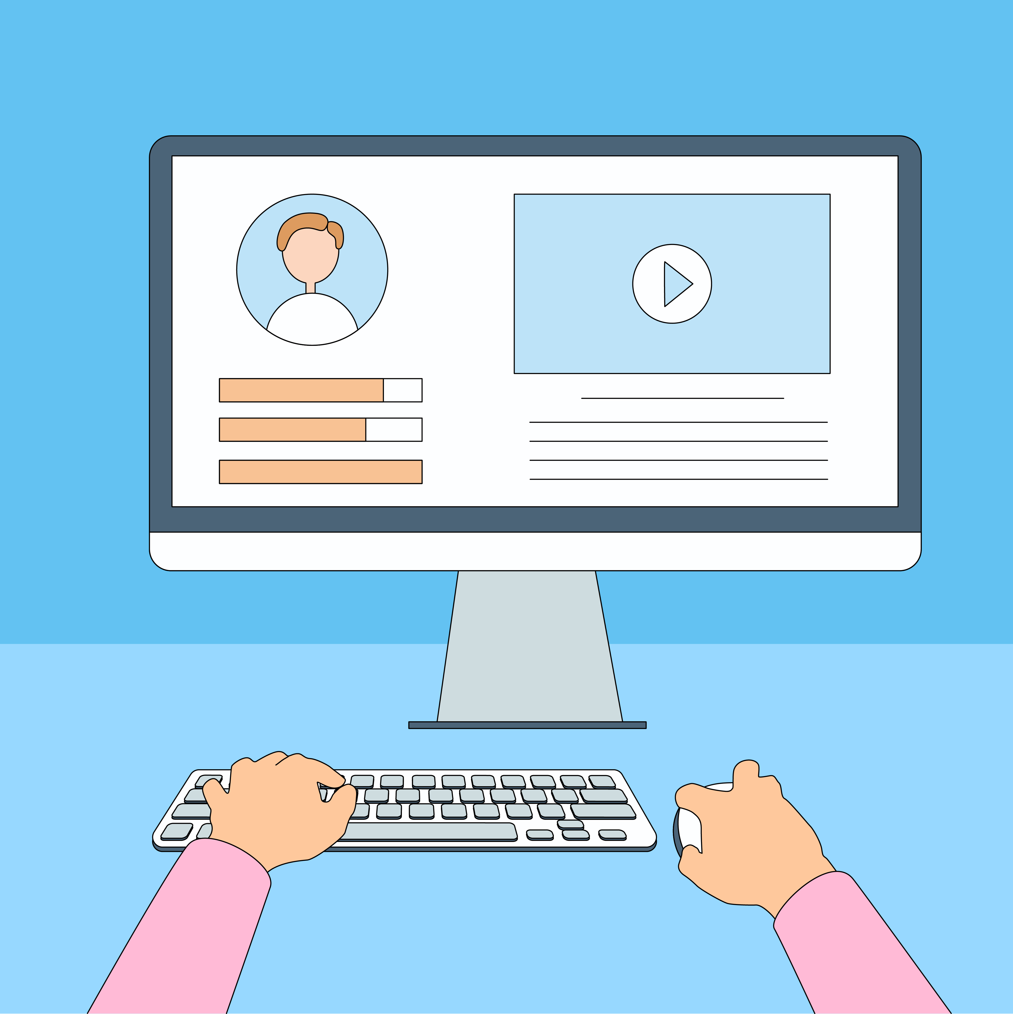
Practice Between Sessions
What did you learn/practice today?
When are you going to practice?
Practice Plan
Notes:
INSTRUCTIONS FOR THE TUTOR:
In-person Tutoring and Remote Tutoring:
Make sure the learner knows how to access the video lesson(s) you just used so they can practice between tutoring sessions.
If relevant, make sure the support person at home knows how to access the video(s) too.
Option One
Email the video link to the learner, and if relevant the at-home support person. They can use the link in the email to access the video lesson(s).
Option Two
Put a link to the specific video lesson(s) you did on the learner’s desktop so they can access the video easily.
How:
Open the website address for the lesson in the browser.
In the address bar, click to highlight the lesson address.
Drag the address (link) onto the desktop. It will make an icon on the desktop.
Find the icon on the desktop and check that the link works.
Show the learner where it is. Tell them to just click to access it for practice.
Remote Tutoring Only:
You can do Option Two above by using Request Remote Control in Zoom during the tutoring session.
Refer to the following for the steps on how to do that:
Tutor Checklist-During Remote Tutoring Sessions
Learner Instructions: Let Tutor have Remote Control of your Computer During a Zoom Session
IMPORTANT: Keep in mind the following:
Before using Remote Control, be sure to get permission from your organization first.
It is crucial that the learner understands what it means, and gives you informed consent.
It is somewhat invasive and must be done respectfully and honouring the confidentiality of the learner.
Don’t use the Request Remote Control feature first! It should be a last resort.
First, try your best to teach the learner and the support person how to do things using Share screen and demonstrating.
Use it if other ways do not work and the learner really needs to learn digital skills.
You may want to record the Zoom tutoring session in case of any possible accusations afterwards.
********************************************************************************************************************************
SAY TO THE LEARNER:
You did well today.
So, what did you learn and practice today? →
Today, we learned and practiced some etiquette tips to have a successful Zoom meeting: [only mention the parts you covered]
1) Video Tips
Position your camera so it shows your whole face
Make sure there is good lighting
Choose a good background. In particular, we learned how to blur our background in Zoom.
Mic Tips
Mute your mic when you’re not speaking
Mute your mic you’re talking to someone in the room you’re in
Mute your mic if there’s noise in the room you’re in
Mute Your when you come to a meeting late
3) Mic & Video Tips
Mute your mic and video when you take a break
Mute your mic and video when you’re listening to a presentation
Communicating in Zoom
Use the Raise Hand icon if you want to speak
Chat etiquette: Do not use all CAPS
Chat etiquette: Do not send a private message to everyone
It’s really important to review and practice as much as you can! Please do that before our next tutoring session.
Watch the video again, as many times as you need.
I’ve emailed you the link. Let’s make sure you can open it.
(OR)
We’ve put the link on your desktop. Here it is. Just click on it to watch the video. Let’s make sure it works ok.
[PRACTICE PLAN]
Instructions for the Tutor:
Email three zoom invitations to the learner, and if you are not able to meet them on Zoom in between sessions, the Support Person should email the invitations to the learner and practice with the learner.
If there is only one learner, make sure to sign in from another device using a different name, so that the meeting has more participants.
Example Zoom Email Invitations:
Subject: Quick Meeting 1, 2 and 3
Hi all,
Let’s meet for a quick meeting on time and date.
Insert Zoom meeting link here.
See you!
Tutor’s name
________________________________________________________________________________________________________________________________
Say to the learner:
Practice at least three more times before our next session.
Here is what to practice:
I will email you this Practice Plan (see below). Please reply to the email so I know you got it and have what you need to do the practice.
[Get learner to confirm they will practice and tell you when. Get specific.]
When are you going to do the practice? How many times? etc.
Practice Plan
Say to the learner:
Mic & Video Tips
Please check your camera that it shows your face fully.
Please check your lighting so that it is not too bright or too dark.
Please check your background that it is clean and professional.
Please blur your background.
You want to take a break. What should you do? Show me.
Someone came into your room to talk to you. What should you do? Show me.
Someone is giving a presentation on Zoom. What should you do? Show me.
You are hungry and want to eat something during the Zoom meeting. What should you do? Show me.
Your phone rang and you want to answer it during the Zoom meeting. What should you do? Show me.
You came into a meeting late. What should you do? Show me.
You are listening to someone talk in a meeting. What should you do? Show me.
Communicating in Zoom
You want to speak in the meeting. What should you do? Show me.
Send a message to everyone in Zoom. Make sure you use upper and lower case letters. This is the message: Hello everybody! How was your weekend?
Send a message to only your tutor or support person. This is the message: I need to take leave next Friday.

Slide 31

Confirm Next Session and Support
Notes:
Instructions for the Tutor:
Confirm the next tutoring session.
Clarify any support in-between sessions if you are offering that.
If offering support outside the session time, put boundaries, be clear about when and how you are giving support.
Say to the Learner.
e.g. Great work today! etc.
Let’s meet again on X date at X time. Does that work for you?
Wonderful.
[If offering support before next session:]
If you need support before our next session, please .........
[For remote support:]
I will send you the Zoom link the day before the tutoring session.
etc.

Slide 32
See you!
Keep Practicing
Notes:
Bye and see you on X date at X time.
Keep practicing!

